Slide 1
SIDDAGANGA INSTITUTE OF TECHNOLOGY, TUMAKURU- 3 COMPUTER SCIENCE ENGINEERING “DIGITAL STEGANOGRAPHY” By MAHESH G 1SI20CS056 DHANARAJ CHANDRASHEKHAR NANDIKOPPA 1SI20CS032 Batch Id: A19 Under the guidance of GURURAJ S P M.Tech

Slide 2
AGENDA
The agenda of a digital steganography project is to develop techniques and tools for hiding data within digital media, in such a way that the presence of the hidden data is not detectable to an observer. The goal is to provide a secure and efficient means of transmitting sensitive information, while maintaining confidentiality and avoiding detection by third parties. The project may involve researching and developing new steganographic algorithms, implementing these algorithms in software tools, and testing the effectiveness of the tools under various scenarios and conditions. The project may also explore the limitations and vulnerabilities of steganography, and consider strategies for detecting and countering steganographic attacks.

Slide 3
INTRODUCTION
Digital steganography is the practice of hiding a message or information within another digital file, such as an image or audio file, in a way that is not visible or detectable by others who are not aware of the hidden information. This technique has a variety of potential applications, from digital security and privacy to covert communication and information sharing.
The purpose of this project is to implement a digital steganography system using the Java programming language. Java is a popular and powerful programming language that is well-suited for developing secure and robust applications. By using Java, we can ensure that our steganography system is reliable and scalable, and can be used in a variety of different contexts and environments.
*

Slide 4
INTRODUCTION
Our project goals include the ability to encode and decode hidden messages within digital images using a variety of different encoding methods and algorithms. We also aim to develop a user-friendly interface that allows users to easily select and encode/decode images, and to customize various settings such as message length and encoding method. Ultimately, we hope that this project will contribute to the field of digital security and privacy, and will help individuals and organizations protect their sensitive information and communications.

Slide 5
MOTIVATION
Digital steganography is motivated by the need to protect sensitive or confidential information from unauthorized access or detection. With the increasing reliance on digital communication and information sharing, it has become more important than ever to develop secure and effective methods of hiding information within digital files. By using digital steganography, individuals and organizations can protect their information from being intercepted or monitored by third parties, whether intentionally or inadvertently. This can be particularly important in fields such as intelligence, law enforcement, and military operations, where secrecy and confidentiality are crucial. Additionally, digital steganography can be used for more benign purposes, such as hiding personal messages within images or audio files for fun or privacy reasons. Overall, digital steganography provides a powerful and flexible tool for protecting and sharing information in the digital age.

Slide 6
LITERATURE SURVEY
SL NO | Paper Title | Authors | References
1 | "Digital Watermarking for Color Image Using DHWT and LSB" | Alvin, A. Wicaksana and M. I. Prasetiyowati | https://ieeexplore.ieee.org/stamp/stamp.jsp?tp=&arnumber=8981835&isnumber=8981808
2 | "A Robust Method for Data Hiding via Combination of Colour Images and PDF Files" | D. Bhattacharyya and A. Haveliya | https://ieeexplore.ieee.org/stamp/stamp.jsp?tp=&arnumber=6200768&isnumber=6200561
3 | "Steganalysis Based on Weighted Stego-Image for 2LSB Replacement Steganography" | M. Ye, F. Liu, C. Yang and X. He | https://ieeexplore.ieee.org/stamp/stamp.jsp?tp=&arnumber=5337197&isnumber=5337075

Slide 7
SL No | Paper Title | Authors | References
4 | "Digital Steganography and Watermarking for Digital Images: A Review of Current Research Directions" | O. Evsutin, A. Melman and R. Meshcheryakov | https://ieeexplore.ieee.org/stamp/stamp.jsp?tp=&arnumber=9187785&isnumber=8948470
5 | "Data hiding in a digital image with FPGA implementation" | Premalatha P and Amsaveni A | https://ieeexplore.ieee.org/stamp/stamp.jsp?tp=&arnumber=7916641&isnumber=7916604

Slide 8
PROBLEM STATMENT
The problem addressed by digital steganography is the need to protect sensitive information by hiding it within digital files in a way that is undetectable by unauthorized parties. However, the security and effectiveness of digital steganography systems can vary, and there is a need for reliable and robust systems that can be used in various applications. The goal of this project is to develop a secure and user-friendly steganography system using Java.

Slide 9
OBJECTIVES
Develop a steganography system using Java programming language
Implement common steganography techniques such as Least Significant Bit (LSB) and Discrete Cosine Transform (DCT)
Evaluate the performance and security of the implemented system through testing and analysis
Explore potential improvements to the steganography system, such as the use of encryption or more sophisticated algorithms
Create a user-friendly interface for the steganography system to allow for easy use and accessibility by a wide range of users
Document the development process, including design decisions, implementation details, and testing procedures, to allow for future maintenance and improvement of the system.

Slide 10
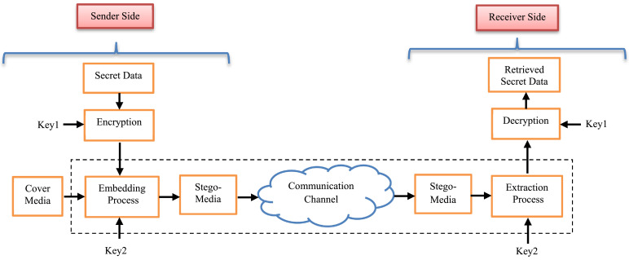
SYSTEM ARCHITECTURE

Slide 11
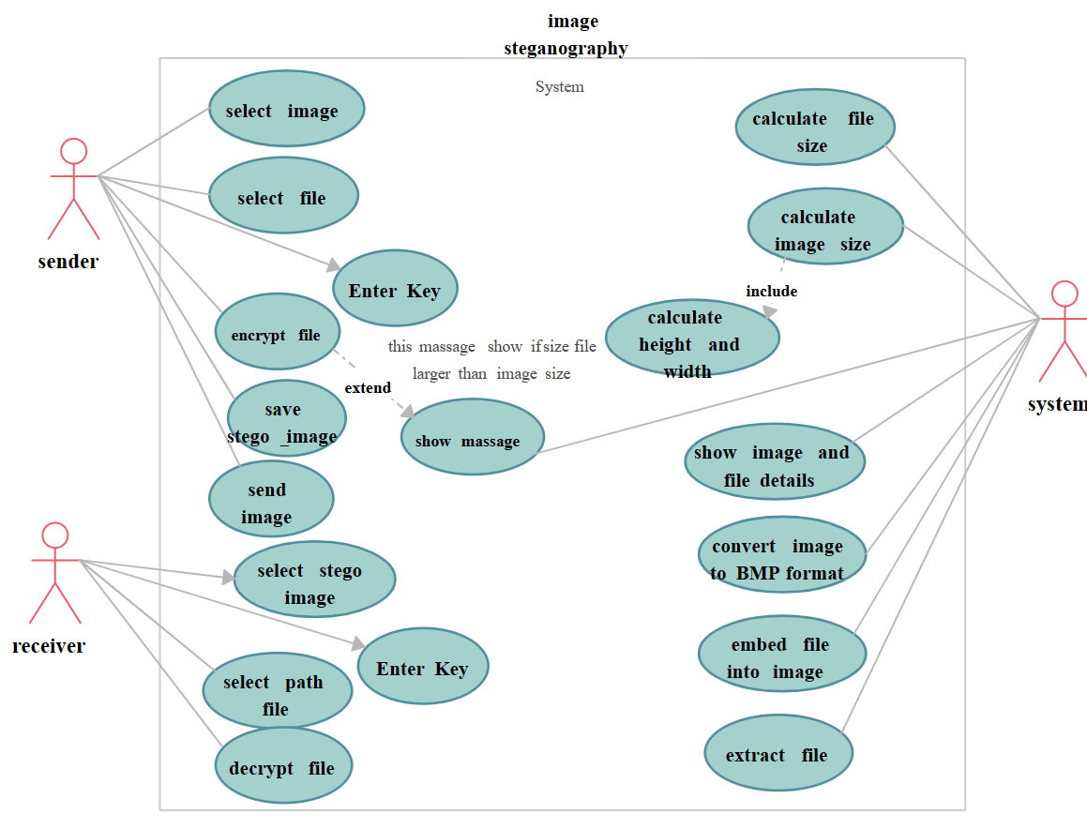
HIGH LEVEL DESIGN

Slide 12
Tools and platform
Java Development Kit (JDK): The JDK provides the necessary tools, compilers, and libraries for Java development. Make sure you have the latest version installed.
Integrated Development Environment (IDE): An IDE like Eclipse, IntelliJ IDEA, or NetBeans can greatly facilitate Java development. Choose one that you are comfortable with or prefer.
Java Swing: Java Swing is a GUI toolkit for Java applications. It provides components and libraries to create a graphical user interface. You can use Java Swing to design and implement the user interface for your steganography system.

Slide 13
Image Processing Libraries: To manipulate multimedia files, you may need libraries or frameworks that offer functionality for image, audio, and video processing. Some popular libraries for multimedia processing in Java include Java Advanced Imaging (JAI) and Java Media Framework (JMF).
Steganography Algorithms: Implementing steganography techniques requires algorithms for embedding and extracting data from carrier files. You will need to design or utilize existing steganography algorithms tailored to your requirements. Popular techniques include LSB (Least Significant Bit) substitution and algorithms based on frequency domain transformations like Discrete Cosine Transform (DCT).
Encryption Libraries: If you plan to incorporate encryption for the hidden data, you will need cryptographic libraries such as the Java Cryptography Architecture (JCA) or Bouncy Castle to implement encryption and decryption algorithms like AES (Advanced Encryption Standard)

Slide 14
Implementation
LSB Encoding Process
The LSB encoding process involves the following steps:
Convert secret data: The secret information to be hidden is converted into a binary format.
Iterate through pixels: Each pixel in the image is accessed sequentially.
Retrieve pixel values: The RGB color values of each pixel are retrieved.
Modify LSBs: The least significant bit(s) of the color values are altered to match the corresponding bits of the secret data.
Update modified pixels: The modified pixel values are updated in the image.

Slide 15
Embedding Capacity and Visual Impact
The LSB algorithm's embedding capacity depends on the number of LSBs modified per pixel. By modifying a single LSB, the algorithm achieves a higher embedding capacity but may introduce more visual distortion. Conversely, modifying fewer LSBs minimizes visual impact but reduces the amount of data that can be concealed.
LSB Decoding Process
To extract the hidden data from the steganographic image, the LSB decoding process is performed:
Iterate through pixels: Each pixel in the steganographic image is accessed sequentially.
Retrieve pixel values: The RGB color values of each pixel are retrieved.
Extract LSBs: The least significant bit(s) of the color values are extracted to reconstruct the binary representation of the hidden data.
Data Recovery and Verification
Once the binary representation of the hidden data is reconstructed, it can be converted back to its original format (e.g., text, binary, or any other data type). Data recovery also involves verifying the integrity and authenticity of the extracted data to ensure its reliability.

Slide 16
results
The result of image steganography is a steganographic image that appears visually similar to the original cover image but contains hidden data embedded within it. The exact nature of the result depends on the specific steganography technique used and the parameters chosen during the embedding process.
When the steganographic image is viewed without knowledge of the hidden data, it should not raise suspicion or indicate the presence of any additional information. The goal is to make the steganographic modifications undetectable to casual observers.
To extract the hidden data from the steganographic image, one needs to use a compatible decoder or extraction algorithm. The extraction process reverses the embedding process and retrieves the original hidden data, allowing the recipient to access the concealed information.

Slide 17
CONCLUSION
In conclusion, this digital steganography project aims to develop a reliable and robust steganography system using Java that can provide high levels of security, accuracy, and usability. The project will implement common steganography techniques and evaluate their performance and security through testing and analysis. The outcome of the project will be a user-friendly interface that allows for easy use and accessibility by a wide range of users. Ultimately, this project will contribute to the field of digital security and privacy, and will help individuals and organizations protect their sensitive information and communications.

Slide 18
REFERENCES
1. B. Champakamala K. Padmini and D. Radhika "Least significant bit algorithm for image steganography" International Journal of Advanced Computer Technology vol. 3 no. 4 pp. 34-38 2014. 2. V. Tyagi "Image steganography using least significant bit with cryptography" Journal of global research in computer science vol. 3 no. 3 pp. 53-55 2012. 3. C. Varade D. Shaikh G. Gund V. Kumar and S. Qureshi "A technique for data hiding using audio and video steganography" International Journal of advanced Reseach in Computer Science and Software Engineering vol. 6 no. 2 2016. 4. Y. Zhang C. Qin W. Zhang F. Liu and X. Luo "On the faulttolerant performance for a class of robust image steganography" Signal Processing vol. 146 pp. 99-111 2018.

