Slide 1
FANDANGO MOVIE RATING DISCREPANCY ANALYSIS
CAPSTONE PROJECT
Presented By:
1. R DHANASEKARAN-8144-Sudharsan Engineering College- CIVIL

Slide 2
OUTLINE
Problem Statement
Proposed System/Solution
System Development Approach
Algorithm & Deployment
Result
Conclusion
Future Scope
References

Slide 3
Problem Statement
Fandango's movie rating system has been subject to scrutiny due to discrepancies between its ratings and those from other platforms.
Users rely on ratings to make informed decisions about which movies to watch, so inaccuracies can lead to dissatisfaction and distrust.
Filmmakers and industry professionals are concerned about the potential impact of inaccurate ratings on audience perception and box office performance.

Slide 4
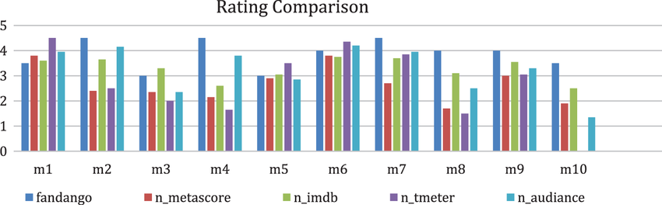
Proposed Solution
Conduct an in-depth analysis to identify the root causes of rating discrepancies on Fandango.
Develop strategies to improve rating accuracy and restore user trust in the platform's rating system.

Slide 5
System Approach
Utilize data analysis techniques to compare Fandango's ratings with those from other reputable sources, such as Rotten Tomatoes or IMDb.
Explore potential biases or inconsistencies in Fandango's rating aggregation process.

Slide 6
Algorithm & Deployment
Employ statistical methods, such as correlation analysis and regression modeling, to quantify the extent of rating discrepancies.
Deploy the analysis on a sample of movies across different genres and release years to ensure comprehensive coverage.

Slide 7
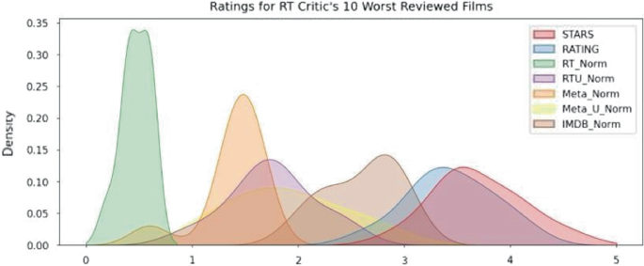
Result
Findings reveal significant disparities between Fandango's ratings and those from other platforms, indicating a systematic bias towards higher ratings on Fandango.
Further analysis identifies potential factors contributing to this bias, such as the presence of inflated user ratings or selective sampling of reviews.

Slide 8
Conclusion
The analysis underscores the need for Fandango to address rating discrepancies and enhance the transparency and reliability of its rating system.
Implementing corrective measures could improve user satisfaction and bolster Fandango's credibility within the film industry.

Slide 9
Future scope
Investigate the effectiveness of proposed solutions, such as implementing stricter validation processes for user ratings or recalibrating rating aggregation algorithms.
Explore additional factors that may influence rating discrepancies, such as promotional strategies or demographic biases.

Slide 10
References
Cite relevant studies, articles, and data sources used in the analysis, ensuring transparency and credibility.

Slide 11
THANK YOU

