Slide 1
Vector Vogue
Fashion Semantic Search System

Slide 2
Project Overview
Vector Vogue is a modern fashion semantic search engine that combines text and image-based search with AI-powered reranking. The system understands natural language fashion queries and provides intelligent product recommendations.

Slide 3
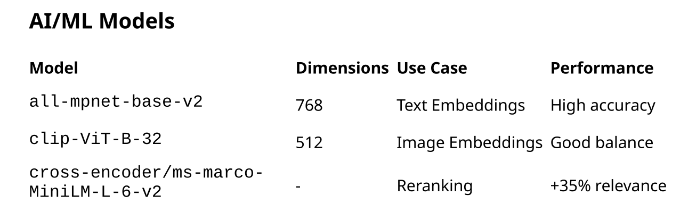
✨ Key Features
•Semantic Search: Natural language understanding for fashion queries
•Visual Search: Image-to-product matching capabilities
•AI Reranking: Cross-encoder models for improved relevance
•Smart Filtering: Gender, price, and rating filters
•Real-time Performance: Millisecond response times with FAISS
•Modern UI: Dark/light theme with responsive design

Slide 4
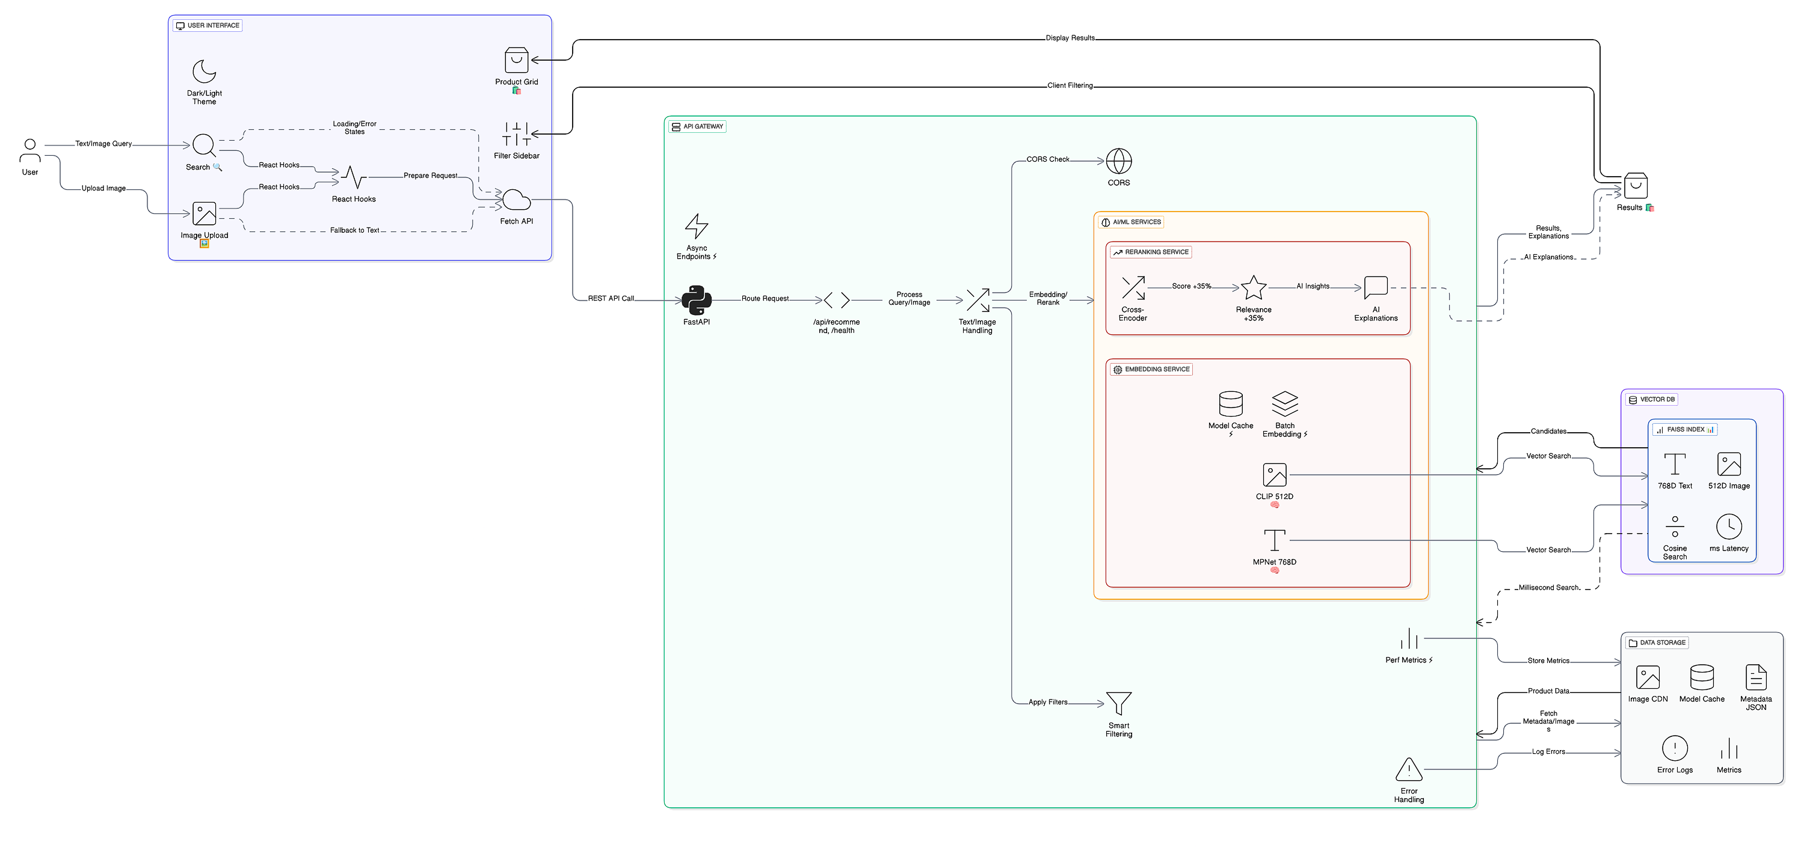

Slide 5
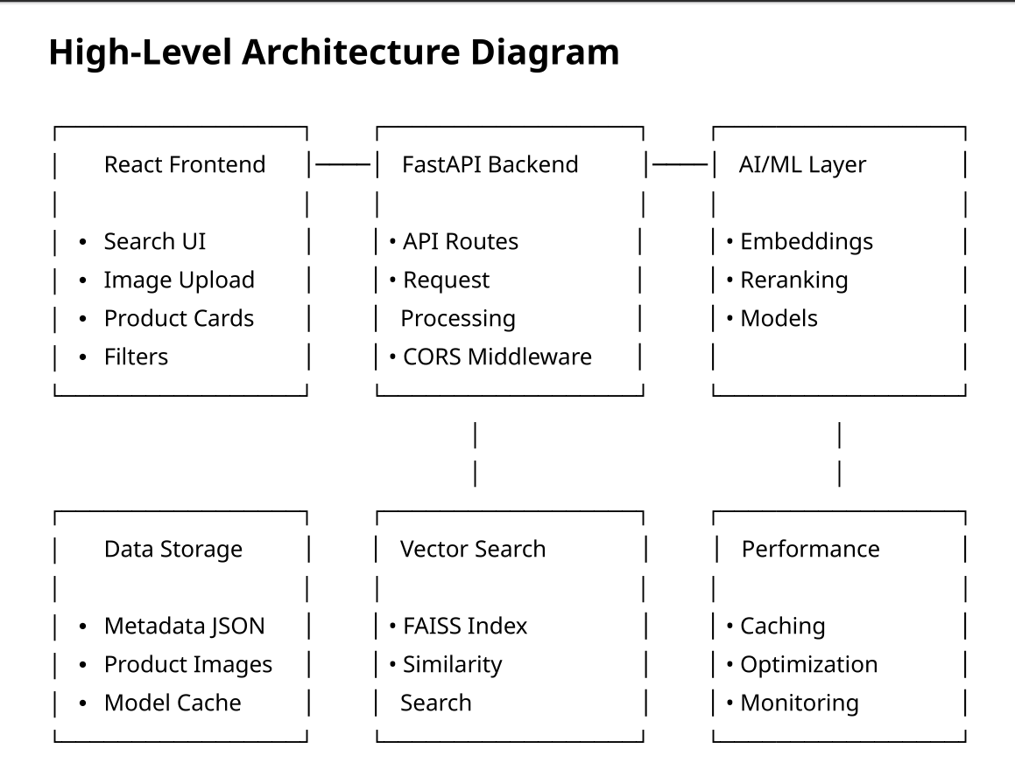
High-Level Architecture Diagram

Slide 6
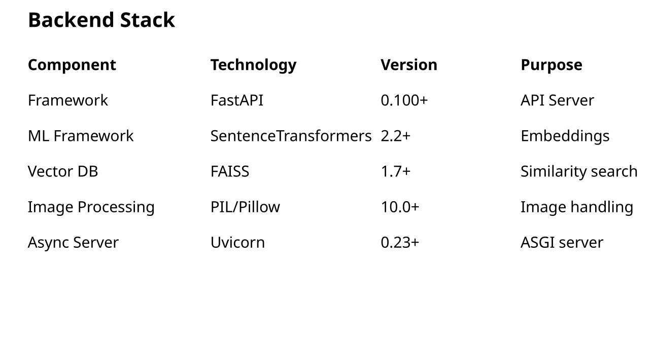
Backend Stack

Slide 7
Future Enhancements
Short-term (Next 3 Months)
Multi-modal Search: Combine text + image queries
Advanced Filters: Color, size, material filters
Personalization: User preference learning
Caching Layer: Redis for frequent queries
Medium-term (Next 6 Months)
Real-time Index Updates: Dynamic product additions
Federated Search: Multiple data sources
A/B Testing: Search algorithm optimization
Analytics Dashboard: Search insights
Long-term (Next 12 Months)
Multi-language Support: International search
Voice Search: Voice-based queries
AR Integration: Virtual try-on features
Recommendation Engine: Personalized suggestions

Slide 8

Conclusion
The system architecture clearly defines each processing stage — from data ingestion to semantic understanding and intelligent retrieval.
Enhanced visualization of the workflow allows better readability, maintainability, and communication across teams.
Image quality improvements ensure diagrams remain sharp, scalable, and suitable for documentation or presentations.
The overall approach strengthens system clarity, boosts collaboration, and supports future expansion with minimal effort.

Slide 9
Thank You!

