Slide 1
Agenda
Introduction
Objective
Technology Used
Use Case Diagram: Admin,User
Screenshots
Conclusion

Slide 2
Introduction
The Crop Recommendation System is a Python Django-based machine learning project that utilizes the Random Forest Classifier algorithm to provide accurate crop recommendations to farmers based on soil and environmental conditions. It consists of user and admin modules, allowing users to receive recommendations, view prediction history, and manage their profiles, while administrators can access analytics and manage users. The system uses parameters like nitrogen, phosphorous, potassium levels, temperature, humidity, pH, and rainfall to determine suitable crops. Its goal is to help farmers make informed decisions and maximize agricultural productivity

Slide 3
Objective
The Crop Recommendation System using Random Forest Classifier aims to achieve accurate crop selection, enhance crop yield, promote sustainable farming practices, serve as a decision support tool, provide a user-friendly interface, and ensure scalability and adaptability. By leveraging historical data and advanced algorithms, the system provides precise recommendations based on soil and environmental parameters, helping farmers make informed decisions for improved productivity and sustainability.

Slide 4
Problem definition
The Crop Recommendation System addresses the challenge of providing accurate and personalized crop recommendations to farmers based on soil and environmental conditions. By leveraging the Random Forest Classifier algorithm and historical data, the system aims to overcome traditional limitations and assist farmers in making informed decisions. Its objective is to optimize agricultural productivity, minimize resource wastage, and contribute to sustainable practices in the agriculture industry

Slide 5
Need of the system
The need for the Crop Recommendation System using Random Forest Classifier arises from the challenges faced by farmers in making informed decisions about crop selection. Traditional methods often lack accuracy and fail to consider various factors affecting crop productivity. By leveraging machine learning techniques, the system provides precise and data-driven recommendations based on factors such as soil composition, temperature, humidity, pH level, and rainfall. This helps farmers optimize resource allocation, improve crop yield, minimize environmental impact, and make informed decisions for sustainable agricultural practices. The system serves as a valuable tool to enhance productivity, profitability, and sustainability in the agriculture sector

Slide 6
User module
Signup: Users can create a new account by providing their personal details, such as name, email, and password.
Login: Registered users can log in to the system using their credentials to access personalized features.
Crop Recommendation Prediction: Users can input various parameters such as nitrogen, phosphorous, potassium levels in the soil, temperature, humidity, pH value, and rainfall to get crop recommendations based on the Random Forest Classifier algorithm.
View Prediction History: Users can view their past crop recommendation predictions, including the recommended crops and relevant details.
Edit Profile: Users have the option to update their profile information, such as name, contact details, or any other relevant information.
Change Password: Users can change their account password to enhance security.
Logout: Users can log out of the system to end their session securely.

Slide 7
Admin module
Login: The admin will have a login functionality to access the admin dashboard and perform administrative tasks.
Dashboard: The admin will have a dashboard that provides an overview of important information such as user counts, recommendation prediction results count, and other relevant statistics.
View Prediction History: The admin will be able to view the
prediction history, which includes the crop recommendations made for different users over time.
View Registered Users: The admin can view the list of
registered users in the system, including their details such as name, contact information, and other relevant information.
Change Password: The admin will have the ability to change their password for security purposes.
Logout: The admin can log out of the admin panel to ensure secure access to the system.

Slide 8
Technology Used
Frontend:
HTML, CSS, BOOTSTRAP
Backend:
PYTHON DJANGO
Database Use:
SQLite(DATABASE)

Slide 9
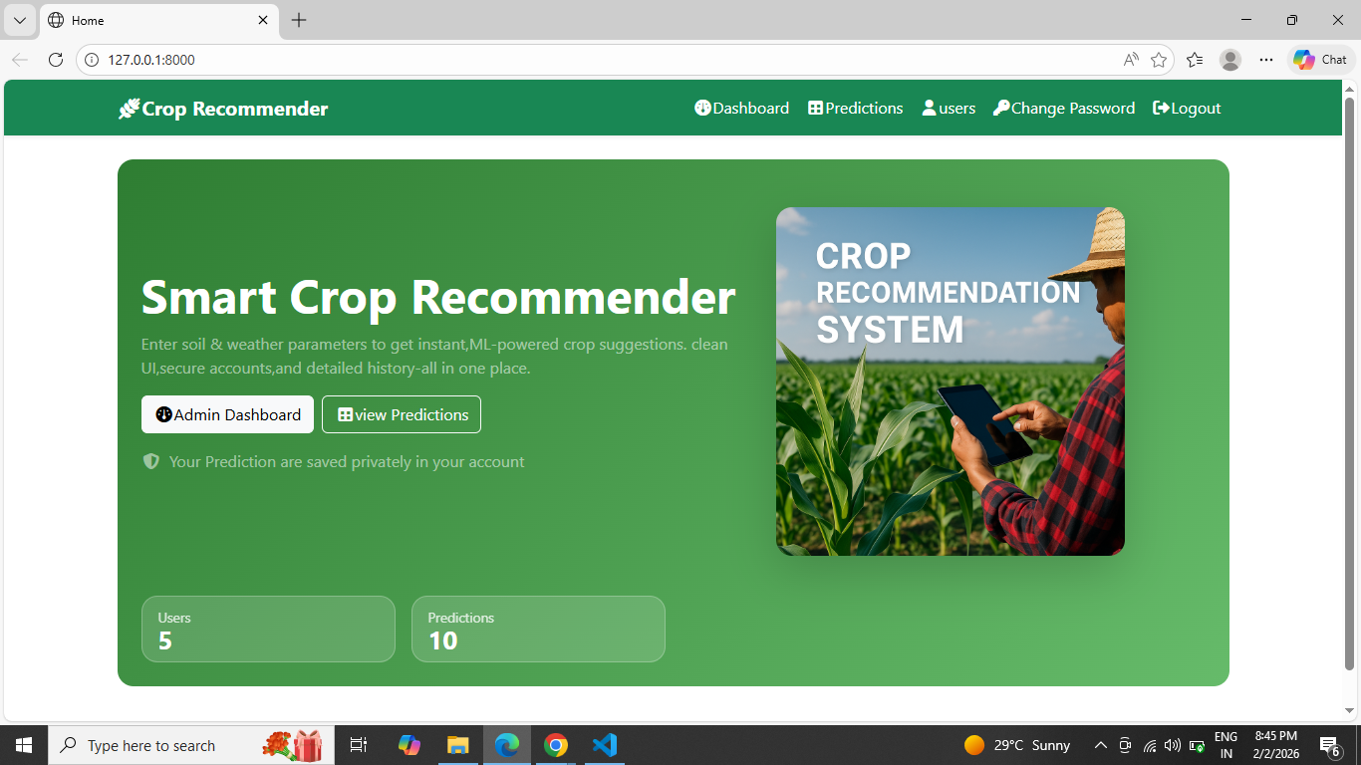
Home Page

Slide 10
Use case diagram - User
Crop Recommendation Prediction
View Prediction results history
Edit Profile
(Update)
Change Password
User
Logout

Slide 11
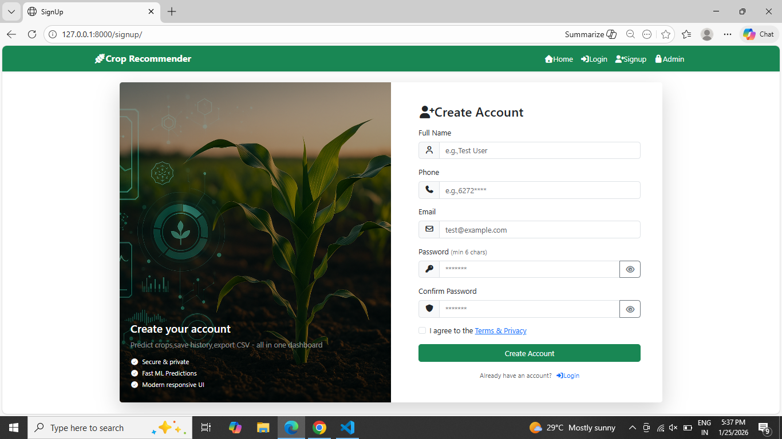
User registration

Slide 12
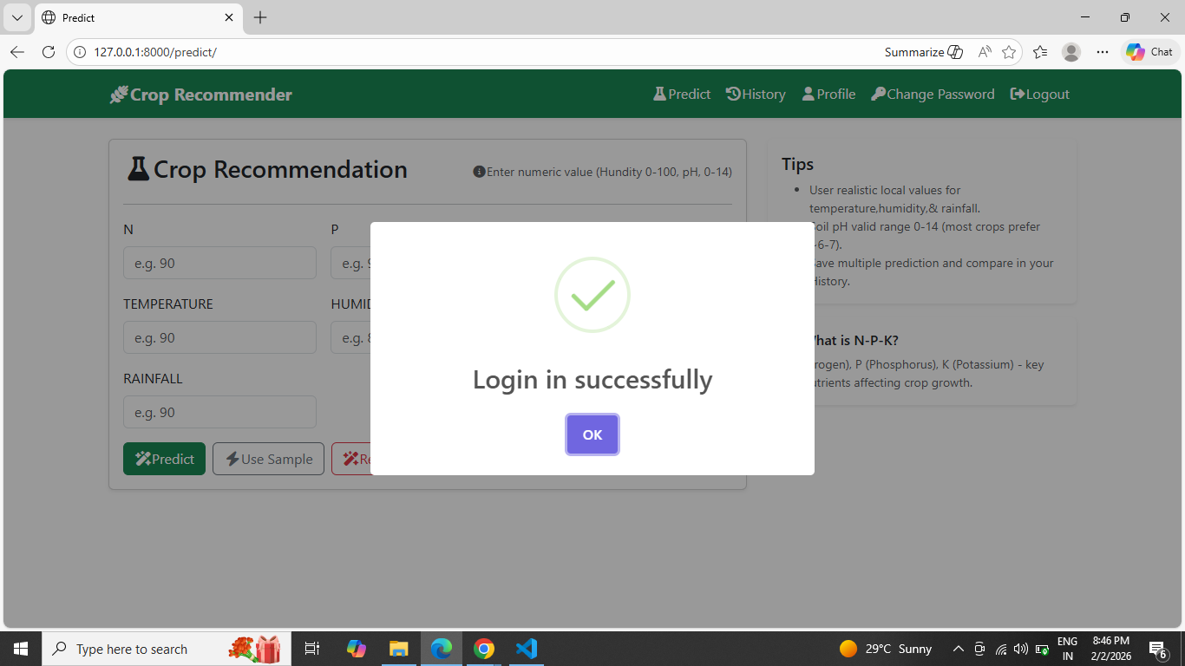
Login Page

Slide 13
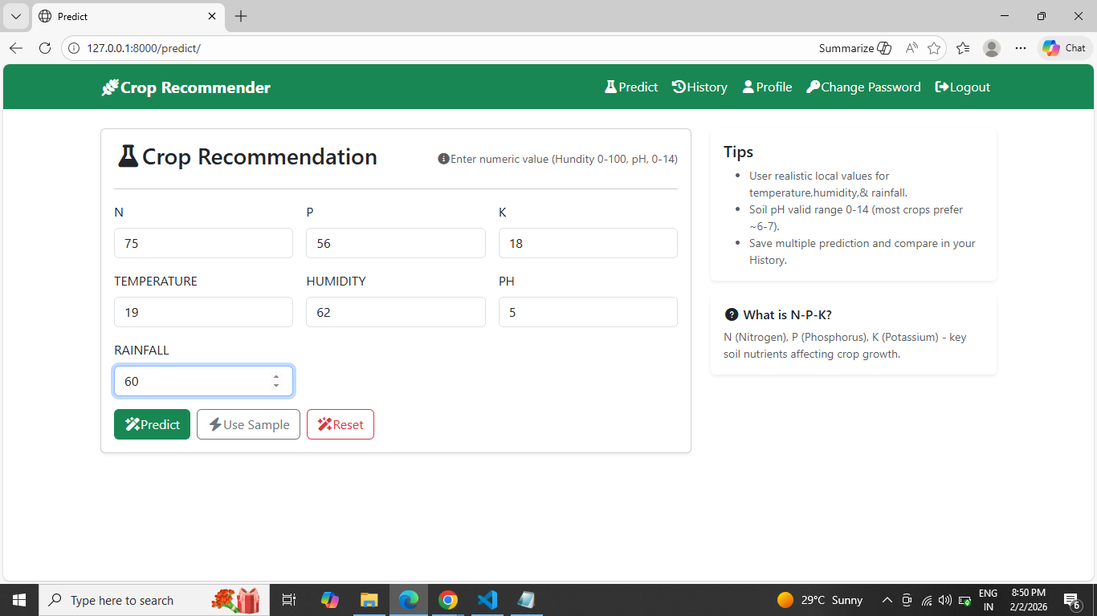
prediction

Slide 14
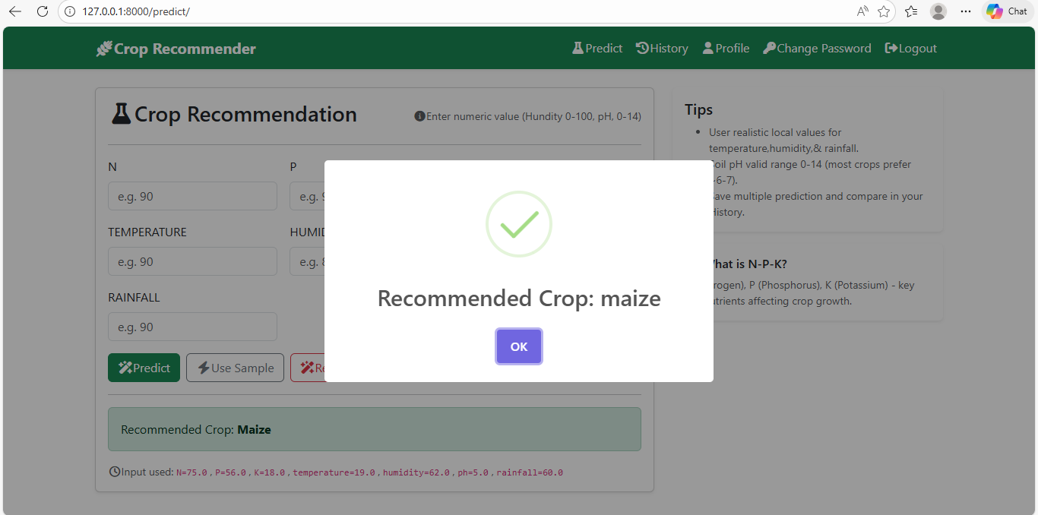
Recommended crop

Slide 15
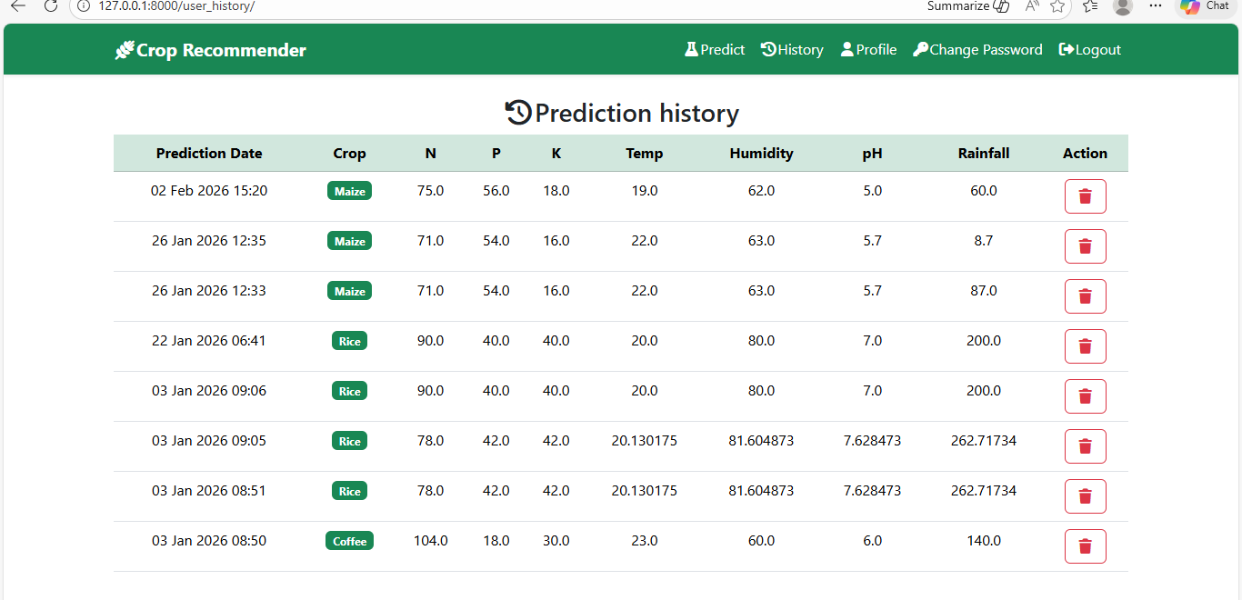
User prediction history

Slide 16
Use case diagram - admin
Admin Dashboard
View Prediction results history
Manage Reg. Users (View / delete)
Change Password
Admin
Logout

Slide 17
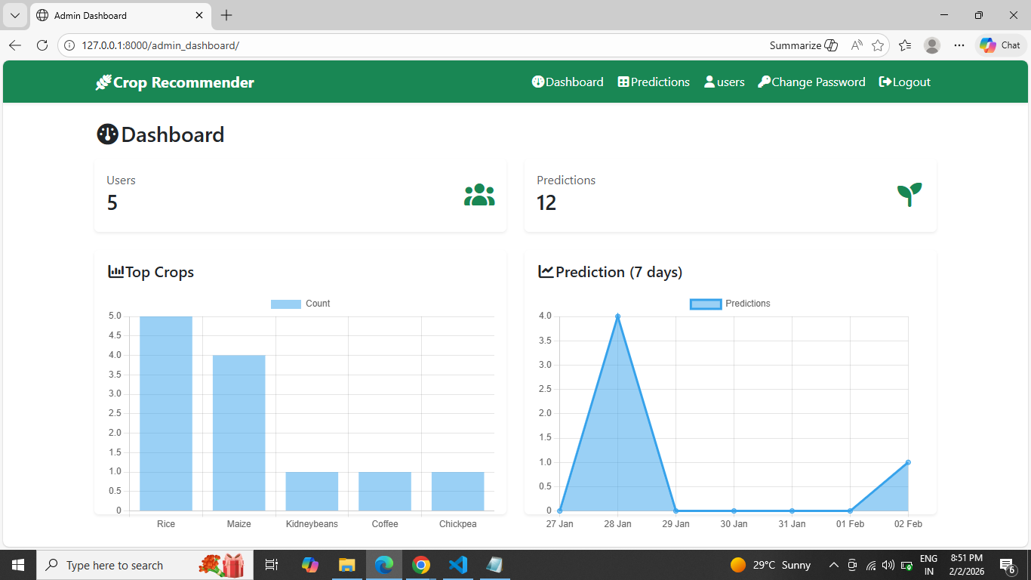
Admin dashboard

Slide 18
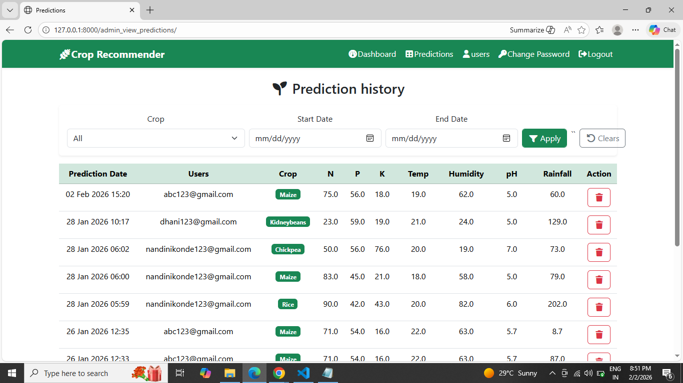
Prediction history

Slide 19
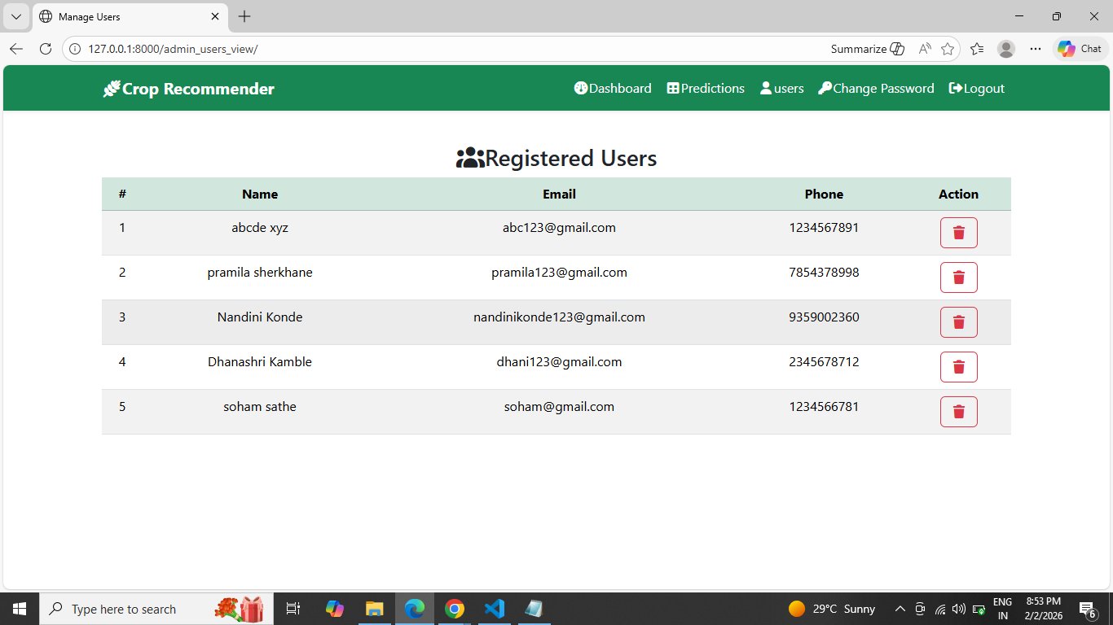
Registered users

Slide 20
Future scope
The future of Crop Recommendation Systems using Random Forest Classifier includes improving accuracy through advanced algorithms and technologies, personalizing recommendations based on individual preferences and farm conditions, integrating climate change adaption strategies, developing mobile applications for enhanced accessibility, fostering knowledge sharing and collaboration, expanding to different regions and crops, and incorporating decision support tools. These advancements aim to optimize agricultural practices, increase productivity, and address emerging challenges in the agricultural sector.

Slide 21
Conclusion
In conclusion, the Crop Recommendation System using Random Forest Classifier offers an efficient and effective solution for assisting farmers in making informed decisions about crop selection. By leveraging machine learning algorithms and historical data, the system provides personalized crop recommendations based on various soil and environmental factors. It simplifies the decision-making process, enhances productivity, and optimizes resource utilization. The system's user-friendly interface and easy accessibility make it a valuable tool for farmers, enabling them to improve their agricultural practices and achieve better crop yields. As technology advances and more data becomes available, there is a great potential for further enhancing the accuracy and performance of Crop Recommendation Systems, ultimately contributing to sustainable farming practices and agricultural growth

Slide 22
Thank you

