Slide 1
MOOD BASED PLAYLIST
Team Members:
Dhanashri Ostwal
Priyanka Sekhar
Saranya Ravichandran

Slide 2
AIM OF THE PROJECT
The idea is to build a model to analyze the lyrics and visualize the confidence level of happy and sad songs popular in each city for a particular date.
Other part of the project is to display the weather condition and recommend a list of songs based on the highest confidence level of the sentiment.

Slide 3
PROCESS FLOW
Collection of training dataset with list of songs ,artists and scraped lyrics.
Classifying the dataset into ‘Happy’ and ‘Sad’ using the Naïve Bayes classifier.
Generating a model using SGD classifier(SVM).
Scraping the test dataset from radio stations of 3 cities and classify the songs played during that week using the model.

Slide 4
PROCESS FLOW
Developing the frontend such that it allows the user to select any date of the week and it displays the happy and sad songs confidence ratio in a bar chart for the 3 cities.
Next the user is given an option to select the city. The weather condition of the city for the previously selected date is displayed.
It displays a recommendation of songs belonging to the highest confidence category for the city on that particular day.

Slide 5
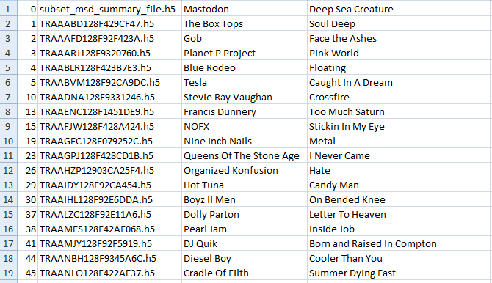
DATASETS
Training Dataset – The fields are song name, artist, lyrics and the classification. It has approximately 700 tuples. The lyrics are scraped from 2 different websites. The classification is obtained using Naïve Bayes classifier.

Slide 6
DATASETS
Test Dataset – The fields are song name, artist and the scraped lyrics. We have test data for 3 cities for an entire week. Each has approximately 150 tuples. We find the classification using the model developed.

Slide 7

Front End

Slide 8
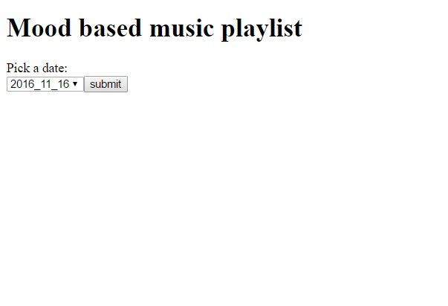
RESULT SCREENSHOTS

Slide 9
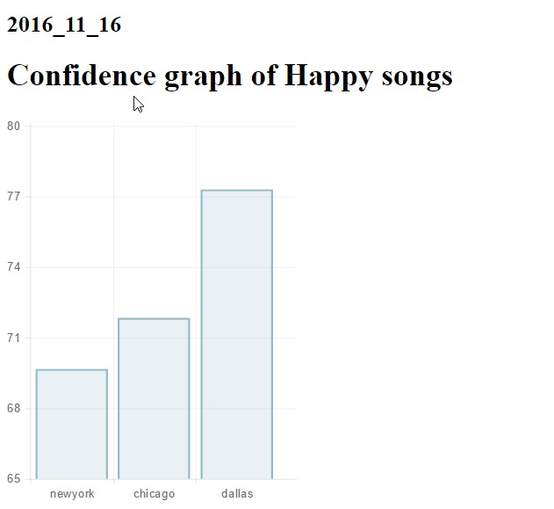
RESULT SCREENSHOTS

Slide 10
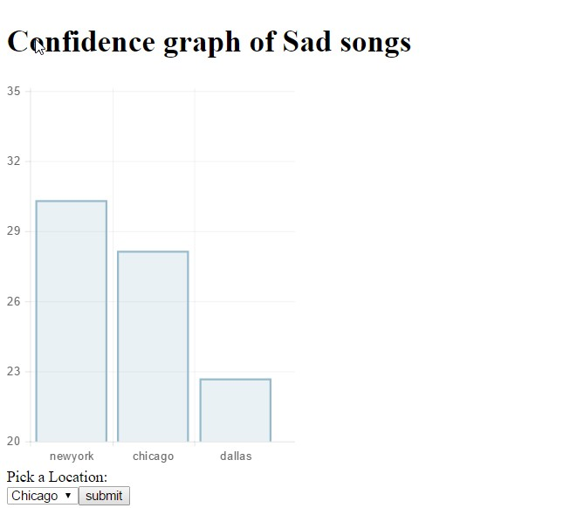
RESULT SCREENSHOTS

Slide 11
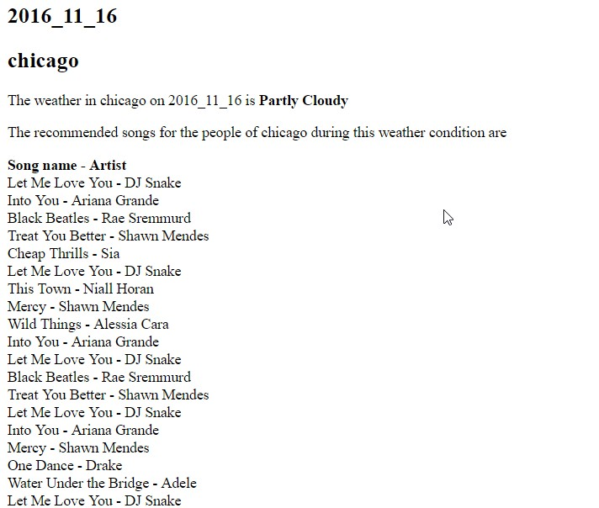
RESULT SCREENSHOTS

Slide 12
Conclusion What did we learn?
Scraping is fun!
Creating a model using SVM to analyze the lyrics
Collecting data is the hardest part
Predicting the outcome of the lyrics
Flask for front end

Slide 13
Thank you!

