Slide 1
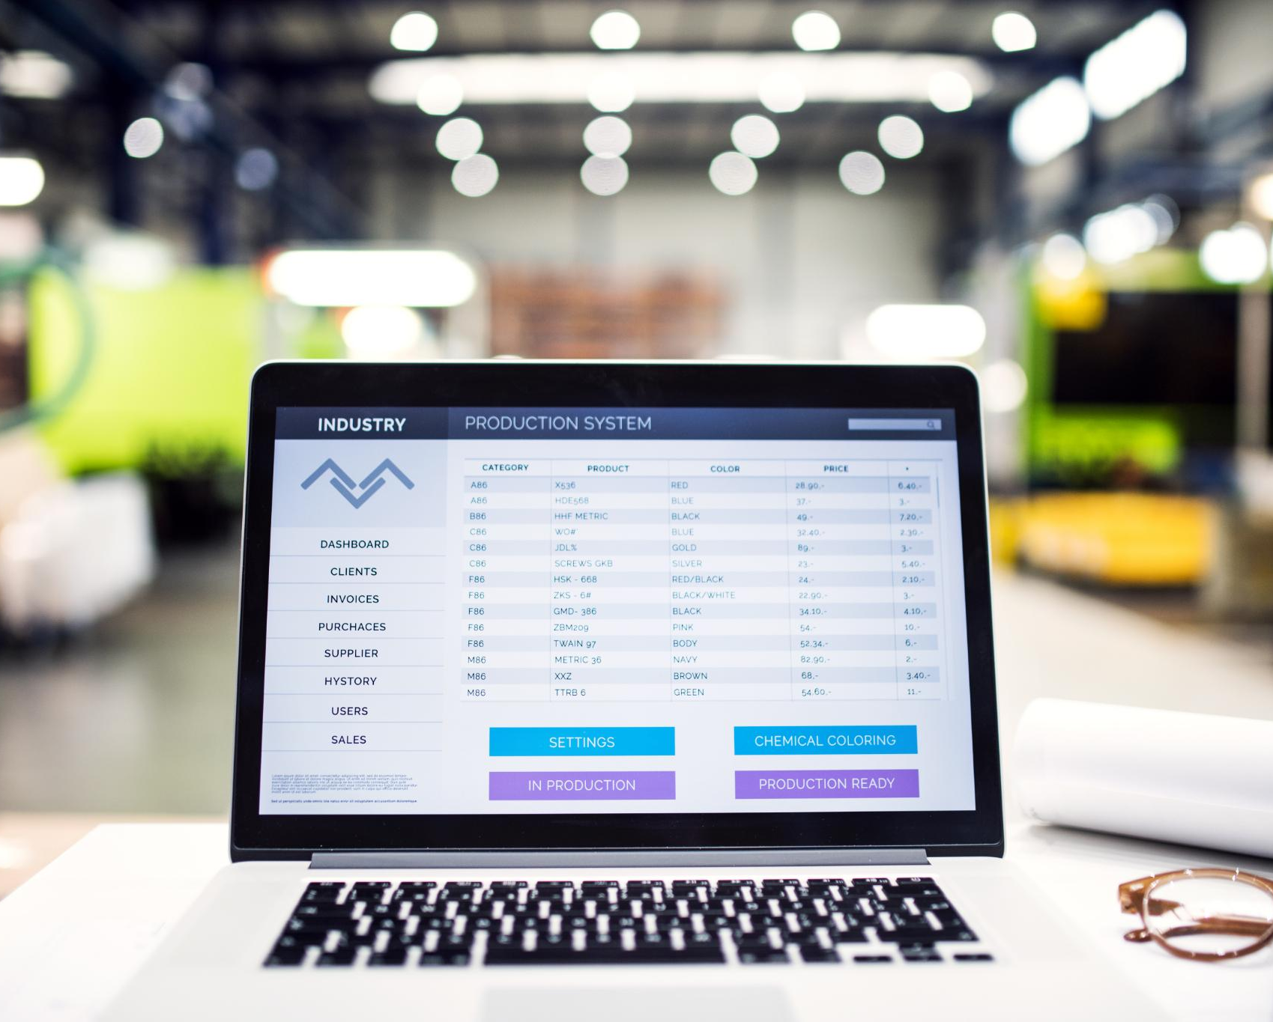
Web-Based Product Expiration Monitoring and Inventory Management System
Efficiently track and manage product expiration dates online
Notes:
---

Slide 2
Project Overview
Notes:
Project Title and Introduction

Slide 3

Project Title and Introduction
Problem of Expired Products
  Expired products pose health risks and financial losses, highlighting the need for effective inventory monitoring.
Automated Inventory Management
  The system automates tracking and alerts to reduce errors and improve inventory control.
Technical Implementation
  Built with Spring Boot, HTML5, and PostgreSQL to ensure robustness, scalability, and responsive design.
Benefits and Goals
  Enhances decision-making, streamlines stock management, and promotes consumer safety through automation.
Notes:
The project titled "Web-Based Product Expiration Monitoring and Inventory Management System Using Spring Boot and PostgreSQL" addresses critical challenges faced by businesses and consumers due to expired products. Expired goods pose severe health risks such as food poisoning and gastrointestinal issues, while businesses suffer financial losses and potential legal consequences. Manual inventory tracking methods are error-prone and inefficient, especially for small and medium enterprises. This project introduces a web-based solution that automates inventory management, monitors expiration dates, and provides timely alerts to prevent losses and health hazards. Built using Spring Boot (Java 8) for backend robustness, HTML5 for a responsive user interface, and PostgreSQL for secure data storage, the system ensures scalability, reliability, and ease of use. It aims to streamline stock management, reduce human error, and enhance decision-making processes for business owners. By integrating batch tracking, expiration alerts, and loss calculation, the system offers a comprehensive approach to inventory control. The introduction sets the stage for understanding the significance of automation in inventory management and highlights how this project contributes to operational efficiency and consumer safety.

Slide 4
Project Objectives
Notes:
Specific Goals of the System

Slide 5

Specific Goals of the System
Intuitive Inventory Platform
  Develop a user-friendly web platform using Spring Boot and PostgreSQL for efficient inventory management.
Product and Batch Tracking
  Maintain detailed product records and implement batch tracking to monitor product lifecycle precisely.
Expiry Detection and Alerts
  Automatically detect expired and near-expiry products and generate timely alerts to minimize losses.
Real-Time Insights Dashboard
  Provide a dashboard offering real-time inventory data, financial loss calculations, and proactive management tools.
Notes:
The primary objective of this project is to develop a web-based inventory management system that efficiently tracks product expiration dates and minimizes losses. Specific goals include: (1) Creating an intuitive platform for managing inventory using Spring Boot and PostgreSQL; (2) Maintaining detailed records of products, including purchase details, manufacturer information, and expiration dates; (3) Implementing batch tracking to monitor product lifecycle; (4) Detecting expired and near-expiry products automatically and generating alerts; (5) Calculating financial losses associated with expired stock; and (6) Providing a dashboard for real-time inventory insights. These objectives aim to eliminate manual errors, improve operational efficiency, and ensure consumer safety. By leveraging modern web technologies, the system offers scalability and reliability, making it suitable for small and medium-sized businesses. The objectives also emphasize the importance of proactive measures such as clearance sales or donations for near-expiry products, thereby reducing waste and enhancing profitability.

Slide 6
Scope and Limitations
Notes:
System Coverage and Constraints

Slide 7

System Coverage and Constraints
Project Scope and Features
  The system offers web access with inventory management, batch tracking, expiration monitoring, alerts, and loss calculation.
Technology Stack
  Uses Spring Boot backend, HTML5 frontend, and PostgreSQL database for secure, reliable system performance.
System Limitations
  Relies on manual data entry, lacks physical spoilage detection, requires internet, and misses barcode scanning and predictive analytics.
Future Enhancements
  Potential upgrades include mobile app integration, barcode scanning, and AI-based predictive stock management.
Notes:
The scope of this project includes developing a web-based application accessible via any internet-enabled device. Key features encompass inventory management, batch tracking, expiration date monitoring, automated alerts, and loss calculation. The system uses Spring Boot for backend development, HTML5 for the user interface, and PostgreSQL for database management, ensuring robust performance and secure data handling. However, the system has certain limitations: it relies on accurate manual data entry for product details, cannot physically detect spoilage beyond recorded expiration dates, and requires internet connectivity for access. Additionally, barcode scanning and predictive analytics are not integrated in the current version. Despite these constraints, the system significantly improves inventory accuracy and reduces risks associated with expired products. Future enhancements could include mobile app integration, barcode scanning, and AI-driven predictive stock management to further optimize functionality.

Slide 8
Methodology
Notes:
Development Approach and Tools

Slide 9

Development Approach and Tools
Structured Development Lifecycle
  The project follows a structured lifecycle starting from requirement gathering to maintenance for systematic development.
Design and Architecture
  Design includes ER diagrams, DFDs, UI wireframes, and architecture based on Spring Boot MVC pattern.
Technology Stack
  Backend uses Spring Boot and Java 8; frontend employs HTML5, CSS, JavaScript; PostgreSQL handles data storage.
Testing and Deployment
  Testing includes unit, integration, and user acceptance tests; deployment uses embedded Tomcat.
Notes:
The methodology for this project follows a structured software development lifecycle. It begins with requirement gathering to understand business needs and identify pain points in manual inventory systems. System analysis is conducted to map existing processes and propose improvements through automation. The design phase includes creating ER diagrams, Data Flow Diagrams (DFDs), and UI wireframes, along with defining the system architecture based on the Spring Boot MVC pattern. Development involves implementing the backend using Spring Boot and Java 8, designing the frontend with HTML5, CSS, and JavaScript, and integrating PostgreSQL for data storage using Spring Data JPA. Testing is performed at multiple levels, including unit testing with JUnit, integration testing, and user acceptance testing to ensure reliability and usability. Deployment utilizes embedded Tomcat for hosting, and maintenance focuses on bug fixes, performance optimization, and feature updates. This methodology ensures a systematic approach to building a scalable and secure web application tailored to inventory management needs.

Slide 10
Significance and Literature Review
Notes:
Importance and Research Background

Slide 11

Importance and Research Background
Project Significance
  This project reduces manual errors, prevents financial losses, and protects consumer health through automation.
Limitations of Previous Systems
  Earlier barcode systems lack scalability and real-time notification features necessary for modern needs.
Modern Technology Integration
  Using Spring Boot and PostgreSQL enhances performance, flexibility, and supports real-time expiry alerts.
Health Compliance and Trust
  Technology ensures health regulation compliance and improves customer trust in inventory management.
Notes:
The significance of this project lies in its ability to reduce manual errors, prevent financial losses, and safeguard consumer health. By automating expiration tracking and inventory management, the system enables timely decision-making for clearance sales, donations, or immediate consumption of near-expiry products. Literature on inventory systems highlights the inefficiencies of manual methods and the benefits of automation in improving accuracy and reducing waste. Previous research has explored barcode-based systems and desktop applications, but many lack scalability and real-time notification features. Modern frameworks like Spring Boot, combined with relational databases such as PostgreSQL, offer enhanced performance and flexibility. This project builds on these advancements by integrating expiry alerts, batch monitoring, and loss calculation into a unified web platform. Studies also emphasize the role of technology in ensuring compliance with health regulations and improving customer trust, making this system a valuable contribution to retail and inventory management practices.

Slide 12
Expected Outcomes and Conclusion
Notes:
Results and Final Thoughts

Slide 13

Results and Final Thoughts
Project Outcomes
  Real-time inventory tracking and alerts reduce losses and improve consumer safety effectively.
System Features
  User-friendly interface manages stock, calculates losses, and delivers actionable insights efficiently.
Technology Stack
  Spring Boot, HTML5, and PostgreSQL provide scalability, security, and reliable backend support.
Future Enhancements
  Mobile apps, barcode scanning, and predictive analytics will optimize inventory control further.
Notes:
The expected outcomes of this project include real-time inventory monitoring, automated alerts for near-expiry and expired products, reduction in financial losses, and improved consumer safety. The system will provide a user-friendly interface for managing stock, calculating losses, and generating actionable insights. By leveraging Spring Boot, HTML5, and PostgreSQL, the application ensures scalability, security, and reliability. In conclusion, this project offers a practical solution to the challenges of manual inventory management by automating critical processes and enhancing operational efficiency. It represents a significant step toward modernizing inventory practices for small and medium businesses, reducing waste, and promoting health compliance. Future improvements could include mobile app integration, barcode scanning, and predictive analytics to further optimize inventory control and decision-making.

