Slide 1

IBM University Engagement Project Submission
“Exploring the Power of Agentic AI with IBM Granite and LangFlow”

Slide 2

Project Tile – Interview Trainer Agent
Domain of Project – Education and Career Development
Student Name | Recent Passport Photo | Email ID | Mobile number [WhatsApp]
Dhana
Vikhyat
Pinnamareddy
dhanavikhyatpinnamareddy
@gmail.com
9502856738

Slide 3
Problem Statement -Interview Trainer Agent
The Challenge:
Many students and job seekers struggle to prepare effectively for technical and HR interviews. Interview preparation resources are
scattered across multiple platforms, making it difficult to identify the right topics, create structured learning plans, and practice
relevant interview questions. Without personalized guidance and a systematic preparation strategy, candidates often lack
confidence, overlook important concepts, and perform below their potential during interviews.
The Objective:
Build an AI-powered Interview Trainer Agent that delivers personalized interview preparation guidance for students and
professionals. The solution should:
Personalized Preparation Roadmaps – Generate structured learning plans based on the user's target role, technology
stack, and experience level.
Interview Topic Guidance – Recommend important concepts, subjects, and interview topics that need revision.
Coding Practice Suggestions – Suggest relevant coding problems, data structures, algorithms, and technical exercises.
Technical Interview Preparation – Provide role-specific technical interview guidance for domains such as Python, Java,
Frontend Development, AI Engineering, and Software Development.
HR & Behavioral Interview Support – Help users prepare for HR rounds, behavioral questions, communication skills, and
confidence building.
Interactive Mock Interview System – Conduct interview sessions by asking questions one at a time and evaluating user
responses.
Career Mentorship – Offer preparation strategies, learning recommendations, and improvement suggestions based on user
goals.
Context-Aware Guidance – Maintain conversation history to provide personalized and continuous interview preparation
support.
Domain-Restricted Assistant – Focus exclusively on interview preparation and career-related guidance to ensure accurate
and relevant responses.

Slide 4
Technology Used
LangFlow – Used for designing and orchestrating the Interview Trainer Agent workflow through a visual drag-and-drop interface.
IBM watsonx.ai – Used for accessing and deploying foundation models to generate interview preparation guidance and career recommendations.
IBM Granite – Used for natural language understanding, roadmap generation, interview question generation, and career mentoring.
Message History Component – Used to maintain conversation context and provide personalized interview preparation support.
GitHub – Used for project version control, documentation, and deployment of project resources.
LangFlow Components Used:
1.Chat Input
2.Message History
3.IBM watsonx.ai Model
4.Chat Output
Tech Stack (Mandatory)
I used:
LangFlow + IBM watsonx.ai + Granite Models

Slide 5
Proposed Solution -
The proposed solution is an AI-powered Interview Trainer Agent built using LangFlow, IBM watsonx.ai, and IBM Granite 8B Code Instruct. The system helps users prepare for technical and HR interviews by providing personalized interview roadmaps, role-specific guidance, and structured preparation strategies.
The workflow uses Message History to maintain conversation context and IBM Granite 8B Code Instruct to generate accurate, interview-focused responses. LangFlow orchestrates the complete workflow, while watsonx.ai enables AI model deployment and processing.
The solution delivers a personalized, interactive, and domain-restricted interview preparation experience, helping users improve confidence, technical knowledge, and interview performance.

Slide 6
Langflow component Used -
Chat Input: Accepts interview-related queries from users.
Message History:Stores and retrieves previous conversations to maintain context.
IBM watsonx.ai Component: Connects LangFlow with IBM watsonx.ai foundation models.
IBM Granite 8B Code Instruct: Generates interview roadmaps, preparation guidance, and role- specific responses.
System Prompt: Restricts the agent to interview preparation and career guidance only.
Chat Output: Displays AI-generated interview guidance and responses to the user.

Slide 7
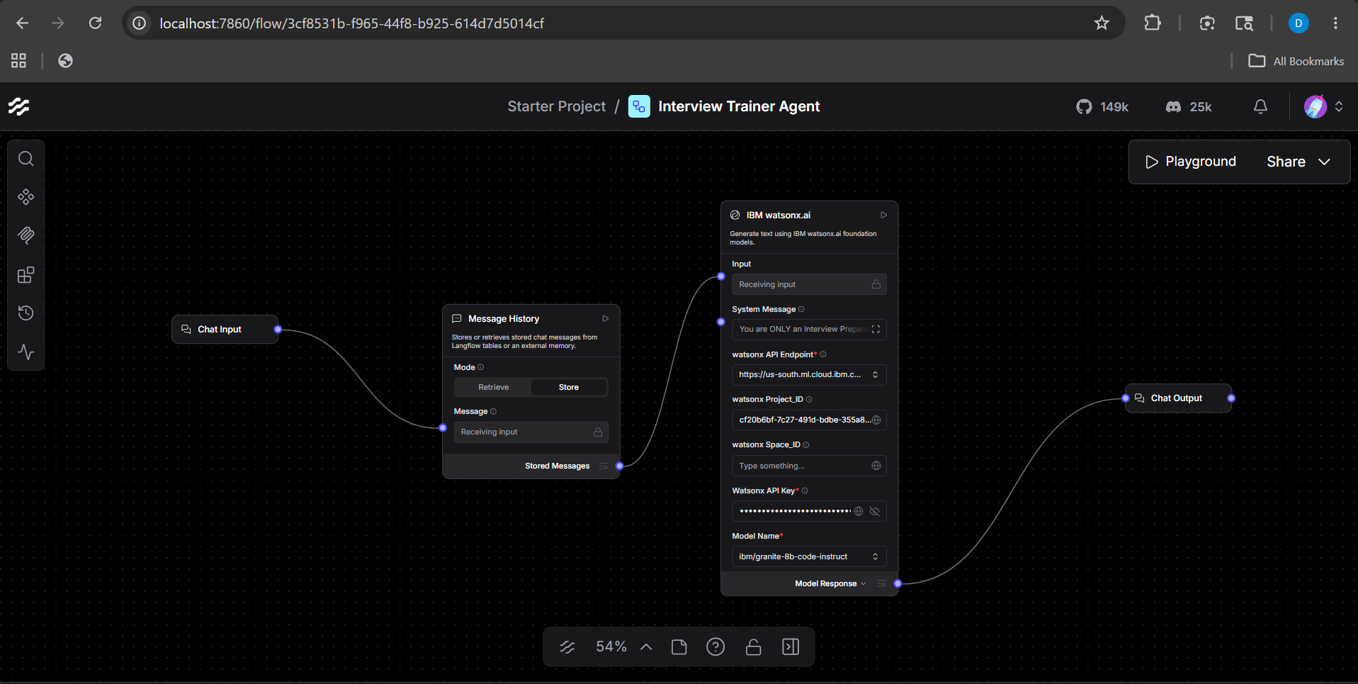
Langflow workflow -

Slide 8
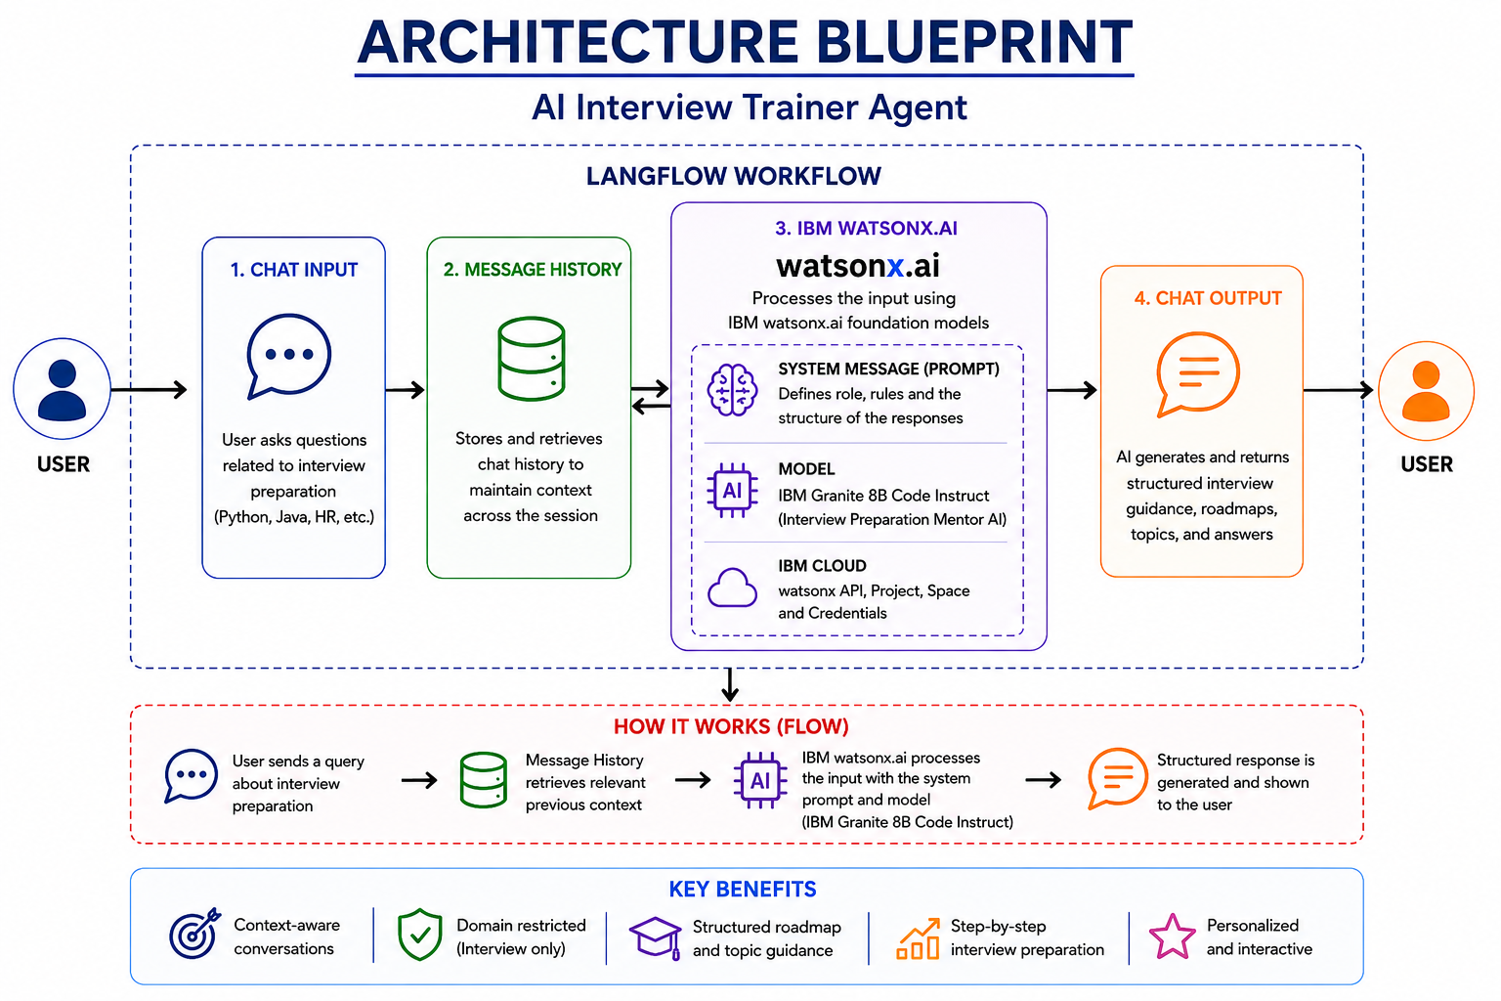
Architecture Blueprint

Slide 9
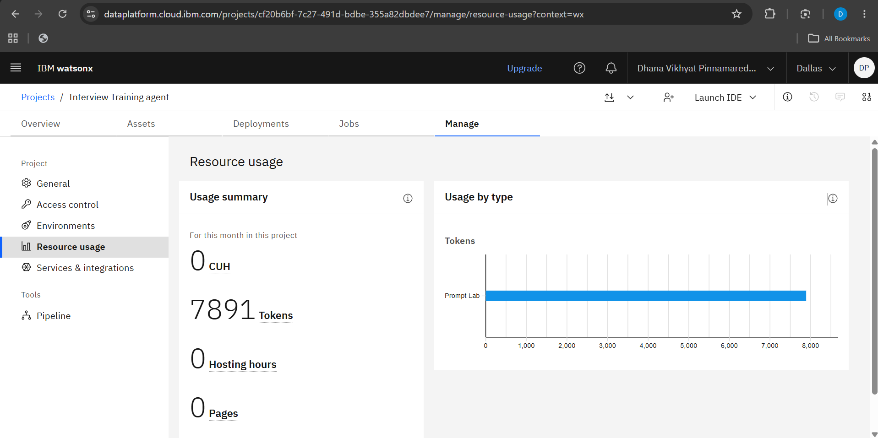

Slide 10

Role of Agentic AI in the solution
Agentic AI enables the Interview Trainer Agent to function as an intelligent career mentor rather than a simple chatbot. It understands user goals, analyzes the interview role or technology specified by the user, and provides personalized preparation guidance.
The agent generates structured learning roadmaps, recommends important topics, suggests coding practice areas, and provides interview preparation strategies based on the user's needs. By maintaining conversation history, it delivers context-aware and adaptive responses throughout the preparation process.
Agentic AI also ensures that the system remains focused on interview preparation and career guidance, providing relevant and goal-oriented assistance. This helps users improve their technical knowledge, communication skills, confidence, and overall interview readiness.
In summary, Agentic AI makes the Interview Trainer Agent personalized, context-aware, adaptive, and focused on helping users succeed in interviews.

Slide 11
Technology Used
LangFlow – Used for designing and orchestrating the Interview Trainer Agent workflow through a visual drag-and-drop interface.
IBM watsonx.ai – Used for accessing and deploying AI foundation models to generate interview preparation guidance.
IBM Granite 8B Code Instruct – Used for generating interview roadmaps, technical guidance, interview questions, and career preparation recommendations.
Message History Component – Used to maintain conversation context and provide personalized responses.
IBM Cloud – Provides the cloud infrastructure for running and managing AI services.
GitHub – Used for project version control, documentation, and repository management.

Slide 12
Novelty and Uniqueness
Personalized Interview Preparation – Generates customized roadmaps and guidance based on the user's target role and technology.
Context-Aware Responses – Uses conversation history to provide relevant and adaptive recommendations.
Domain-Restricted Intelligence – Focuses exclusively on interview preparation and career guidance, ensuring accurate and goal-oriented responses.
Interactive Learning Approach – Guides users through structured preparation rather than simply answering questions.
Role-Specific Guidance – Supports interview preparation for technologies such as Python, Java, Frontend Development, and Software Engineering.
Powered by IBM watsonx.ai and Granite Models – Leverages enterprise-grade AI models to deliver reliable and professional interview preparation support.

Slide 13
Git Hub Link
https://github.com/dhanavikhyatpinnamareddy/Interview-Trainer-Agent
·
·
·

Slide 14
Future Scope
Resume Analyzer Integration – Analyze user resumes and provide personalized interview preparation plans.
Mock Interview System – Conduct interactive technical and HR mock interviews with performance evaluation.
Voice-Based Interview Training – Enable users to practice interviews through voice conversations and receive feedback.
Company-Specific Preparation – Provide interview questions and preparation strategies tailored to specific companies.
Progress Tracking Dashboard – Monitor learning progress, completed topics, and interview readiness over time.
Multi-Agent Architecture – Introduce specialized agents for Technical Interviews, HR Interviews, DSA Preparation, and Career Guidance.
·
·
·

Slide 15


