Slide 1

Welcome to
DhanBhoomi Agrotech Pvt Ltd.
Undri, Tal – Haveli, Dist- Pune 411060
E-mail – info.dhanbhoomi@gmail.com
www.dhanbhoomi.com

Slide 2

About us
Mr. Sandeep Hanumant Hole was born in a farmer family. His passion for agriculture since childhood is his hobby of doing new experiments in agriculture as well as propagating and disseminating organic farming with the help of Warkari sect....
Reached out to farmers through the Toplife Group and learned a lot about organic farming. With the experience of the CEO post here, we are ready to bring some organic farming products for the farmers. That's it

Slide 3
Organic farming is not our business, organic farming is our life.
Only to convince and propagate about organic farming.
Companion to the bright and secure future of the farmers !!!!!!!

Slide 4
Goals and Objectives
Goals :
Farming using organic products and the health of nature as well as human nature.
Objectives :
Dhanbhoomi aims to contribute to the creation of a brighter India by providing human life with health and healthy health through organic.
Companion to the bright and secure future of the farmers !!!!!!!

Slide 5
Organic Farming
Excessive use of chemical fertilizers reduces soil fertility. Agricultural income began to decline and agricultural production costs began to rise. Modern seed varieties are on the verge of. extinction and the use of chemical fertilizers is making the soil hard and dying. We have to think of organic farming in the interest of the farmers and the country.

Slide 6
Organic Farming
Organic farming is farming done using natural ingredients. The use of organic products enhances the quality of the crop and the right amount of curb in the soil increases the fertility of the soil, improves the growth of the crop and produces high quality and healthy nutrients.
Companion to the bright and secure future of the farmers !!!!!!!

Slide 7
Advantages of organic farming products
Help maintain soil health level.
Recycling of nutrients and surrounding organic matter between crops and surrounding plants.
To maintain the balance of nature, not to use unnatural objects, organisms unfamiliar with nature (pesticides, chemicals, GMO Etc).
Diversity in production.
The right to live a natural life for the organisms that depend on agriculture.

Slide 8
Advantages of organic farming products
An important role in environmental protection.
Assuring food security and helping to raise living standards.
Better financial planning by increasing financial income and reducing costs.
Companion to the bright and secure future of the farmers !!!!!!!

Slide 9
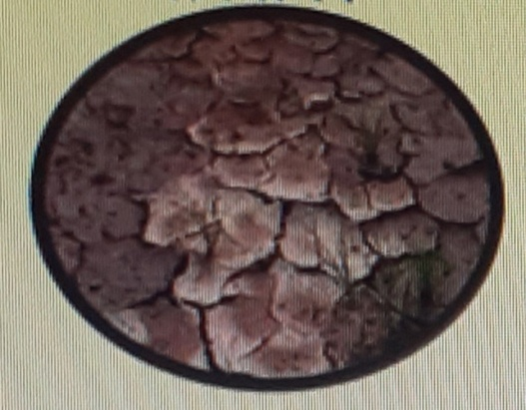
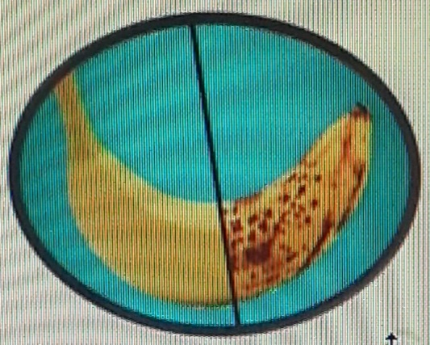
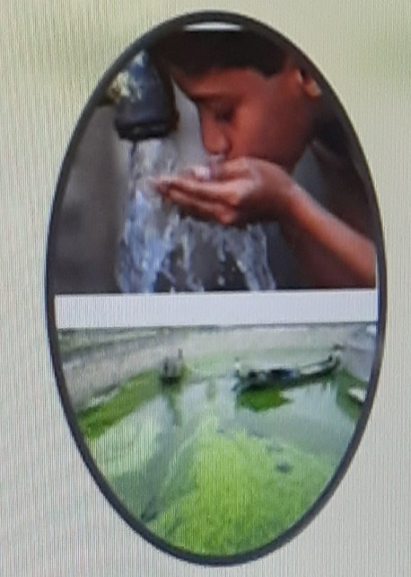
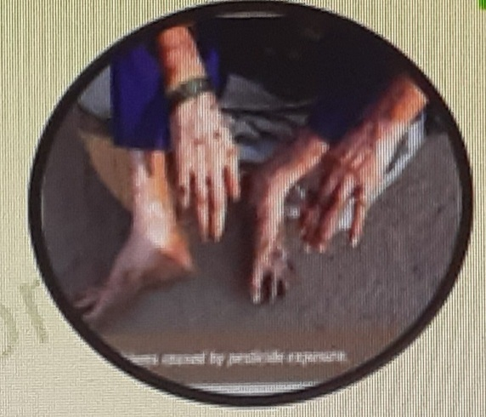
Adverse effects caused by chemical products
On the ground
On foodstuffs
On the water
On human body
The panacea for all this
Companion to the bright and secure future of the farmers !!!!!!!

Slide 10
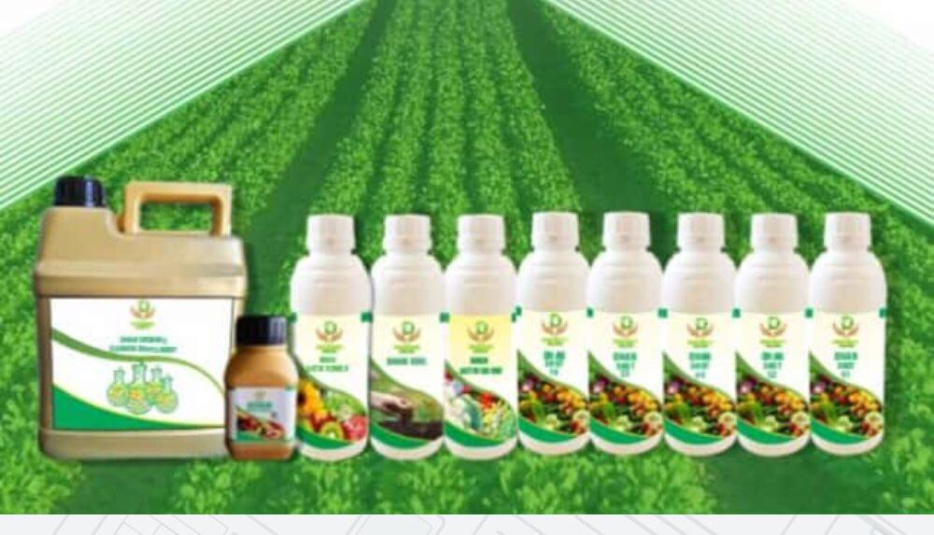
Range of Products
Companion to the bright and secure future of the farmers !!!!!!!

Slide 11
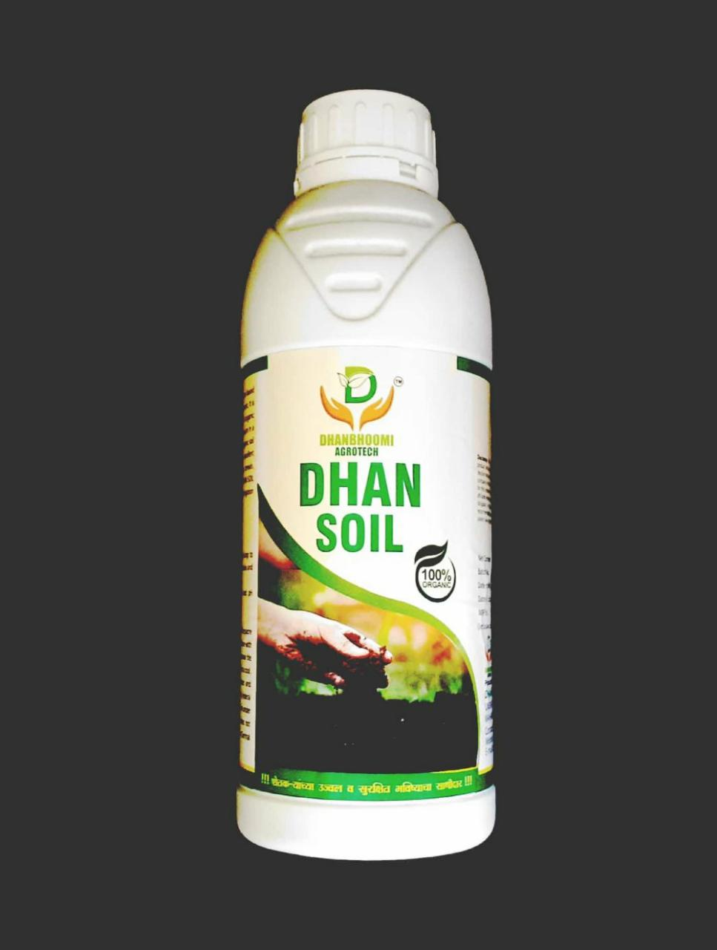
Dhan Soil
100 % Organic.
Soil is loose material that lies on top of the land.
To Increase the capacity of Nutritional substance.
Acts as a buffer to maintain soil acidity.
Increases soil organic matter.
Improves overall plant health and increases crop grading and yield.
Method of use :
1 ltr. Driching for one acre in 200
ltr. of water or giving to the soil.
Companion to the bright and secure future of the farmers !!!!!!!

Slide 12
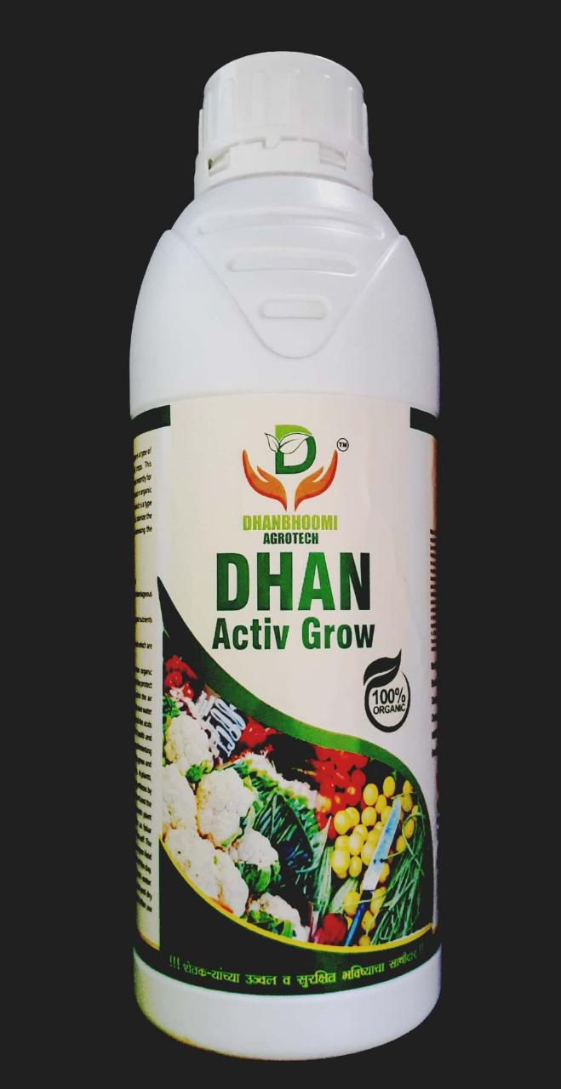
Dhan Grow
Features
Dhan Grow accelerates plant growth.
Plays an important role in total plant
production. It also enhances the
plant's resistance to heat stress, extreme humidity and
extreme temperatures.
Maintaining the right level of essential nutrients enhances
the plant's ability to resist stress.
Plant sugars work by rotating, affecting cell division, and
helping to make some wraps.
Dhan Grow feeds the plant, provides food, helps in growth,
increases the number of flowers, increases the fruit bearing
capacity and therefore increases the yield.

Slide 13
Dhan Grow
Method of use
For better nutrition and growth: Apply 2-3 ml / ltr. of
water after 10-15 days. Apply drops to the leaf tips and
roots. Let only moisture in the descending area. Give only
during the hot and humid period of the day.
After spraying, remove the spray and all its parts and
wash the inside and outside with clean water..
Companion to the bright and secure future of the farmers !!!!!!!

Slide 14
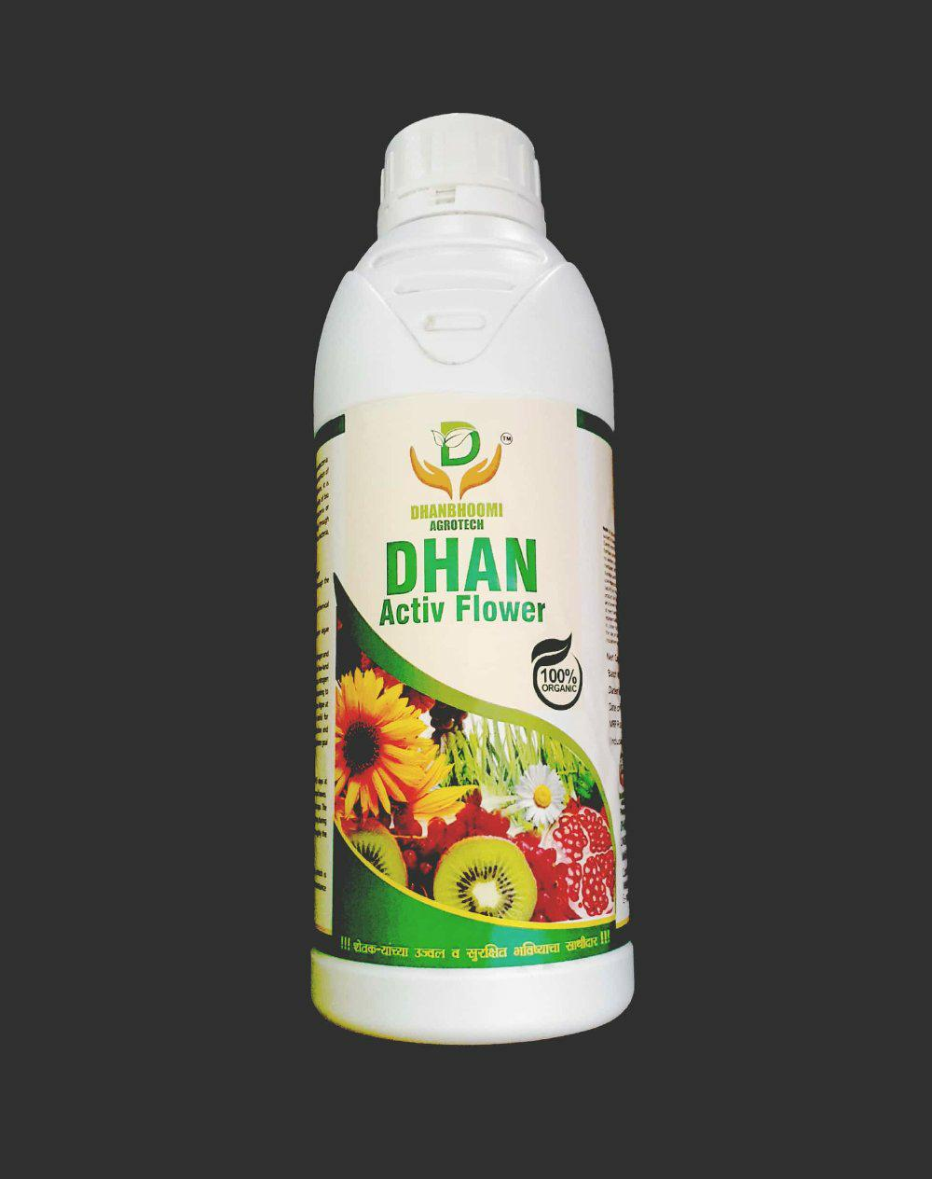
Dhan Flower
Features
Dhan Flower is an organic grading modifier enhancing
the flowering and fruit bearing capacity of plants. It is a
catalyst for nutrients, which stimulates the plant to
supply its energy and fruit set.
Increases the highest yields and increases the quality
and long-term viability of the fruit after harvest.
Dhan Flower is a special catalytic blend that adds to the
plant's antioxidants, minerals and growth to produce
more tasty, fresh fruits.
By working with the natural oxen's in the positive flower
plant, it stimulates the cell division in the plant and
promotes parallel growth. Increases the acidity of the
plant so that early crops are formed, self-life is enhanced
and the taste is better. Suitable for both fruits and
vegetables.

Slide 15
Dhan Flower
Method of use
Spray at the rate of 2-3 ml every 10-15 days to get more
nutrients and adequate nutrients to the seedlings.
Sprinkle the bottom and ends of the leaf with only the
lower part of the leaf. Apply lower rates for protected
crops while higher rates apply lower rates for more
stress free open crops, spray during daytime and cold
periods. After spraying, remove the sprayer and rinse
with water.
Companion to the bright and secure future of the farmers !!!!!!!

Slide 16
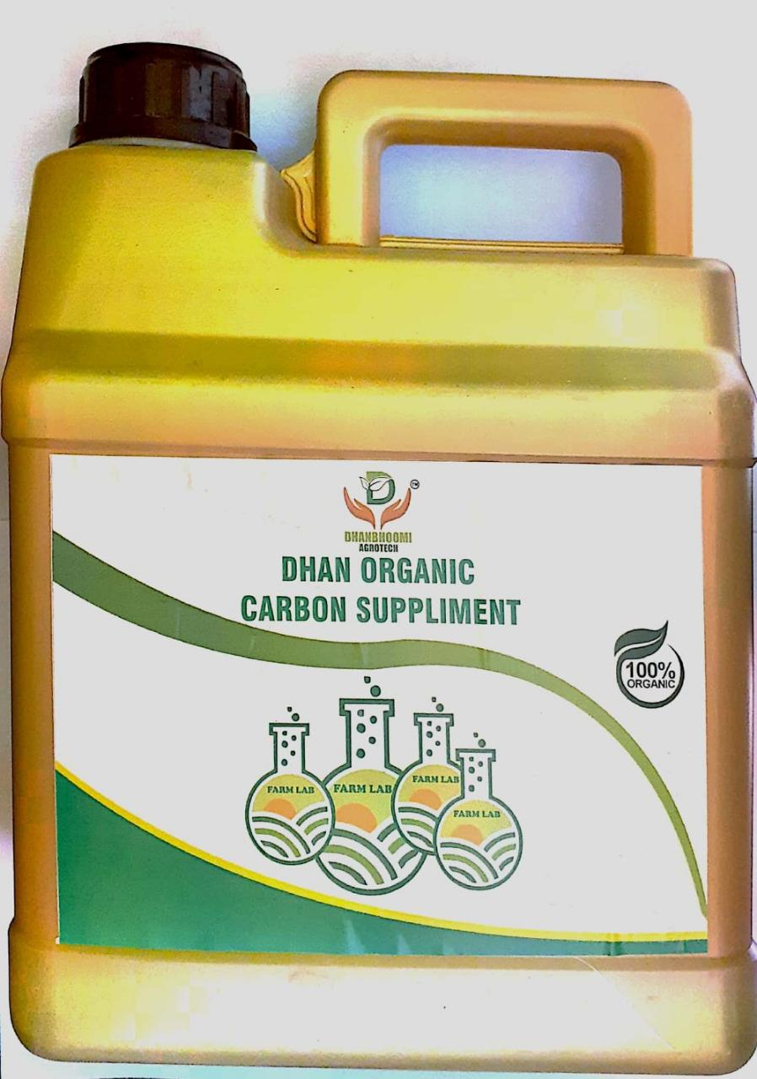
Dhan Organic Carbon Supliment
Features
Helps to store 90-95% nitrogen, 50-80%
phosphorus and 20-30% sulphur in the soil.
The soil stores calcium, magnesium, potassium
and other nutrients.
The pH of the soil, helps to balance.
Plants grow and increase the number of friendly bacteria in the soil.
Prevents water from being carried away and
stores it in the soil.

Slide 17
Dhan Organic Carbon Supliment
Method of use
Use 20 ltr. of organic carbon supplement per
acre in 1 month.
Use 5 ltr. of water per acre per week. It can be
used with drip irrigation, watering near radish and flood water.
Companion to the bright and secure future of the farmers !!!!!!!

Slide 18
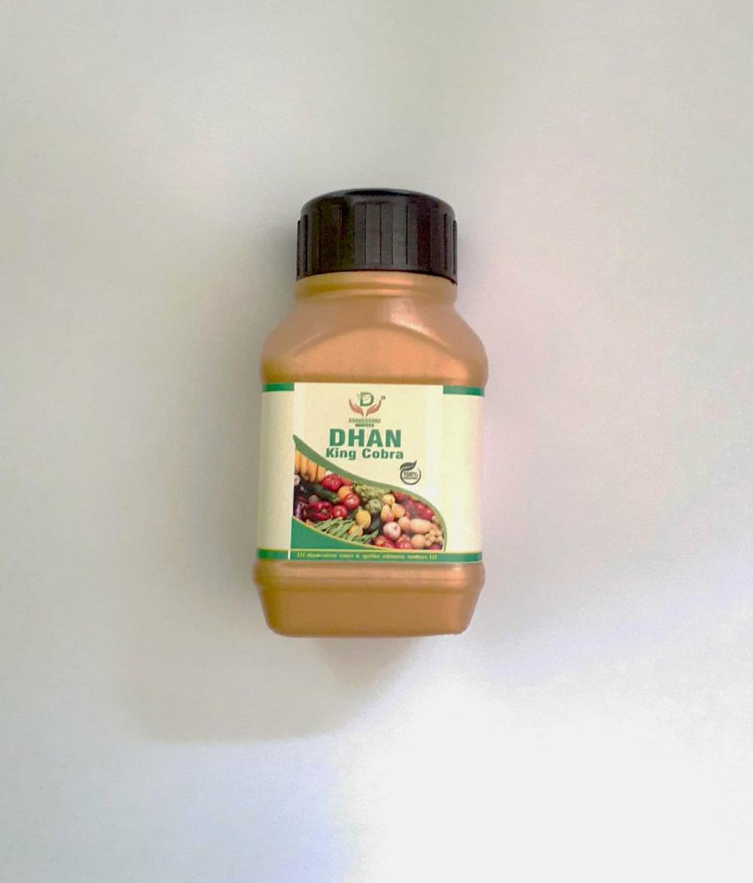
Dhan King Kobra
The Dhan King Cobra is an effective pesticide with specific functions. Its use instantly kills sucking insects like red spider, red brips, snake ginger, white flag. Yes, it is a sophisticated organic pesticide. So that the tree is not affected in any way.
Features
Quick extermination of insects.
Protects plants from pests for a long time.
A single drug kills most types of (sucking) insects,
eliminating the need to use other drugs.
Being organic, friendly to the environment.
Method of use
5 Ml / 200 ltr. of water
Companion to the bright and secure future of the farmers !!!!!!!

Slide 19
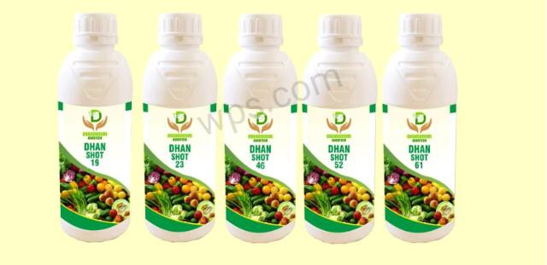
Dhan Shot N.P.K
Companion to the bright and secure future of the farmers !!!!!!!

Slide 20

In short, my victim king
Not in powder form. N.P.K. Fertilizers and Dhan Agro Organic N.P.K fertilizers
In powder form / granules | Dhan agro in liquid form
1) 19:19:19 in powder form is N13, P8, K15 | 1) 19:19:19 All the elements appear in full form
2) The solubility of powder is 56 gms / 100 ml. | 2) The liquid is 100% water soluble and has a solubility of 100 ml / 100 ml.
3) Chemical fertilizers contain oxides which increase the salinity of the soil and make the soil barren. | 3) Dhan Agro's Liquid Fertilizers are bio-organic without any side effects and help to improve soil texture.
4) The higher the price the lower the quantity available to the tree. | 4) The lower the price, the higher the yield.
5) The plant gets less nutrients and is more likely to be side effect. | 5) Being organic, it does not cause side effects and provides the right amount of nutrients.

Slide 21
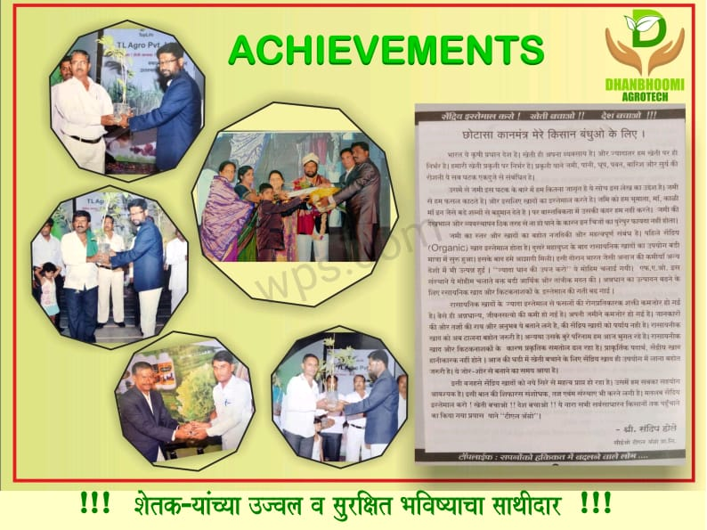

Slide 22
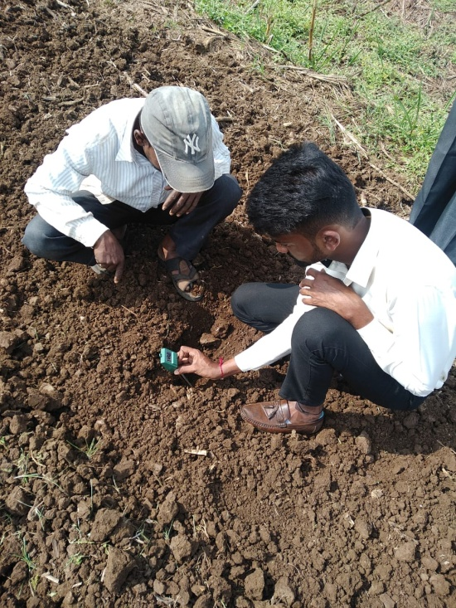
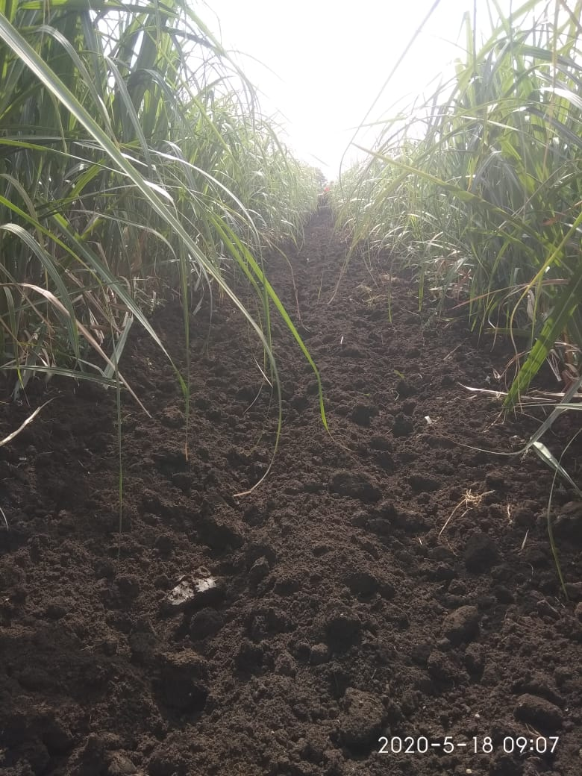
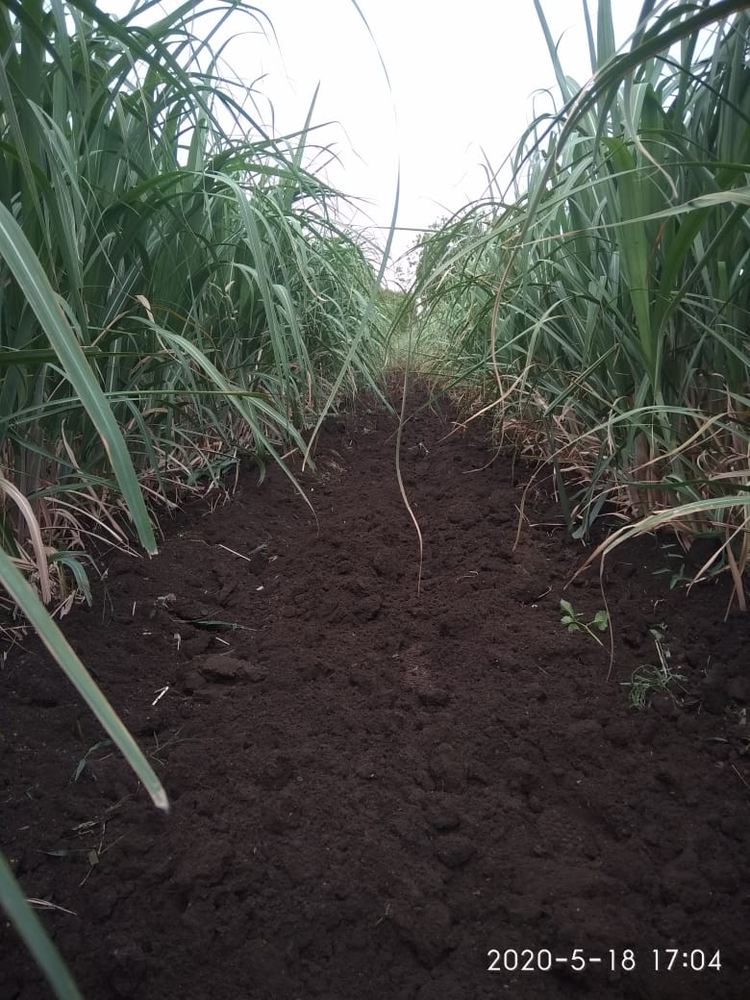
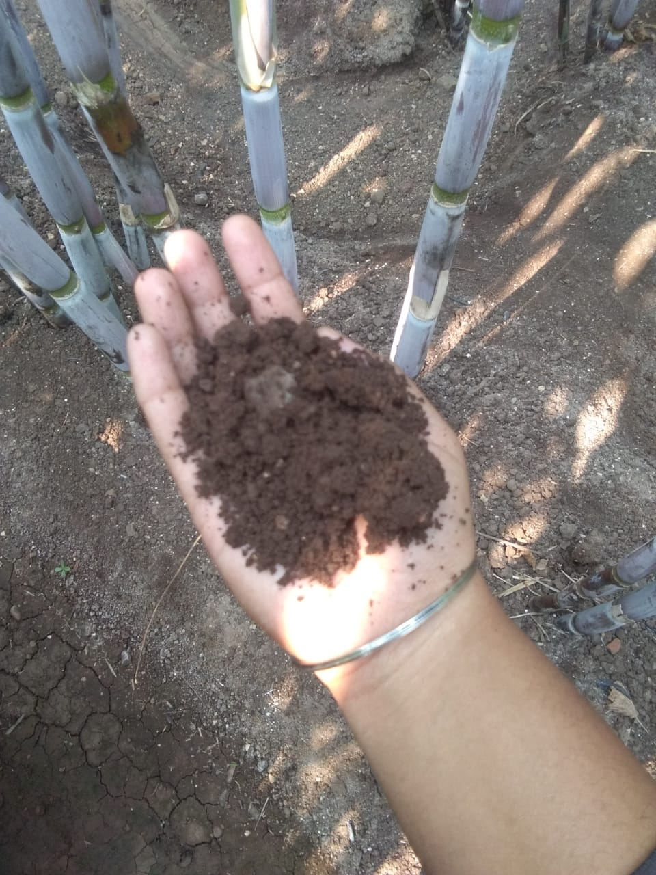
Soil Testing

Slide 23
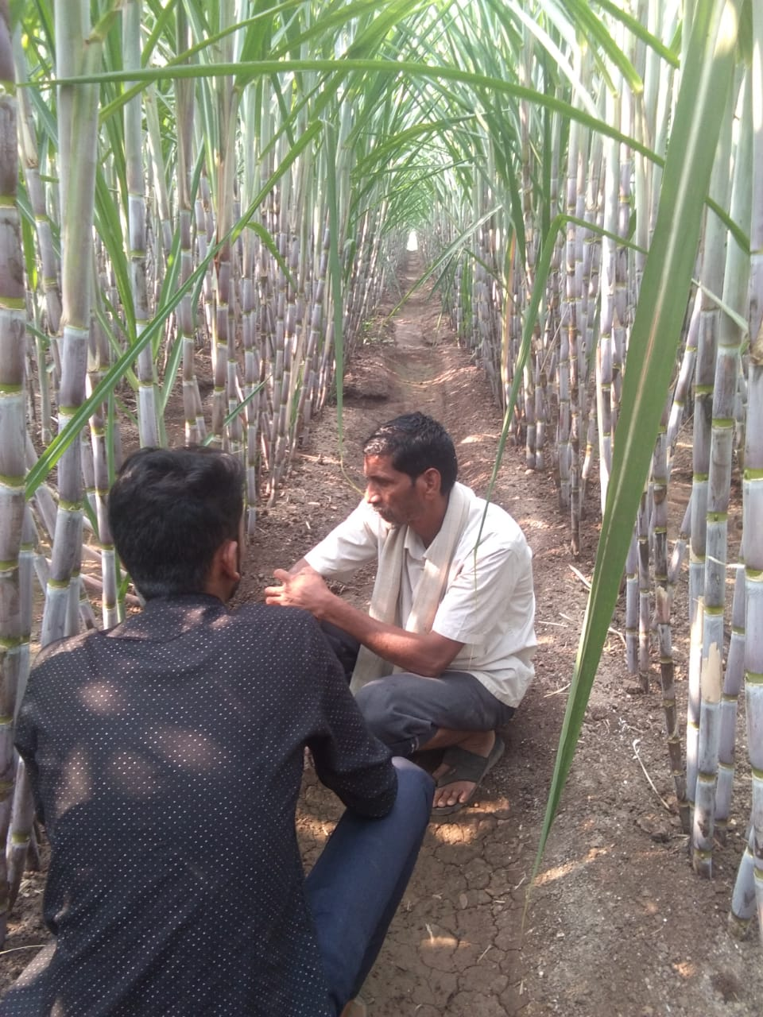
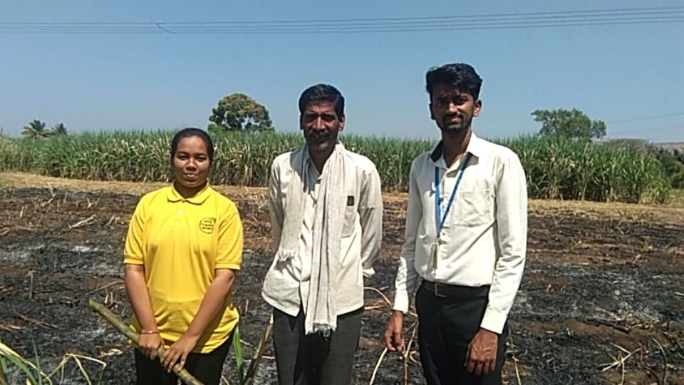
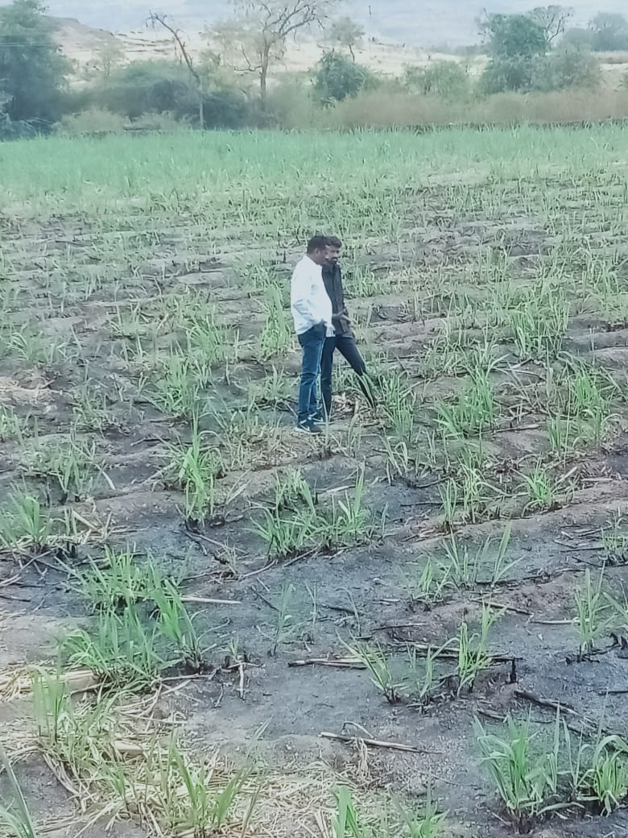
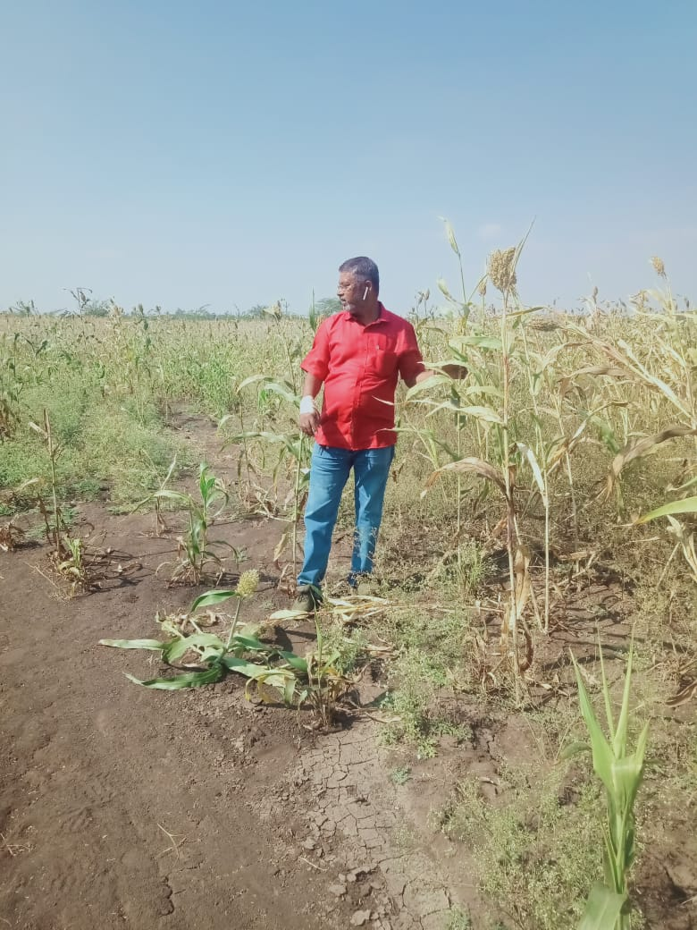
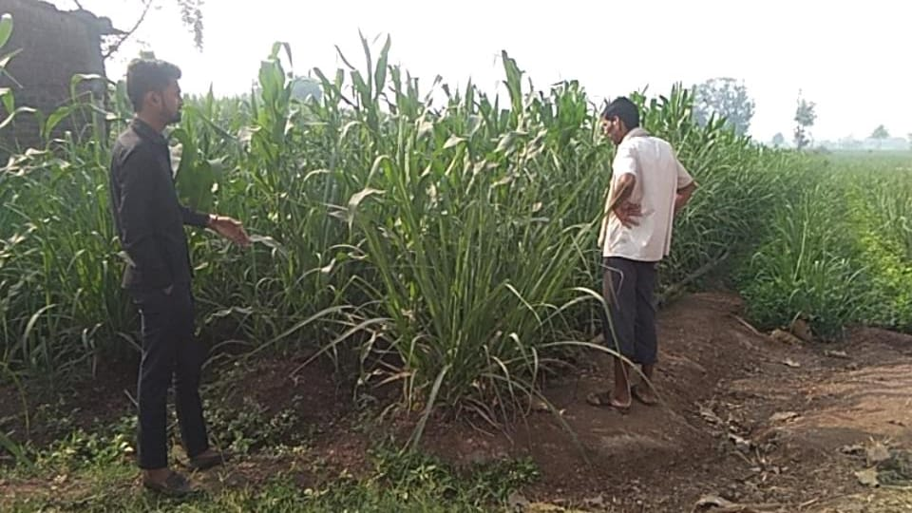
Plot Visit

Slide 24
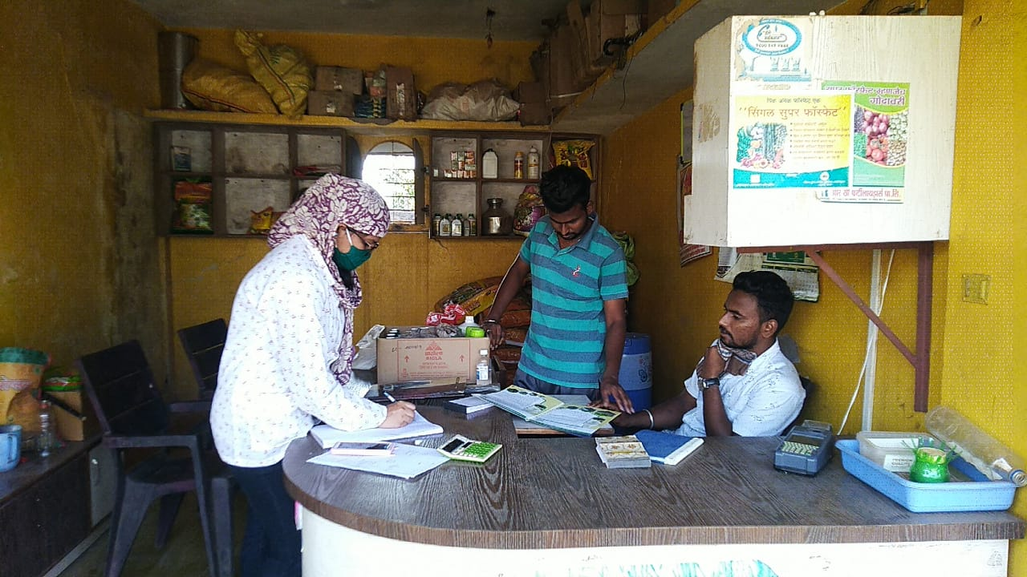
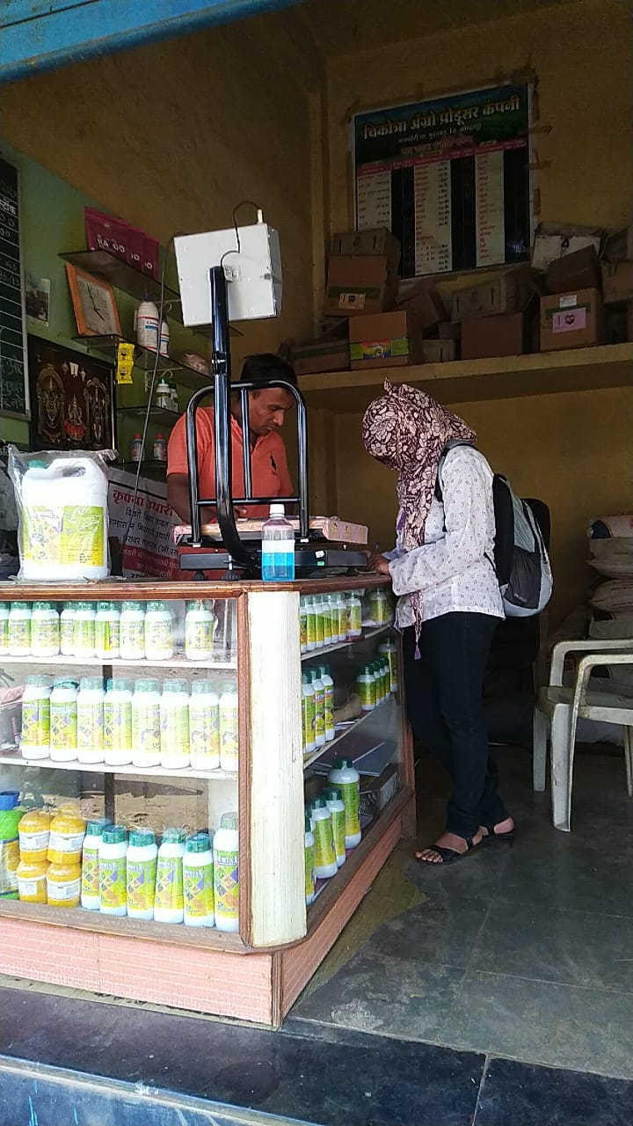
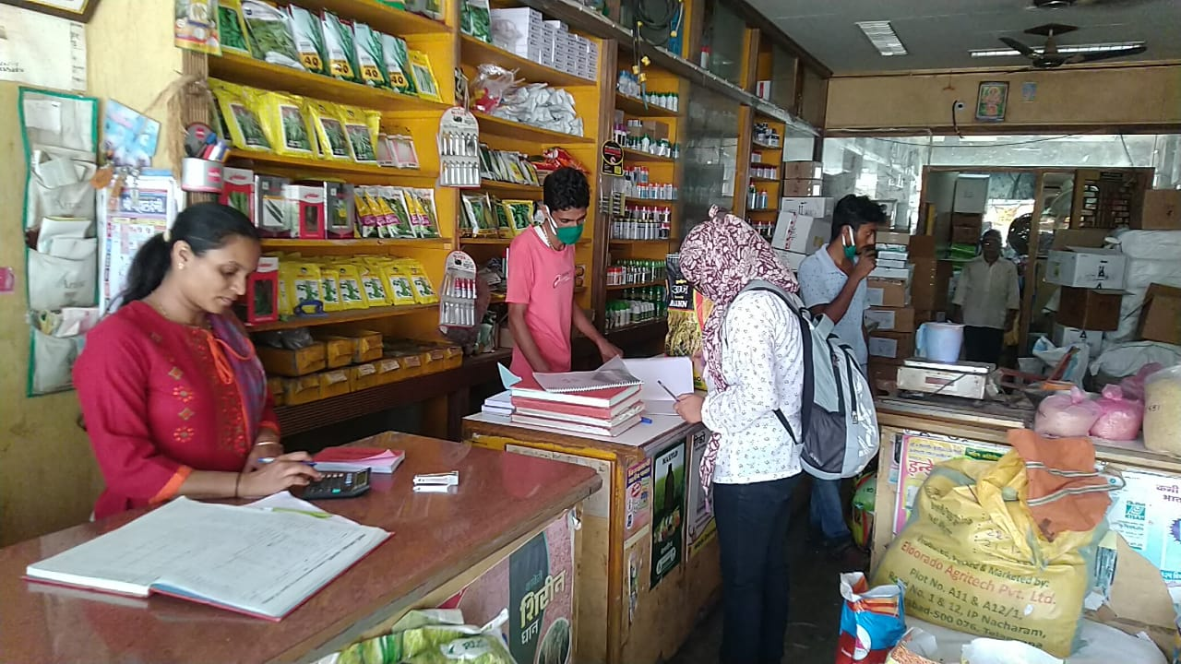
Visits to Krushiseva kendra

Slide 25
Thank You
DhanBhoomi Agrotech Pvt Ltd.
Undri, Tal – Haveli, Dist- Pune 411060
E-mail – info.dhanbhoomi@gmail.com
www.dhanbhoomi.com

