Slide 1
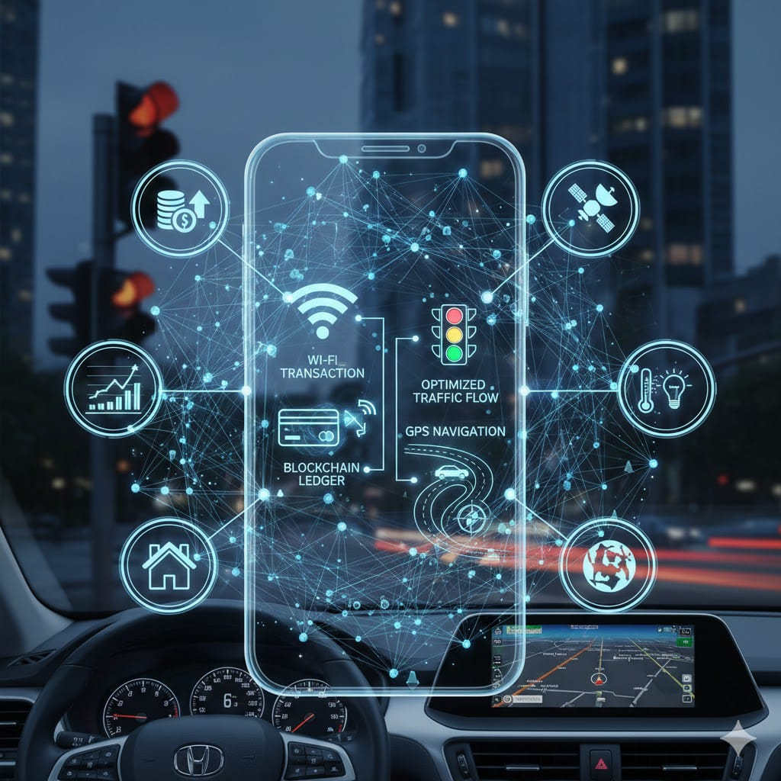
INVISIBLE STRUCTURES AROUND US
“INVISIBLE STRUCTURES QUIETLY SUPPORT
OUR
WORLD, SHAPING
WITHOUT BEING SEEN”
BY:
DHANANJAYA N, CHETHAN B, CHINMAI C HOLLA,DISHA S, CHINTHANA M D

Slide 2
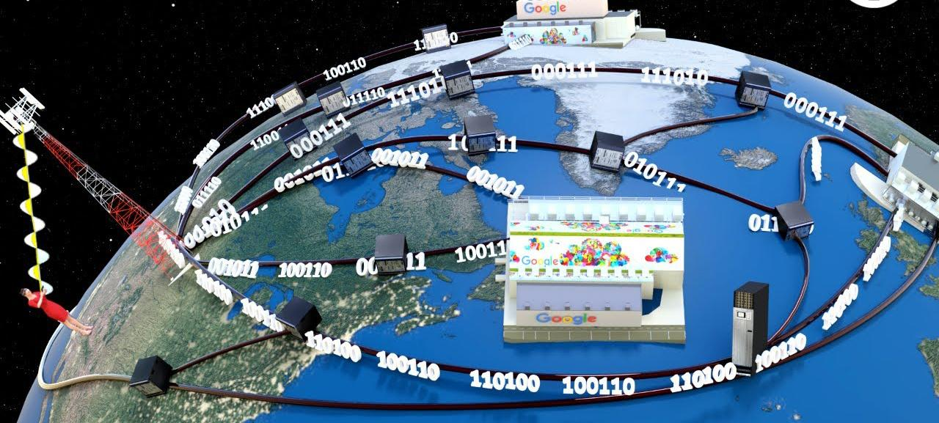
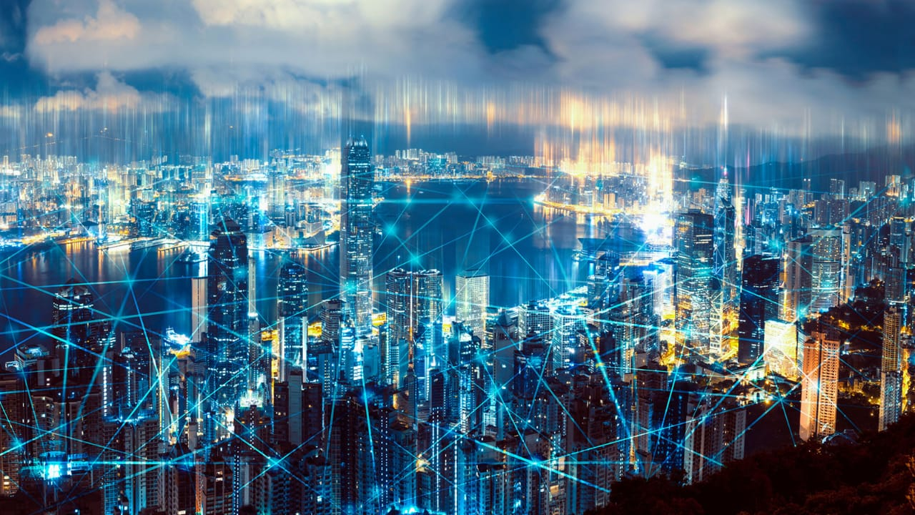
Wifi-wireless fidelity
Invented by: Dr. John O'Sullivan and his team at CSIRO.
Year: Development began in 1992.
Tech: Used radio waves for wireless data.
Breakthrough: Created wireless networking without cables.
Standard: First Wi-Fi standard released in 1997.

Slide 3
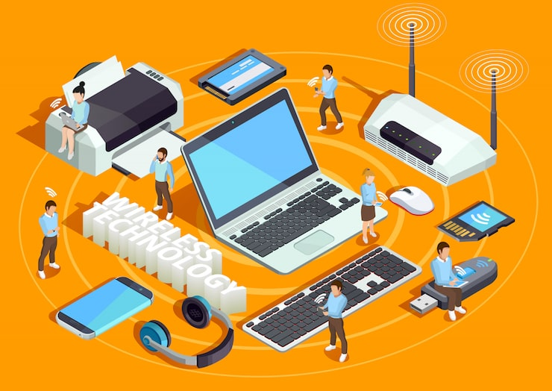
Wifi- working behind us
Wi-Fi uses radio waves to transmit data wirelessly.
A router connects to the internet and broadcasts the signal.
Your device receives the signal via its built-in Wi-Fi receiver.
Data is exchanged between your device and the router.
Encryption secures the connection to protect your information.

Slide 4
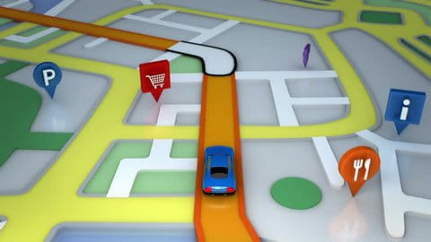
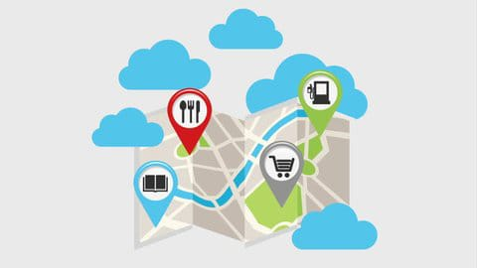
Gps- Global Positioning System.
Started by: It was developed by the U.S. Department of Defense in the 1970s.
Purpose : Initially designed for military use, to provide accurate navigation for ships, planes, and vehicles.
How it Works:GPS uses a network of satellites orbiting Earth to send signals that devices can
use to determine location.
Public Access: In 1983, GPS became available for civilian use, allowing everyone to use it for navigation .
So, it started for the military but is now widely used in phones, cars,
and other devices for location tracking.

Slide 5
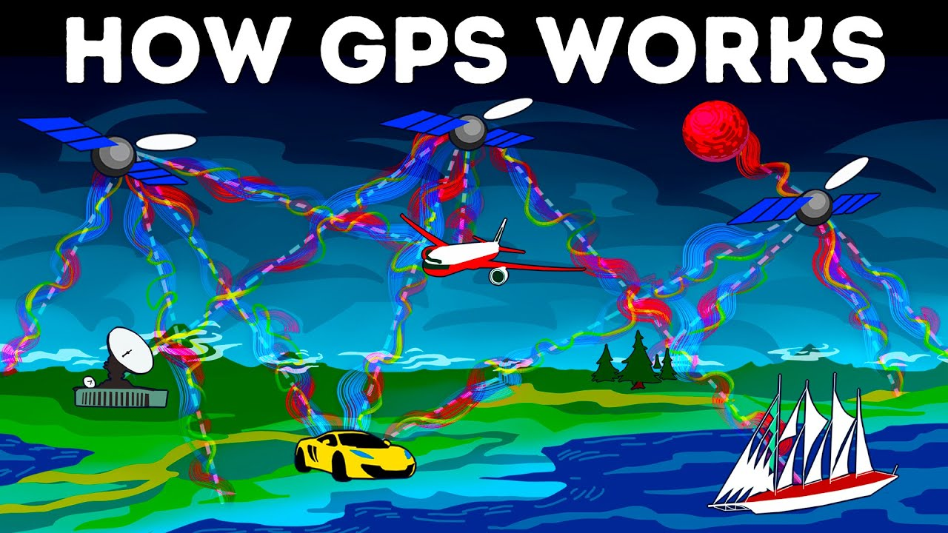
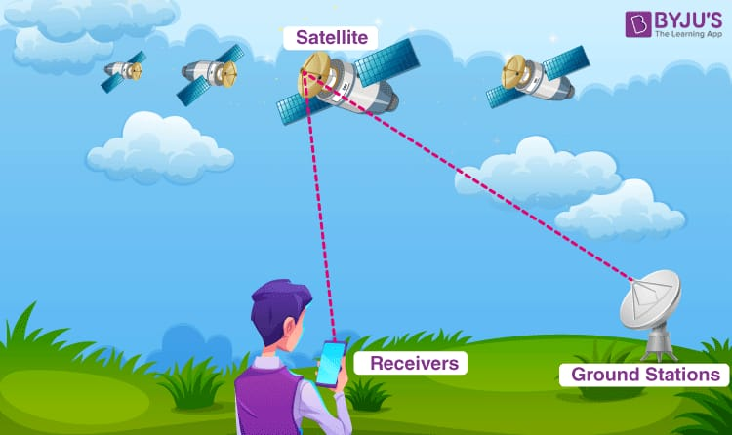
Gps- working behind us
Satellites send signals from space.
Device picks up signals from at least 4 satellites.
Time is measured to calculate distance.
Location is pinpointed based on signal timing.
Map shows your exact position.

Slide 6
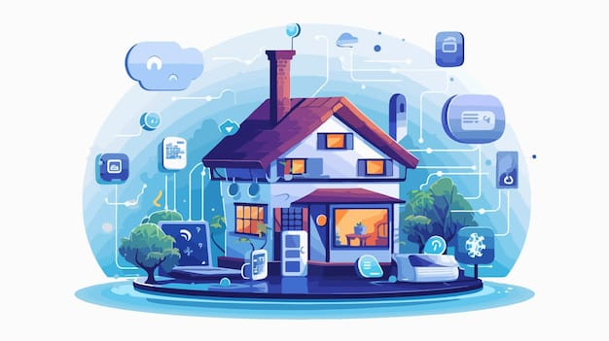
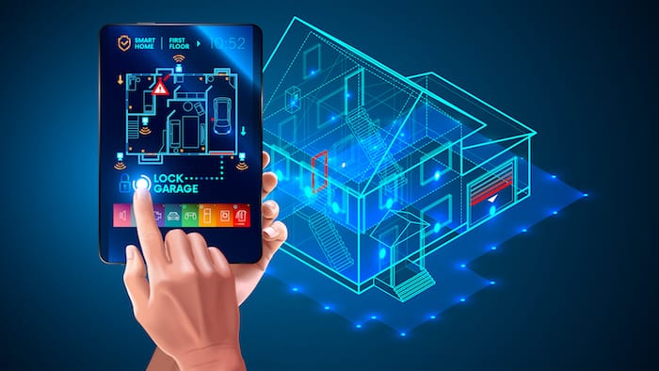
Smart home applicians
Invention: Smart homes began in the 1960s and gained traction in the 1990s.
Purpose: Created to automate tasks, improve convenience, and save energy.
Who: X10 was a key pioneer in home automation in the 1970s.
Growth: The rise of Wi-Fi, smartphones, and voice assistants boosted smart homes.
Today: Modern smart homes are focused on security, efficiency, and comfort.

Slide 7
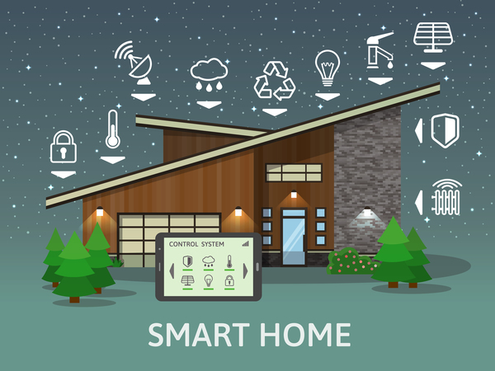
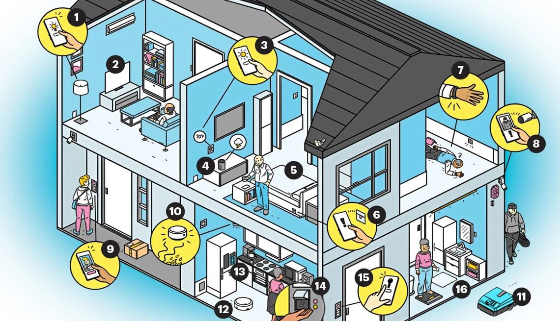
Smart home devices- working behind
Smart Home: Uses internet-connected devices to control your home.
Convenience: Makes everyday tasks easier with remote control.
Energy Efficiency: Saves energy by automating lighting and temperature.
Security: Enhances safety with smart cameras and alarms.
Accessibility: Helps people with disabilities manage their environment.
Smart homes are all about comfort, control, and efficiency!

Slide 8
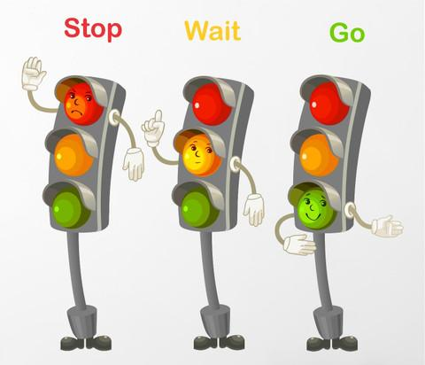
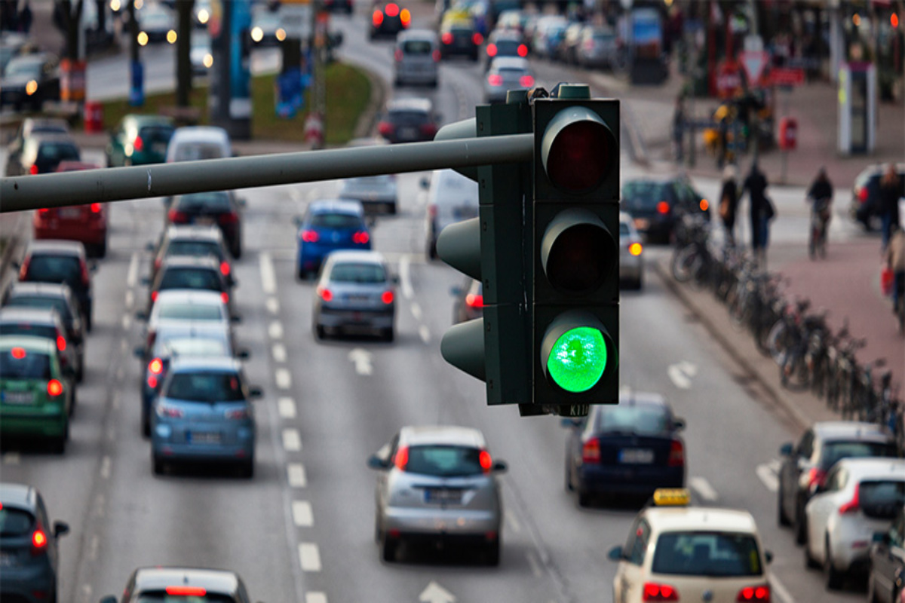
Traffic lights
Invention: GPS (Global Positioning System) was developed by the U.S. Department of Defense in the 1970s.
Purpose: Originally created for military navigation to track ships, planes, and troops.
How it Works: Uses satellites that send signals to devices on Earth to determine precise locations.
Public Use: Opened for civilian use in 1983, allowing everyone to use GPS for navigation.
Why It’s Used: Helps with navigation, tracking, mapping, and location-based services worldwide.

Slide 9
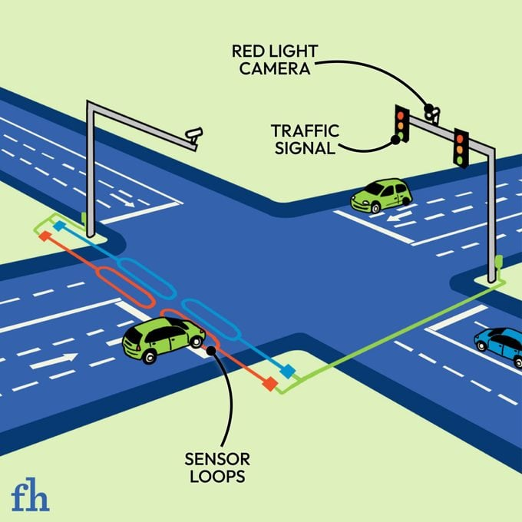
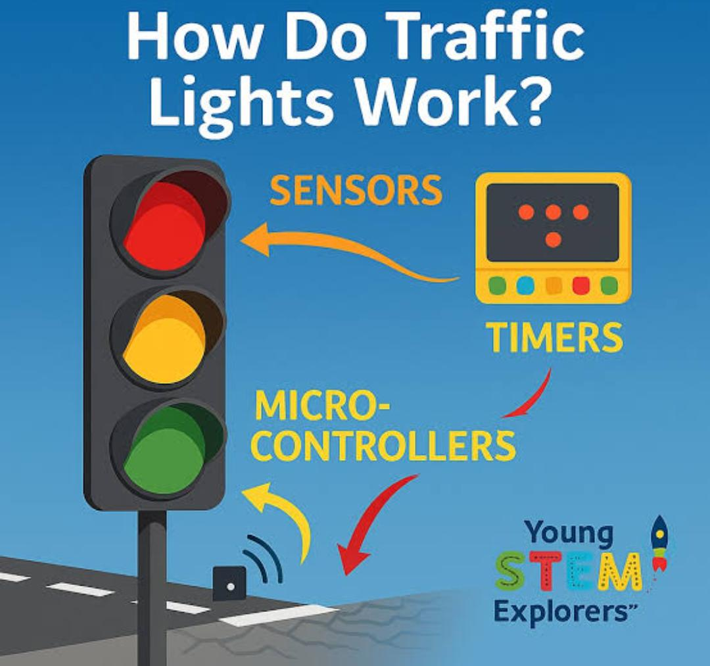
Traffic light-working behind us
Controller: Traffic lights are controlled by a timer or computer.
Sensors: Detect cars waiting at the intersection.
Sequence: Lights change green → yellow → red to manage traffic.
Timing: Each light stays on based on traffic flow.
Coordination: Lights at nearby intersections are synced to reduce jams.

Slide 10
SUMMARY
Definition: Invisible structures are systems that work behind the scenes to support our daily life.
Examples: Includes GPS, Wi-Fi, traffic lights, and smart home devices.
Purpose: They make life easier, safer, and more convenient.
How They Work: Operate silently using technology, signals, and automation.
Importance: Without them, navigation, communication, safety, and home control
wouldn’t function smoothly.

Slide 11


