Slide 1

RETAIL STRATEGY
Markdown is leaking
6–9 pts of margin
A 12-month path to price with intent—not panic—across full-price, promo and clearance.
BCG-STYLE
For merchandising, planning and finance leaders
APPAREL · MARKDOWN STRATEGY
01

Slide 2
SECTION
The problem
Clearance is running the P&L
APPAREL · MARKDOWN STRATEGY
02

Slide 3
Reactive markdown vs intentional markdown
Same inventory decisions; very different margin outcomes
TODAY
TARGET
Late, blunt, channel-blind
Early, SKU-aware, testable
Clearance rates climb after sell-through stalls
Predict residual risk before week 6
Promo and outlet compete with full-price
Next-best price by cluster, not blanket %
Planners lack a shared demand signal by SKU-size
Holdouts prove lift vs margin trade-off
APPAREL · MARKDOWN STRATEGY
03

Slide 4
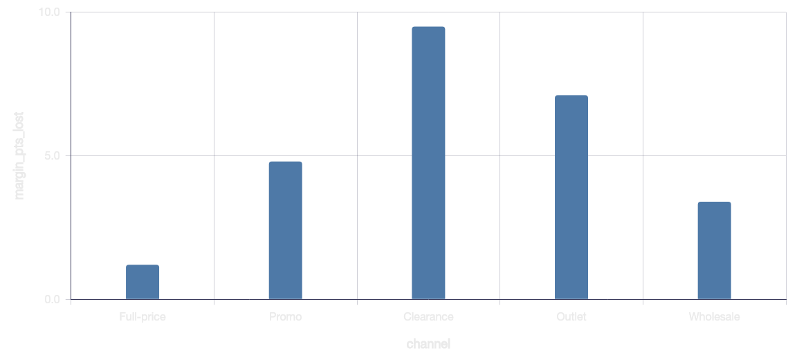
Clearance already destroys more margin than promo
KEY INSIGHTS
Clearance markdown rate ~41% of units
~9.5 pts gross margin lost in that lane
Full-price is the only lane under control
APPAREL · MARKDOWN STRATEGY
04

Slide 5
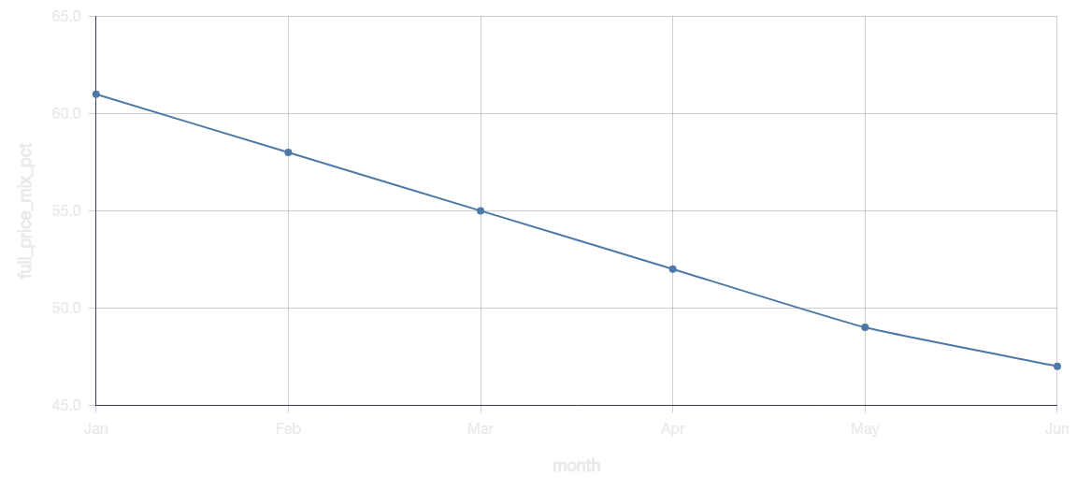
Full-price mix is eroding
Full-price mix fell from 61% → 47% in six months—before peak holiday.
APPAREL · MARKDOWN STRATEGY
05

Slide 6
Where to act — and what it buys
INTERVENE FIRST
ANNUAL IMPACT (ILLUSTRATIVE)
Unit contribution
PROTECT
PRICE NOW
MARGIN RECOVERY
Core basics
Seasonal fashion
+$23M
Mid-case GP uplift
FULL-PRICE MIX
+5 pts
Within 12 months
EXIT
TEST
Test capsules
Aged novelty
AGED INVENTORY
−20%
Weeks of supply
Sell-through risk
APPAREL · MARKDOWN STRATEGY
06

Slide 7
Sequence the capability—not a one-off promo calendar
0–90 DAYS
3–9 MONTHS
9–18 MONTHS
Diagnose & pilot
Scale decisions
Optimize system
SKU risk scores + 2 categories
Planner workflow + guardrails
Cross-channel price fabric
Residual demand model MVP
Next-best price service
Outlet / wholesale rules
Markdown playbook v1
Assortment linkage
Auto-clearance with caps
Holdout in 40 doors
Weekly margin readout
Finance-owned KPI pack
Each gate requires a merchant owner and a stop / scale rule.
APPAREL · MARKDOWN STRATEGY
07

Slide 8
90-day pilot squad
Keep commercial ownership next to the algorithm
WEEKS 1–3
WEEKS 4–7
WEEKS 8–12
Merchandising
Category charter
Planning
Risk rules
Data science
Model + holdout
Stores / e-comm
Execution path
Finance
Margin gate
APPAREL · MARKDOWN STRATEGY
08

Slide 9
THE DECISION
Treat markdown as a
decision system—not a fire drill.
Start with two categories, one holdout design, and a finance co-owner.
1. PICK PILOTS
2. PROVE INCREMENTALITY
3. SCALE THE FABRIC
High-volume categories with residual risk
Holdouts on price depth and timing
Reuse signals across channels
Next step: convene the 90-day squad and lock the first two categories.
APPAREL · MARKDOWN STRATEGY
09

