Slide 1

Q1 Results
Revenue review — generated by ppt-gen
PRODUCT · DATA ROADMAP
01

Slide 2
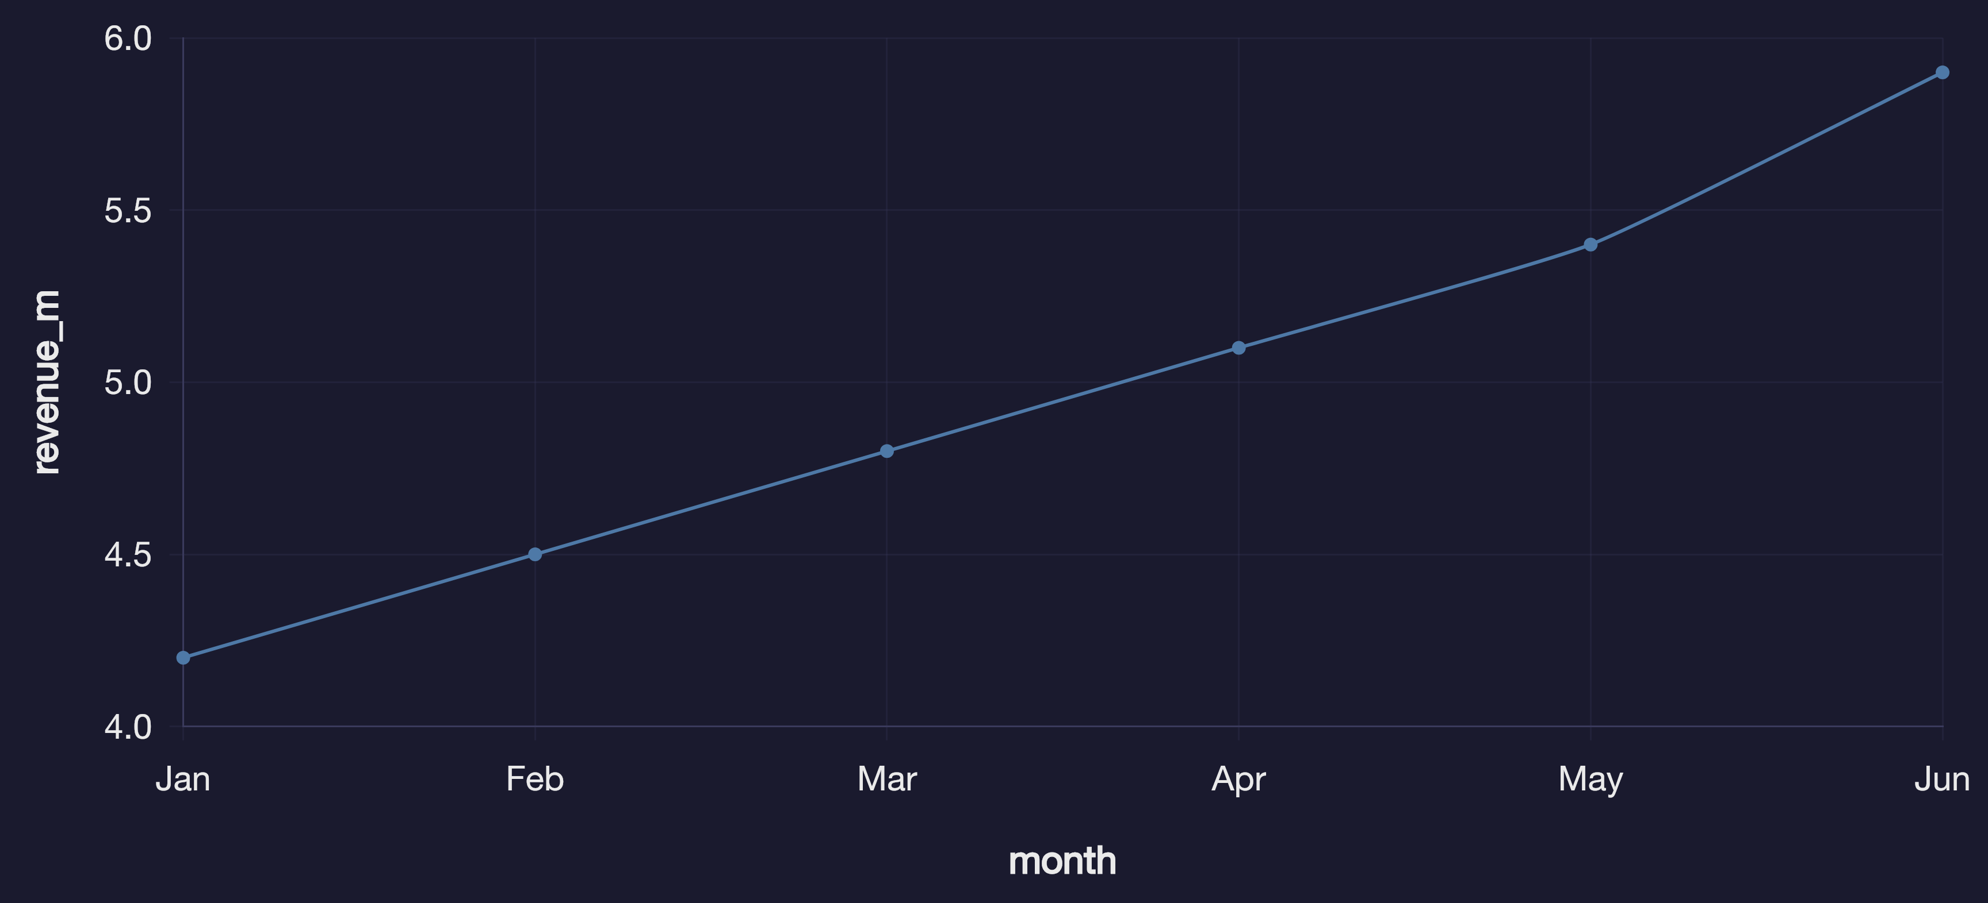
Revenue trend
Revenue grew 12% YoY in the latest quarter.
PRODUCT · DATA ROADMAP
02

Slide 3
Regional breakdown
region | revenue_m | growth_pct
North America | 12.4 | 11.2
Europe | 8.7 | 9.5
Asia Pacific | 6.1 | 14.8
Latin America | 2.3 | 7.1
PRODUCT · DATA ROADMAP
03

Slide 4
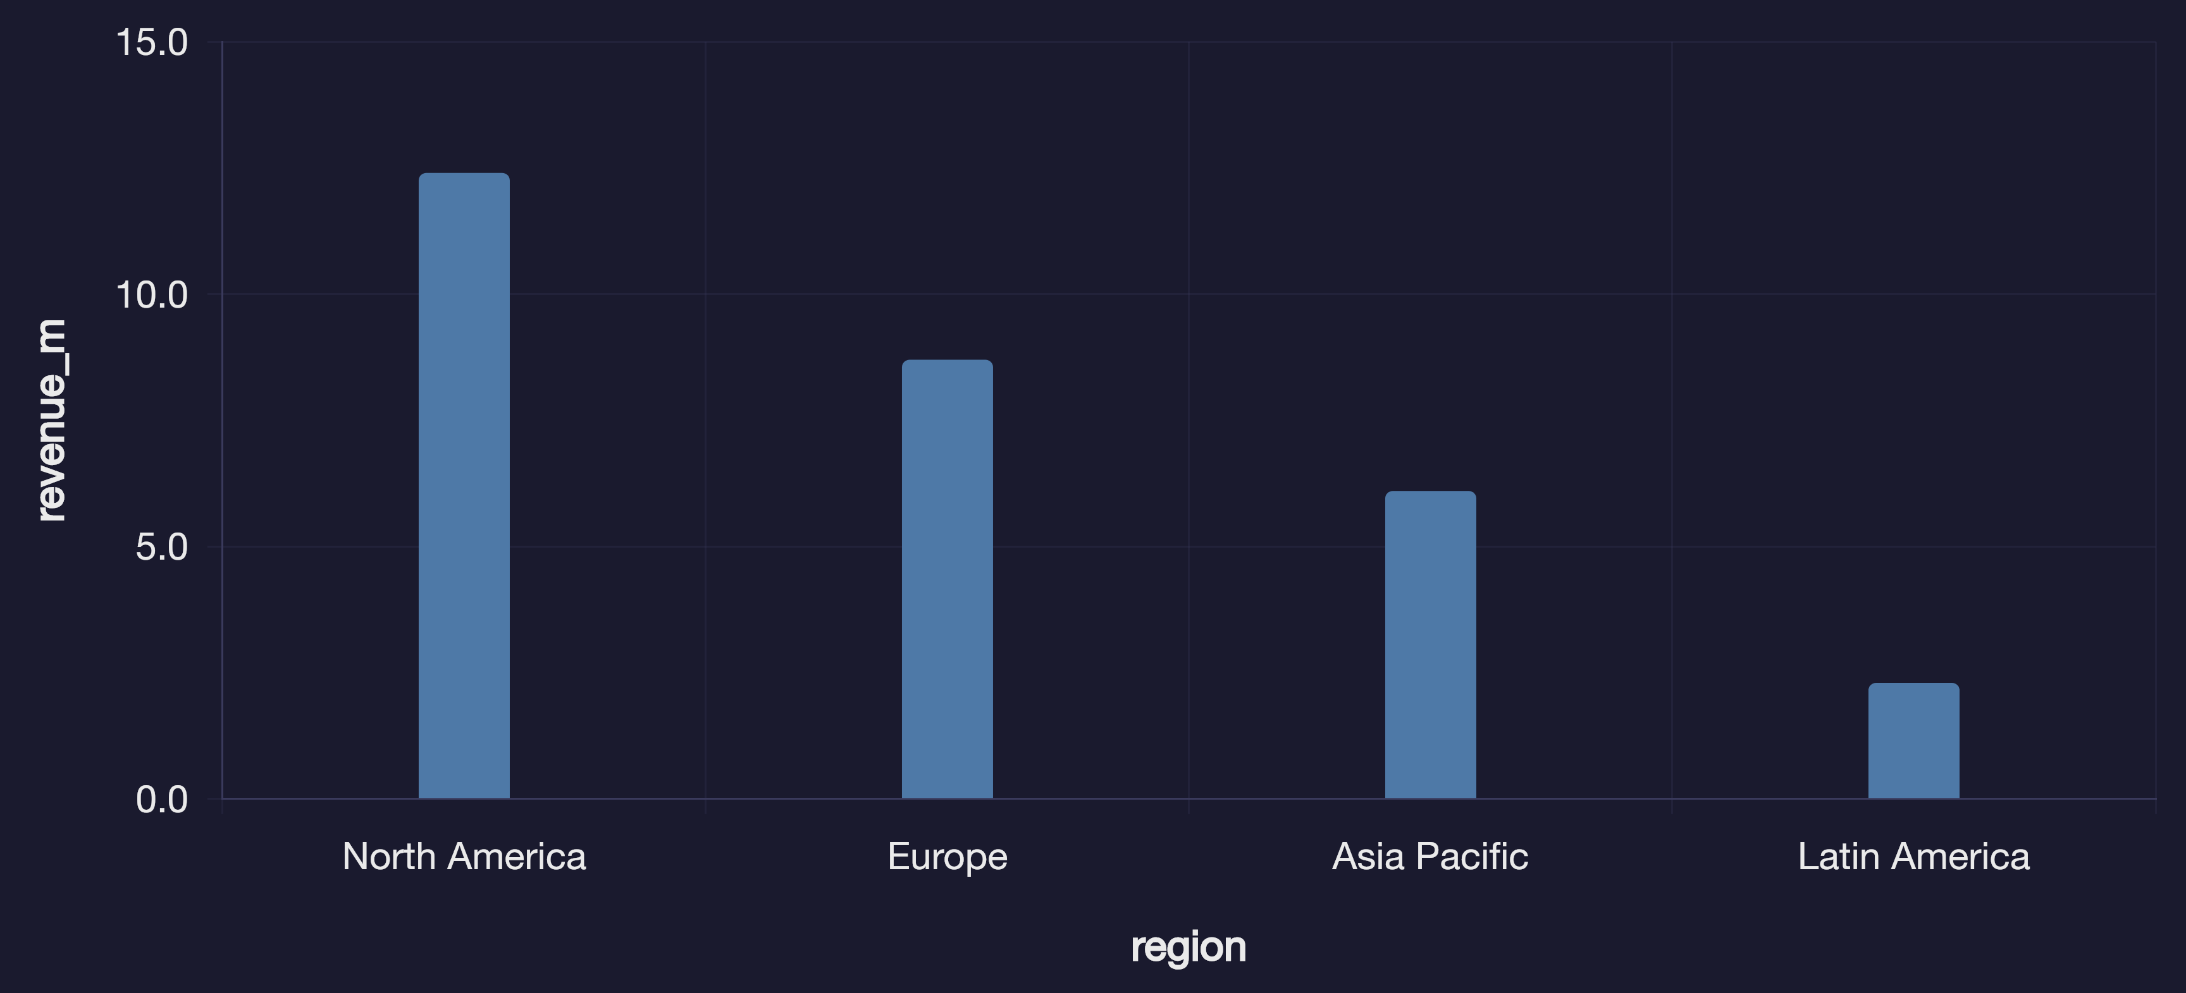
Revenue by region
Asia Pacific leads on growth; North America still carries the revenue base.
PRODUCT · DATA ROADMAP
04

Slide 5
Channel mix
channel | share_pct | nps
Web | 34 | 42
Mobile app | 28 | 51
Email / CRM | 18 | 38
Partners | 12 | 29
In-product | 8 | 55
PRODUCT · DATA ROADMAP
05

Slide 6
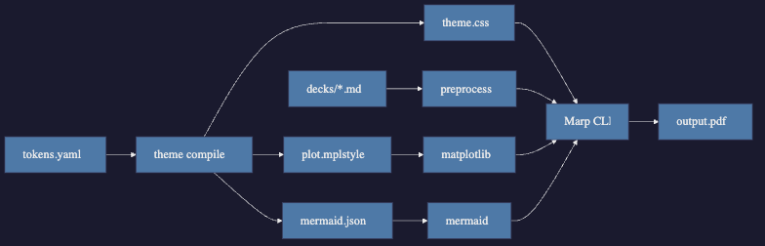
Pipeline architecture
PRODUCT · DATA ROADMAP
06

Slide 7
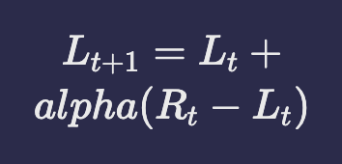

Learning rate
The discrete update behind our experiment cadence:
Holdouts keep honest.
PRODUCT · DATA ROADMAP
07

Slide 8
Summary
Unified theme drives Marp CSS, plots, and diagrams
Layout catalog shares tokens, fit engine, and markdown source
Edit this file and run `npm run build:constructs` or `npm run build:pdf`
PRODUCT · DATA ROADMAP
08

Slide 9
STRATEGY
A practical roadmap
for product analytics
Connect discovery, delivery and measurement into one learning system over 12–18 months.
ROADMAP
For product, data and engineering leaders
CUSTOMER
PRODUCT
CHANNEL
PRODUCT · DATA ROADMAP
09

Slide 10
SECTION
Argument
From fragmented signals to a decision fabric
PRODUCT · DATA ROADMAP
10

Slide 11
Every release should make the next decision sharper
Move from fragmented metrics to a shared decision fabric.
TODAY
TARGET
Signals live in silos
One decision loop
Product, growth and support dashboards disagree
Shared identity and event taxonomy
Experiments optimize local KPIs, not portfolio outcomes
Next-best action for surface and lifecycle
Roadmap bets lack a shared measurement design
Incrementality tied to retention and margin
PRODUCT · DATA ROADMAP
11

Slide 12
Prioritize use cases that compound across the journey
Start where decisions are frequent, measurable and owned.
DISCOVER
CONSIDER
ACTIVATE
RETAIN
Audience insight · Opportunity sizing
Personalized content · Fit / intent scoring
Next-best offer · In-product guidance
Churn early warning · Expansion plays
SHARED DECISION SIGNALS
Identity
Product context
Channel state
Inventory / capacity
Experiment exposure
PRODUCT · DATA ROADMAP
12

Slide 13
Pilot readouts and next moves
FIRST 90 DAYS
LIFT
SPEED
WASTE
+9%
11d
−18%
Incremental reactivation
Idea → live holdout
Low-margin offers
SCALE PATH
Prove
Productize
Scale
Holdouts in 2 journeys
Playbooks + owners
Coverage → 80%
PRODUCT · DATA ROADMAP
13

Slide 14
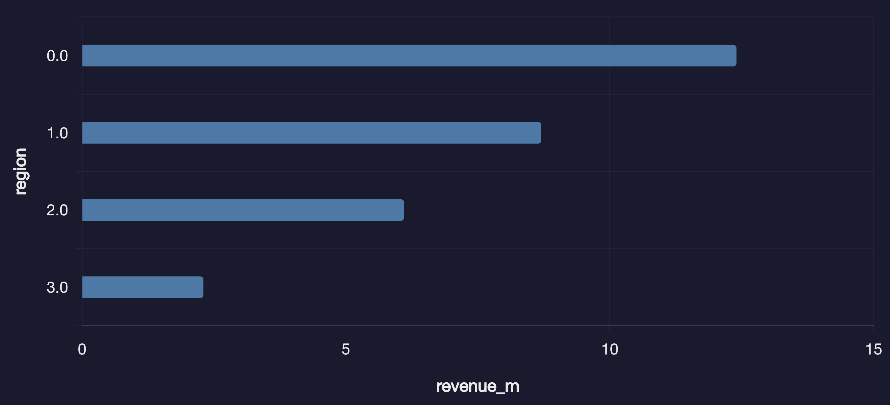
Revenue concentration still favors NA
Growth is elsewhere — sequence capacity accordingly
North America is 42% of revenue
Asia Pacific leads growth at 14.8%
Channel mix still web-heavy
PRODUCT · DATA ROADMAP
14

Slide 15
Same numbers as a table
media.table loads CSV into a native PPTX table
Drop CSVs in data/
region | revenue_m | growth_pct
North America | 12.4 | 11.2
Europe | 8.7 | 9.5
Asia Pacific | 6.1 | 14.8
Latin America | 2.3 | 7.1
Reference by stem name
Rebuild the deck
PRODUCT · DATA ROADMAP
15

Slide 16
Portfolio is overweight in question marks
Rebalance toward proven retention plays
Learning value
BET
SCALE
Next-best offer
Reactivation
PAUSE
OPTIMIZE
Vanity NPS dash
Taxonomy MVP
Relative capability
PRODUCT · DATA ROADMAP
16

Slide 17
Sequence: prove the signal, scale decisions, then optimize
Each phase ships a production decision and a measurement design.
0–90 DAYS
3–9 MONTHS
9–18 MONTHS
Prove the signal
Scale the decisions
Optimize the system
Identity, baseline, 2–3 pilot use cases
Reusable models and activation paths
Cross-surface optimization at scale
Event taxonomy MVP
Next-best-action service
Budget via incrementality
Measurement baseline
CRM + in-product hooks
Capacity-aware offers
[object Object]
Always-on test engine
Guarded automation
Each phase ends with a stop / scale gate owned by a commercial lead.
PRODUCT · DATA ROADMAP
17

Slide 18
Build a decision fabric—not one-off models
Reusable foundations let new use cases launch in weeks.
SIGNALS
ENTITIES
DECISIONS
LEARNING
Product · CRM · support · billing · experiments
Identity · catalog · consent · features
Propensity · recommend · optimize · guardrails
Activation · holdouts · monitoring
PRODUCT · DATA ROADMAP
18

Slide 19
Measure incremental value, not vanity engagement
Every use case needs a test design before production.
USER
Relevance · trust · retention
PRODUCT
Activation · conversion · time-to-value
COMMERCIAL
Incremental revenue · margin · LTV
PRODUCT · DATA ROADMAP
19

Slide 20
Always-on learning loop
OBSERVE
HYPOTHESIZE
Instrument decisions
Design the holdout
ACT
LEARN
Ship the treatment
Promote or stop
PRODUCT · DATA ROADMAP
20

Slide 21
Capability stack
Automation
Decisions
Features
Signals
PRODUCT · DATA ROADMAP
21

Slide 22
90-day launch milestones
WEEK 2
WEEK 5
WEEK 8
WEEK 12
Pilot charter signed
Features + holdout live
First readout
Scale / stop gate
PRODUCT · DATA ROADMAP
22

Slide 23
From signal to scaled decision
Raw events
Trusted features
Scored actions
Measured lift
PRODUCT · DATA ROADMAP
23

Slide 24
Ownership for the 90-day squad
COMMERCIAL OWNER
PRODUCT
GROWTH / CRM
DATA SCIENCE
MEASUREMENT
PRODUCT · DATA ROADMAP
24

Slide 25
Impact × effort for the next backlog
Taxonomy
Reactivation
NBA service
Auto-budget
PRODUCT · DATA ROADMAP
25

Slide 26
Why learning is slow today
SLOW LEARNING
FRAGMENTED IDENTITY
NO HOLDOUT DESIGN
LOCAL KPI OPTIMIZATION
PRODUCT · DATA ROADMAP
26

Slide 27
From dashboard debt to decision system
FROM
DRIVERS
TO
Today
Fix identity
Shared features
Holdouts
Target
→
→
PRODUCT · DATA ROADMAP
27

Slide 28
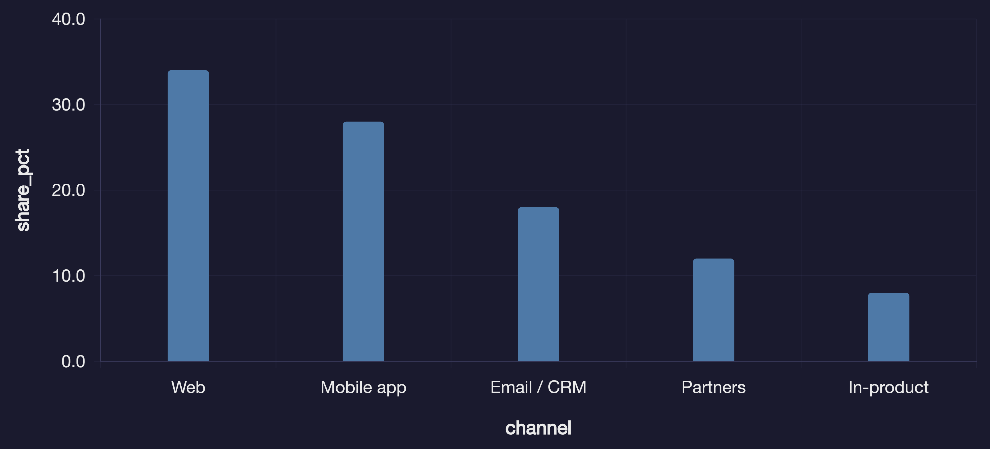
Channel mix still under-indexes in-product
KEY INSIGHTS
In-product is only 8% share
NPS is highest in-app (55)
Shift next pilots to product surfaces
PRODUCT · DATA ROADMAP
28

Slide 29
Operating model shift
BEFORE
AFTER
Dashboard reviews without owners
Decision squads with stop/scale gates
→
BEFORE
AFTER
PRODUCT · DATA ROADMAP
29

Slide 30
Start with a 90-day launch team that can ship and learn
Keep accountability close to commercial owners.
WEEKS 1–3
WEEKS 4–7
WEEKS 8–12
Product
Pilot charter
Growth / CRM
Activation design
Data science
Model + rules
Data engineering
Feature set
Finance / measure
Readout + scale gate
PRODUCT · DATA ROADMAP
30

Slide 31
THE DECISION
Invest in a decision system—
not isolated dashboards.
Start with two connected use cases that move retention and learning speed.
1. CHOOSE PILOTS
2. PROVE INCREMENTALITY
3. SCALE THE FABRIC
High-frequency decisions with clear owners.
Holdouts and margin-aware readouts.
Reuse identity, features and activation.
Next step: convene the 90-day squad and pick the first two decisions.
PRODUCT · DATA ROADMAP
31

