Slide 1

PRODUCT BRIEF
A messaging product
built for trust at scale
TARGET
10M MAU
Requirements and architecture for a WhatsApp-class chat experience—1:1, groups, media, calls.
PRD
SLO
<150ms ack
For product, engineering and design
CRYPTO
E2EE 1:1
PRODUCT · REALTIME CHAT
01

Slide 2
SECTION
Problem & goals
What we must nail on day one
PRODUCT · REALTIME CHAT
02

Slide 3
Why users stay (and leave)
MUST-WIN
NICE-LATER
Reliability + privacy feel
Differentiate after parity
Messages arrive in order, fast, offline-safe
Channels / communities at massive fanout
End-to-end encryption by default on 1:1
Rich business APIs
Media that just works on weak networks
Multi-device without breaking E2EE story
PRODUCT · REALTIME CHAT
03

Slide 4
Targets and journeys (v1)
EXPERIENCE TARGETS
CORE JOURNEYS
1:1 CHAT
GROUPS
MEDIA
Text, react, reply, delete
Admin roles, mentions, invites
Images, video, voice, docs
SEND→ACK
SYNC CATCH-UP
GROUP SIZE
<150ms
<2s
1k
p50 same region
24h offline
Members v1
PRODUCT · REALTIME CHAT
04

Slide 5
Non-functional requirements
Security
E2EE 1:1; group E2EE roadmap; device verification
Availability
99.95% message API; multi-AZ
Scale
10M MAU year-1; horizontal message plane
Compliance
Age gates, report/block, regional data controls
PRODUCT · REALTIME CHAT
05

Slide 6
Scope and message path
V1 SCOPE CUT
Build cost
DEFER
BUILD NOW
Status/stories
1:1 + receipts
Groups 1k
SKIP
PARTNER
Payments
User value
MESSAGE PATH
CLIENT
GATEWAY
MESSAGE SVC
DEVICES
Encrypt + queue
Auth + WS
Persist + fanout
Sync + receipts
PRODUCT · REALTIME CHAT
06

Slide 7
System ownership
CHAT PLATFORM
MESSAGING
MEDIA
PRESENCE / PUSH
IDENTITY / KEYS
PRODUCT · REALTIME CHAT
07

Slide 8
12-week build plan
WEEKS 1–4
WEEKS 5–8
WEEKS 9–12
Product
PRD freeze
Client
Sync protocol
Messaging
Persist + fanout
Media
Upload pipeline
SRE / security
Threat model sign-off
PRODUCT · REALTIME CHAT
08

Slide 9
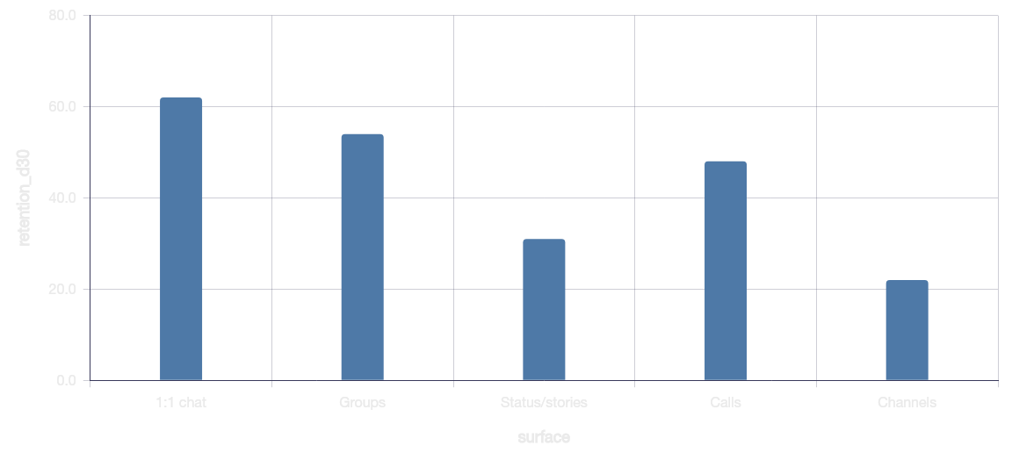
Surface priority from comps
KEY INSIGHTS
1:1 and groups dominate retention
Calls matter but trail chat DAU
Stories are growth—not retention—first
PRODUCT · REALTIME CHAT
09

Slide 10
Activation funnel (north-star)
Install
Verify phone
Import contacts
First message sent
D7 return
PRODUCT · REALTIME CHAT
10

Slide 11
DECISION
Ship private, reliable chat—
then earn the right to expand.
v1 = 1:1 + groups + media + receipts under clear SLOs and E2EE.
1. FREEZE SCOPE
2. INSTRUMENT SLOS
3. DOGFOOD HARD
Cut stories and payments from v1
Ack latency, sync time, drop rate
Internal fleet before public beta
Next: approve architecture ADR and staff the 12-week squad.
PRODUCT · REALTIME CHAT
11

