Slide 1

ARCHITECTURE
Mixture of Experts
for large language models
Sparse activation, dense capacity—how routing, load balance and capacity interact at scale.
RESEARCH
For ML engineers and research leads
EXPERT ACTIVATION
ML SYSTEMS · MIXTURE OF EXPERTS
01

Slide 2
SECTION
Motivation
Scale parameters without scaling FLOPs linearly
ML SYSTEMS · MIXTURE OF EXPERTS
02

Slide 3
Dense vs sparse activation
Same peak capacity; different compute per token
DENSE TRANSFORMER
MIXTURE OF EXPERTS
Every parameter on every token
Few experts fire per token
Compute grows with all layers × width
Top-k routing selects specialists
Simple training dynamics
Parameters grow faster than FLOPs
Hard to add capacity without cost
New failure modes — collapse & imbalance
ML SYSTEMS · MIXTURE OF EXPERTS
03

Slide 4
Canonical MoE block
MOE LAYER
ROUTER (GATING NET)
EXPERT FFNS
COMBINE / RESIDUAL
ML SYSTEMS · MIXTURE OF EXPERTS
04

Slide 5
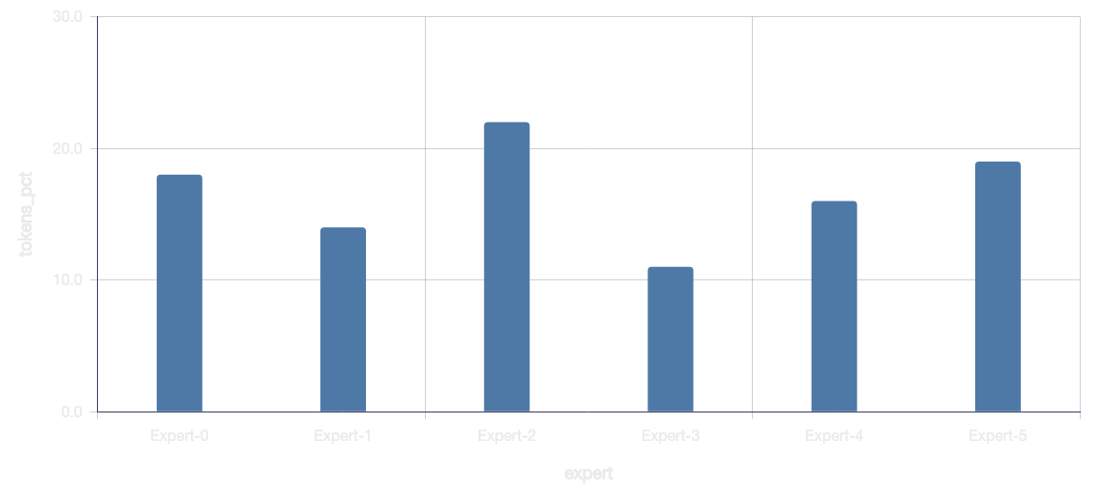
Expert load is uneven in practice
Without balancing, a few experts absorb most tokens—others starve.
ML SYSTEMS · MIXTURE OF EXPERTS
05

Slide 6
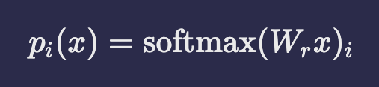
Gating and load-balance objective
Top-k experts receive token x; auxiliary load-balance loss penalizes deviation from uniform expert usage.
ML SYSTEMS · MIXTURE OF EXPERTS
06

Slide 7
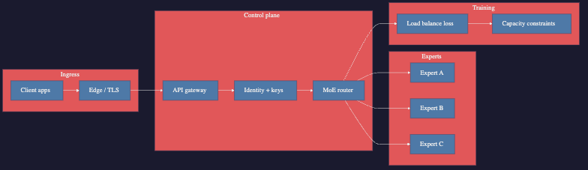
Router → experts → train constraints
ML SYSTEMS · MIXTURE OF EXPERTS
07

Slide 8
Forward pass (simplified)
EMBED
ROUTE
EXPERT FFN
MERGE
Token → hidden state
Softmax over experts
Top-k compute
Weighted sum + residual
ML SYSTEMS · MIXTURE OF EXPERTS
08

Slide 9
Failure modes to monitor
Collapse
Router picks 1–2 experts always
Imbalance
Capacity overflow / dropped tokens
Under-train
Rare experts never specialize
Latency tails
Hot experts dominate p99
ML SYSTEMS · MIXTURE OF EXPERTS
09

Slide 10
Design space and operating points
DESIGN CHOICES
OPERATING POINTS
Capacity efficiency
HASH / STATIC
LEARNED TOP-K
EXPERTS
TOP-K
Token hashing
Switch / GShard
8–64
1–2
Per MoE layer
Active per token
DENSE
SOFT MOE
WATCHOUTS
Dense LLaMA-style
Expert Choice
Collapse
Router sticks to 1–2 experts
Imbalance
Capacity overflow / drops
Routing complexity
ML SYSTEMS · MIXTURE OF EXPERTS
10

Slide 11
Stack to get right (bottom → top)
Serving
Training recipe
Router design
Expert FFN
ML SYSTEMS · MIXTURE OF EXPERTS
11

Slide 12
TAKEAWAY
MoE buys capacity—
only if routing stays healthy.
Instrument expert usage, capacity drops and latency tails as first-class metrics.
1. START SPARSE CAREFULLY
2. WATCH BALANCE
3. SCALE EXPERTS LATER
Few layers, strong aux loss
Per-expert token share dashboards
After collapse is controlled
Next: reproduce a 8-expert top-2 layer and plot token share over training.
ML SYSTEMS · MIXTURE OF EXPERTS
12

