Slide 1

Project Name :- Employees Management System
Under Guidance Of
POOJA MEHTA SUBMITTED BY
1. MAHESH DHANLOBHE
2. ADITYA DHOPE
3. DHANESH JADHAV

Slide 2


Employee Management System is a distributed application, developed to maintain the details of employees working in any organization.
It maintains the information about the personal Details of the employees.

Slide 3
SCOPE OF PROJECT
Better Scope in Industries
Any Organisation.
Schools & college also can use to maintain their employees

Slide 4
TECHNOLOGIES USED
Spring Boot
Postman
MySQL
Angular

Slide 5
REQUIRED SPECIFICATIONS
Hardware Configuration
Software Configuration
Software IDE: Spring Tool Suite
Language: Java
Front End: Angular
Back End: MySQL ,Postman
Operating System: Windows 10
Hard Disk: 1 TB
RAM: 4GB

Slide 6



Helps in maintaining the computerized employee details.

Slide 7
SPRING ANNOTATIONS
@Controller :The @Controller annotation indicates that a particular class serves the role of a controller. Spring Controller annotation is typically used in combination with annotated handler methods based on the @RequestMapping annotation.
@Autowired: The @Autowired annotation provides more fine-grained control over where and how autowiring should be accomplished.
@RequestMapping : @RequestMapping is one of the most common annotation used in Spring Web applications. This annotation maps HTTP requests to handler methods of MVC and REST controllers.
@Entity:The Entity annotation specifies that the class is an entity and is mapped to a database table.

Slide 8
SPRING ANNOTATIONS
@Table: The Table annotation is used to create a table in database.
@PutMapping :@PutMapping is used for update the records.
@PostMapping: @PostMapping is used to create a resource Mapping.
@GetMapping: @GetMapping is used to read all the inserted records.
@DeleteMapping : @DeleteMapping is used to delete the records.
@PathVariable: The Path Variable annotation is used to extract the value from the URL.

Slide 9
SPRING ANNOTATIONS
@Request Body: The @RequestBody annotation is applicable to handler methods of spring controller. spring should deserialize a request body into an object.
@OneToOne Mapping: The @OneToOne JPA annotation is used to map the source entity with the target entity, Hibernate maps the tables in your database to the Entity classes in your application.
@OneToMany Mapping:OneTo-Many relationship between table A and table B indicates that one row in a table A link to many rows in table B.but one row in table B links to only one row in table A.
@ ManyToOne Mapping: @Many-to-One mapping means that many instances of this entity are mapped to one instance of another entity.

Slide 10
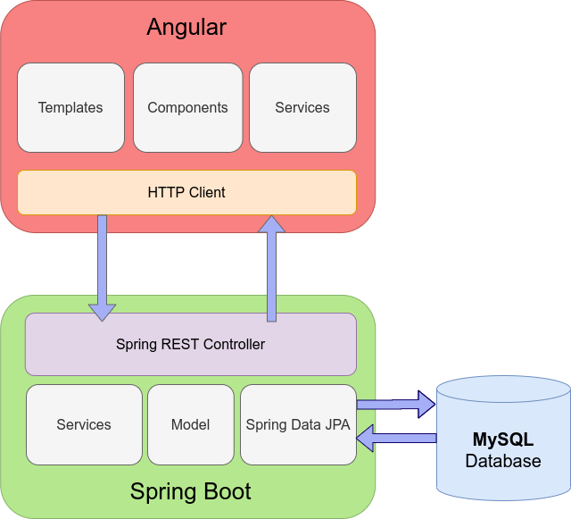
SYSTEM FLOW DIAGRAM

Slide 11
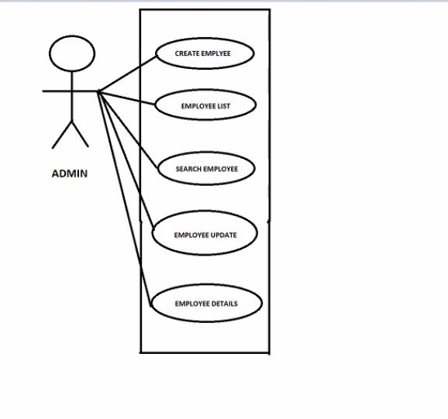
USECASE DIAGRAM

Slide 12
MODULES
The system contains 3 Modules
Employee List
Add Employee
Search Employee

Slide 13
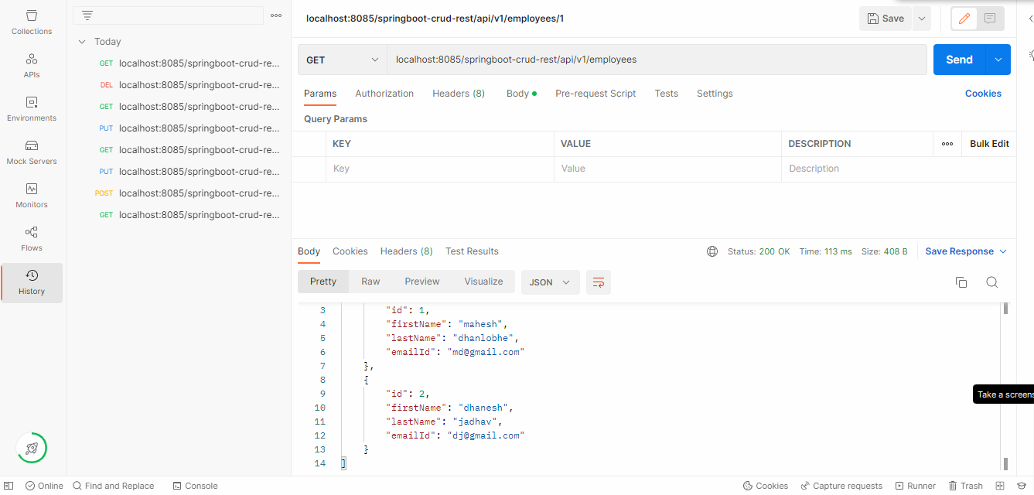
OUTPUT SCREENSHOTS IN POSTMAN

Slide 14
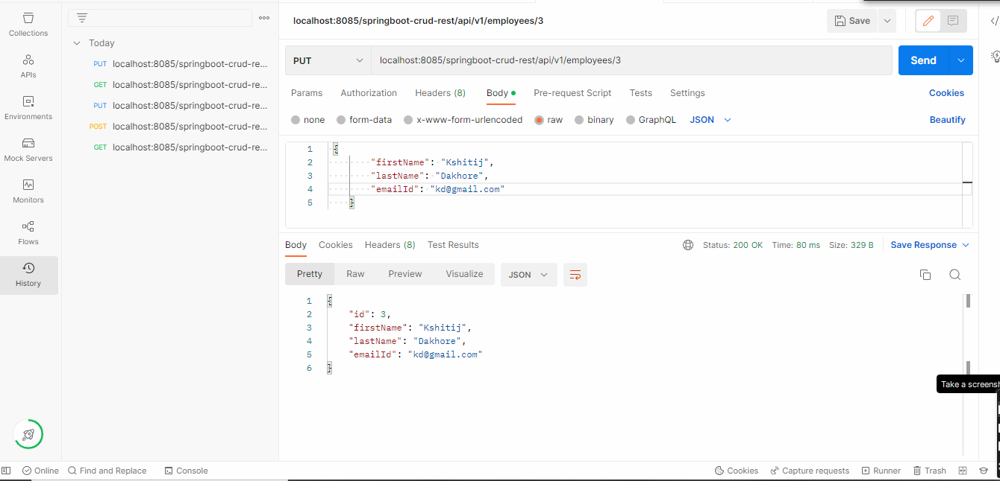
The system contains 3 Modules
Employee List
Add Employee
Search Employee

Slide 15
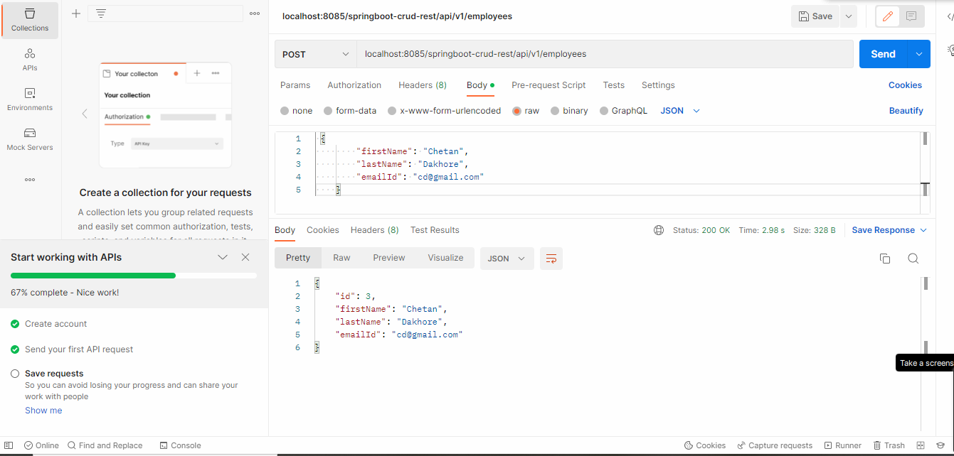
The system contains 3 Modules
Employee List
Add Employee
Search Employee

Slide 16
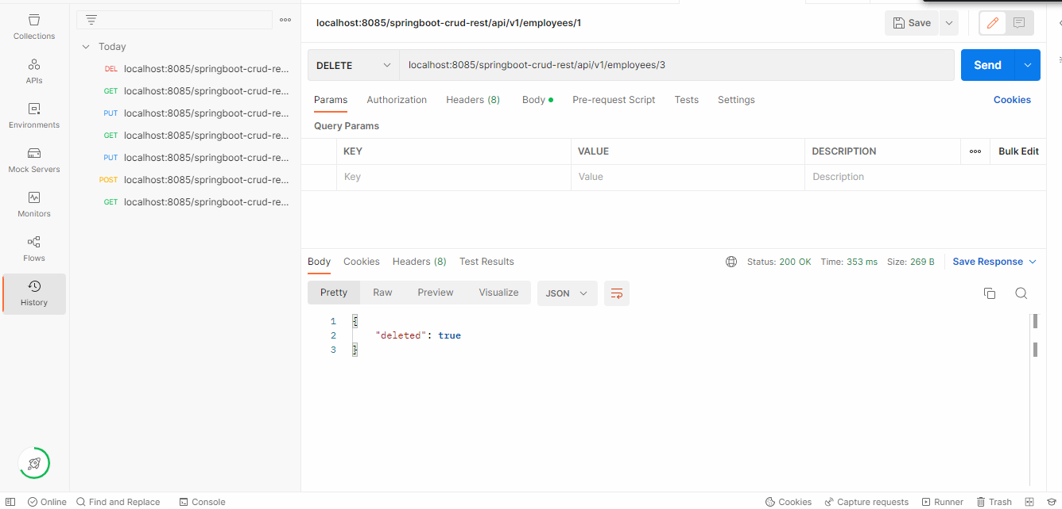
The system contains 3 Modules
Employee List
Add Employee
Search Employee

Slide 17
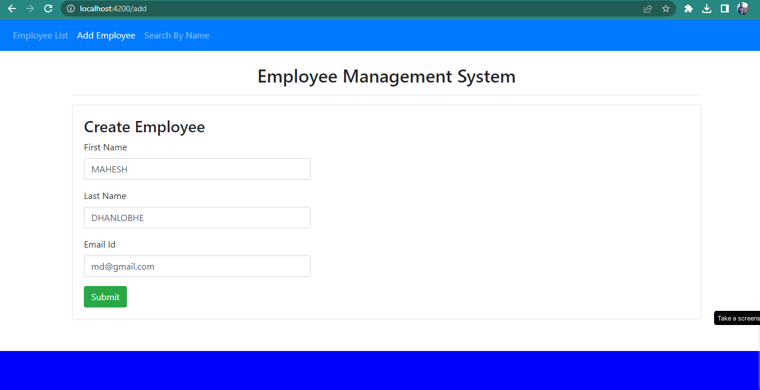

Slide 18
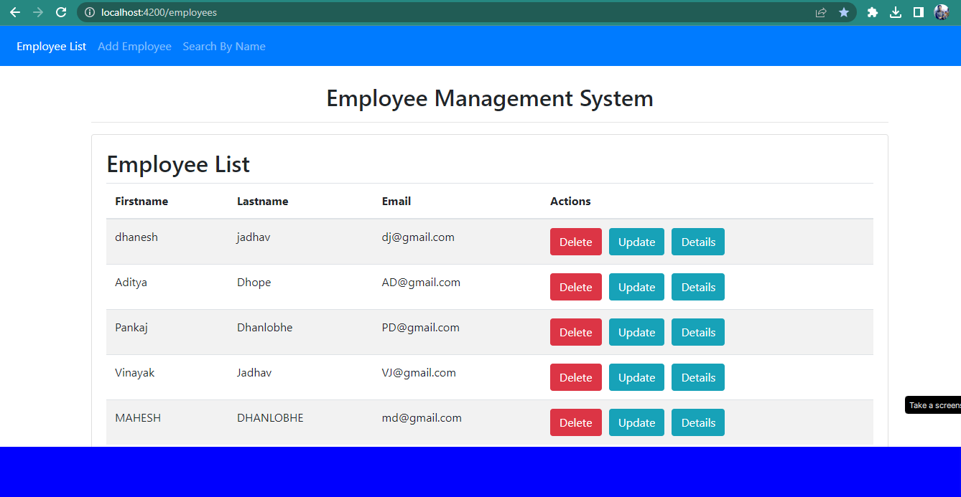

Slide 19
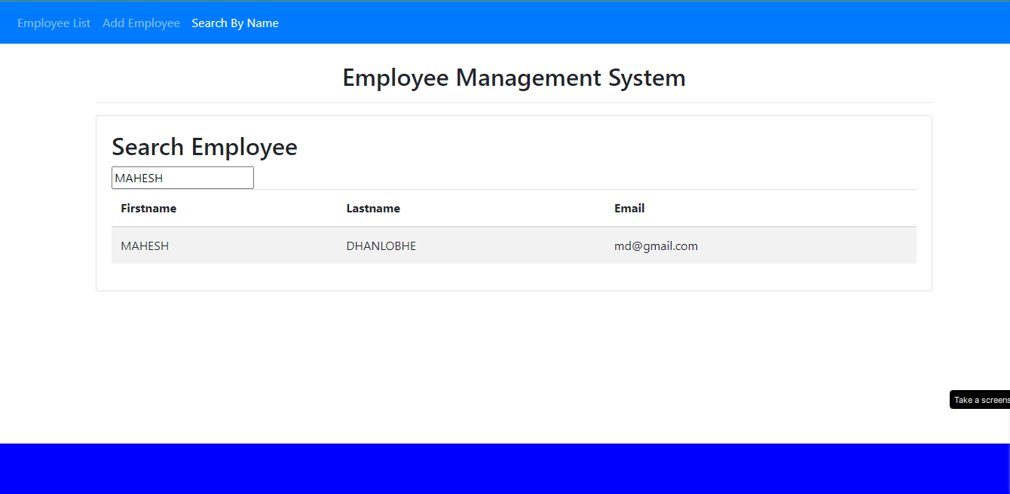

Slide 20
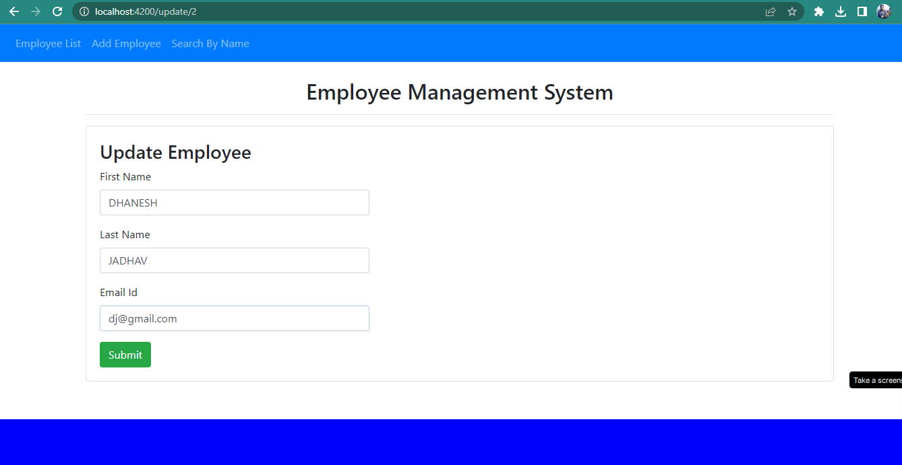

Slide 21
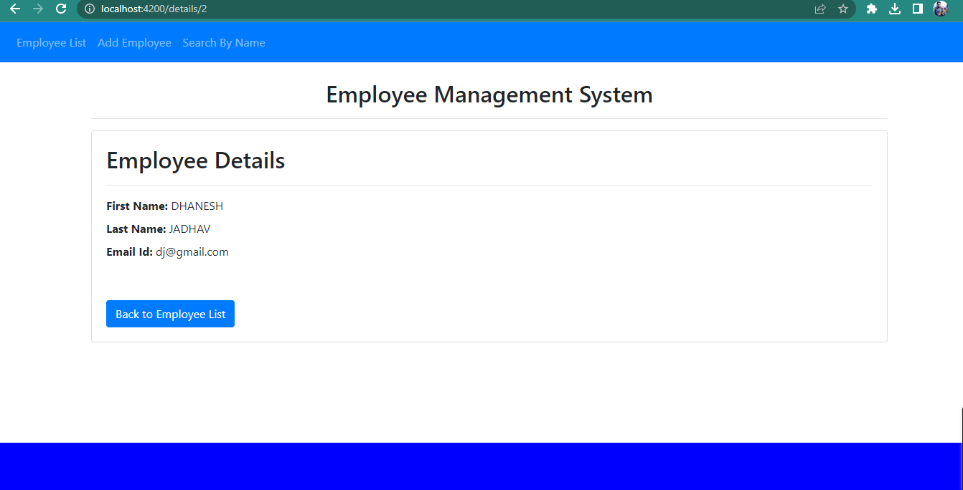

Slide 22

This project aims to simplify the task of maintaining records of the employees of Company.
To develop an well-designed database to store employee information

Slide 23

The records are maintained in registers.
Time consuming process.
Complicated searching, editing & updating.

Slide 24


Provide computerized system for maintaining records.
More efficient & reliable.
Less time consuming and easy to use.
Huge data storage with less computer memory.
Avoid Human errors & efforts for Maintaining daily data.
Avoid Data manipulations.

Slide 25

Thank you !

