Slide 1
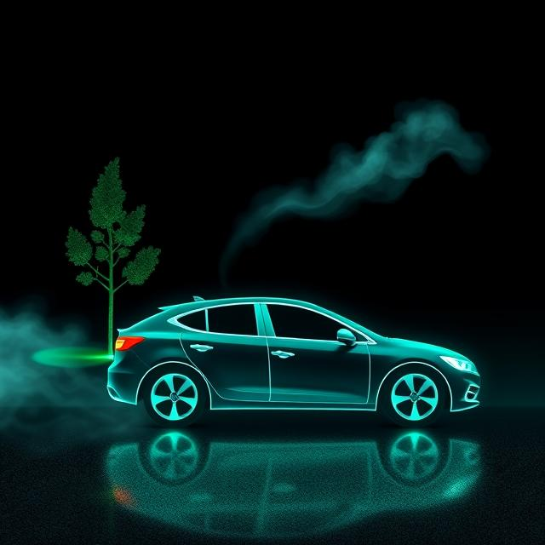

Vehicle Fuel Efficiency and CO2 Emissions
Presented by : Dhanesh MN

Slide 2

CO2 Emissions: A Critical Indicator
CO2 emissions are a direct measure of a vehicle's environmental impact.
Carbon dioxide emissions (g/km) are a key metric for assessing a vehicle's environmental footprint. Lower values indicate better environmental performance.

Slide 3
Dataset Overview
Our analysis is based on a comprehensive dataset including various vehicle attributes and performance metrics.
Variable Name Data Type Description
Brand Categorical Vehicle manufacturer
Model Categorical Specific vehicle model name
Vehicle_class Categorical EPA vehicle size classification
Engine_Size(L) Numeric Engine displacement in liters
Cylinders Numeric Number of engine cylinders
Transmission Categorical Transmission type (Manual, Automatic )
Fuel_type Categorical Fuel grade (X=Regular, Z=Premium)
Fuel_consumption_city (L/100 km) Numeric Fuel consumed in city driving (litres per 100 km)
Fuel_consumption_hwy (L/100 km) Numeric Fuel consumed in highway driving (litres per 100 km)
Fuel_consumption_comb (L/100 km Numeric Combined fuel consumption (city + highway,L/100 km)
CO2_emissions (g/km) Numeric Tailpipe carbon dioxide emissions in grams per kilometre

Slide 4
Research Objectives
Vehicle Emissions & Fuel Efficiency Analysis
Vehicle Diversity
Count of unique brands, models, and vehicle classes
Comprehensive market landscape analysis
Emissions Analysis
Identify vehicles with highest and lowest CO₂ emissions
Distribution across emission intensity categories
Percentage analysis for CO₂ > 200 and < 150 g/km
1
2
Efficiency Insights
Top most fuel-efficient vehicles
Categorize by fuel efficiency levels
Compare city vs highway fuel economy
Brand & Feature Comparison
Average emissions and fuel consumption by:
Brand, Fuel Type, Vehicle Class
Transmission, Engine Cylinders, Engine Size
3
4
Performance vs Emissions
Correlation between engine size, fuel consumption, and CO₂ emissions
Emission Intensity Ratio (CO₂ per liter of engine displacement)
Identify optimal engine size category balancing performance and efficiency
5

Slide 5
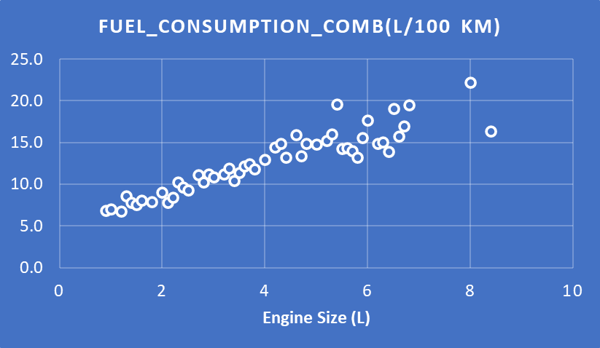
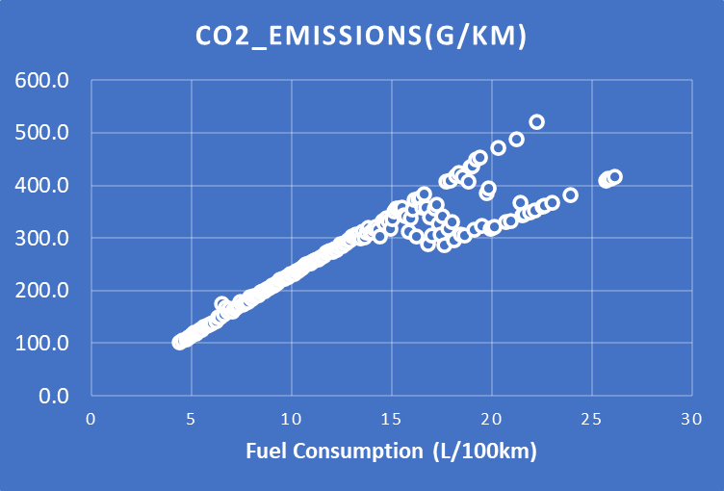
Vehicle Emissions & Fuel Efficiency Analysis
Comprehensive analysis of 3105 vehicles across 42 brands
Vehicle Diversity
42
1596 models, 16 classes
Average CO₂ Emissions
251.9 g/km
50.0% high emitters (>200)
Average Fuel Economy
11.09 L/100km
Combined city/highway
Low Emitters
1.87%
58 vehicles <150 g/km
Emission Categories
Low (<100) 1 vehicles
Moderate (101-150) 57 vehicles
Medium (151-200) 601 vehicles
High (201-250) 989 vehicles
Very High (250-300) 850 vehicles
Extremely High (>300) 607 vehicles
Most Efficient
HYUNDAI IONIQ BLUE: 4.1 L/100km
96 g/km CO2
Highest Emissions
BUGATTI CHIRON: 22.2 L/100km
522 g/km CO2

Slide 6




Key Metrics: Fuel Consumption
Understanding how different vehicles consume fuel in various driving conditions.
City Consumption
Highway Consumption
Fuel consumption in urban driving (L/100 km).
Fuel consumption on highways (L/100 km).
12.7 (L/100 km)
9.1 (L/100 km)
Combined Consumption
Combined MPG
Average of city and highway consumption (L/100 km).
Combined consumption in miles per gallon (mpg).

Slide 7
Impact of Engine Size and Cylinders
Larger engines and more cylinders generally correlate with higher fuel consumption and emissions.
1.0L
8.0L
Compact Engines
High-Performance Engines
Typically found in smaller vehicles, offering better fuel economy.
Common in luxury and sports cars, with higher consumption.
4
12
4-Cylinder
12-Cylinder
Efficient and common in many vehicle classes.
Powerful, but with significantly higher fuel use and emissions.

Slide 8
Transmission Types and Fuel Efficiency
Different transmission types can significantly affect a vehicle's fuel efficiency.
Automatic (AS)
Convenient, but sometimes less efficient than manual.
Manual (M)
Often more fuel-efficient, offering greater control.
Automated Manual (AM)
Combines aspects of both, aiming for efficiency.
Continuously Variable (AV)
Designed for optimal fuel economy.

Slide 9




Fuel Types and Their Implications
The type of fuel a vehicle uses directly impacts its emissions and performance.
Gazoline(Z)
Diesel (D)
Natural Gas
Ethanol
Standard fuel type,
widely available.
Often more fuel-efficient, but with different emission profiles.
Burns cleaner with significantly lower NOₓ
Usually delivers lower CO₂ emissions and higher octane

Slide 10
Vehicle Class and Efficiency Trends
Different vehicle classes exhibit varying fuel efficiency and emission characteristics.
Smaller, more compact vehicles generally have lower CO2 emissions compared to larger SUVs and high-performance two-seaters.
Smaller, more compact vehicles generally have lower CO2 emissions compared to larger SUVs and high-performance two-seaters.

Slide 11
Key Takeaways and Next Steps
Informed Choices
Environmental Impact
Consider these factors when choosing a vehicle for better fuel economy and reduced environmental footprint.
Efficiency Factors
Smaller vehicles and hybrids generally have lower CO2 emissions.
Engine size, cylinders, transmission, and fuel type all influence fuel efficiency and emissions.

Slide 12
Regulatory frameworks for reducing vehicle emissions
3
1
4
2
Public awareness and environmental advocacy
People and organizations play a significant role in advocating for stricter emissions regulations, influencing public policy.
.
Government policies promoting clean vehicles
Various governments have implemented policies aimed at improving fuel efficiency and reducing emissions, impacting vehicle technology.
Global initiatives for sustainable transport
Various global initiatives aim to promote sustainable transport solutions, highlighting their importance in reducing vehicle emissions.
Impact of emissions standards on manufacturers
Emissions standards force vehicle manufacturers to innovate and improve their fuel efficiency, affecting the market landscape.

Slide 13
Thank You

