Slide 1
TRANSPORTATION ENGINEERING · FINAL PROJECT
Mode Choice and Policy Welfare
in Jabodetabek
An MNL → Nested Logit → Mixed Logit Comparison
Dhaneswaramandrasa
Hiroshima University · Transportation Engineering AY2026
Session L15 · June 3, 2026

Slide 2
01 · MOTIVATION
Why Jabodetabek mode choice matters
SCALE
COVERAGE GAP
WELFARE
30M+ population
Spatial inequality
Policy question
3.5 million daily commuters. Car/motorcycle-dominated mode split despite massive transit investment.
Transit expansion is spatially uneven: J1b (Parung) and J3b (Gading Serpong) have no formal transit at all.
Which policies maximize welfare? How are gains distributed across zones and income segments?
Framework: 6-mode choice set → MNL / NL / MXL → AIC / LR / Wald selection → logsum ΔCS → 8 policy scenarios
Dhaneswaramandrasa · Transportation Engineering · Hiroshima University AY2026
2 / 15

Slide 3
02 · STUDY AREA & DATA
Seven zones, six modes, synthetic population
Zones (7)
J1a–J5, Bodetabek → Jakarta CBD
Modes (6)
Car, Motorcycle, KRL, TransJakarta, RoyalTrans, MRT
Nest structure
Transit {KRL, MRT, TJ, Royal} · Private {Car, Moto}
Population
5,000 synthetic persons; 3 income segments (BPS Susenas 2023)
Transit LOS
r5py GTFS routing (AM peak 07:00–09:00, fallback 180 min)
Private LOS
BPR free-flow speeds (toll 80, arterial 40, local 25 km/h)
DGP
NL GEV closed-form choice generation, μ=25 scale normalization
β calibration: β_time,m derived from Ilahi et al. (2021) Table 11 mode-specific VTTS via β_time = β_cost · VTTS / 60,000. β_cost = −1.42. VOT preserved exactly under μ=25 scale normalization (Train 2009 §3.7).
Dhaneswaramandrasa · Transportation Engineering · Hiroshima University AY2026
3 / 15

Slide 4
03 · MNL ESTIMATION
MNL: specification & IIA problem
Vₘₙ = ASCₘ + β_time,m · Tₖₙ + β_cost · Cₖₙ
12 parameters · L-BFGS-B MLE · KRL = reference alternative
Parameter recovery
12/12 within 2 SE
IIA IS VIOLATED
Red-bus/blue-bus: clone KRL as "KRL Express" → transit share nearly doubles (11.7% → 21.8%)
NL cross-elasticity: within-nest substitution 1.67× cross-nest. MNL forces equal proportional substitution.
ρ²
0.280
AIC
10,121.65
MNL fails to capture the correlation among transit alternatives → need Nested Logit.
Dhaneswaramandrasa · Transportation Engineering · Hiroshima University AY2026
4 / 15

Slide 5
04 · NESTED LOGIT
NL: λ̂ = 0.763 — nesting confirmed
Pₙ(m) = Pₙ(m|k) · Pₙ(k), Pₙ(k) = exp(λ Iₖₙ) / Σₗ exp(λ Iₗₙ)
Two nests · 13 parameters · FIML via L-BFGS-B
λ̂
0.763 ± 0.068
KEY FINDING
95% CI
[0.627, 0.900] — excludes 1.0
λ = 1 rejected at p < 0.01
LR test vs MNL
χ² = 8.57, df = 1, p = 0.003
Transit modes share unobserved attributes (crowding, schedule coordination, station environment) that make them closer substitutes than IIA allows.
Recovery
13/13 within 2 SE
AIC / BIC
10,115.08 / 10,199.80
Dhaneswaramandrasa · Transportation Engineering · Hiroshima University AY2026
5 / 15

Slide 6
05 · MIXED LOGIT
MXL: σ̂ = 0.010 — no taste heterogeneity
Random β_cost ~ N(μ, σ) · R = 100 Halton draws (base=2)
H₀: σ_cost = 0 — any heterogeneity beyond NL nest correlation?
Parameter
Estimate
SE
Positive control: Mixed-DGP (σ_true=0.02) → Wald p ≈ 0 ✓
Finding: No taste heterogeneity signal. MXL LL (−5,048.79) ≈ MNL LL (−5,048.83). Adding random β_cost gains 0.03 LL units — negligible.
NL captures the departure from IIA that matters.
σ_cost
0.010
0.033
μ_cost
−0.037
0.183
Wald: W = 0.091, p = 0.763 → fail to reject H₀
Dhaneswaramandrasa · Transportation Engineering · Hiroshima University AY2026
6 / 15

Slide 7
06 · MODEL SELECTION
NL wins on every criterion
Criterion
MNL
NL
MXL
K
12
13
13
LL(β̂)
−5,048.83
−5,044.54
−5,048.79
AIC
10,121.65
10,115.08
10,123.59
BIC
10,199.86
10,199.80
10,208.31
LR vs MNL (p)
—
0.003
0.799
Wald σ=0 (p)
—
—
0.763
NL selected: ΔAIC = −6.6 vs MNL, −8.5 vs MXL. LR rejects IIA at p<0.01. Wald fails to reject σ=0. Parsimonious correct specification → best_model.json
Dhaneswaramandrasa · Transportation Engineering · Hiroshima University AY2026
7 / 15

Slide 8
07 · WELFARE MEASUREMENT
Logsum consumer surplus from NL
EMUₙ = ln Σₖ exp(λ · Iₖₙ), Iₖₙ = ln Σⱼ∈ₖ exp(Vⱼₙ / λ)
CSₙ = EMUₙ / |β_cost|, ΔCSₙ = (EMU^policy − EMU^baseline) / |β_cost|
ΔW_annual = Σₙ ΔCSₙ × 250
Baseline CS
P10
P90
β_cost (NL)
−53.65
−115.30
−9.48
−0.077
Th IDR/trip
Th IDR/trip
Th IDR/trip
SE = 0.097
Bootstrap CIs use truncated-Normal draws (upper bound = −0.3·|β̂|) to bound welfare estimates.
Dhaneswaramandrasa · Transportation Engineering · Hiroshima University AY2026
8 / 15

Slide 9
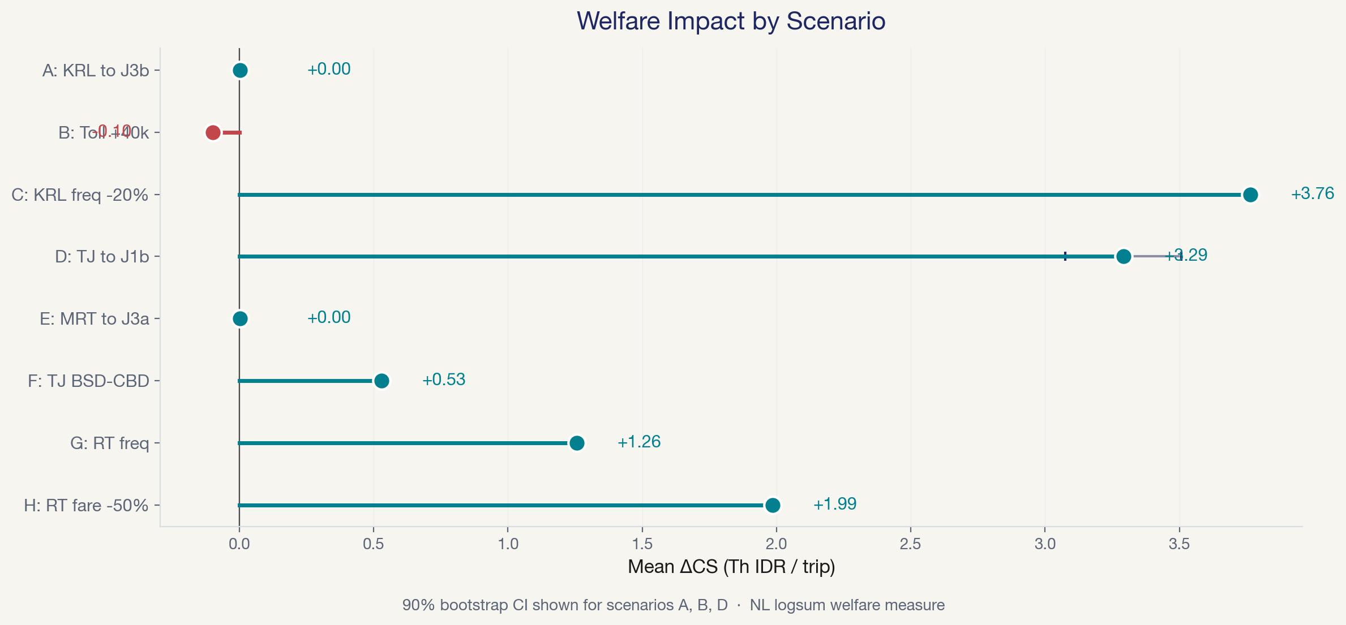
08 · POLICY SCENARIOS
Eight scenarios — aggregate ΔCS comparison
Top 3 by ΔCS: C (KRL freq, +3.76) > D (TJ→J1b, +3.29) > H (RT fare, +1.99). Regressive: B (toll, −0.10, 0 winners)
Dhaneswaramandrasa · Transportation Engineering · Hiroshima University AY2026
9 / 15

Slide 10
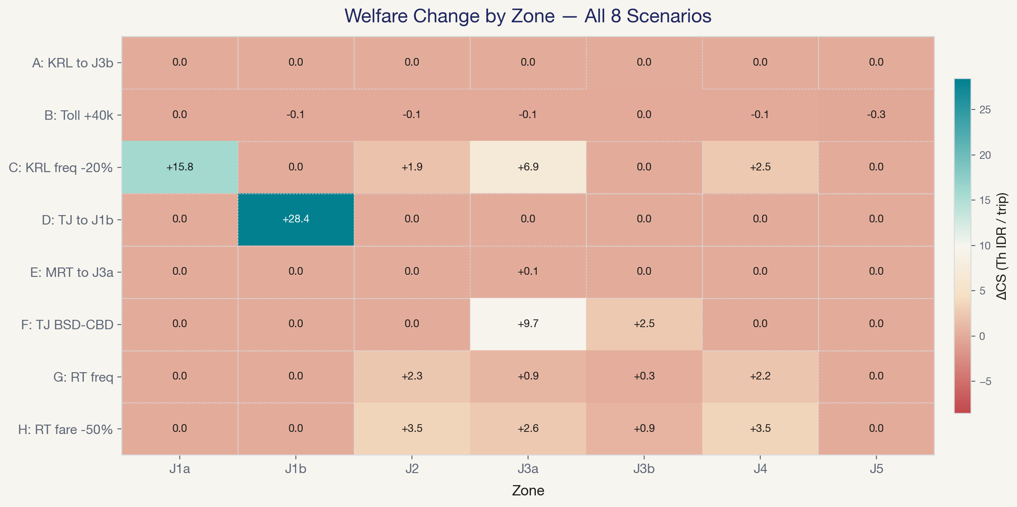
09 · DISTRIBUTIONAL IMPACT
Who wins and who is left out?
SC C
Maximizes aggregate welfare but J1b/J3b receive zero — no rail access.
SC D
Concentrates gains in transit-orphan J1b (+28.43 Th IDR). TJ draws from motorcycles (−10.1 pp), not other transit.
SC F
Benefits both J3a (+9.66) and J3b (+2.49) through TJ BSD→CBD route restructuring.
Dhaneswaramandrasa · Transportation Engineering · Hiroshima University AY2026
10 / 15

Slide 11
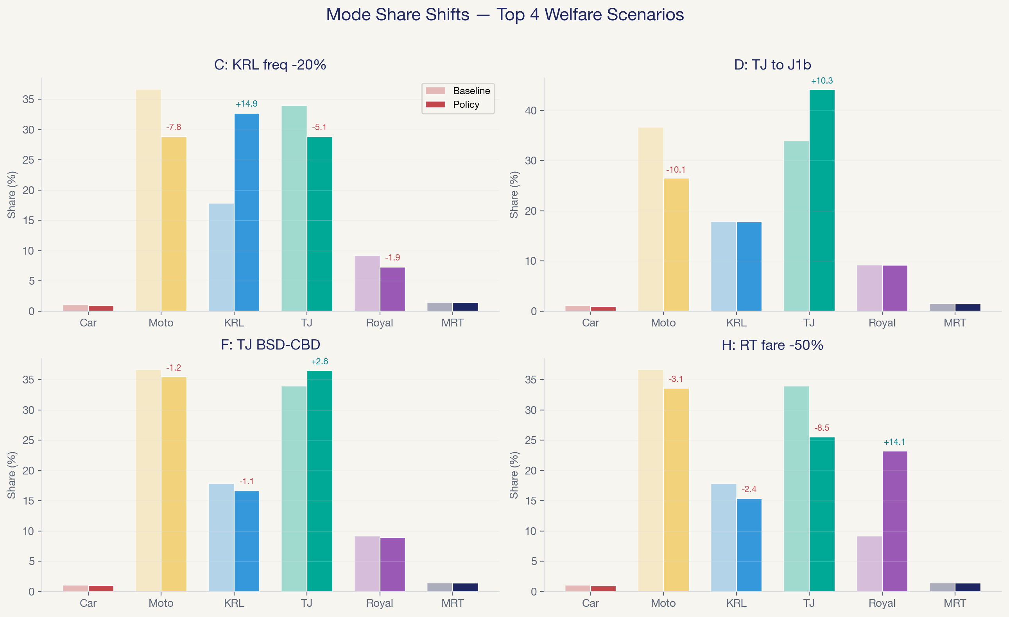
10 · MODE SHIFTS
Where do new riders come from?
Budget transit (TJ at Rp 3,500) draws primarily from motorcycles, not from other transit modes — expanding the pie rather than reshuffling it.
Dhaneswaramandrasa · Transportation Engineering · Hiroshima University AY2026
11 / 15

Slide 12
11 · CONCLUSIONS
Four takeaways
1
NL is the appropriate model
λ̂ = 0.763, LR p = 0.003, MXL adds no signal (Wald p = 0.763)
2
Top aggregate gain: Sc C
KRL frequency improvement: +3.76 Th IDR/trip, +6,580 Bn IDR/year
3
Most pro-equity: Sc D
TJ extension to J1b: +3.29 Th IDR/trip — concentrated in the most underserved zone
4
Bundle quality + expansion
Service quality improvements alone leave transit orphans behind. Combine with network expansion for equitable gains.
Dhaneswaramandrasa · Transportation Engineering · Hiroshima University AY2026
12 / 15

Slide 13
Thank You
Questions?

Slide 14
BACKUP A
Why scale parameter μ = 25?
Scale identification theorem (Train 2009 §3.7):
True utility: U = V + ε, where ε ~ Gumbel(0, μ)
Normalized: Ũ = Ṽ + ε̃, where ε̃ ~ Gumbel(0, 1)
All coefficients compressed: β̃ = β / μ
VOT = β_time / β_cost is preserved — μ cancels
Without μ = 25
With μ = 25
Utility gaps too large → choice becomes deterministic (99%+ choosing one mode). No meaningful choice model.
β estimates have larger SEs (the tradeoff), but Gumbel noise produces realistic choice distributions: Moto 36.7%, TJ 34.0%, KRL 17.8%.
Dhaneswaramandrasa · Transportation Engineering · Hiroshima University AY2026
14 / 15

Slide 15
BACKUP B
Why drop ride-hailing & LRT?
2WRH (GoRide/GrabBike)
Ilahi β_time_2wrh = −5.10 estimated on short urban trips → near-zero share on 30–105 km commutes. Parameter non-transferability (Wardman et al. 2016).
4WRH (GoCar/GrabCar)
ASC calibration required >+40 utility units to match BPS aggregate share — outside defensible range.
LRT Jabodebek
Available in only 1 of 7 zones (J2). Single-zone presence → ASC absorbs zone unobservables, not mode preference.
Nine-mode DGP tested → six-mode adopted. Documented in report §2.2, §6.3.
Dhaneswaramandrasa · Transportation Engineering · Hiroshima University AY2026
15 / 15

