Slide 1



YouTube Trending Videos Analysis
BDA LAB | LA2 PROJECT
Trending videos by country
using Apache Spark and Cassandra
Dhanishtha Deshpande
Roll No. 06
Himani Dalvi
Roll No. 07
IN
US
GB
CA
Palak Bhutada
Roll No. 13
Guides: Bhagyashree Madan, Sonam Chopade
152,794 rows | 205 days | 4 countries
Ramdeobaba University, Nagpur | 2026–27
Notes:
Introduce the team and the topic. We analysed YouTube's daily trending lists for four countries. Spark does the processing, Cassandra stores the data and results, and Streamlit shows them on a dashboard.

Slide 2




What we wanted to find out
Which categories and channels trend the most?
4
158,098
How many days after upload does a video trend?
countries: India, USA,
Great Britain, Canada
rows in the raw data
How long does it stay on the list?
205
8
When are trending videos uploaded?
days of data
(Nov 2017 to Jun 2018)
questions answered
with Spark SQL
Which videos trend in more than one country?
No prediction. We only analysed what happened.
Dataset: Trending YouTube Video Statistics (Kaggle)
Notes:
The dataset has one CSV file per country plus a JSON file for category names. We used four countries. Dates were in yy.dd.mm format and there were duplicates and broken IDs, so cleaning came first.

Slide 3




How we built it
1. Dataset
2. Spark
3. Cassandra
4. Spark SQL
5. Streamlit
4 CSV + 4 JSON files in Google Drive
Load, fix dates and types, remove duplicates
Cleaned rows saved in the main table
8 queries, results saved in 8 tables
Dashboard reads Cassandra and shows charts
Cassandra primary key
Tools used
((country, trending_date), video_id)
PySpark 3.5.3 and Spark SQL
Cassandra 4.1.5 + Spark Cassandra Connector 3.5.1
Streamlit + Plotly, all on Google Colab
One country's list for one day sits in one partition, so the date search reads only that partition.
Notes:
Walk through the five steps from left to right. Spark writes into Cassandra and reads it back for the analysis. The dashboard only talks to Cassandra. Explain why the partition key is country plus date.

Slide 4
What we found
74%
11.8 days
of Indian videos reached trending within 1 day of upload
average stay on the list in Great Britain, vs 2 days in India
77 videos
Entertainment
trended in all four countries, like Ed Sheeran's "Perfect"
is the top category in India, USA and Canada. Music leads in Great Britain
Notes:
India and Canada have many unique videos that stay one or two days, mostly daily TV episodes and news. Great Britain and the USA have fewer videos that stay much longer. All numbers come from our Spark SQL results stored in Cassandra.

Slide 5
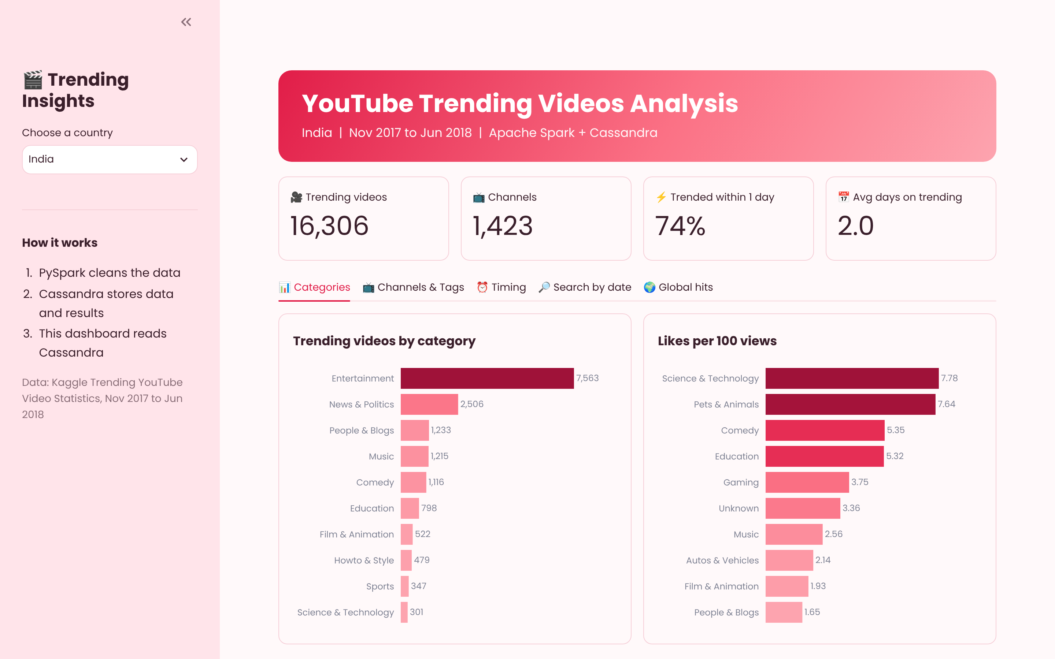
Dashboard and conclusion
The dashboard
Pick a country: 4 key numbers, charts and an upload heatmap
Pick a date: see what was trending that day with a live CQL query
Conclusion
Spark cleaned 158,098 rows to 152,794 and Cassandra stored the data and all results. The whole pipeline runs on Google Colab.
Thank you
Streamlit dashboard reading live from Cassandra
Notes:
If the Colab session is running, open the live dashboard: change the country, then try the date search. End with the conclusion. Future scope: live data from the YouTube API and a multi-node cluster.

