Slide 1

AI Content Creator Marketplace
A trusted, AI-native way for brands and agencies to discover creators, shape briefs, and manage production from first idea to final delivery.

Slide 2
CHALLENGE
AI production has outgrown traditional freelance marketplaces
The work is changing faster than the marketplace grammar.
WHAT AI CREATED
WHAT BRANDS STILL LACK
New specialist roles
Reliable evaluation
Generative AI has created new specialists: AI filmmakers, AI animators, and generative content creators.
Brands still lack a reliable way to discover, evaluate, and engage creators with proven AI-production skills.
WHY EXISTING MODELS BREAK
Existing marketplaces do not expose the tools, workflows, licensing, and iteration patterns behind AI-generated work.
2

Slide 3

SOLUTION
One marketplace connects the complete creative engagement
Brand publishes a structured brief; the marketplace matches relevant AI creators; the brand reviews AI-native portfolios and workflow evidence; creator and brand collaborate through generations, revisions, licensing, and delivery.
Publish brief
Match creators
Review portfolios
Collaborate & deliver
3

Slide 4



CREATOR PROFILES
Creator profiles make AI work legible and comparable
A portfolio becomes useful when the production evidence travels with the work.
Portfolio
Tool stack
Capabilities
Videos, animations, graphics, and other AI-generated work.
Models, generation tools, editing tools, and production workflow.
Skills, specialization, content types, formats, and aspect ratios.
4
TRUST LAYER · verified tools, verified workflows, and verified past work make comparison credible.

Slide 5

BRIEF BUILDER
Briefs turn rough campaign ideas into production-ready requirements
Campaign goal and audience
Content type, style, references, and format or aspect ratio
Deliverables, timeline, revisions, and collaboration expectations
Commercial-use, licensing, ownership, and usage requirements
BONUS · an AI-assisted brief builder expands a rough idea into a complete brief.
5

Slide 6
DISCOVERY
Search and filtering move brands from browsing to confident shortlists
Make creator relevance clear—and give every search a next step.
Filter
Explain the match
Recover empty results
Search by skills, specialization, tools, content type, format, and other profile attributes.
Show tool fit, style fit, portfolio fit, and availability signals so brands can see why a creator matches the brief.
Offer adjacent suggestions, relaxed filters, or an AI-assisted refinement path.
THE OUTPUT · a reasoned shortlist, not an endless browse.
6

Slide 7




DATA MODEL
The product model keeps creative, technical, and commercial context together
Creator
Portfolio item
Identity, skills, specializations, tools, workflows, portfolio items, verification signals.
Media, content type, style, aspect ratio, tools/models used, workflow notes, rights status.
Brief
Engagement
Campaign requirements, content type, style, format, usage rights, timeline, budget, and revision rules.
Selected creator, milestones, feedback rounds, license terms, approvals, and delivery.
Together, the model supports discovery, evaluation, collaboration, rights, and delivery across the engagement.
7

Slide 8
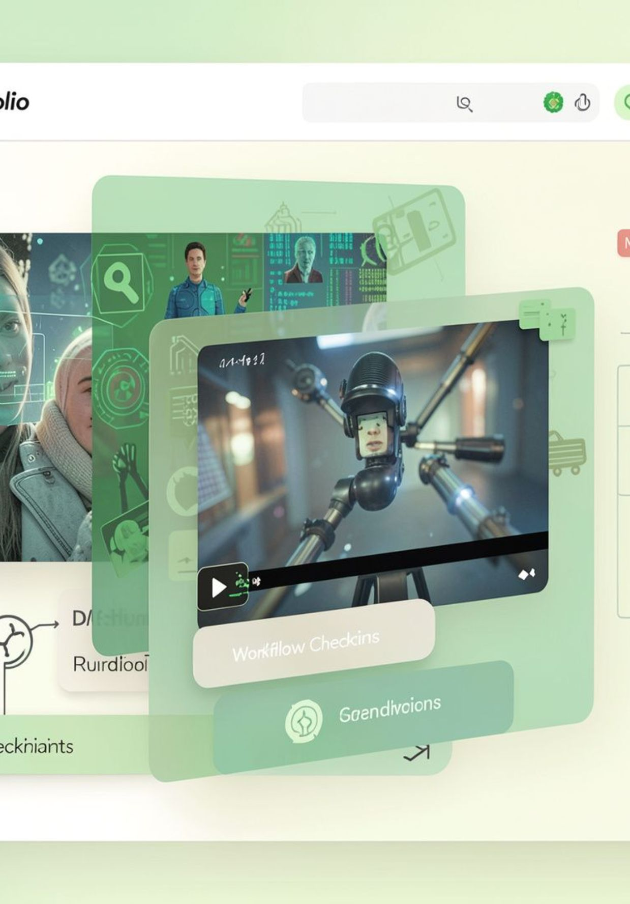
DIFFERENTIATION
AI-native portfolio evidence replaces guesswork
Previous creator sites show the output. Collabe Gen shows how the output was made—and whether the process can be trusted.
Tools, models, prompts, and workflow stages travel with each portfolio item.
Verification signals make capability and repeatability easier to assess.
Brands compare evidence, not just polished thumbnails.
8

Slide 9


DIFFERENTIATION.
Brief-to-delivery collaboration is built in
Previous freelance sites stop at discovery. Collabe Gen carries the commercial engagement through production.
Structured matching connects brief requirements to creator evidence.
Commercial-use rights, licensing, revisions, milestones, and approvals stay attached.
One shared path moves from first generation to final delivery.
9

Slide 11
DEMO PATH .
DEMO & EVALUATION
Evaluation area | Weight | What the prototype demonstrates
Creator Profiles & AI Portfolios | 30% | AI portfolio evidence, tools, capabilities, and verification signals
Brief Definition | 20% | Structured requirements, rights, timeline, and revision rules
Discovery & Filtering | 25% | Relevant filters, match rationale, and shortlist quality
User Experience | 15% | Clear, efficient movement through the product
Presentation & Demo | 10% | A coherent end-to-end story
create brief → filter creators → inspect portfolio evidence → shortlist → review engagement details.
Prototype scope and evaluation logic
A focused prototype proves the path from intent to evidence-backed shortlist.
Bonus credit strengthens the relevant criteria through verification signals and the AI-assisted brief builder.
11

Slide 12
CONCLUSION
Collably makes AI creative production easier to trust—and easier to run.
Discover the right creator, shape the right brief, and deliver the work with evidence, clarity, and commercial confidence.
12

