Slide 1
XIOS Modification and
Compression Implementation

Slide 2
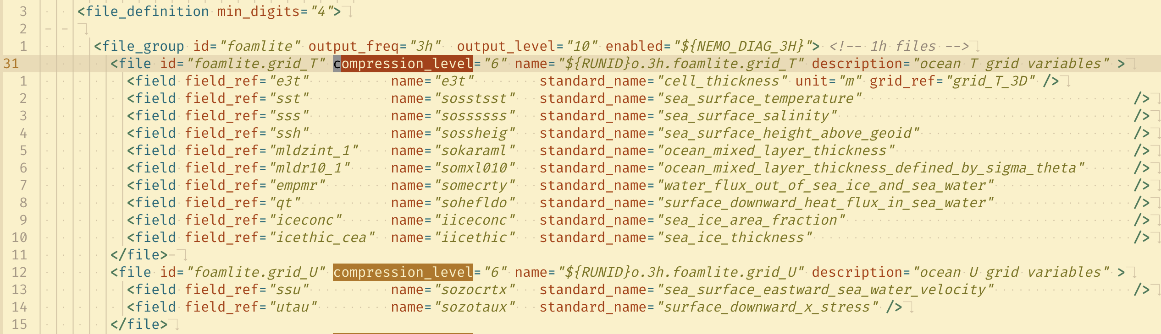
□ Modify the iodef.xml configuration on NEMO
XIOS Modification and Compression Implementation
The XIOS has default compression using gzip.
The gzip can be enabled by adding compression_level to iodef.xml
The gzip has compression level 0 - 9.

Slide 3
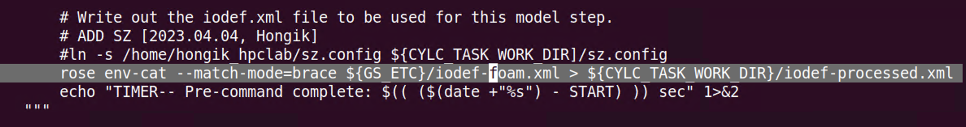
□ Modify the iodef.xml configuration on NEMO
XIOS Modification and Compression Implementation
The iodef.xml filename is defined as iodef-foam.xml in NEMO Low GloSea6
The NEMO is hosted in subversion and built using FCM. The new branch is needed to support the gzip configuration.

Slide 4
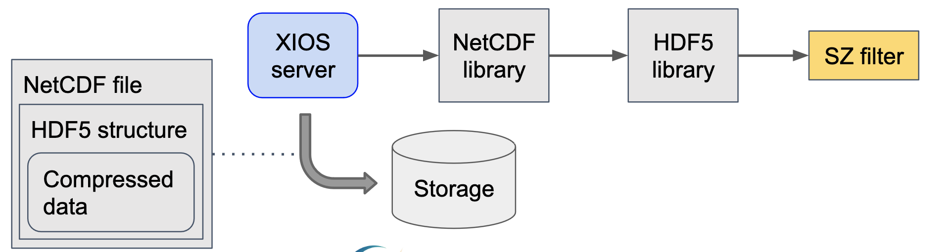
□ Implement SZ compression using SZ filter
XIOS Modification and Compression Implementation
The H5Z-SZ filter support to apply SZ compression for NetCDF4 format
The approach to implementing SZ compression is shown in the Figure below

Slide 5
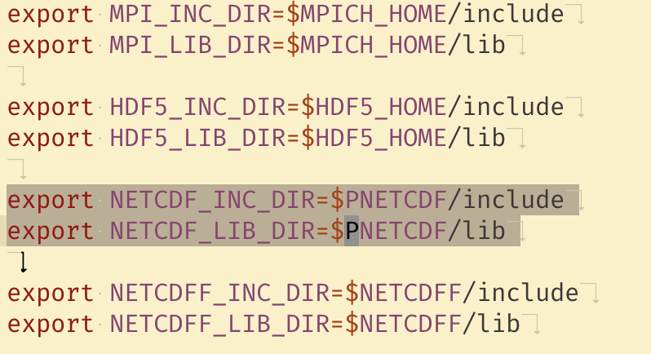
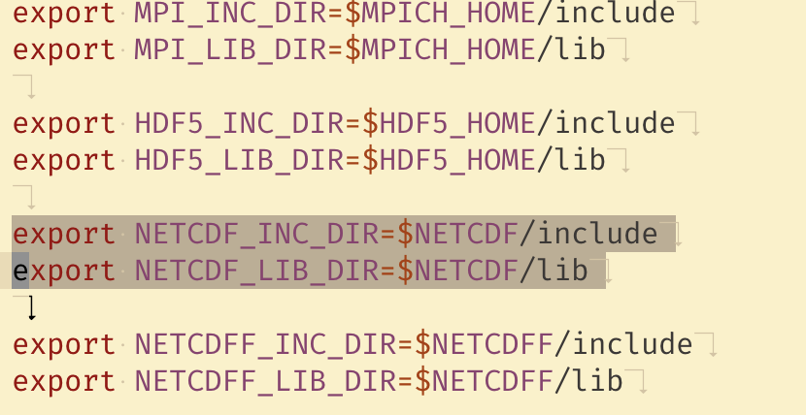
□ Implement SZ compression using SZ filter
XIOS Modification and Compression Implementation
Adjust the NetCDF library in XIOS
The SZ compression using SZ filter doesn’t support PnetCDF library
Adjust the environment variables for recompilation is required

Slide 6
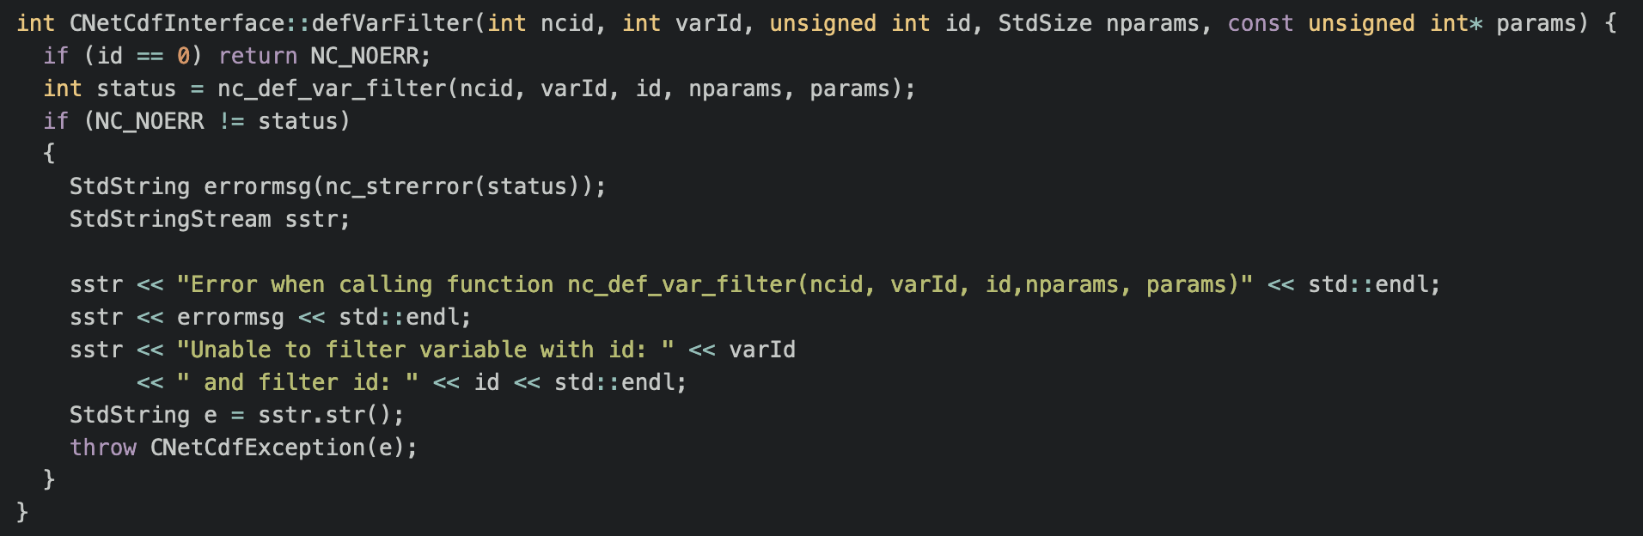
□ Implement SZ compression using SZ filter
XIOS Modification and Compression Implementation
Declare defVarFilter function at io/netCdfInterface.hpp
Add implementation at io/netCdfInterface.cpp

Slide 7
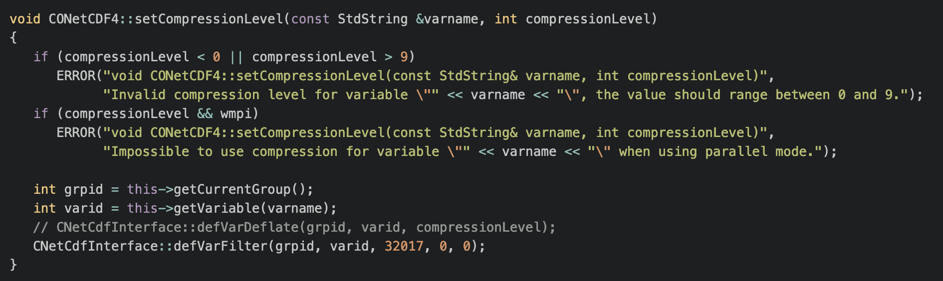
□ Implement SZ compression using SZ filter
XIOS Modification and Compression Implementation
Modification at io/onetcdf4.cpp

Slide 8
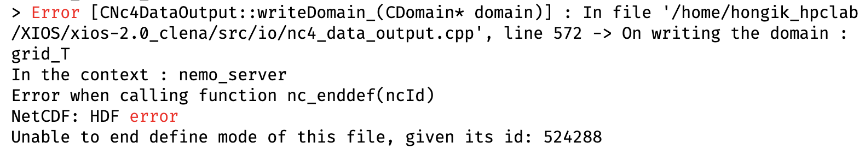
□ Implement SZ compression using SZ filter
XIOS Modification and Compression Implementation
Result Modification

Slide 9
□ Setup New Environment for XIOS Modification
XIOS Modification and Compression Implementation
Decouple XIOS from Low GloSea6
Testing the compression modification requires a long time running of the model.
Compression technique applied in XIOS directly. So, the evaluation of the compression feature does not depend on Low GloSea6.
Decouple XIOS from Low GloSea6 can give the log directly without running the Low GloSea6.

Slide 10
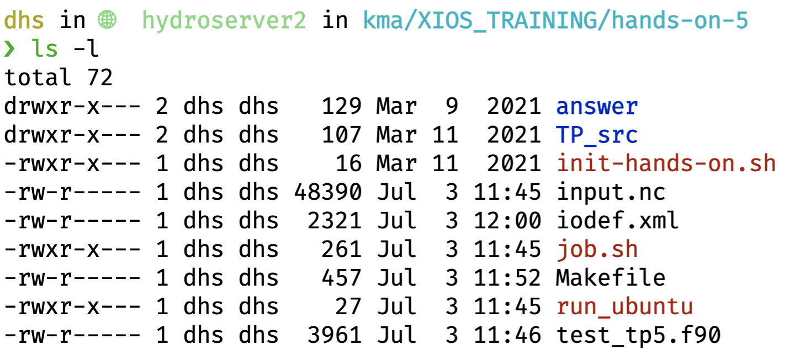
□ Setup New Environment for XIOS Modification
XIOS Modification and Compression Implementation
Find the configuration and setup the standalone XIOS
XIOS TRAINING (Hands-On, source code and XML configuration) available at https://docs.google.com/document/d/1zH5ZJ-J6lesaqiMNBHu8t-CkJ-i8Zx2ZkiBsYh3T9YE/edit?pli=1
Setup the standalone XIOS
It only requires recompiling the XIOS source code to evaluate code changes.
Find the hands-on training related to netCDF as input as shown in the Figure below

Slide 11
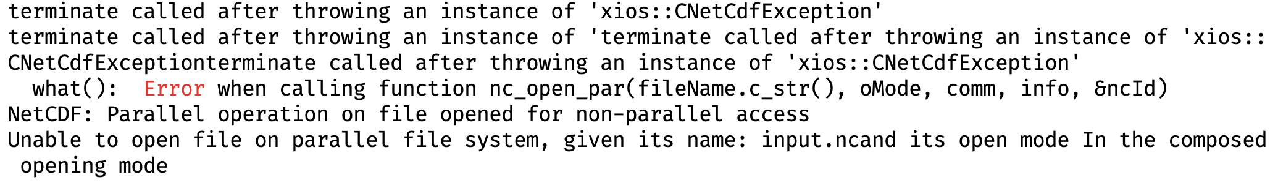
□ Setup New Environment for XIOS Modification
XIOS Modification and Compression Implementation
Testing the standalone XIOS
The hands-on consists of source code (Fortran), XML configuration and netCDF file.
The compilation of source code can be performed by running the make command using the provided Makefile.
It can display the log result after the XIOS client is executed.
No issue when running the standalone XIOS to proceed with basic input. But when run using the netCDF there is some issue with the compatibility of the netCDF library as shown in the Figure.
Adjusting the netCDF library in Makefile and disabling parallel in iodef.xml doesn’t help.

Slide 12
감사합니다
Thank you

