Slide 1
XIOS Modification and
Compression Implementation

Slide 2
Summary
Ensure the SZ filter is registered in the HDF5 filter
Update the code modification XIOS integration with H5Z-SZ
Check the compatibility of SZ versions
Check the compatibility of Low GloSea6 data with the H5Z-SZ filter (progress)

Slide 3
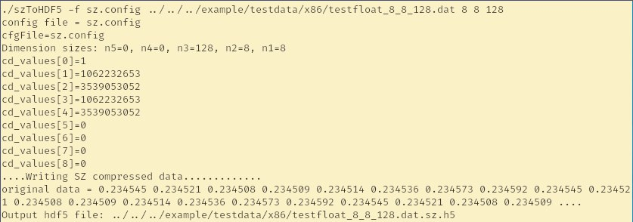
□ Ensure the SZ filter is registered in server
XIOS Modification and Compression Implementation
The H5Z-SZ is an HDF5 filter based on the SZ compressor
It is part of the SZ project
Register the filter
export HDF5_PLUGIN_PATH=$SZPATH/lib
Run the test to ensure the filter has been registered

Slide 4
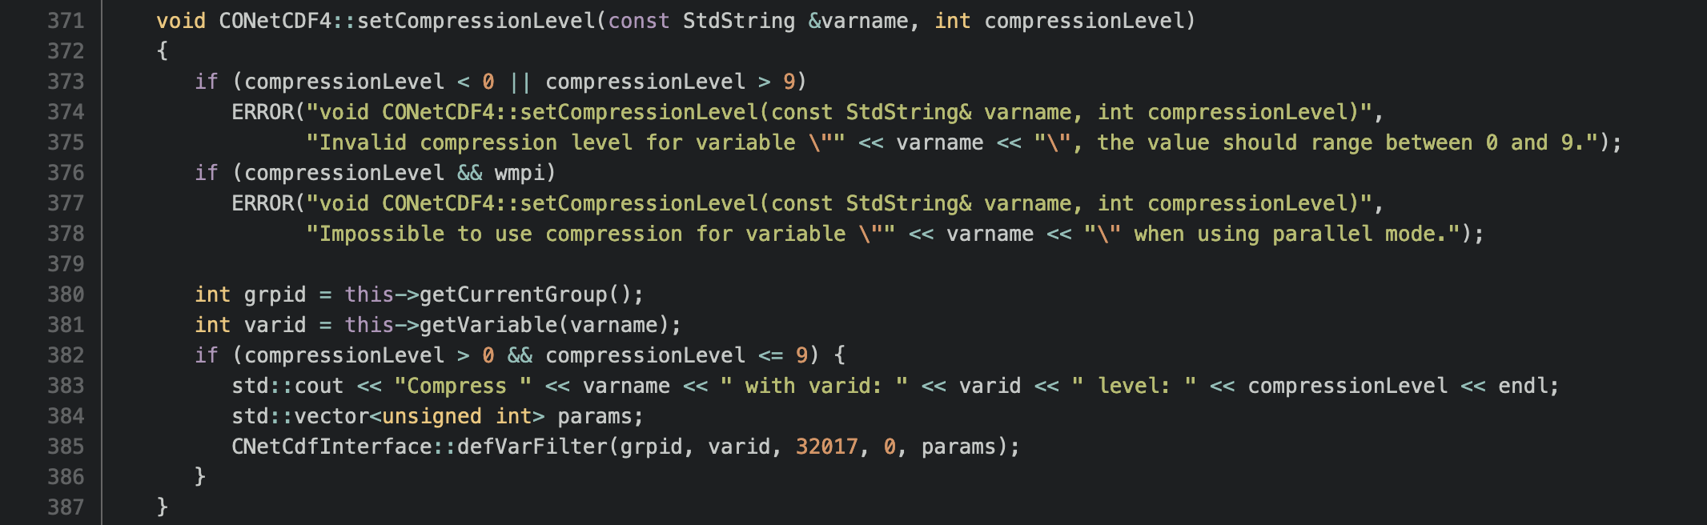
□ Updated the code when call the SZ filter
XIOS Modification and Compression Implementation
The XIOS call the setCompressionLevel for all variables by default.
Level 0 means no compression applied to the variable
The SZ filter will be applied on certain variables, conditional added before calling the SZ filter.

Slide 5
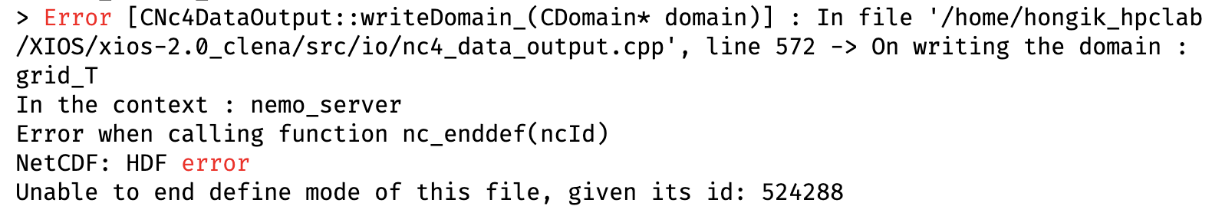
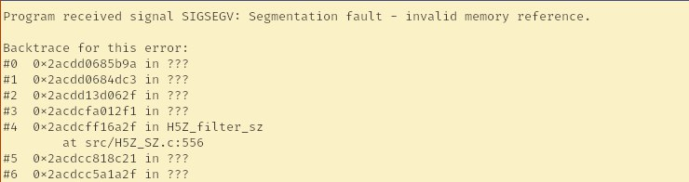
□ Result of modification
XIOS Modification and Compression Implementation
Before modification
After modification

Slide 6
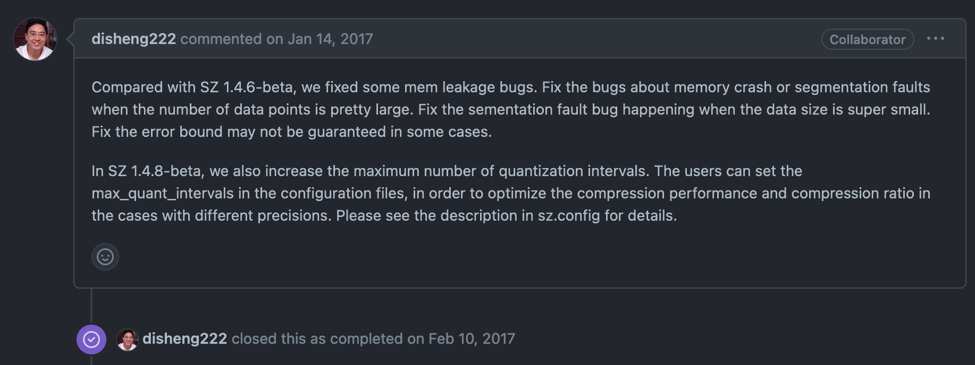
□ Issue segmentation fault mentioned in SZ project
XIOS Modification and Compression Implementation
The segmentation fault can be caused by incompatibility version of SZ or unsupported handling data

Slide 7
Summary of experiments using several SZ versions
XIOS Modification and Compression Implementation
SZ+H5Z-SZ | Mode | Result
Master | Attach | Segmentation Fault
 | Detach | Segmentation Fault
V2.1.0 | - | Failed to compile (too old)
V2.1.8 | Attach | Segmentation Fault
 | Detach | Segmentation Fault
The segmentation fault occurred in several SZ versions, evaluation for limitation of supported data is required.

Slide 8
Test H5Z-SZ capability to handle Low GloSea Nemo Data and SZ versions
XIOS Modification and Compression Implementation
The time needed to run the experiment is around 60 minutes
Creating separate a test code is required to ensure no issues with libraries and data.
No issue when running the test code compression using a single variable with the H5Z-SZ approach

Slide 9
Conclusion
XIOS Modification and Compression Implementation
The H5Z-SZ filter has been registered and integrated into the XIOS
The segmentation fault that occurred can be caused by incompatibility issues with the library version and unsupported data.
A faster method is required to ensure the compatibility library and data before running the experiment.

Slide 10
감사합니다
Thank you

