Slide 1
Outsourcing Data Processing Jobs with Lithops
J. Sampé, M. Sánchez-Artigas, G. Vernik, I. Yehekzel and P. García-López
IEEE Transactions on Cloud Computing, vol. 11 Jan.-March 2023

Slide 2
Summary
Functions as a Service (FaaS) is a cloud computing model that allows developers to run code without provisioning or managing servers.
Lithops is a Python framework that makes it easy to run FaaS applications.
Lithops provides a number of features that make it well-suited for running data processing jobs, such as:
Support for multiple cloud providers
Simplified programming model
Automatic scaling
Fault tolerance
Lithops has been used to run a variety of data processing jobs, such as:
Machine learning
Image processing
Natural language processing
Lithops is a promising framework for running data processing jobs on FaaS. It is easy to use, scalable, and fault-tolerant

Slide 3
Introduction
Growing Interest in FaaS (Functions-as-a-Service):
Major cloud providers like Amazon, Microsoft, and IBM have launched FaaS offerings.
Shift in Usage Pattern:
Originally designed for microservices and other small, asynchronous tasks.
Now also being explored for massive-scale parallel computing.
Pioneering Work in Serverless Parallel Computing:
Eric Jonas et al. developed PyWren in 2017, showing how serverless can be used for parallel workloads.

Slide 4
FaaS Serverless Challenges
While FaaS has various challenges, existing solutions only address some of them.
Frameworks need to overcome various limitations specific to FaaS such as:
Simplifying parallel computations like MapReduce.
Absence of direct, P2P communication between functions.
Lack of support for function synchronization.
Potential inconsistency in dependencies and libraries compared to local machines.
Lack of portability due to proprietary APIs from each cloud provider.
Existing related works ExCamera and gg address the direct communication P2P challenge.
PyWren lacks a reduce primitive and is specific to AWS Lambda.

Slide 5
Contributions
Lithops makes it easy for cloud users to quickly run parallel tasks in cloud services.
Introducing Lithops: A simple tool for running parallel tasks in MapReduce fashion across multiple cloud services like IBM, Google, and AWS.
Target Audience: Ideal for occasional cloud users, making it easier to run simple parallel tasks on the cloud.
Performance Metrics: Performance assessed using practical scientific applications such as stock prediction and sentiment analysis.

Slide 6
Differences between PyWren and Lithops
 | PyWren | Lithops
MapReduce | Mapping portion; reducing is still experimental. | Broader support for MapReduce jobs. It includes a reduceByKey like operation to run one reducer per object key in parallel.
Data discovery & partitioning | None | Automatic; data partitioning based on user-defined chunk sizes or on the data object granularity
Composability | None | Dynamic compositions of functions;
Runtime | Fixed; AWS Lambda, along with Anaconda, a packaged version of Python. | Based on Docker; possibility for users to create its own custom runtime (a different Python version, extra packages) and share it with other users.
Proxied function invocation | Due to network overhead & AWS throttling, it may be slow to launch jobs with many functions. | Faster; client calls a remote invoker function, which starts all functions in parallel within the cloud.
Monitoring | Polling-based monitoring using Amazon S3 | More efficient; event-based monitoring using RabbitMQ
Open-source portability & extensibility | Adapted to work with AWS Lambda and Amazon S3 | Multi-cloud: IBM Cloud, Google Cloud, AWS, Azure, etc., in addition to Kubernetes

Slide 7
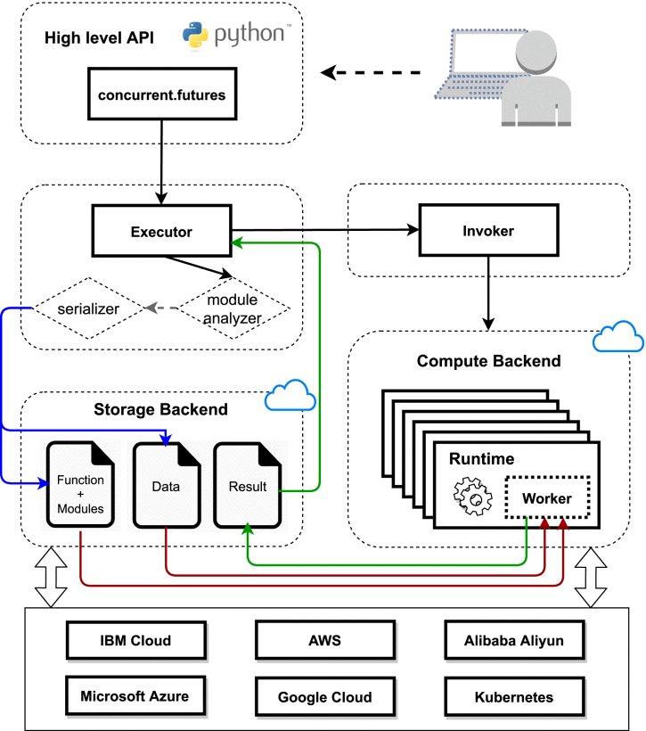
High Level Architecture of Lithops
Supports standard APIs like Python's concurrent.futures.
Uses two cloud services: compute backend for MapReduce jobs and storage backend for data.
Designed to be serverless, typically using FaaS for computing and BaaS for storage, allowing both pillars to scale independently.

Slide 8
Main Components of Lithops
Executor: Enables users to run code in the cloud through API calls, handles data transfer between local machine and cloud storage, and monitors for output data.
Invoker: Manages the number of cloud function invocations based on the API call and can operate in the cloud to reduce latency.
Worker: Executes the user's code on the cloud backend, fetching input data and user code from storage and saving the output back to storage.

Slide 9
Runtime of Lithops
Lithops operates in containerized Docker, making it easy to share the runtime.
The Lithops runs in a containerized Docker environment
Docker images can be stored in Docker registry. Enables easy sharing of custom runtime environment.
Lithops automatically detects the Python version of the client and deploys a corresponding runtime. Ensure both client and server have same Python version.
Currently, Lithops only supports Pythons version >= 3.5

Slide 10
Programming Model
Lithops simplifies cloud computing with an intuitive programming model
Lithops is designed for easy use by cloud experts and novices, offering an API similar to PyWren with added functionalities like map_reduce() for enhanced data processing.
Main components of Lithops Programming Model:
Function Executor
Application Programming Interface (API)
Data Discovery and Partitioning
Monitoring
Composability

Slide 11
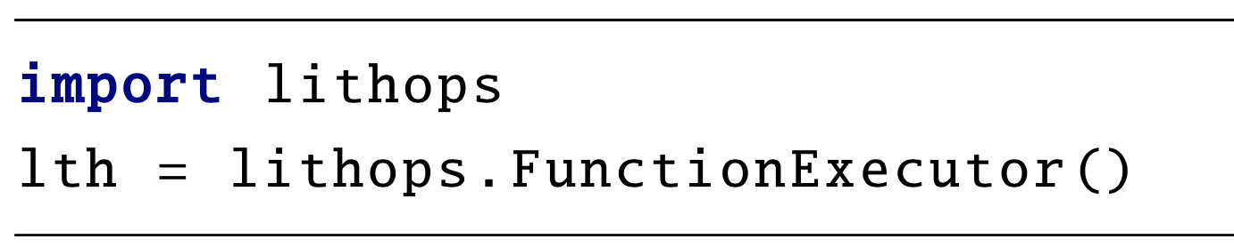
Function Executor
The Function Executor handles all tasks and settings required for running code on cloud services.
The core object in Lithops is the 'executor,' which allows calls to the Lithops API for running parallel tasks.
Import the 'lithops' module and instantiate the 'FunctionExecutor()' class to get an executor instance.
Each executor instance is assigned a unique ID for tracking function invocations and stored results.
the executor loads necessary configuration details, such as account information, to access the compute and storage backends for launching Lithops.

Slide 12
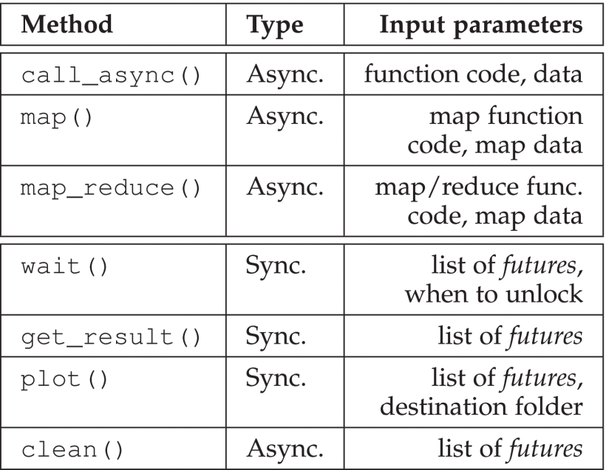
Lithops Programming API
call_async(): Executes User Defined Function (UDF) in the cloud and stores output in the storage backend, without blocking code.
map(): Spawn multiple function activations based on the items of an input list.
map_reduce(): Map the map_function over the data and apply the reduce_function across all futures.
wait(): Wait for the future instances to complete.
get_result(): Getting the results from all function activations
plot(): Creates timeline and histogram of the current execution.
clean(): Deletes all the temp files from storage.
More documentation at https://lithops-cloud.github.io/docs
Programming API Specification

Slide 13
Data Discovery and Partitioning
Data Discovery
Users only need to provide a list of object keys or name of the storage bucket(s).
The framework handles discovering all the objects and partitions them automatically.
Partitioning
Data partitions are created based on a user-configurable chunk size.
If no size is specified, each object is processed by a single executor.

Slide 14
Monitoring
Ongoing functions execution in Lithops can be tracked using either a polling-based or event-based approach.
Monitoring keeps track of ongoing function executions and synchronize their completion.
Polling-based:
Periodically polls the storage backend every 'x' seconds to check if tasks are complete.
Advantage: No need for extra services.
Drawback: Increases job execution time and high IO overhead, especially for large numbers of function executors.
Event-based:
Function executors signal their completion through a termination event.
Drawback: Requires an extra service, typically RabbitMQ, to manage the event queue.
Advantage: Reduces monitoring overhead significantly, sometimes by up to 99% compared to the polling-based approach.
Function execution produces result.pickle for results and status.json for metadata and statistics in the storage backend.

Slide 15
Composability
Lithops enables function chaining through its composition feature
Lithops offers a feature called function composition (function chain), which allows for a certain level of composability within the framework.
Unlike AWS Step Functions, which uses JSON state machines for function composition, Lithops achieves this programmatically. This makes it potentially more powerful as it utilizes Python's control flow instructions.
It currently works with the Futures API, and can chain the map(), map_reduce(), wait(), and get_result() methods.

Slide 16
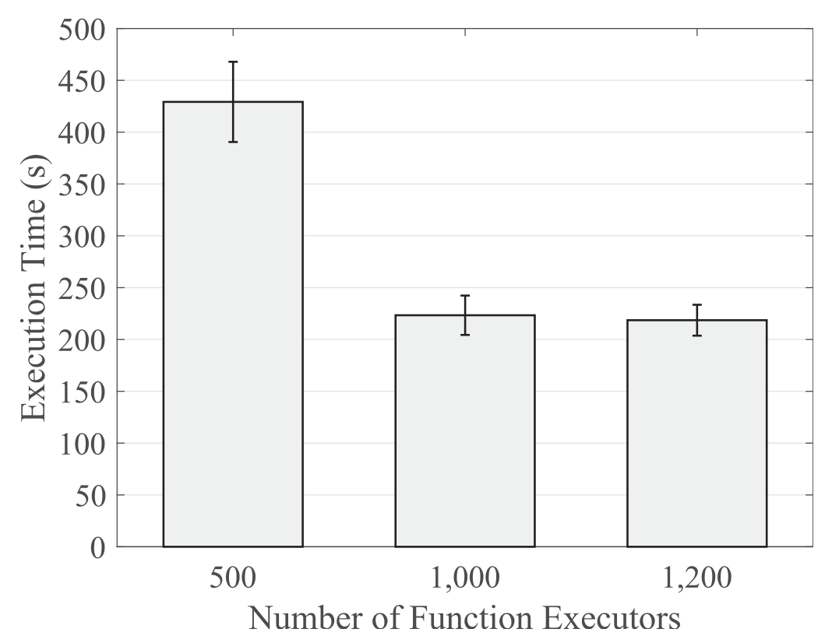
Use Cases: Monte Carlo-Based Stock Prediction
The Lithops was used to parallelize the Monte Carlo simulations to predict IBM stock prices.
When the number of function executors doubled from 500 to 1000, the execution time was halved. However, the performance gain did not improve beyond 1200 executors due to stragglers.
Straggler is a task that takes longer to complete than other tasks in a parallel computing system. The task may be waiting for a resource that is not available.

Slide 17
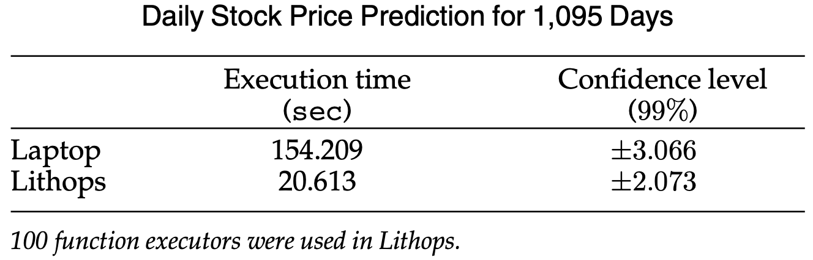
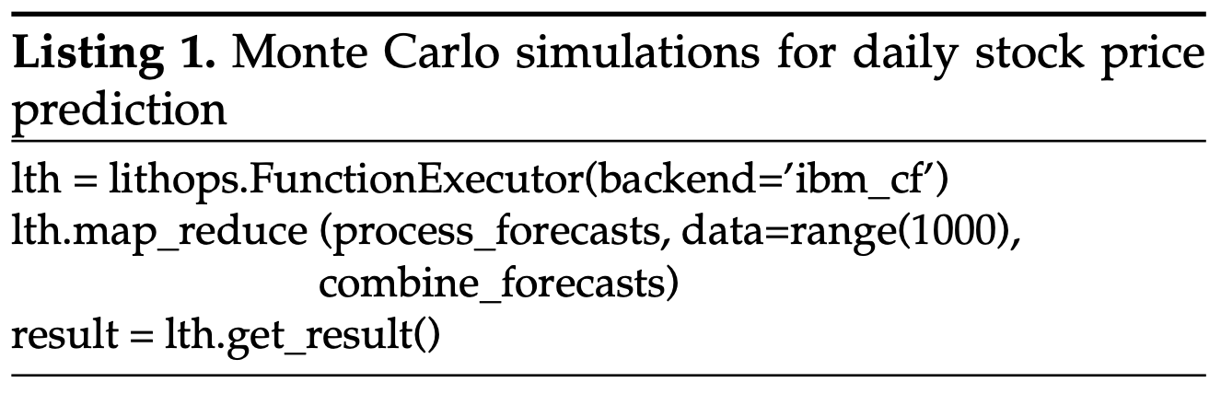
Use Cases: Monte Carlo-Based Stock Prediction
A significant reduction in execution time was achieved: from 2.56 min down to just a few seconds. (87% improvement)
This performance improvement required minimal code changes, specifically just three additional lines of code. (Shown in Listing 1)

Slide 18
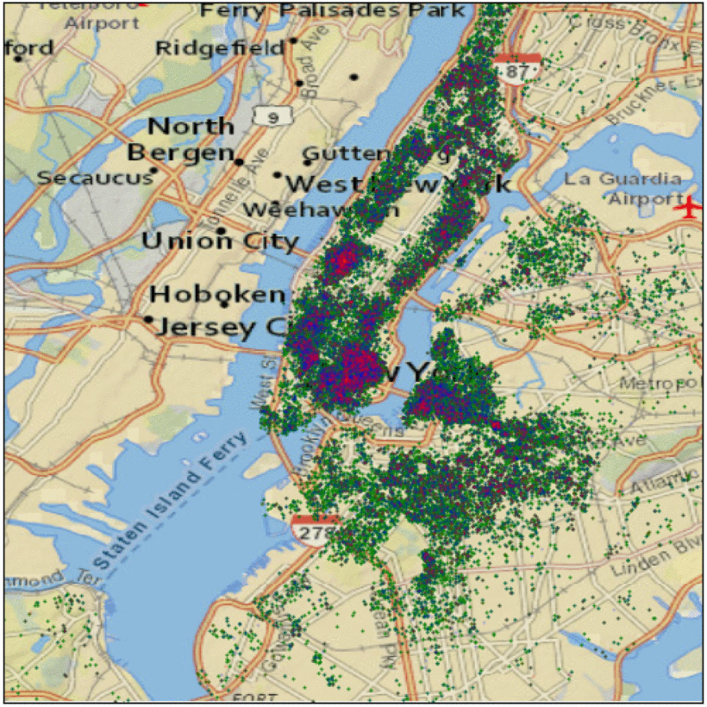
Use Cases: Sentiment Analysis
Lithops analyzes Airbnb reviews from various cities using tone analyzer datasets stored in IBM Cloud Object Storage.
Datasets: Retrieved from IBM Watson Studio Community, the dataset comprised reviews for 33 cities, with a total size of 1.9GB and 3M comments.
Experiment Setup: Initially, the processing was done serially using a Jupyter notebook in IBM Watson Studio, with hardware specs matching a typical laptop (4 vCPUs and 16GB RAM). It took 1 hour and 26 minutes to process all comments and generate maps for 33 cities.
Tone analysis: Green, blue
and red points stand for good, neutral, and bad comments

Slide 19
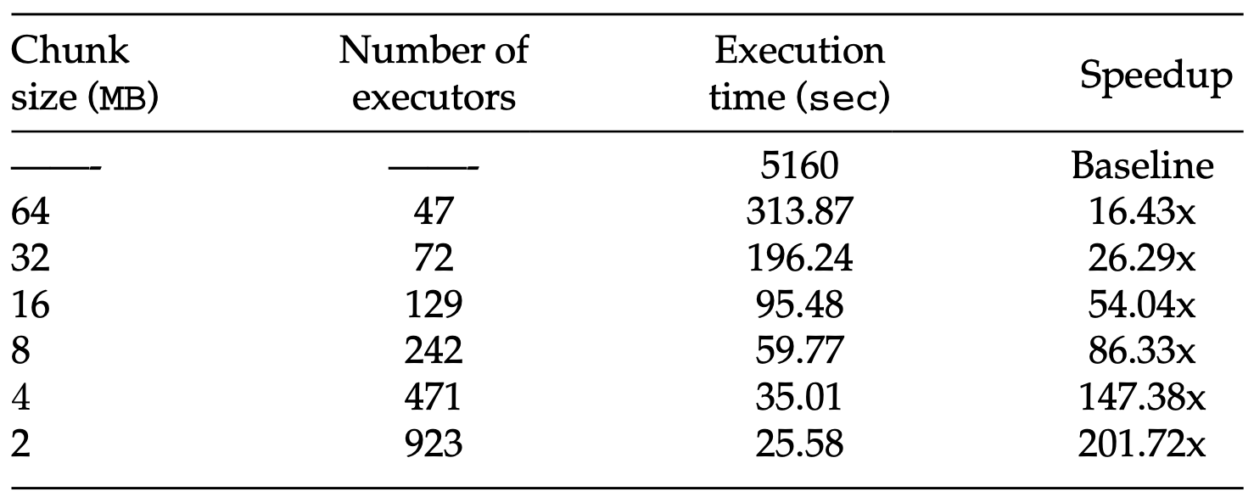
Use Cases: Sentiment Analysis
Lithops achieved a speedup greater than 100x, demonstrating its value, especially for those not versed in cloud computing. The speedup eliminates the need for specialized stacks like Spark and MPI.
Performance of Tone Analysis of Airbnb reviews for Different Chunk Sizes
The findings suggest that Lithops can significantly reduce compute times at nearly zero devops cost, making it extremely beneficial for users who prioritize time savings over parallel efficiency.

Slide 20
Conclusion
The article proposes a novel serverless platform called Lithops, designed for executing parallel tasks in a MapReduce fashion.
Lithops is compatible with popular cloud providers such as IBM, AWS, and Google.
Designed for minimal overhead, it is particularly accessible for occasional cloud users.
Key features of Lithops include automated data discovery, partitioning, nested composability, and seamless integration with Jupyter notebooks.
Performance benchmarks indicate that using Lithops can result in speedups greater than 100x compared to executing the same code on a local machine.

Slide 21
Thank You

