Slide 1
XIOS Modification and
Compression Implementation

Slide 2
Summary
Ensure the SZ filter is registered in the HDF5 filter
Update the code modification XIOS integration with H5Z-SZ
Check the compatibility of SZ versions
Check the compatibility of Low GloSea6 data with the H5Z-SZ filter (progress)

Slide 3
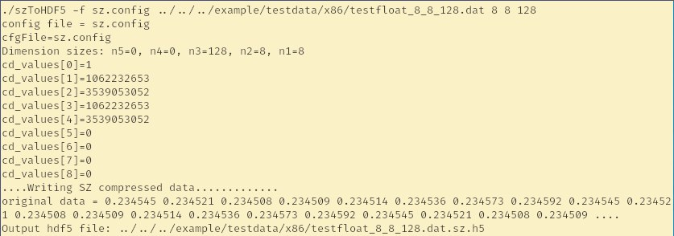
□ Ensure the SZ filter is registered in server
XIOS Modification and Compression Implementation
The H5Z-SZ is an HDF5 filter based on the SZ compressor
It is part of the SZ project
Register the filter
export HDF5_PLUGIN_PATH=$SZPATH/lib
Run the test to ensure the filter has been registered

Slide 4
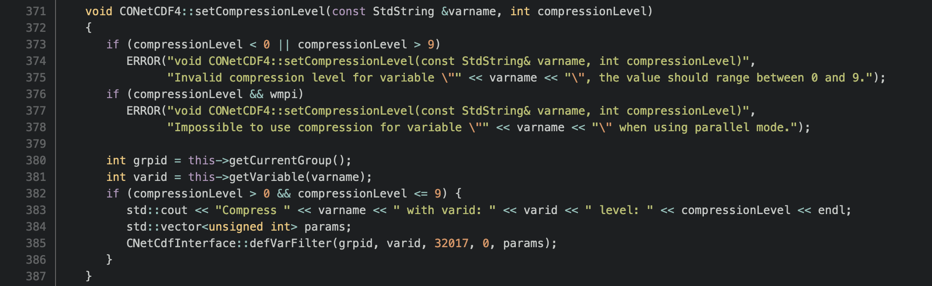
□ Updated the code when call the SZ filter
XIOS Modification and Compression Implementation
The XIOS call the setCompressionLevel for all variables by default.
Level 0 means no compression applied to the variable
The SZ filter will be applied on certain variables, conditional added before calling the SZ filter.

Slide 5
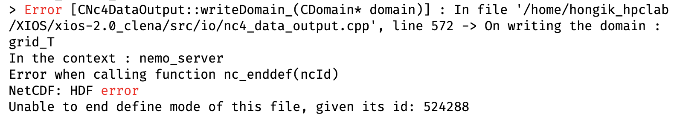
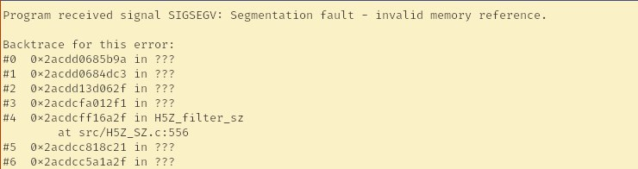
□ Result of modification
XIOS Modification and Compression Implementation
Before modification
After modification

Slide 6
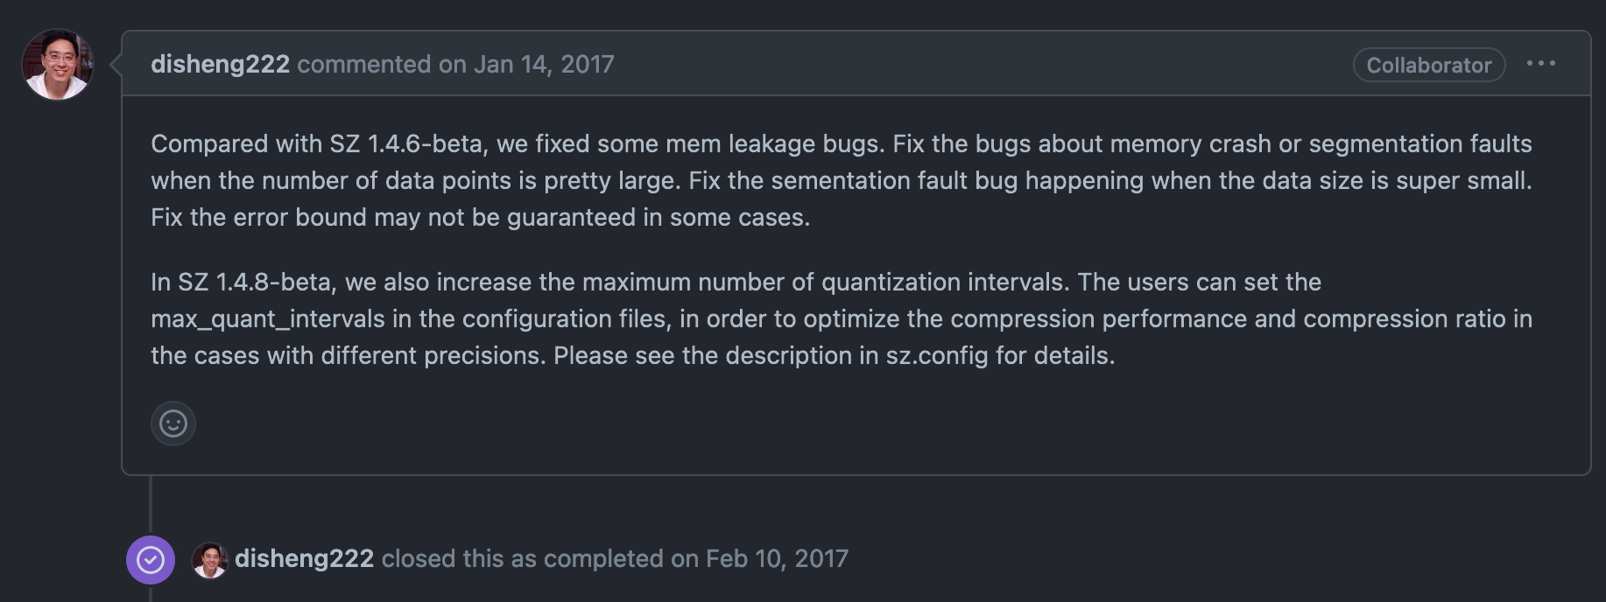
□ Issue segmentation fault mentioned in SZ project
XIOS Modification and Compression Implementation
The segmentation fault can be caused by incompatibility version of SZ or unsupported handling data

Slide 7
Summary of experiments using several SZ versions
XIOS Modification and Compression Implementation
SZ+H5Z-SZ | Mode | Result
Master | Attach | Segmentation Fault
 | Detach | Segmentation Fault
V2.1.0 | - | Failed to compile (too old)
V2.1.8 | Attach | Segmentation Fault
 | Detach | Segmentation Fault
The segmentation fault occurred in several SZ versions, evaluation for limitation of supported data is required.

Slide 8
Test H5Z-SZ capability to handle Low GloSea Nemo Data and SZ versions
XIOS Modification and Compression Implementation
The time needed to run the experiment is around 60 minutes
Creating separate a test code is required to ensure no issues with libraries and data.
No issue when running the test code compression using a single variable with the H5Z-SZ approach

Slide 9
Conclusion
XIOS Modification and Compression Implementation
The H5Z-SZ filter has been registered and integrated into the XIOS
The segmentation fault that occurred can be caused by incompatibility issues with the library version and unsupported data.
An alternative method is required to ensure the compatibility library and data before running the experiment.

Slide 10
감사합니다
Thank you

