Slide 1
XIOS Modification and
Compression Implementation

Slide 2
Summary
XIOS Modification and Compression Implementation
Approaches to implement SZ compression
Implementation of SZ compression via SZ filter
Implementation of SZ compression via modifying the netCDF library
The implementation result of SZ compression in XIOS via SZ filter
Code modification in XIOS by plugging SZ filter to the nc_def_var_filter function in netCDF library has been conducted.
However, there is an issue of segmentation fault with the SZ filter approach
An alternative approach to performing SZ compression is by modifying the netCDF4+HDF5 library.
We analyze the needed code modification as shown in flowcharts (slide 7).
The netCDF4 compression depends on the HDF5 library. Thus, modification on both libraries is required to implement SZ compression.
The progress of SZ compression by modifying the netCDF4+HDF5 library
The required parameters to perform SZ compression modification has been added to the netCDF4 library
The SZ compress process has been added to the HDF5 library
The result is successful in the toy program. However, there is a nc_close function issue in XIOS call.

Slide 3
Progress in integration of the SZ Filter into XIOS
XIOS Modification and Compression Implementation
SZ compression needs to load `sz.config` in the same directory as the program that use the SZ API
Modify the ROSE configuration, 'suite.rc', to link 'sz.config' to the same directory as the model program (ocean.exe). → Done
SZ filter is HDF5 filter plugin that need to be registered into the system.
Add export HDF5_PLUGIN_PATH=$SZ_HOME/lib into the ~/.bash_profile→ Done
Add SZ-related compilation is required to integrate SZ library into the XIOS
Add -lSZ -lzstd -lhdf5sz into arch.path in XIOS → Done
Code modification:
Adding the nc_def_var_filter interface in src/io/netCDFInterface.cpp → Current work
Integrate the SZ filter in src/io/onetcdf.cpp → Current work
Add compression type SZ option in iodef.xml config parser → Next work (after resolving issue)

Slide 4
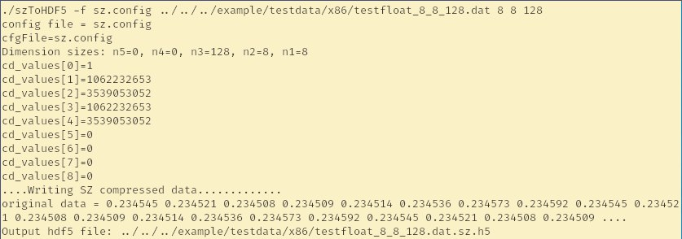
□ Ensure the SZ filter is registered in server
XIOS Modification and Compression Implementation
The H5Z-SZ is an HDF5 filter based on the SZ compressor
H5Z-SZ is part of the SZ compression project
SZ Filter can be registered by following code in ~/.bash_profile
export HDF5_PLUGIN_PATH=$SZ_HOME/lib
To ensure the filter has been registered, run the test.

Slide 5
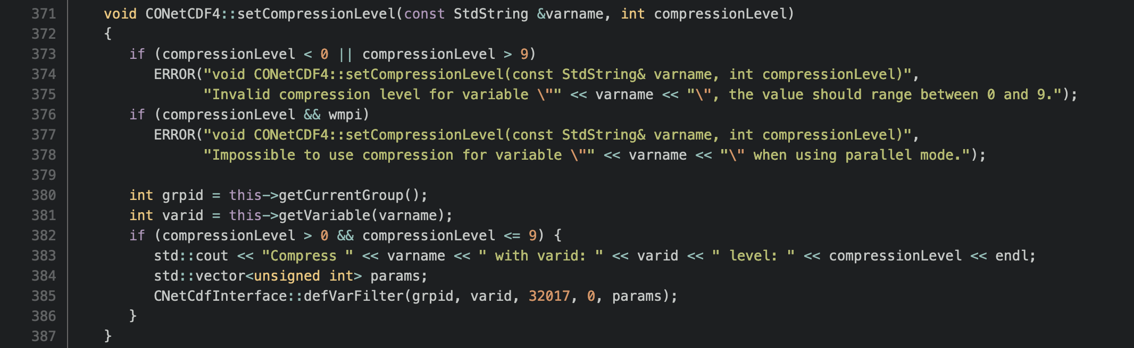
□ Code modification when the XIOS calls the SZ filter
XIOS Modification and Compression Implementation
The XIOS calls the setCompressionLevel for all variables by default.
Compression level 0 means no compression applied to the variable
The SZ filter is applied on certain variables

Slide 6
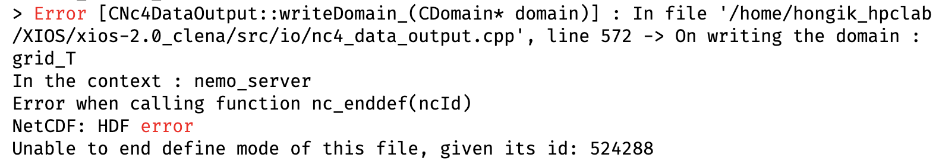
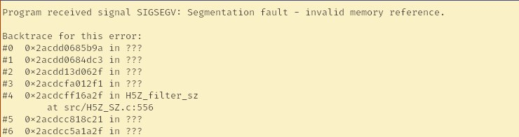
□ Result of modification and registering the HDF5 plugin
XIOS Modification and Compression Implementation
Before modification
After modification

Slide 7
Summary of experiments using several SZ versions
XIOS Modification and Compression Implementation
One of reason the segmentation fault occurred may related with SZ versions.
SZ+H5Z-SZ | Mode | Result
Master | Attach | Segmentation Fault
 | Detach | Segmentation Fault
V2.1.0 | - | Failed to compile (version too old)
V2.1.8 | Attach | Segmentation Fault
 | Detach | Segmentation Fault

Slide 8
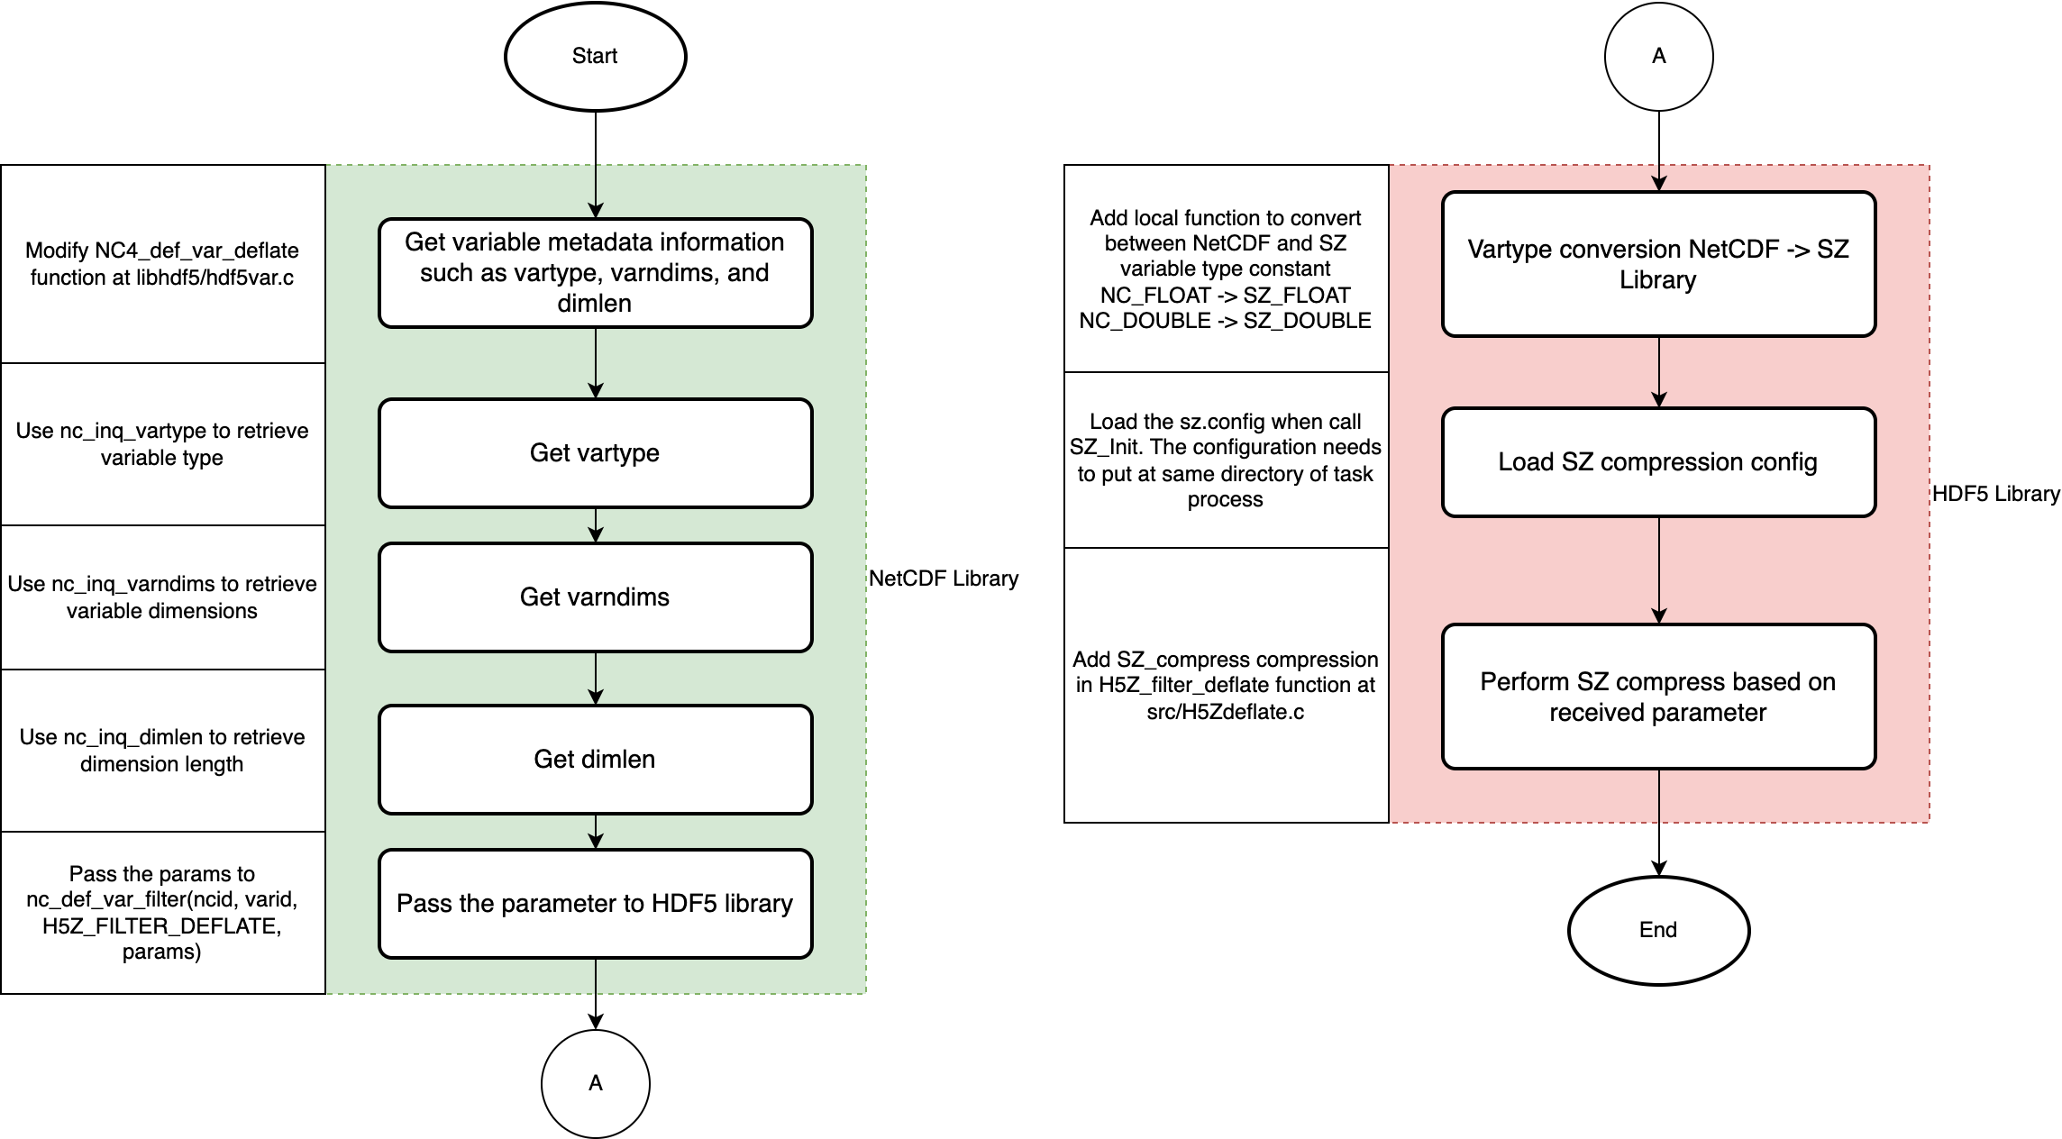
Alternative approach: Flowchart to modify NetCDF and HDF5 Library to implement SZ compression
XIOS Modification and Compression Implementation

Slide 9
Progress integration of the SZ compression by modifying netCDF4+HDF5
XIOS Modification and Compression Implementation
SZ compression needs to load `sz.config` in the same directory as the program that uses the SZ API → Done
Link `sz.config` to the same directory as the model program (ocean.exe)
Code modification in netCDF4: → Done
Modify NC4_def_var_deflate function at libhdf5/hdf5var.c
Use nc_inq_vartype to retrieve variable type
Use nc_inq_varndims to retrieve variable dimensions
Use nc_inq_dimlen to retrieve dimensions length
Pass the params to nc_def_var_filter(ncid, varid, H5Z_FILTER_DEFLATE, 8, params)
Code modification in HDF5: → Done
Add local function to convert between netCDF4 and SZ variable type constants
Load sz.config from SZ_Init function
Add compress/uncompress in H5Z_filter_deflate function at src/H5Zdeflate.c when using the max deflate level
However, there is an nc_close issue when running the modified code in XIOS.

Slide 10
NetCDF library Code Modification at libhdf5/hdf5var.c
XIOS Modification and Compression Implementation
int
NC4_def_var_deflate(int ncid, int varid, int shuffle, int deflate,
int deflate_level)
{
int stat;
unsigned int level = (unsigned int)deflate_level;
/* Set shuffle first */
if ((stat = nc_def_var_extra(ncid, varid, &shuffle, NULL, NULL, NULL,
NULL, NULL, NULL, NULL, NULL, NULL, NULL)))
return stat;
// Code Modification is required
/* Don't turn on deflate if deflate_level = 0. It's a valid zlib
* setting, but results in a write slowdown, and a file that is
* larger than the uncompressed file would be. So when
* deflate_level is 0, don't use compression. */
if (deflate && deflate_level)
if ((stat = nc_def_var_filter(ncid, varid, H5Z_FILTER_DEFLATE, 1, &level)))
return stat;
return NC_NOERR;
}
Retrieves metadata variables using ncid and varid
Pass the required parameters to HDF5 library via nc_def_var_filter function

Slide 11
HDF5 library Code Modification at src/H5Zdeflate.c
XIOS Modification and Compression Implementation
/*-------------------------------------------------------------------------
* Function: H5Z__filter_deflate
*
* Purpose: Implement an I/O filter around the 'deflate' algorithm in
* libz
*
* Return: Success: Size of buffer filtered
* Failure: 0
*
*-------------------------------------------------------------------------
*/
static size_t
H5Z__filter_deflate(unsigned flags, size_t cd_nelmts, const unsigned cd_values[], size_t nbytes,
size_t *buf_size, void **buf)
{
// NetCDF - SZ vartype conversion
// Load SZ configuration
if (flags & H5Z_FLAG_REVERSE) {
// Call the SZ_decompress function
} else {
// Call the SZ_compress function
}
}

Slide 12
Retrieve netCDF4 metadata at libhdf5/hdf5var.c
XIOS Modification and Compression Implementation
int
NC4_def_var_deflate(int ncid, int varid, int shuffle, int deflate, int deflate_level)
{
// variable declarations
if (deflate && deflate_level)
if (deflate_level == NC_MAX_DEFLATE_LEVEL) {
// Get information about vartype
if ((stat = nc_inq_vartype(ncid, varid, &vartype))) {
printf("Error getting variable type: %s\n", nc_strerror(stat));
return stat;
}
// Get information about variable’s number of dimensions
if ((stat = nc_inq_varndims(ncid, varid, &ndims))) {
printf("Error getting variable ndims: %s\n", nc_strerror(stat));
return stat;
}
if ((stat = nc_inq_vardimid(ncid, varid, dimids))) {
printf("Error getting variable dimension ids: %s\n", nc_strerror(stat));
return stat;
}
} else {
}
}

Slide 13
Retrieve netCDF4 metadata at libhdf5/hdf5var.c
XIOS Modification and Compression Implementation
int
NC4_def_var_deflate(int ncid, int varid, int shuffle, int deflate, int deflate_level)
{
// variable declarations
if (deflate && deflate_level)
for(int i = 0; i < MAX_DIMS; i++) {
if (i < ndims) {
// Get the length of the dimension
nc_inq_dimlen(ncid, dimids[i], &dimlen);
printf("Dimension %d has length %lu\n", dimids[i], dimlen);
dimids[i] = dimlen;
} else {
dimids[i] = 0;
}
}
} else {
}
return NC_NOERR;
}

Slide 14
Send parameters at libhdf5/hdf5var.c
XIOS Modification and Compression Implementation
int
NC4_def_var_deflate(int ncid, int varid, int shuffle, int deflate,
int deflate_level)
{
// variable declarations
if (deflate && deflate_level)
unsigned int params[8];
params[0] = level;
params[1] = vartype;
params[2] = ndims;
params[3] = dimids[4];
params[4] = dimids[3];
params[5] = dimids[2];
params[6] = dimids[1];
params[7] = dimids[0];
if ((stat = nc_def_var_filter(ncid, varid, H5Z_FILTER_DEFLATE, 8, params)))
return stat;
} else {
if ((stat = nc_def_var_filter(ncid, varid, H5Z_FILTER_DEFLATE, 1, &level)))
return stat;
}
return NC_NOERR;
}

Slide 15
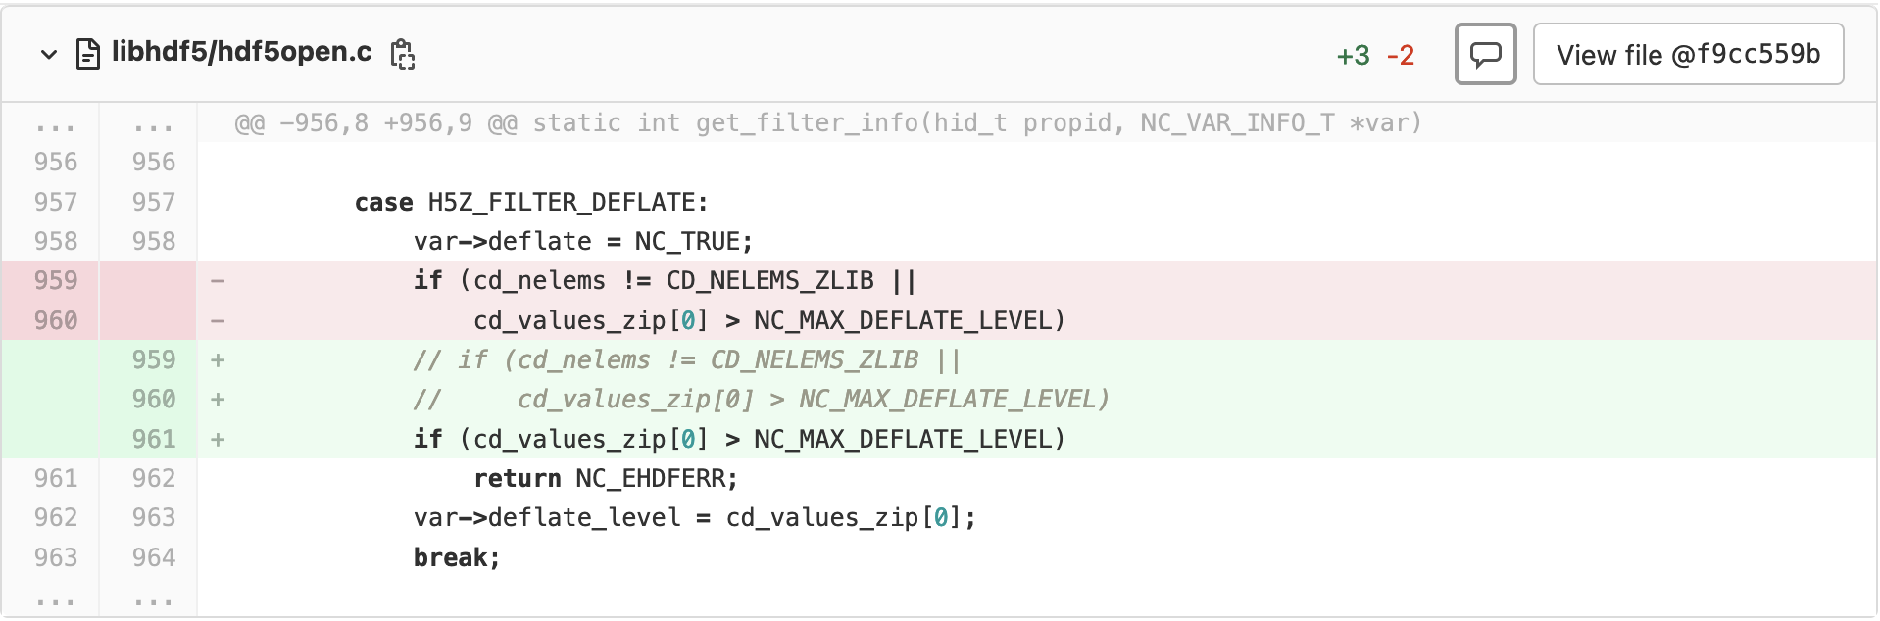
Additional modification at libhdf5/hdf5open.c in netCDF4 library
XIOS Modification and Compression Implementation

Slide 16
Add local function at src/H5Zdeflate.c
XIOS Modification and Compression Implementation
static int nc2sztype(int vartype)
{
switch (vartype) {
case 1: return SZ_INT8;
case 2: return SZ_INT8;
case 3: return SZ_INT16;
case 4: return SZ_INT32;
case 5: return SZ_FLOAT; // NC_FLOAT -> SZ_FLOAT
case 6: return SZ_DOUBLE; // NC_DOUBLE -> SZ_DOUBLE
case 7: return SZ_UINT8;
case 8: return SZ_UINT16;
case 9: return SZ_UINT32;
case 10: return SZ_INT64;
case 11: return SZ_UINT64;
default: return -1;
}
}

Slide 17
Call vartype conversion and load SZ_Init at src/H5Zdeflate.c
XIOS Modification and Compression Implementation
static size_t
H5Z_filter_deflate (unsigned flags, size_t cd_nelmts,
const unsigned cd_values[], size_t nbytes,
size_t *buf_size, void **buf)
{
if (cd_nelmts != 1) {
int vartype = nc2sztype(cd_values[1]); // call local function to convert NC -> SZ constants
size_t _r[5];
filterDimension(cd_values[3],cd_values[4],cd_values[5],cd_values[6],cd_values[7],_r);
size_t r5 = _r[4],
r4 = _r[3],
r3 = _r[2],
r2 = _r[1],
r1 = _r[0];
SZ_Init(cfgFile);
printf("flags: %d H5Z_FLAG_REVERSE: %d\n", flags, H5Z_FLAG_REVERSE);
if (flags & H5Z_FLAG_REVERSE) {
// decompress
} else {
// compression
}
}
}

Slide 18
Add SZ decompression at src/H5Zdeflate.c
XIOS Modification and Compression Implementation
static size_t
H5Z_filter_deflate (unsigned flags, size_t cd_nelmts, const unsigned cd_values[], size_t nbytes,
size_t *buf_size, void **buf)
{
if (cd_nelmts != 1) {
if (flags & H5Z_FLAG_REVERSE) {
// decompress
size_t nbEle = computeDataLength(r5, r4, r3, r2, r1);
if (vartype == SZ_FLOAT) {
float *data = SZ_decompress(vartype, *buf, nbytes, r5, r4, r3, r2, r1);
printf("Decompress SZ_FLOAT\n");
free(*buf);
*buf = data;
*buf_size = nbEle*sizeof(float);
} else if (vartype == SZ_DOUBLE) {
double *data = SZ_decompress(vartype, *buf, nbytes, r5, r4, r3, r2, r1);
printf("Decompress SZ_DOUBLE\n");
free(*buf);
*buf = data;
*buf_size = nbEle*sizeof(double);
} else {
printf("Decompression error: unknown data type: %d\n", vartype);
}
} else {
// compression
}
}
}

Slide 19
Add SZ compression at src/H5Zdeflate.c
XIOS Modification and Compression Implementation
static size_t
H5Z_filter_deflate (unsigned flags, size_t cd_nelmts, const unsigned cd_values[], size_t nbytes,
size_t *buf_size, void **buf)
{
if (cd_nelmts != 1) {
if (flags & H5Z_FLAG_REVERSE) {
// decompress
} else {
// compression
size_t outSize = 0;
if (vartype == SZ_FLOAT) {
float *data = (float*)(*buf);
unsigned char *bytes = NULL;
bytes = SZ_compress(vartype, data, &outSize, r5, r4, r3, r2, r1);
free(*buf);
*buf = bytes;
*buf_size = outSize;
} else if (vartype == SZ_DOUBLE) {
// compress vartype of double
} else {
printf("Compression error: unknown data type: %d\n", vartype);
exit(0);
}
}
}
}

Slide 20
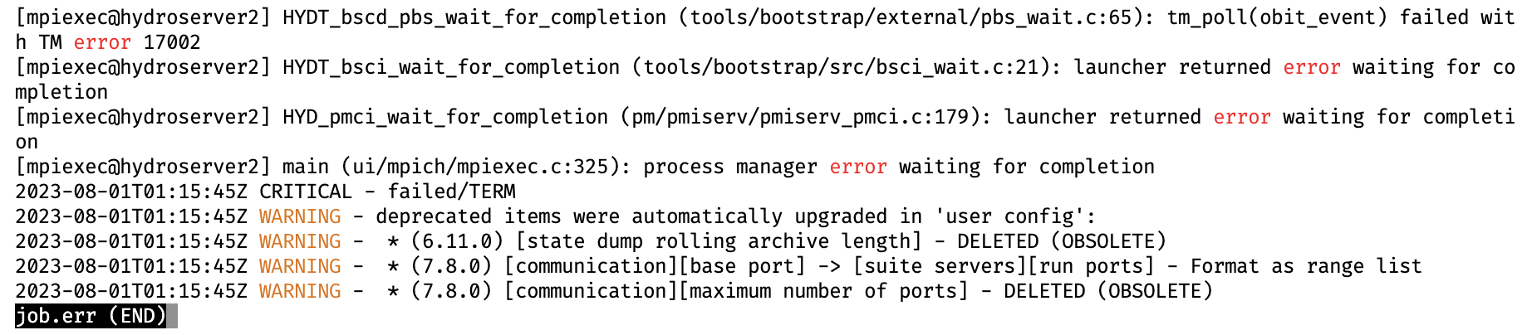
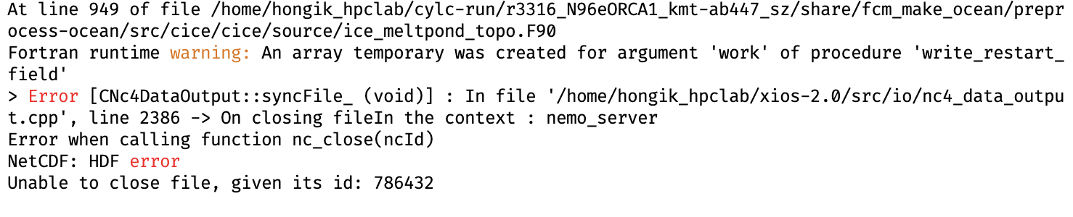
Experiments Results
XIOS Modification and Compression Implementation
Experiment in XIOS detach mode, NEMO_NPROCX=4, NEMO_NPROCY=2
Result: The experiments run indefinitely
Experiment in XIOS attach mode, NEMO_NPROCX=4, NEMO_NPROCY=2
Result: There is issue in nc_close function

Slide 21
Testing using Toy Program with single variable nc file.
XIOS Modification and Compression Implementation
#include <netcdf.h>
#include <stdio.h>
#include <stdlib.h>
#include <sz.h>
#define FILE_NAME "example.nc"
#define NEW_FILE_NAME "example_deflate.nc"
#define VAR_NAME "temperature"
#define DIM1 1000
#define DIM2 1000
int main(void) {
int ncid, new_ncid, varid, new_varid, status;
int dimids[2];
size_t start[2] = {0, 0};
size_t count[2] = {DIM1, DIM2};
// …
if ((status = nc_def_var_deflate(new_ncid, new_varid, true, true, 9))) {
printf("Error setting deflate: %s\n", nc_strerror(status));
return 1;
}
// …
return 0;
}

Slide 22
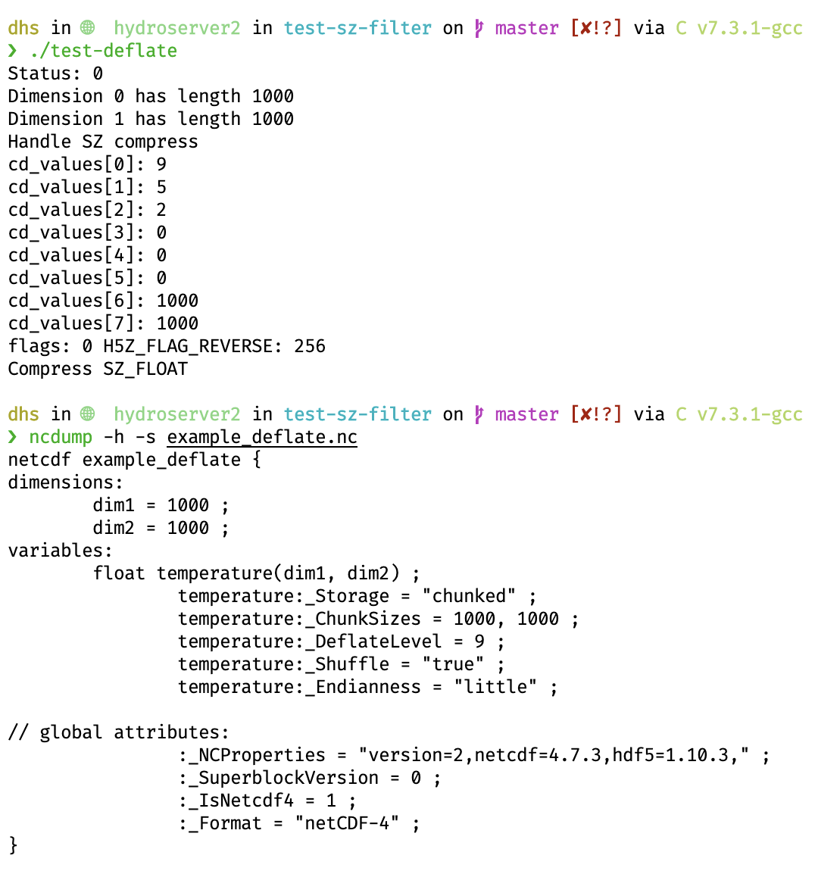
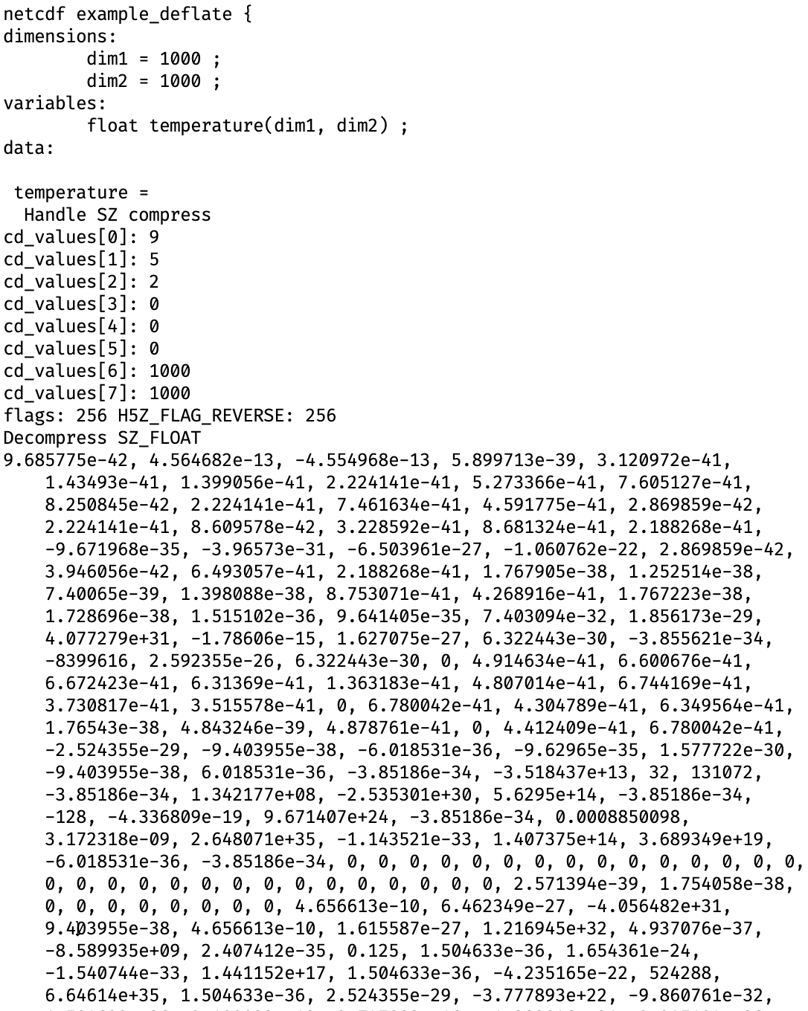
No issues for SZ Compression in Toy Program, but the modification have issues in XIOS because of the parallel environment, HDF5 API or multiple variables factor.
XIOS Modification and Compression Implementation
run test program deflate to perform SZ compression
Open nc file using ncdump will call the decompress when there is deflate metadata.
_DeflateLevel 9 indicate the SZ compression in the nc file

Slide 23
Conclusion
XIOS Modification and Compression Implementation
The H5Z-SZ filter has been registered and integrated into the XIOS. However, there is a segmentation fault issue.
An alternative approach is considered to perform SZ compression by modifying the netCDF4 and HDF5 libraries.
The experiment is successful in toy program with single variable. However, there is an nc_close function issue in XIOS.
The issue in XIOS may be related to the parallel environment, HDF5 API or multiple variables of nc file.

Slide 24
감사합니다
Thank you

