Slide 1

Codesign for Extreme Heterogeneity: Integrating Custom Hardware With Commodity Computing Technology to Support Next-Generation HPC Converged Workloads
James A. Ang et. al, Pacific Northwest National Laboratory
Presented by: Dian Hanifudin Subhi

Slide 2
Outline
Motivation
Codesign The Future HPC Systems
Challenges
Conclusion

Slide 3

Motivation
Next-generation converged workloads require diverse hardware resources to function efficiently
Traditional approaches to designing HPC systems are no longer sufficient in meeting the demands of modern workloads
Codesign approaches that integrate custom hardware with commodity computing technology are becoming increasingly important to meet the performance requirements of diverse workloads
HPC systems must be able to handle extreme levels of heterogeneity, incorporating custom hardware alongside commodity computing technology

Slide 4
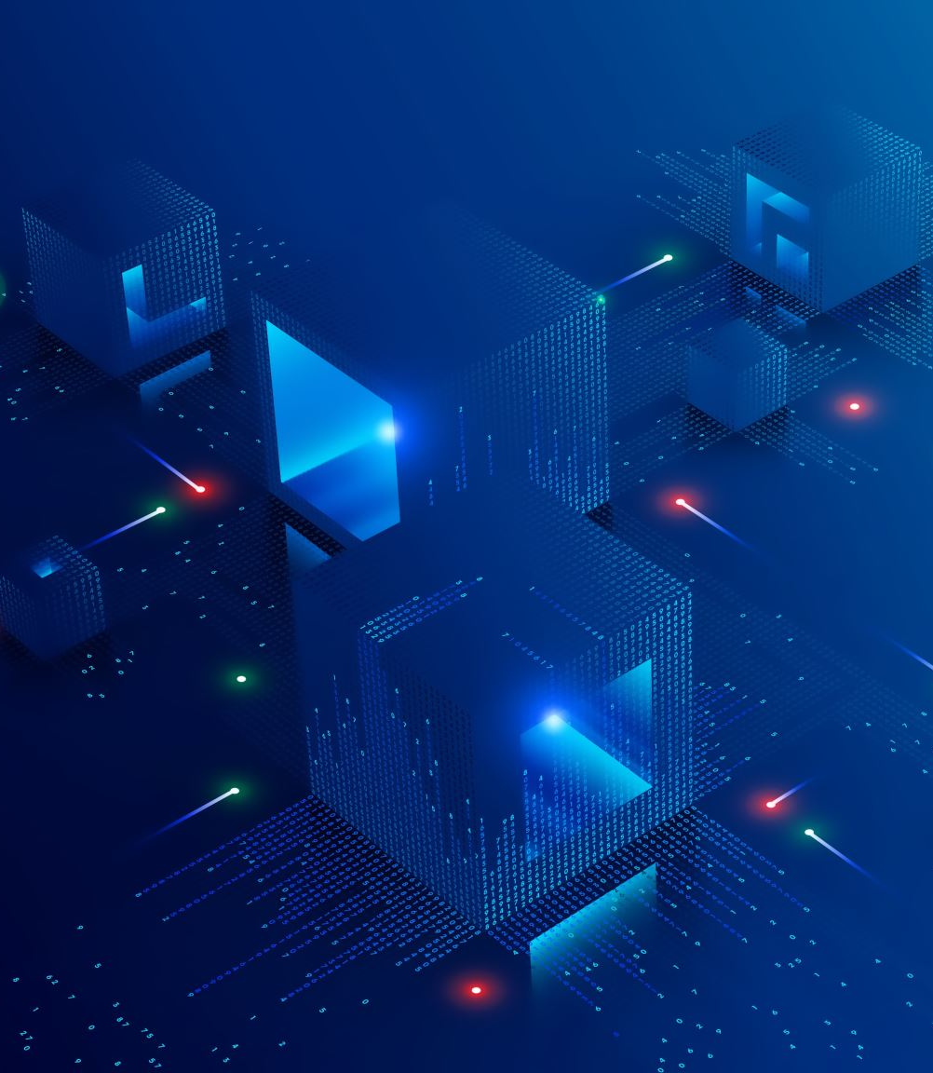
Codesign The Future HPC Systems
Data Model Convergence (DMC)
Converged Applications
Heterogeneous Computing

Slide 5
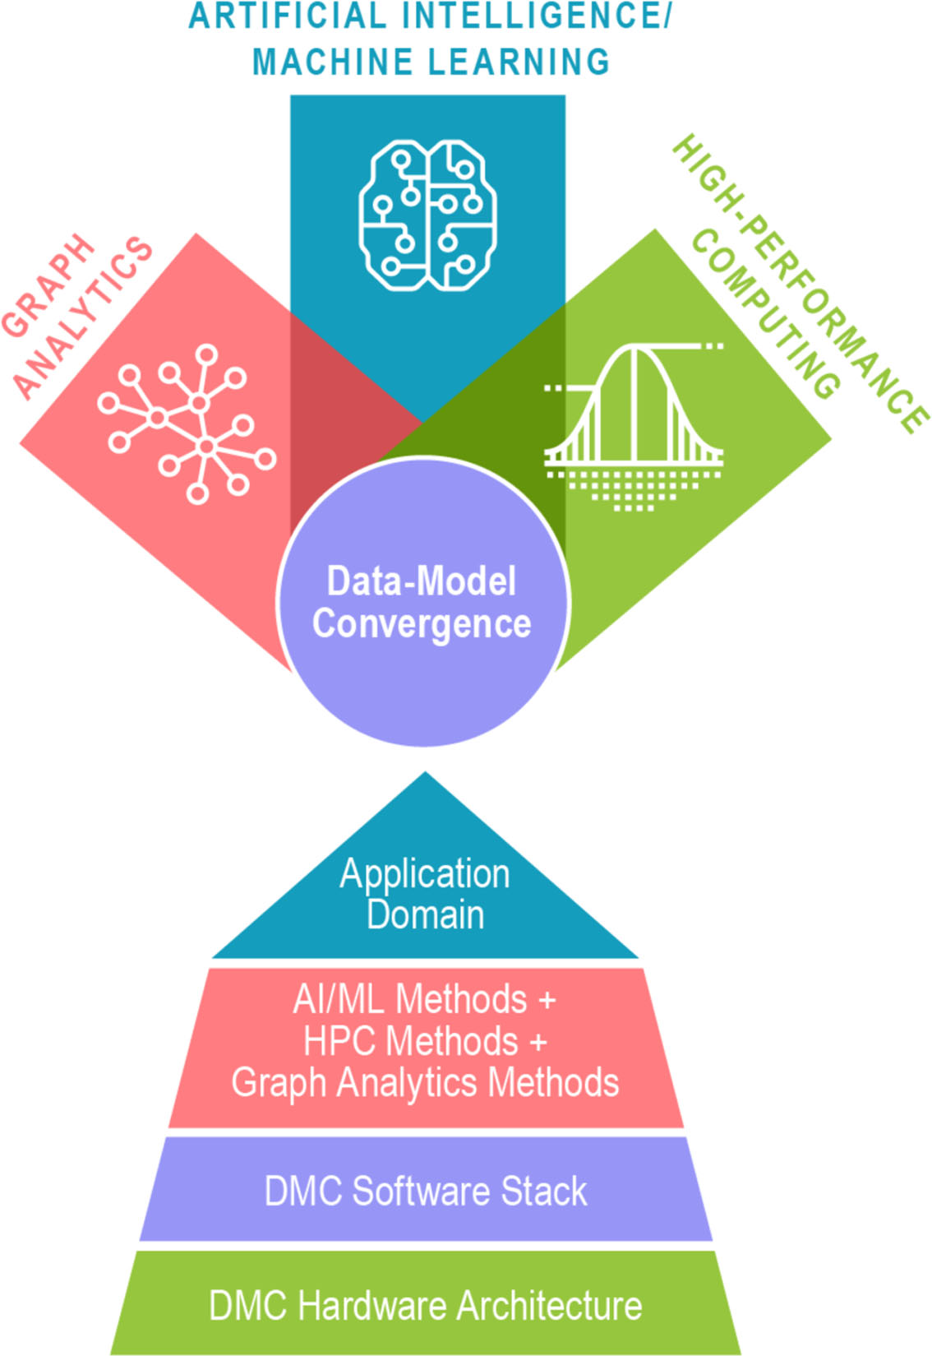
Data Model Convergence (DMC)
Process of integrating data models or data structure into a single, unified model.
Create unified view of data model from different sources or formats.
Organizations can gain accurate understanding of their data, leading to better decision making and improved business outcomes.

Slide 6
Converged Applications
Converged applications combine multiple workloads and require a heterogeneous computing environment.
DMC is developing technologies that support converged applications by integrating custom hardware with commodity computing technology and providing a seamless programming environment.
These technologies include compilers, runtime systems, and reconfigurable architectural models.
Converged applications offer improved performance and efficiency, reduced costs, and better handling of complex workloads

Slide 7
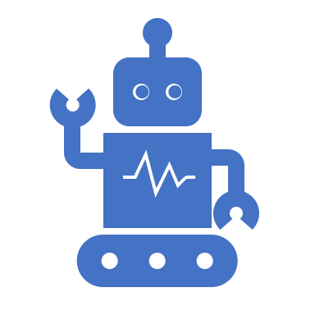
Converged Applications: Use cases
Embedding of domain knowledge in data-driven models
Accelerate solutions of simulated complex dyna- mic systems
Optimal decisions and control for dynamic systems are represented by scientific ML
Hybridized algorithms for multiagent decision systems with underlying graphical topology

Slide 8
Heterogeneous Computing
Heterogeneous computing utilizes different processing units for different tasks.
Combining processors in a heterogeneous system can provide better performance, energy efficiency, and cost-effectiveness.
Designing heterogeneous systems is challenging due to differences in hardware, programming models, and communication.
DMC is developing technologies to integrate custom architectures and provide a seamless programming environment.
The DMC Minos Computing Library (MCL) runtime manages resources, exploits data locality, and handles communication and dependencies among tasks.
Heterogeneous computing offers optimized performance for specific applications by tailoring the system to workloads.

Slide 9

Heterogeneous Computing Approach
DMC's codesign strategy for heterogeneous systems is based on
exploring tradeoffs and causal relationships in the early stages of system design
studying full converged applications and workflows
developing novel hardware concepts using an agile flow
supporting domain scientist usage of novel hardware accelerators.
DMC provides a holistic codesign environment for HPC, data analytics, and AI/ML converged applications at all levels of the hardware and software stack.

Slide 10
Compilers and Languages
Domain scientists prefer high-level, domain-specific languages.
DMC is developing a "write once, run everywhere" compiler called COMET (MLIR based).
MLIR (Multi-Level Intermediate Representation) which is a compiler infrastructure for building and optimizing machine learning models and other computational graphs.
COMET converts different language frontends (Python, COMET Domain Specific Language, Rust) to a unified IR (Intermediate Representation).
The unified IR is optimized and lowered to architecture-specific IRs (e.g., CPU, GPUs, FPGA, AI engines).

Slide 11
Runtime and system software
Runtime systems manage computation, data transfer, and command execution.
Some standards exist, but most do not meet DMC requirements for converged applications.
DMC is developing technologies to integrate custom architectures and provide a seamless programming environment.
The DMC Minos Computing Library (MCL) manages computing and memory resources, exploits data locality on heterogeneous devices, and handles communication and data/control dependencies among tasks.

Slide 12
Software-defined and reconfigurable architectures
Customized processors can be more efficient but require time and effort.
DMC is developing capabilities to produce architectural models from high-level software specifications.
DMC is also developing architectural models for coarse-grained reconfigurable architectures that can be reconfigured to suit application needs.
This approach can mitigate drawbacks of application-defined architectures such as wasted area and power.
OpenCGRA is an open-source framework for modeling, testing, and evaluating CGRAs (Coarse-Grained Reconfigurable Arrays).

Slide 13
Heterogeneous and Reconfigurable Testbeds
Testbed platforms are crucial for validating DMC's codesign approach and resulting software and hardware, enabling rapid prototyping of advanced architectural concepts and testing of design automation, synthesis, and compiler toolchains.
DMC's testbeds include heterogeneous reconfigurable hardware, making them ideal for system and application software targeting heterogeneous processing capabilities.
DMC benefits from PNNL's CENATE project, which evaluates early technologies and quantifies their potential on future system design using metrics of performance, power efficiency, and security.
The Junction cluster is a key platform for the development of DMC software and architecture concepts, featuring multicore AMD CPUs, AMD Instinct GPUs, Xilinx Versal ACAP accelerators, and two network interface cards.
The Junction cluster demonstrates compiler-level optimizations, high-level synthesis toolchains, and customized accelerator architectures developed using DMC's codesign approach.

Slide 14
Challenges
Design complexity due to the need to handle extreme levels of heterogeneity
Integration challenges due to differences in hardware architecture and programming models.
Power management difficulties when using different types of processors with varying power requirements.
Communication and data transfer issues due to differences In data formats and transfer rates.
Complex software development requiring specialized skill and knowledge.
Time-consuming and expensive testing and validation due to the complexity of the hardware and software components involved.

Slide 15
Conclusion
HPC systems are evolving to support extreme levels of heterogeneity for next-generation converged workloads.
Codesign approaches offer a promising avenue for future HPC system design, but challenges include design complexity, integration, power management, communication, software development, and testing.
Addressing these challenges requires specialized knowledge and collaboration between hardware and software designers.
The benefits of codesign approaches include improved performance and energy efficiency, reduced costs, and effective handling of diverse workloads.
Future research should focus on developing new programming models, frameworks, and tools to support codesign approaches and simplify implementation.

Slide 16
Questions?
Thanks

