Slide 1
XIOS Modification and
Compression Implementation

Slide 2
□ Files Related to netCDF Output
XIOS Modification and Compression Implementation
node/file.cpp: instantiate data output object and define the logic main flow.
data_output.{cpp,hpp}: Base class regarding to handle data output
io/onetcdf4.{cpp,hpp}: Responsibility of general output of netCDF capability (open, close, definition and initialize)
io/nc4_data_output.{cpp,hpp}: Class that have write responsibility of variable, attribute and also dimension.
io/netCdfInterface.cpp: C++ wrapper of netCDF C API function

Slide 3
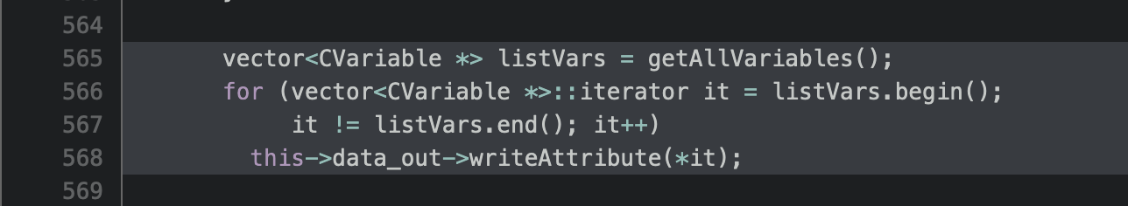
□ Current Issues of Modification Analysis
XIOS Modification and Compression Implementation
The SZ_compress function was never called on the previous modification.
SZ applied on writeAttribute_() function at io/nc4_data_output.cpp
The writeAttribute_() function depends on the size of variables from getAllVariables() as shown picture below.

Slide 4
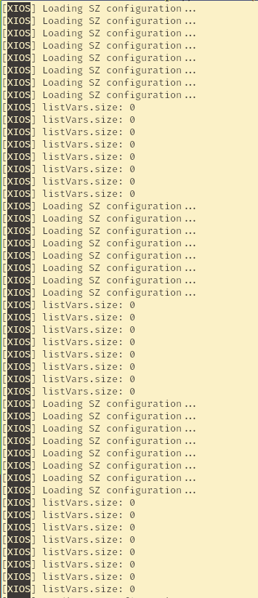
□ Current Issues of Modification Analysis
XIOS Modification and Compression Implementation
Based on logging, we can get information that size of listVars is 0.
It is necessary to move compression logic from writeAttribute_() function or find the information regarding variables modification.

Slide 5
□ Modification Candidate
XIOS Modification and Compression Implementation
XIOS supporting compressionLevel 0-9 (0 disables the compression, 9 is the higher compression).
The compression depends on nc_def_var_deflate netcdf function.
Study of the SZ compression compatibility with the nc_def_var_deflate approach is required.

Slide 6
□ Modification Candidate
XIOS Modification and Compression Implementation
Source code analysis related to compressing, the other candidate is writeFieldData_() function at io/nc4_data_output.cpp.
Implementation of compression from writeFieldData_() function, related to field.cpp class.
There is outputCompressedField() function at field.cpp.
Converting the outputCompressedField() using SZ_compress is required.

Slide 7
감사합니다
Thank you

