Slide 1
XIOS Modification and
Compression Implementation

Slide 2
□ Files Related to netCDF Output
XIOS Modification and Compression Implementation
node/file.cpp: instantiate data output object and define the logic main flow.
data_output.{cpp,hpp}: Base class regarding to handle data output
io/onetcdf4.{cpp,hpp}: Responsibility of general output of netCDF capability (open, close, definition and initialize)
io/nc4_data_output.{cpp,hpp}: Class that have write responsibility of variable, attribute and also dimension.
io/netCdfInterface.cpp: C++ wrapper of netCDF C API function

Slide 3
□ Troubleshooting
XIOS Modification and Compression Implementation
The indefinite running of the model caused by the SZ library is not detected by ocean.exe on hydroserver1
Scan the ocean.exe using ldd command, to ensure the libSZ is detected
Solution: Updating the ldconfig configuration then check using ldd command.

Slide 4
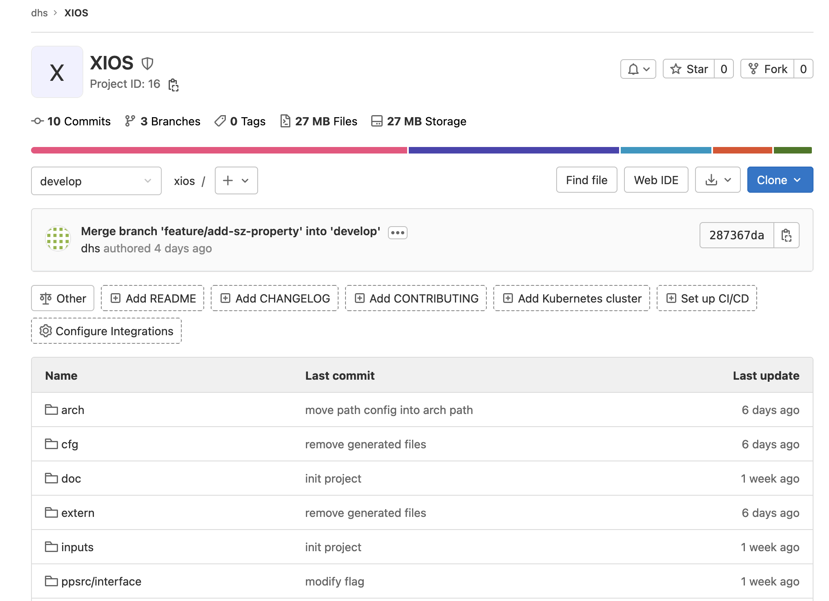
XIOS Modification for Applying SZ Compression
□ Implementation Progress::XIOS Repository
The previous repository is large, slow when navigate into directory
Create new git repository at HPCLab GitLab dhs/xios. It can be added later using git submodule into the previous repository.
Remove/Ignore compiled files or generated files (reduce sized and faster clone/backup

Slide 5
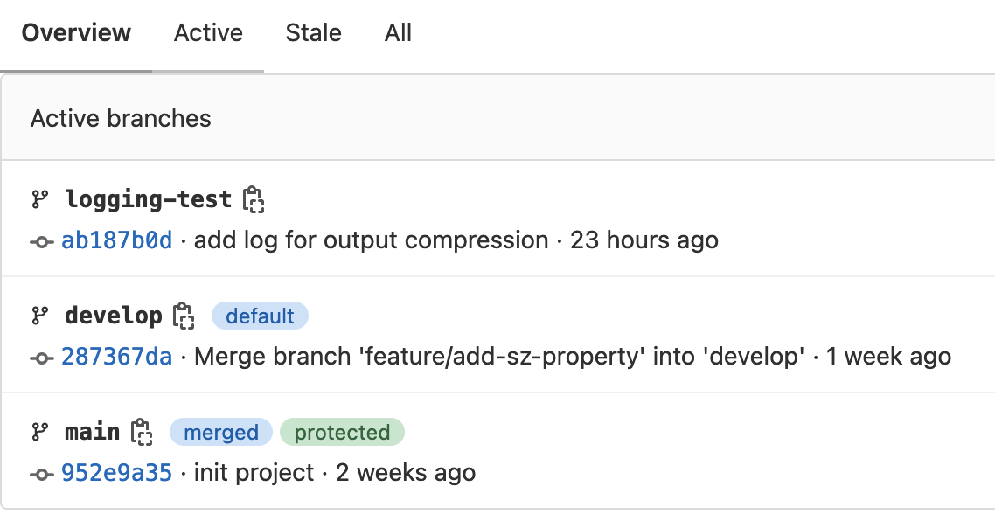
XIOS Modification for Applying SZ Compression
□ Implementation Progress::Branches
Development follow Git branching methodology
main: store main XIOS code (before modification)
develop: development version of XIOS (modified)
feature-branch: feature specific development version.
feature-branch will be merged when the feature is mature.
Branches can help to avoid bugs and easy to switch to a working version.

Slide 6
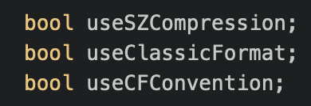
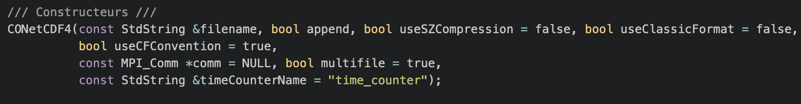
XIOS Modification for Applying SZ Compression
□ Modification::src/io/nc4_data_output.{cpp,hpp} and src/io/onetcdf4.{cpp.hpp}
Add useSZCompression property in onetcdf4.{cpp,hpp} and nc4_data_output.{cpp,hpp}
Modify the constructor to enable/disable SZ compression

Slide 7
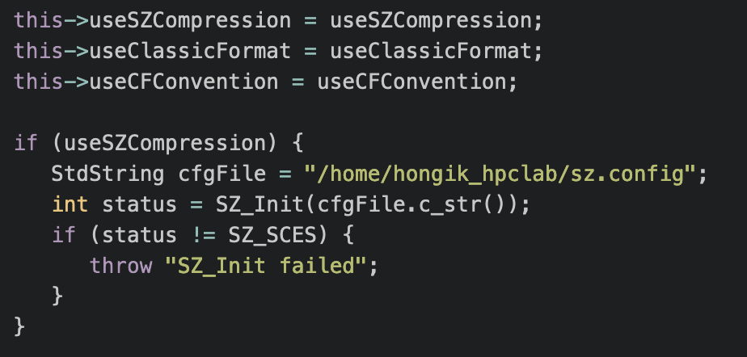
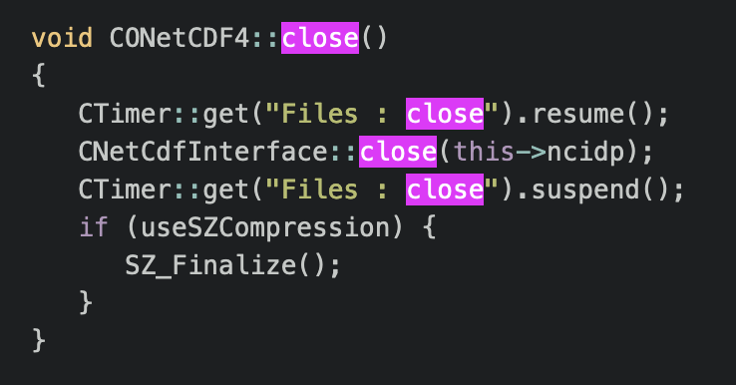
XIOS Modification for Applying SZ Compression
□ Modification::src/io/onetcdf4.cpp
Call SZ_Init if useSZCompression is enabled on initialize() function
Add SZ_Finalize() when close the file

Slide 8
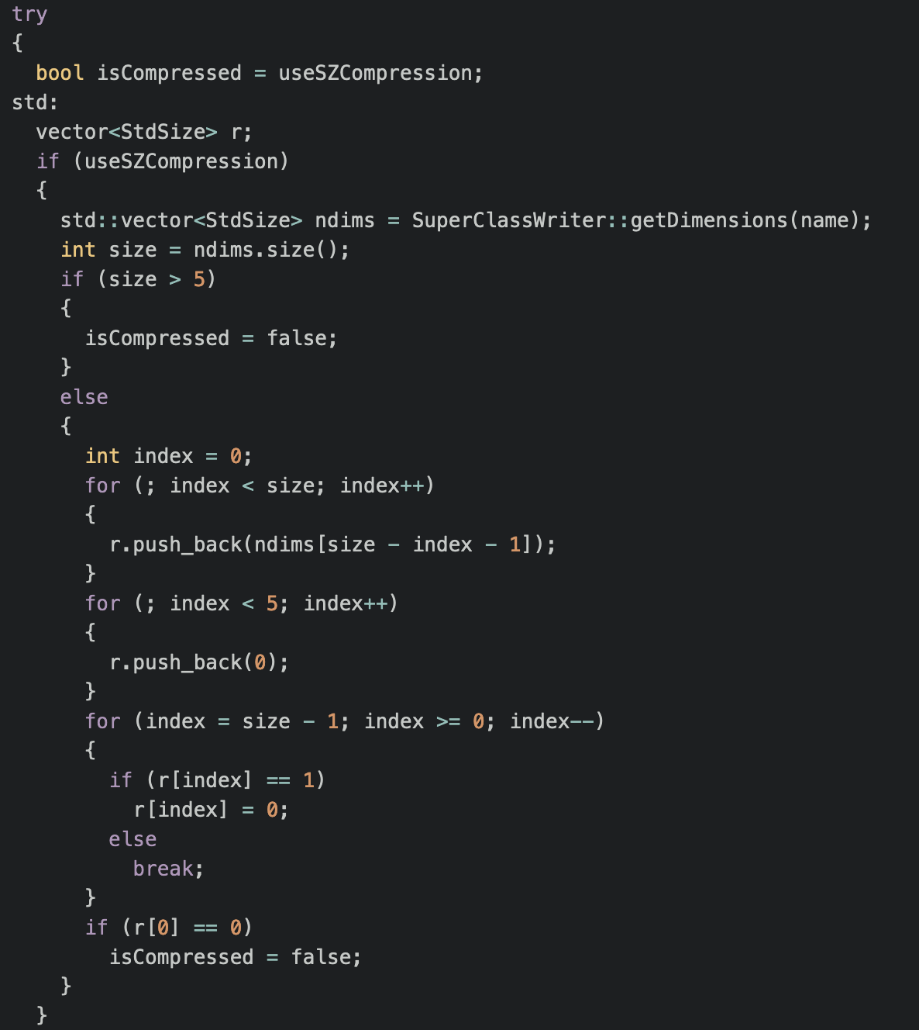
XIOS Modification for Applying SZ Compression
□ Modification::src/io/nc4_data_output.cpp
Calculate dimension and normalize
Set into 0 for the remaining dimension
Check if compression is supported for given dimension

Slide 9
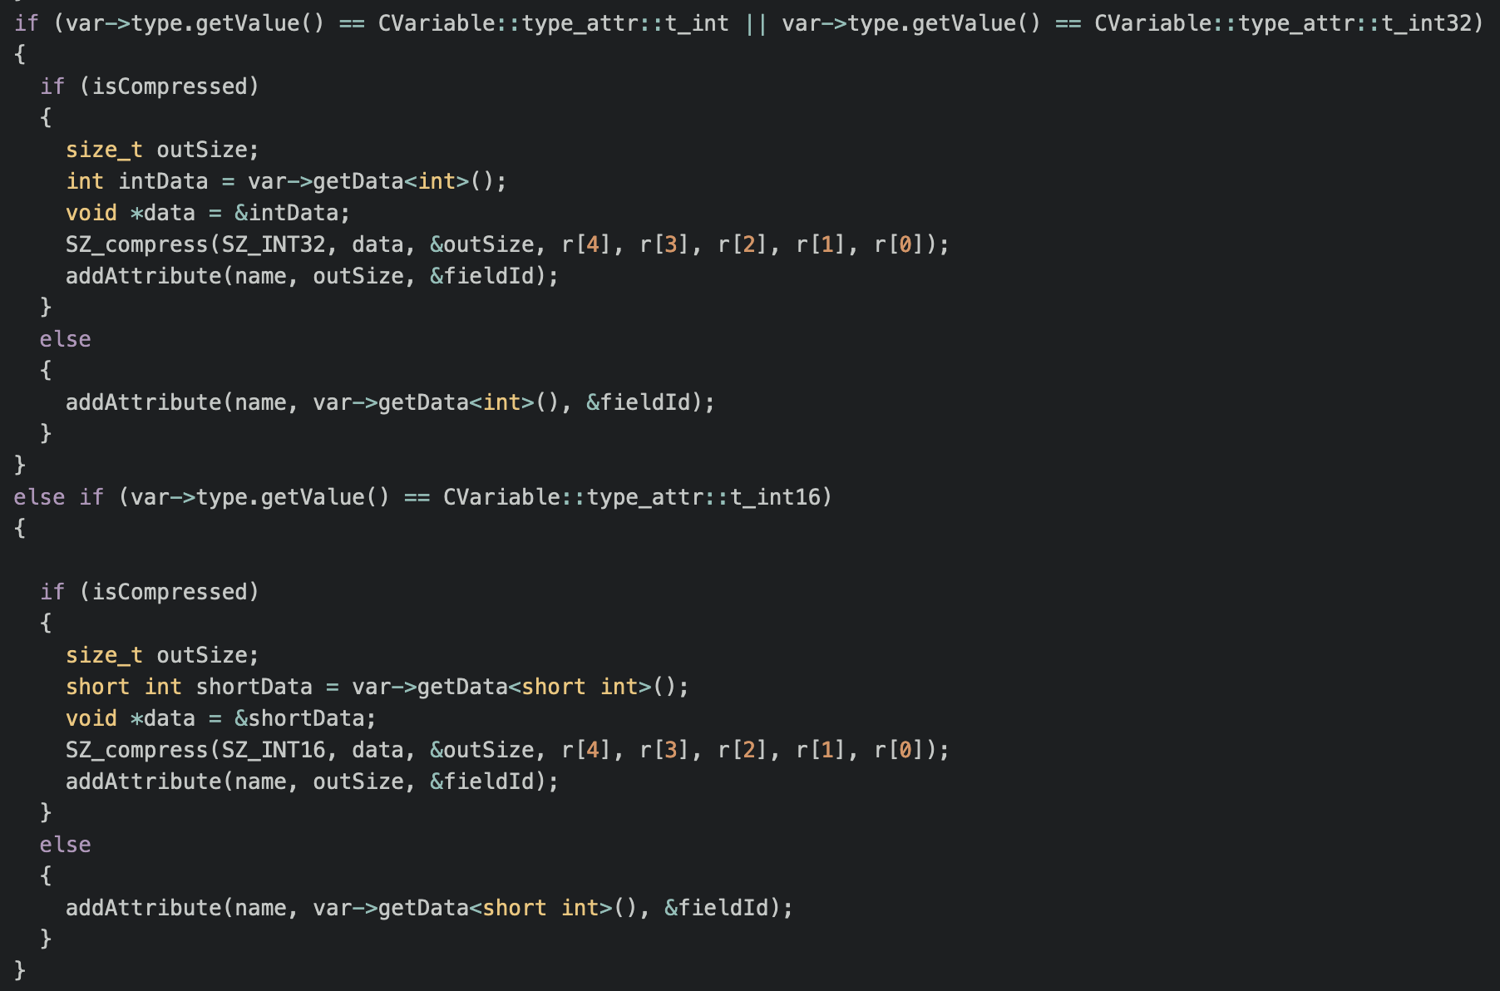
XIOS Modification for Applying SZ Compression
□ Modification

Slide 10
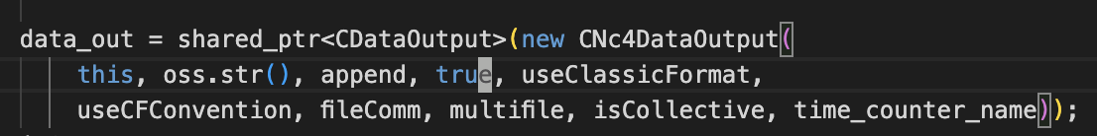
XIOS Modification for Applying SZ Compression
□ Modification::src/node/file.cpp
Enable SZ compression by passing true parameter when instantiate CNc4DataOutput object.

Slide 11
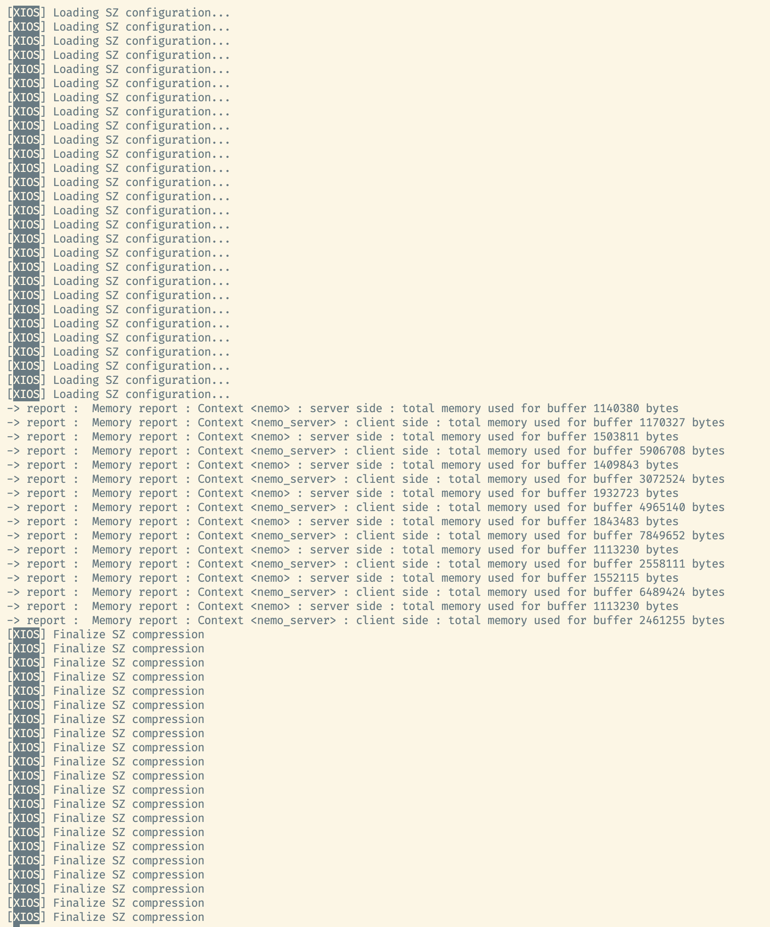
XIOS Modification for Applying SZ Compression
□ Conclusion & Result Log
The issue related to indefinite running has been solved.
The SZ compress process in previous modification never called
The log of result only trace initialization and finalization of SZ

Slide 12
XIOS Modification for Applying SZ Compression
□ Conclusion
The issue related to indefinitely running has been solved.
The SZ_compress function never called, only initialization and finalization of SZ.

Slide 13
감사합니다
Thank you

