Slide 1
XIOS Modification and
Compression Implementation

Slide 2
□ Files Related to netCDF Output
XIOS Modification and Compression Implementation
node/file.cpp: instantiate data output object and define the logic main flow.
data_output.{cpp,hpp}: Base class regarding to handle data output
io/onetcdf4.{cpp,hpp}: Responsibility of general output of netCDF capability (open, close, definition and initialize)
io/nc4_data_output.{cpp,hpp}: Class that have write responsibility of variable, attribute and also dimension.
io/netCdfInterface.cpp: C++ wrapper of netCDF C API function

Slide 3
□ Troubleshooting
XIOS Modification and Compression Implementation
The indefinite running of the model caused by the SZ library is not detected by ocean.exe on hydroserver1
Scan the ocean.exe using ldd command, to ensure the libSZ is detected
Solution: Updating the ldconfig configuration then check using ldd command.

Slide 4
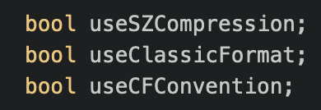
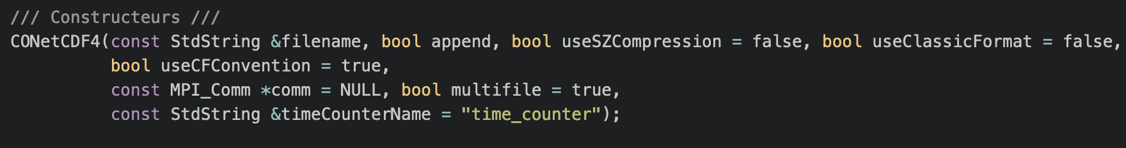
XIOS Modification for Applying SZ Compression
□ Modification::src/io/nc4_data_output.{cpp,hpp} and src/io/onetcdf4.{cpp.hpp}
Add useSZCompression property in onetcdf4.{cpp,hpp} and nc4_data_output.{cpp,hpp}
Modify the constructor to enable/disable SZ compression

Slide 5
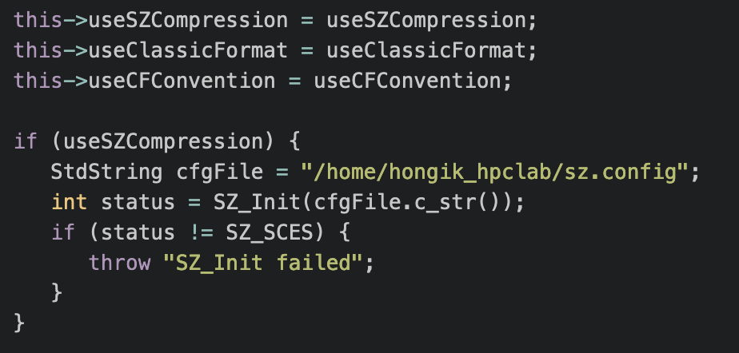
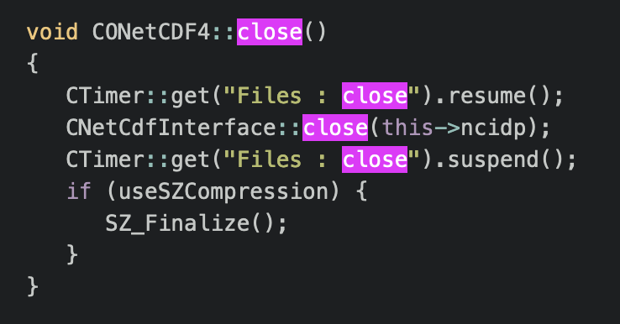
XIOS Modification for Applying SZ Compression
□ Modification::src/io/onetcdf4.cpp
Call SZ_Init if useSZCompression is enabled on initialize() function
Add SZ_Finalize() when close the file

Slide 6
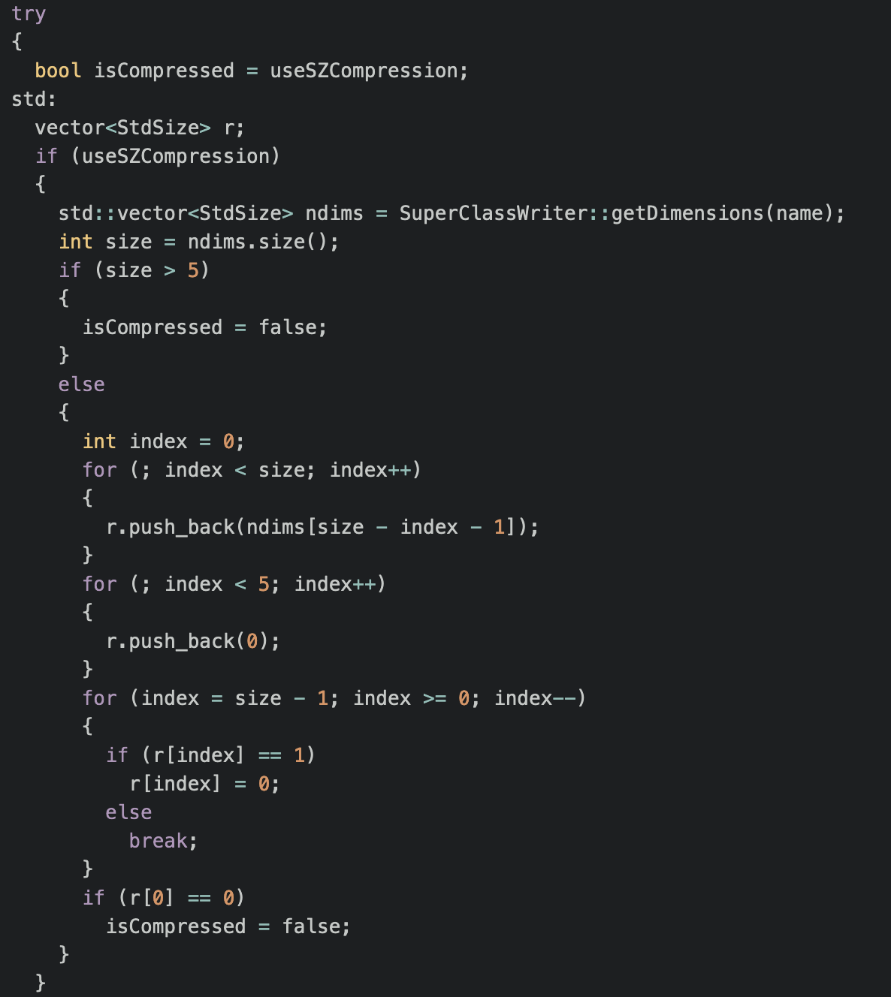
XIOS Modification for Applying SZ Compression
□ Modification::src/io/nc4_data_output.cpp
Calculate dimension and normalize
Set into 0 for the remaining dimension
Check if compression is supported for given dimension

Slide 7
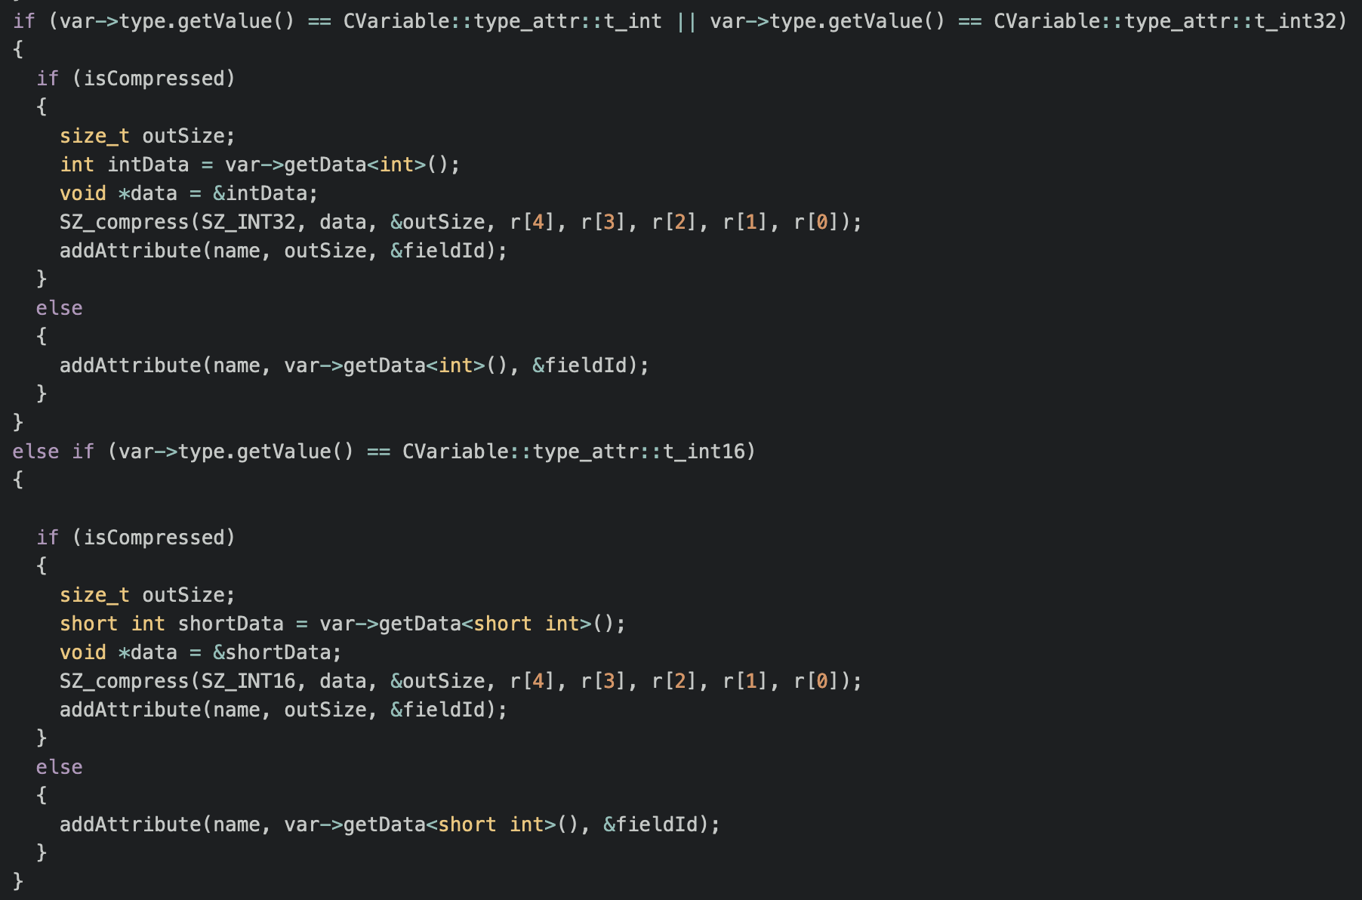
XIOS Modification for Applying SZ Compression
□ Modification

Slide 8
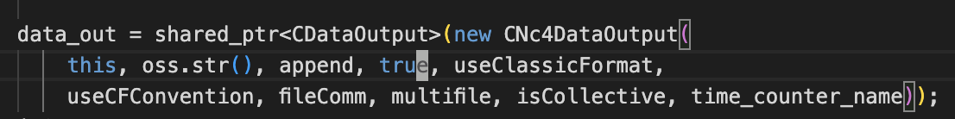
XIOS Modification for Applying SZ Compression
□ Modification::src/node/file.cpp
Enable SZ compression by passing true parameter when instantiate CNc4DataOutput object.

Slide 9
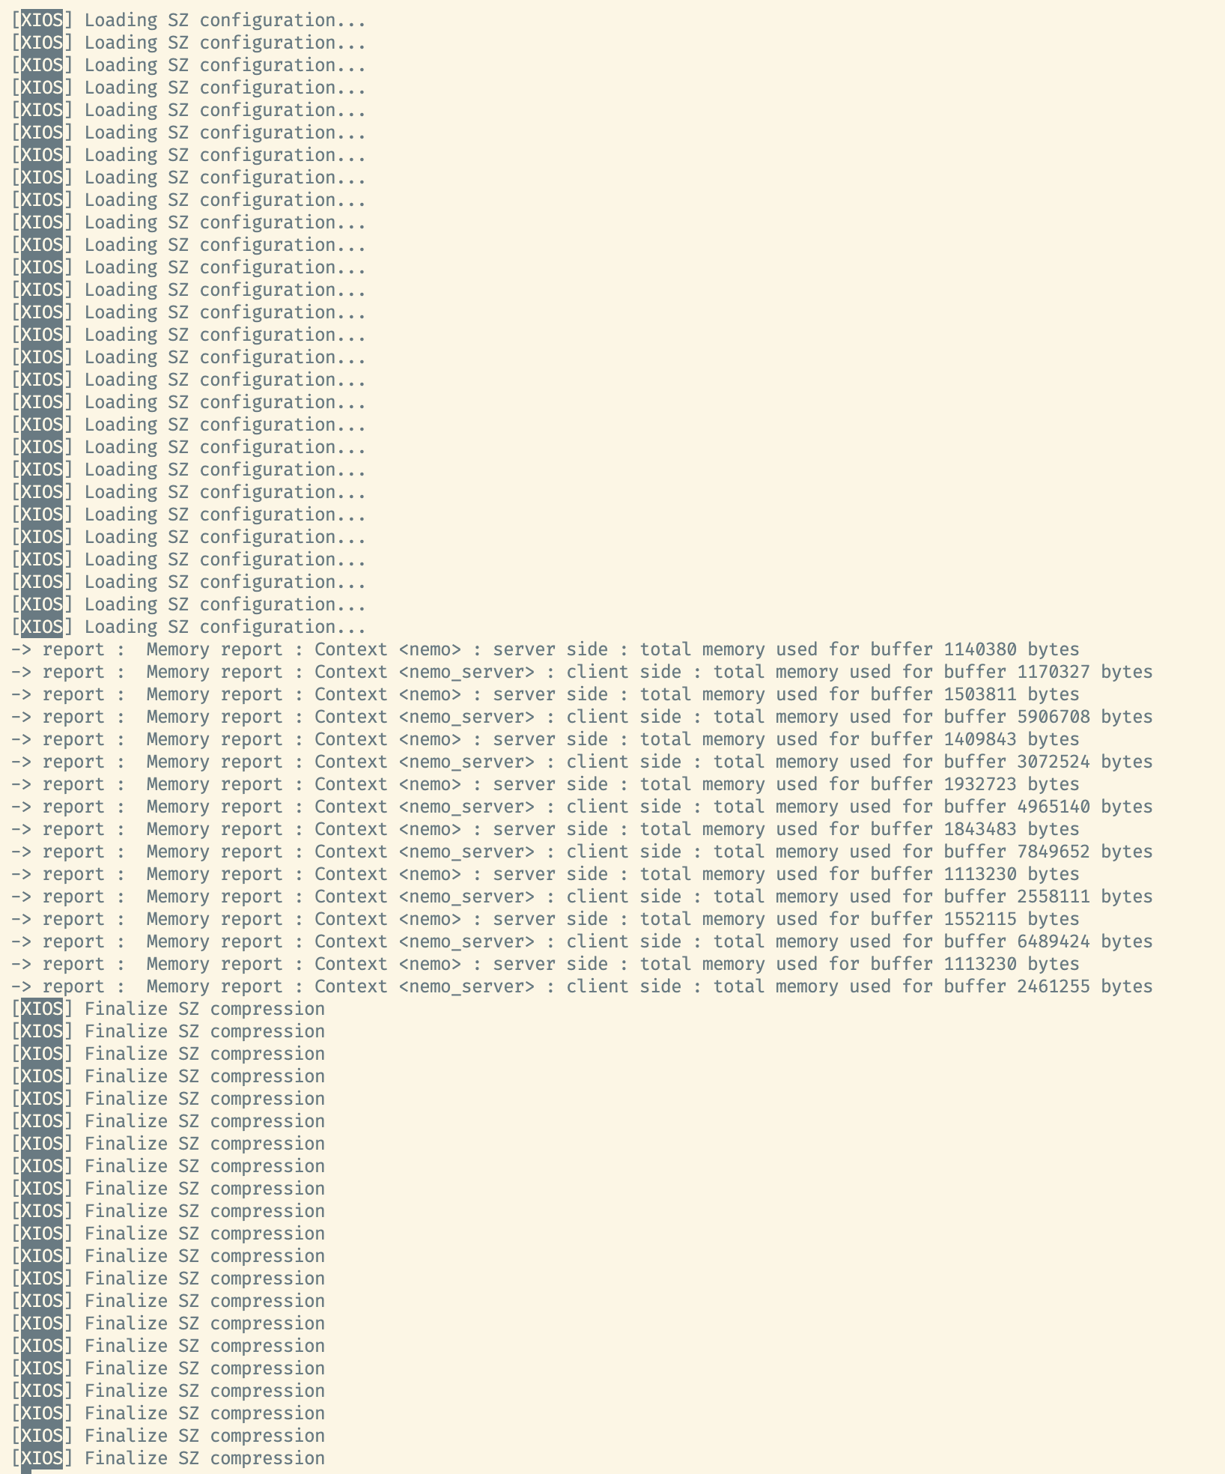
XIOS Modification for Applying SZ Compression
□ Conclusion & Result Log
The issue related to indefinite running has been solved.
The SZ compress process in previous modification never called
The log of result only trace initialization and finalization of SZ

Slide 10
감사합니다
Thank you

