Slide 1
OpenRAN NS-3 Visualization

Slide 2
Getting Visualization from ns-3
Tracing and packet traces
Gnuplot and Matplotliib
Flow Monitor
PyViz
NetAnim
Statistics
Data Collection Framework

Slide 3
Gnuplot and Matplotlib Capabilities
Plotting: support 2D and 3D plots, line, point, bar, histogram etc.
Customization: offers wide range of customizing plots, label, styles, colors, font and sizes.
Scripting: support automate the plotting process using script
Data manipulation: support for filtering, transforming and aggregating data
Output formats: PNG, PDF, EPS, SVG and LaTeX
Interactivity: supports interactivity features such as zooming, panning, and rotating

Slide 4
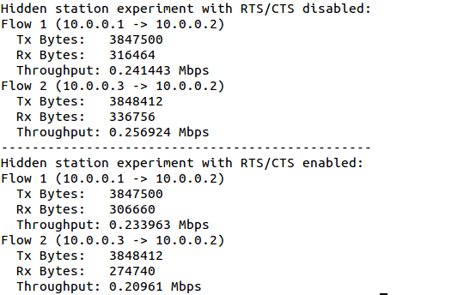
FlowMonitor
Detects all flows passing through network
Stores metrics for analysis such as bitrates, duration, delays, packet sizes, packet loss ratios
Visualization support can be performed using pyviz

Slide 5

PyViz
Live simulation visualizer
It can load trace files
Useful for debugging
Make sure PyViz is enabled in the build
Pass the ”--vis” option to enable visualization in command line

Slide 6
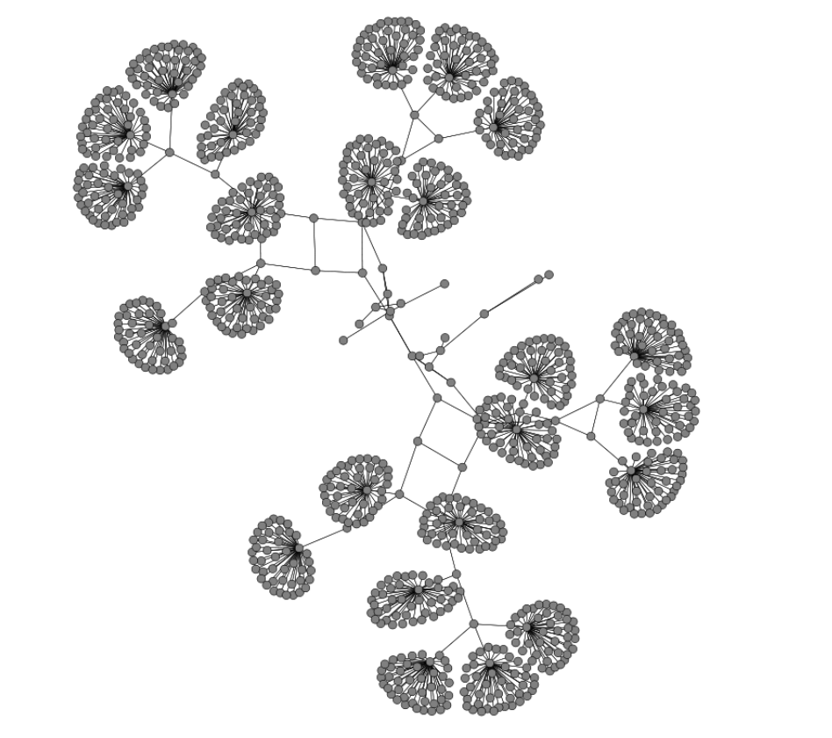
PyViz Visualization

Slide 7
NetAnim
Animate packets over wired and wireless
limited support for LTE traces
Node position statistics with node trajectory plotting
Print brief packet-meta data on packets

Slide 8
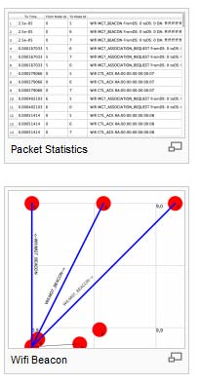
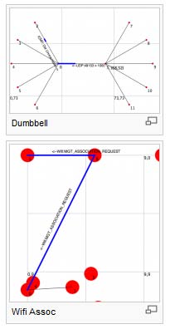
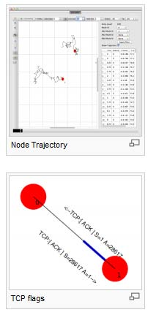
NetAnim

Slide 9
Summary of Capabilities
Capability | NetAnim | PyViz
Type | 2D and 3D | 2D only
Supported file | PCAP, NS-2 Trace, XML | PCAP, PCAPNG, NS-3 Trace, CSV
Node movement | Static, Linear, Random Waypoint, Random Walk, Gauss Markov Mobility, Group Mobility, External Trace | Static, Linear, Random Waypoint, Random Walk, Gauss Markov Mobility, Group Mobility, External Trace, Node Animation
Visualization | Node positions, Packet traces, Throughput, Packet loss, Signal Strength, Energy consumption, MAC header fields, IP header fields | Node positions, Packet traces, Throughput, Packet loss, Signal Strength, Energy consumption
Scripting | No | Yes, using Python
User Interface | GUI | CLI

