Slide 1
XIOS Modification and
Compression Flow for
Applying SZ Compression
Dian Hanifudin Subhi

Slide 2
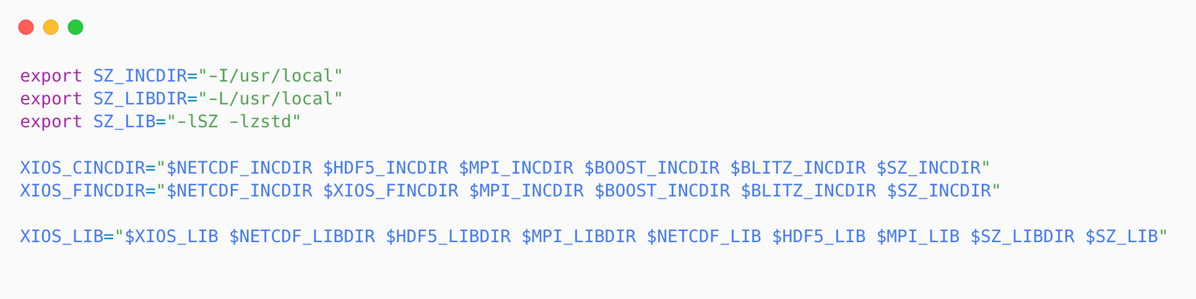
□ Integrate SZ into XIOS Project
XIOS Modification for Applying SZ Compression
Modify the make_xios script to include SZ library
Add include and linker related to SZ location path
Add flag for compiler options

Slide 3
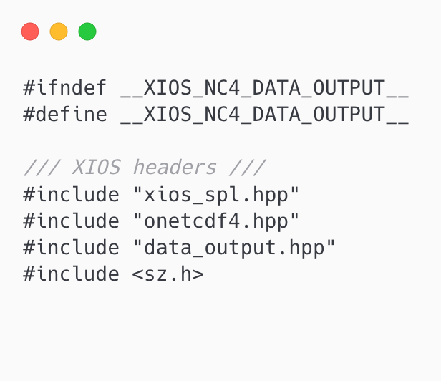
XIOS Modification for Applying SZ Compression
□ Test SZ Integration into XIOS Project
Add include header for SZ library
Modify the src/io/nc4_data_output.hpp for testing

Slide 4
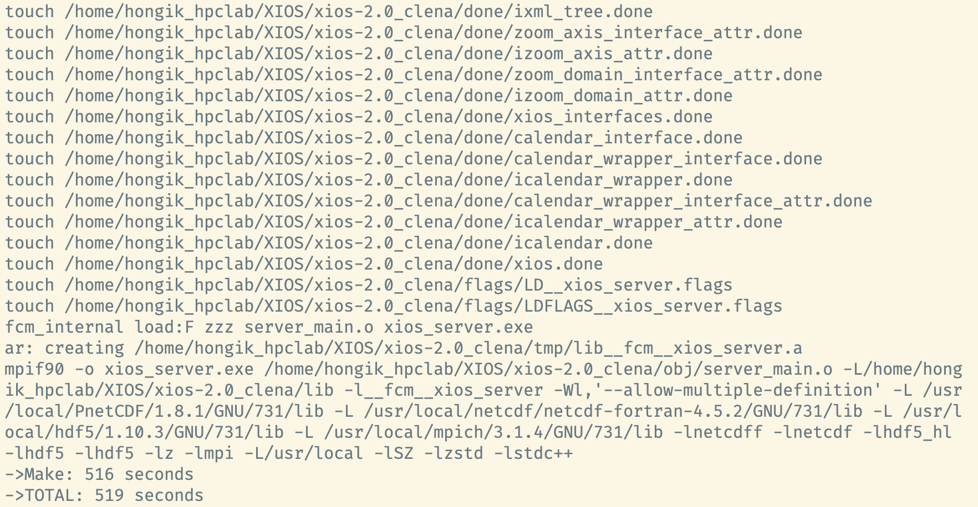
XIOS Modification for Applying SZ Compression
□ Running Compilation for XIOS Project
Rerun compilation command
./make_xios --full --use_extern_boost true --use_oasis oasis3_mct --prod --arch GCC_local

Slide 5
XIOS Modification for Applying SZ Compression
□ Related Work
PnetCDF-SZ: Integration of SZ compression into PnetCDF (Parallel netCDF)
Only support SZ compression for netcdf classic and cdf5
It’s written on C (XIOS using C++ with C wrapper)
Provides SZ compression logic flow implementation

Slide 6
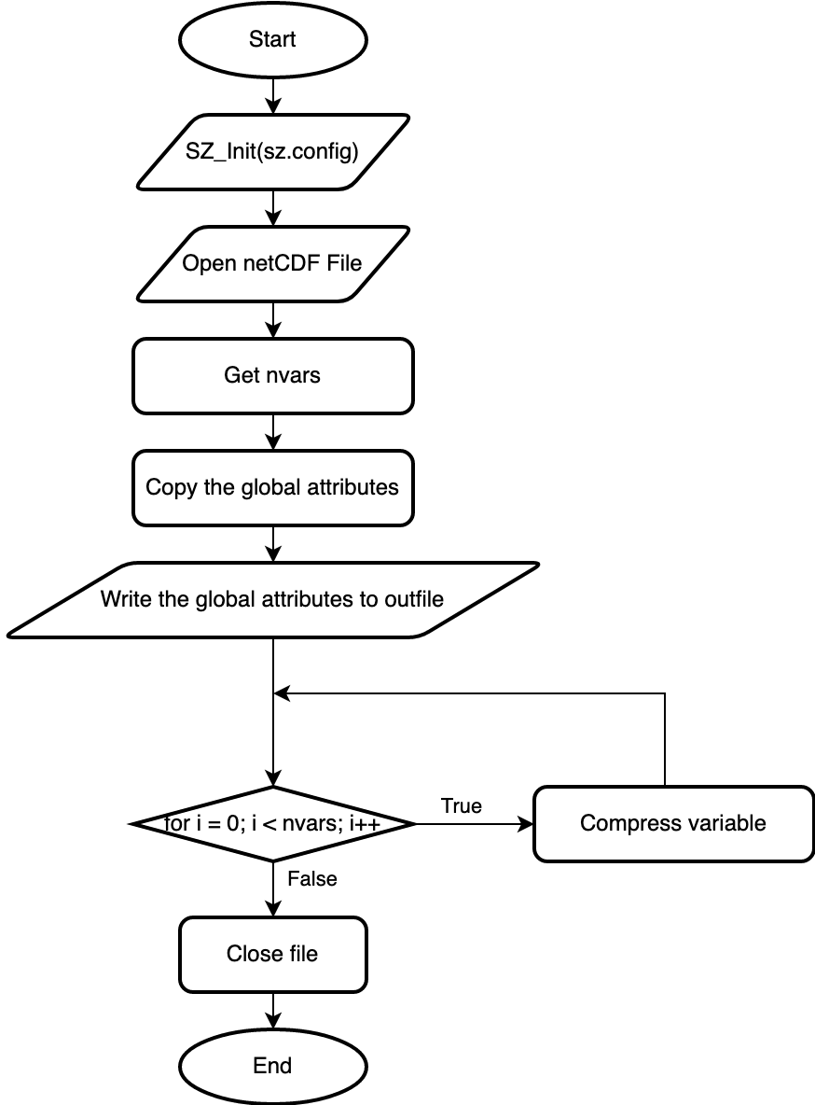
XIOS Modification for Applying SZ Compression
□ Related Work - SZ Compression Flow
Performing SZ compression required sz.config
Compression will be performed for each variable

Slide 7
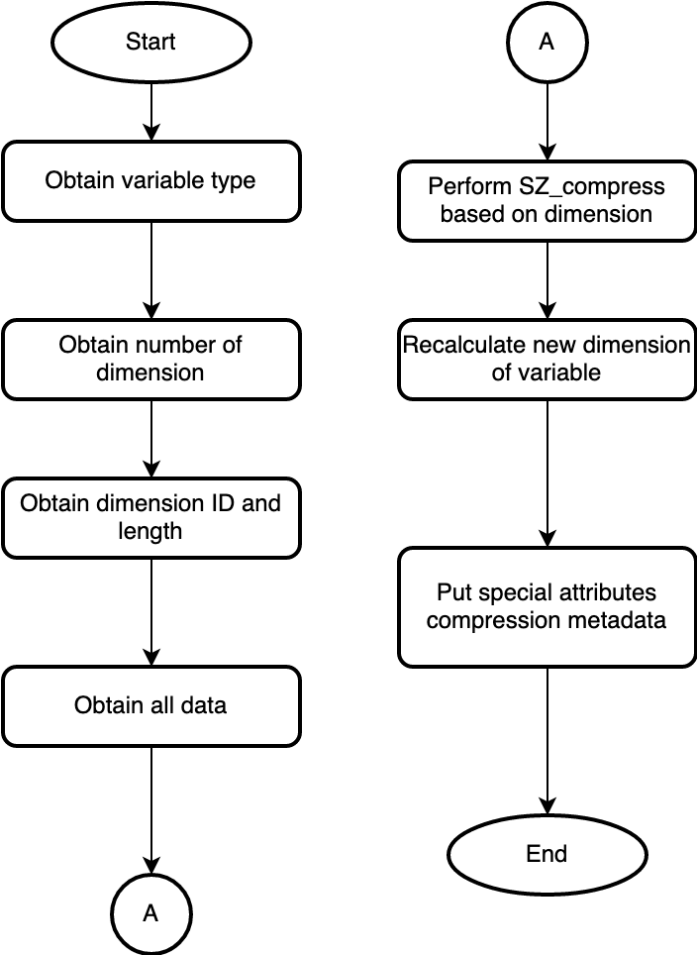
XIOS Modification for Applying SZ Compression
□ Related Work - SZ Compression Flow
SZ API
char* SZ_compress(
int dataType,
void* data,
size_t* outSize,
size_t r5,
size_t r4,
size_t r3,
size_t r2,
size_t r1
);

Slide 8
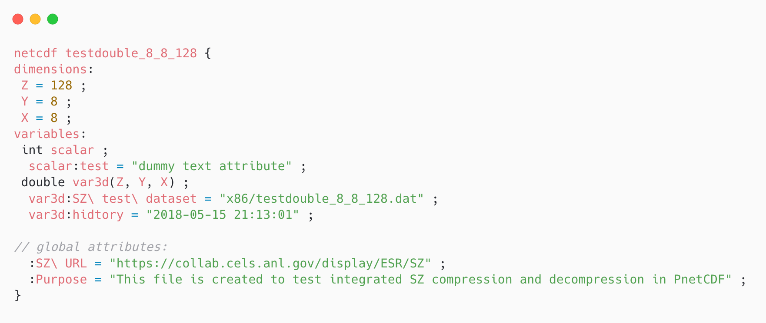
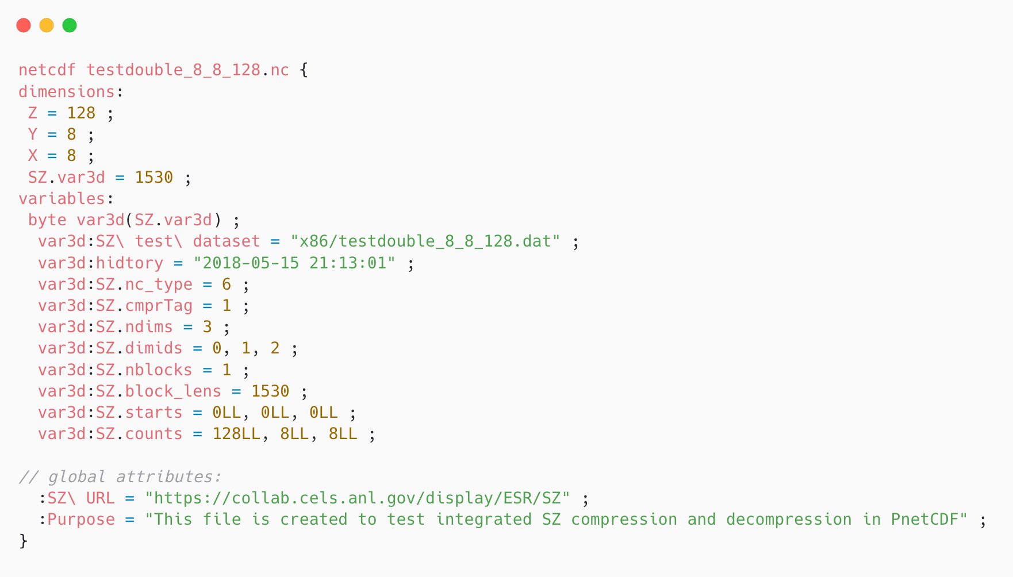
netCDF Structure Comparassion
XIOS Modification for Applying SZ Compression
Original
Compressed

Slide 9
감사합니다
Thank you

