Slide 1
XIOS Modification and
Compression Implementation

Slide 2
□ Files Related to netCDF Output
XIOS Modification and Compression Implementation
io/nc4_data_output.{cpp,hpp}: Class that have write responsibility of variable, attribute and also dimension.
io/onetcdf4.{cpp,hpp}: Responsibility of general output of netCDF capability (open, close, definition and initialize)
io/netCdfInterface.cpp: C++ wrapper of netCDF C API function
node/file.cpp: model file, instantiate netCDF output object.

Slide 3
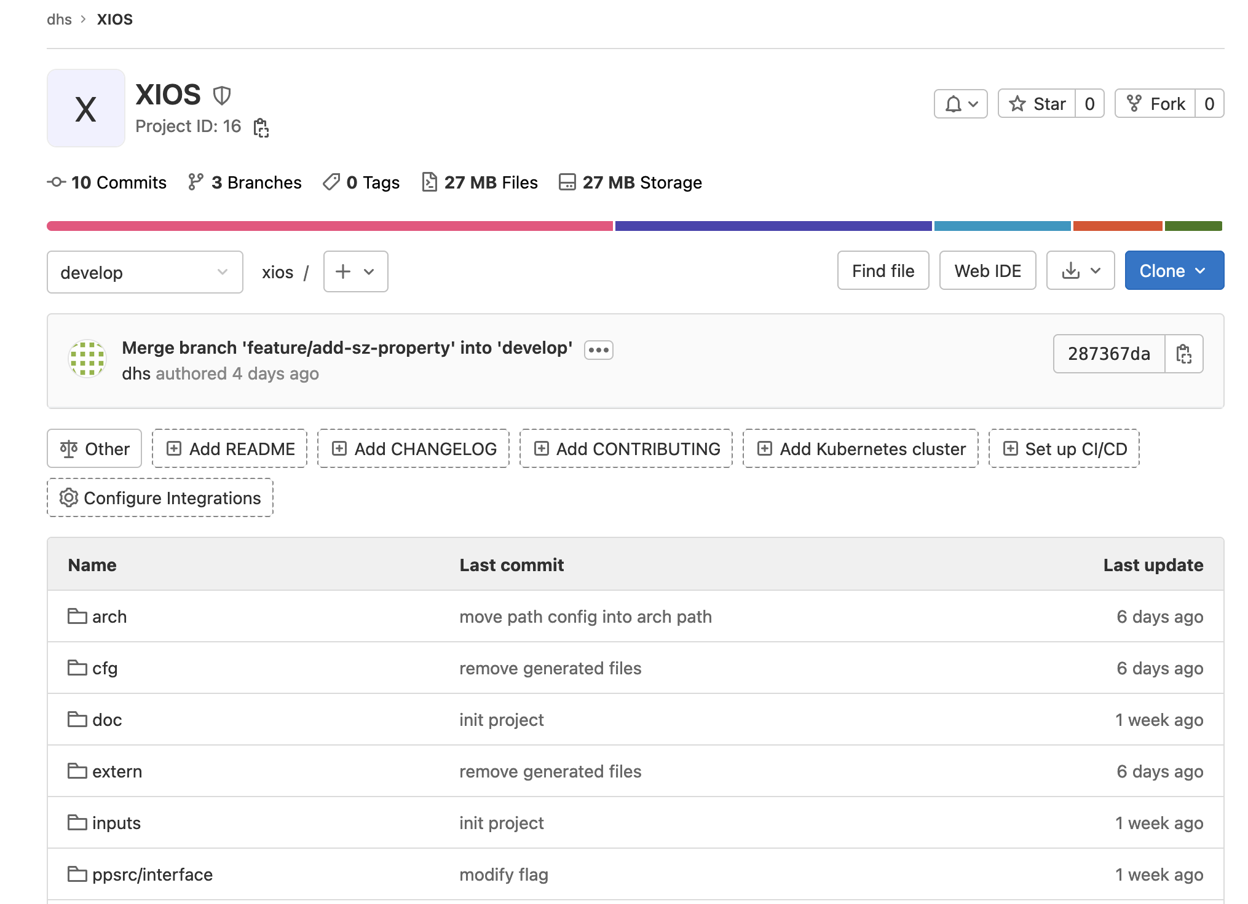
XIOS Modification for Applying SZ Compression
□ Implementation Progress::XIOS Repository
The previous repository is large, slow when navigate into directory
Create new git repository at HPCLab GitLab dhs/xios. It can be added later using git submodule into the previous repository.
Remove/Ignore compiled files or generated files (reduce sized and faster clone/backup

Slide 4
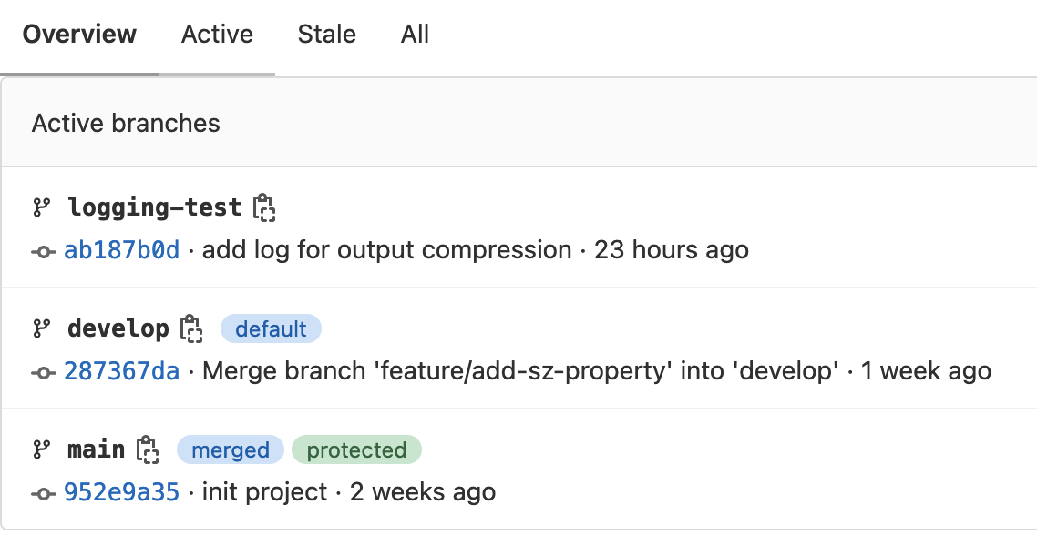
XIOS Modification for Applying SZ Compression
□ Implementation Progress::Branches
Development follow Git branching methodology
main: store main XIOS code (before modification)
develop: development version of XIOS (modified)
feature-branch: feature specific development version.
feature-branch will be merged when the feature is mature.
Branches can help to avoid bugs and easy to switch to a working version.

Slide 5
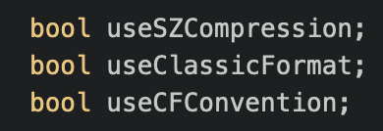
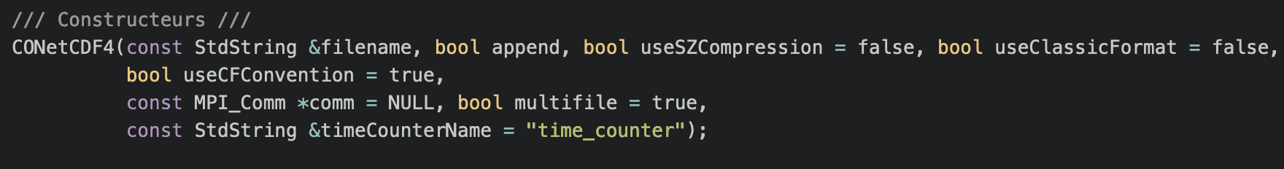
XIOS Modification for Applying SZ Compression
□ Modification::src/io/nc4_data_output.{cpp,hpp} and src/io/onetcdf4.{cpp.hpp}
Add useSZCompression property in onetcdf4.{cpp,hpp} and nc4_data_output.{cpp,hpp}
Modify the constructor to enable/disable SZ compression

Slide 6
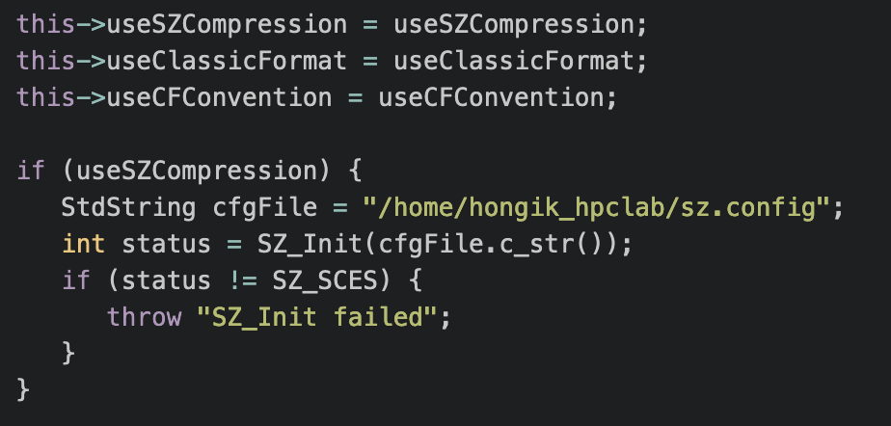
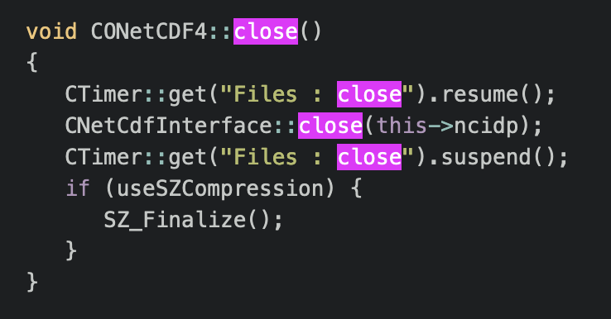
XIOS Modification for Applying SZ Compression
□ Modification::src/io/onetcdf4.cpp
Call SZ_Init if useSZCompression is enabled on initialize() function
Add SZ_Finalize() when close the file

Slide 7
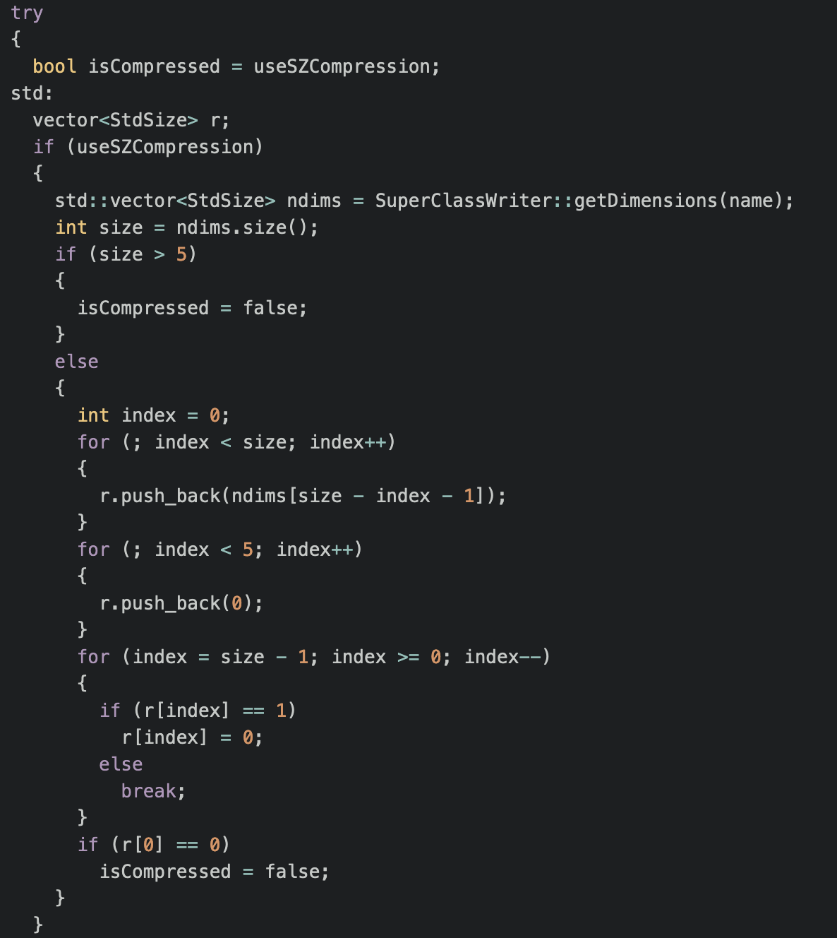
XIOS Modification for Applying SZ Compression
□ Modification::src/io/nc4_data_output.cpp
Calculate dimension and normalize
Set into 0 for the remaining dimension
Check if compression is supported for given dimension

Slide 8
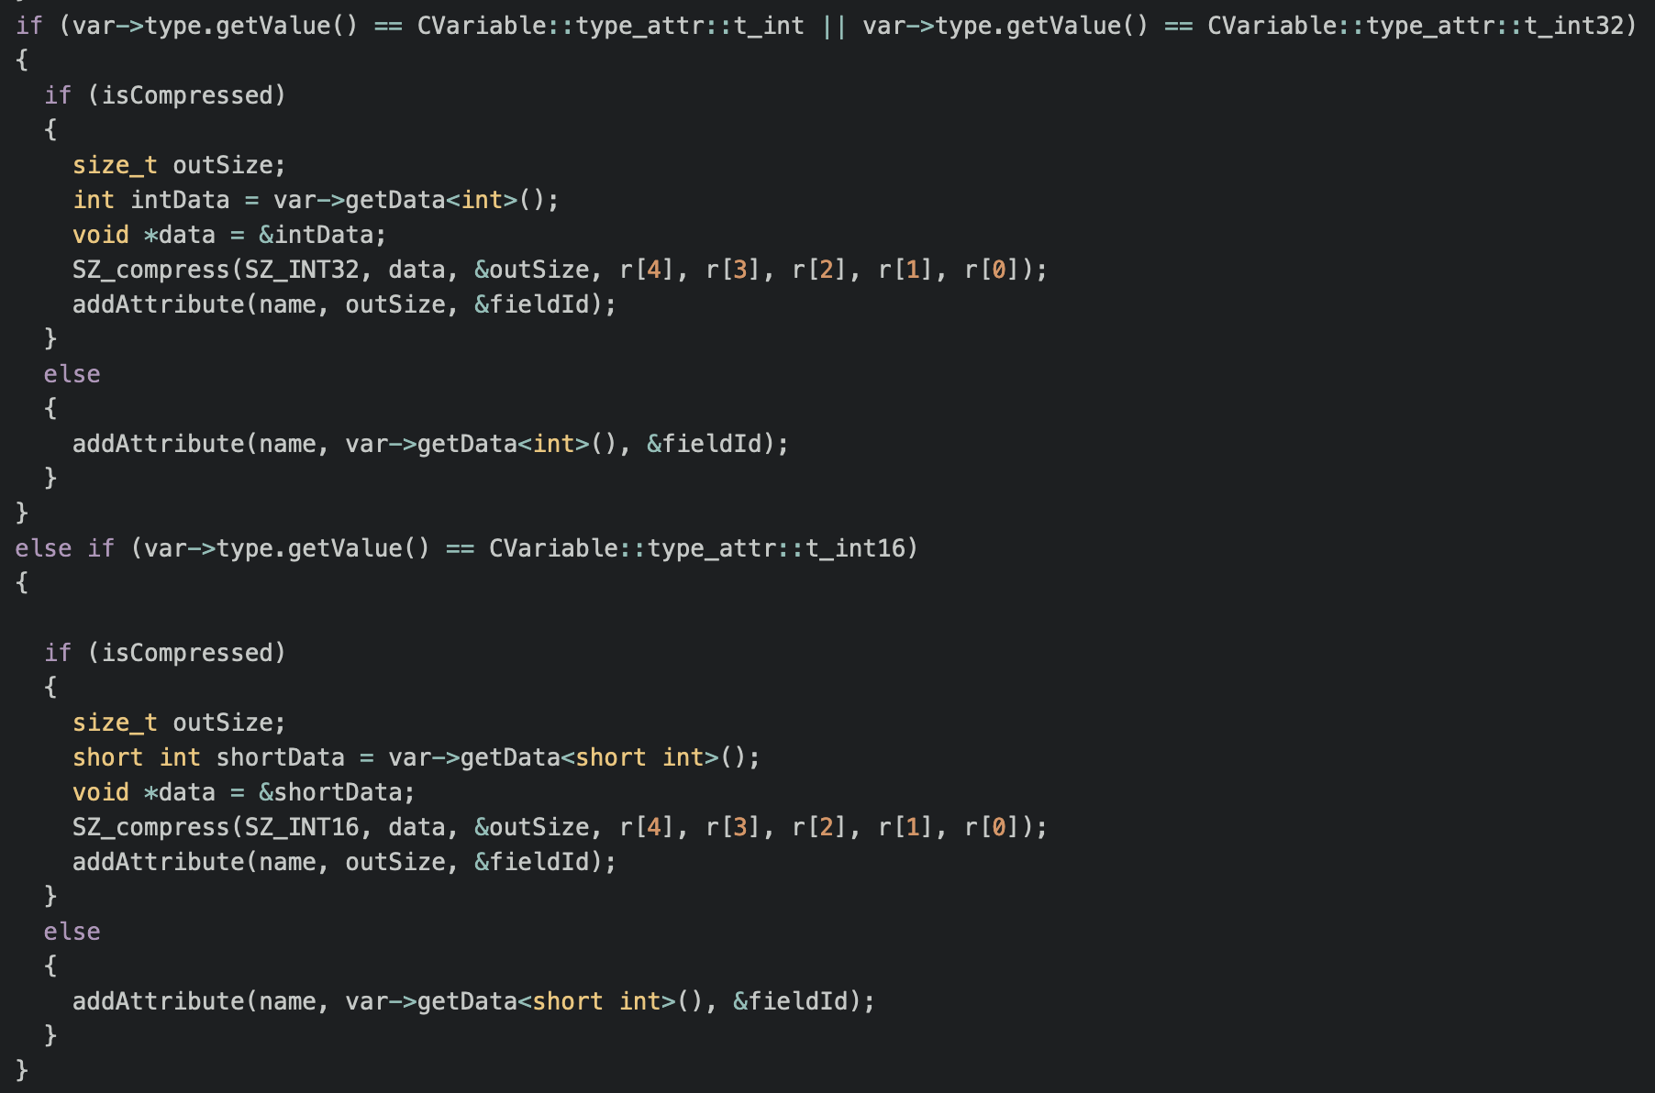
XIOS Modification for Applying SZ Compression
□ Modification

Slide 9
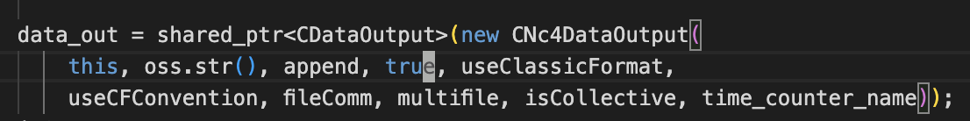
XIOS Modification for Applying SZ Compression
□ Modification::src/node/file.cpp
Enable SZ compression by passing true parameter when instantiate CNc4DataOutput object.

Slide 10
XIOS Modification for Applying SZ Compression
□ Result of Modification
There is an issue with the running model via Rose, it took forever.
The root cause is unknown but may relate to additional third-party SZ and ZSTD CFLAGS not detected.
Enable logging for further investigation is needed

Slide 11
감사합니다
Thank you

