Slide 1
XIOS Modification and
Compression Implementation

Slide 2
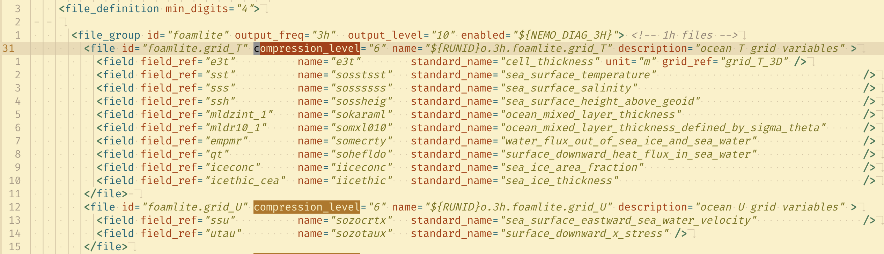
□ Modify the iodef.xml configuration on NEMO
XIOS Modification and Compression Implementation
The XIOS has default compression using gzip.
The gzip can be enabled by adding compression_level to iodef.xml
The gzip has compression level 0 - 9.

Slide 3
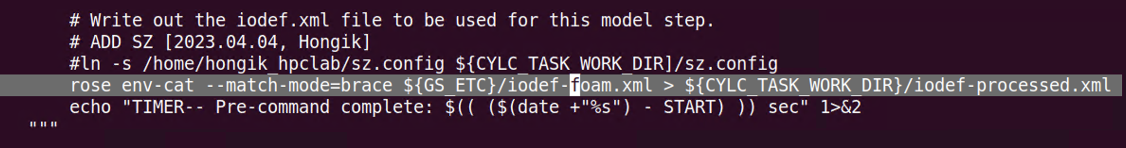
□ Modify the iodef.xml configuration on NEMO
XIOS Modification and Compression Implementation
The iodef.xml filename is defined as iodef-foam.xml in NEMO Low GloSea6
The NEMO is hosted in subversion and built using FCM. The new branch is needed to support the gzip configuration.

Slide 4
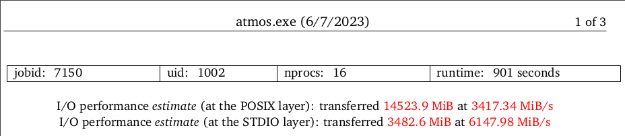
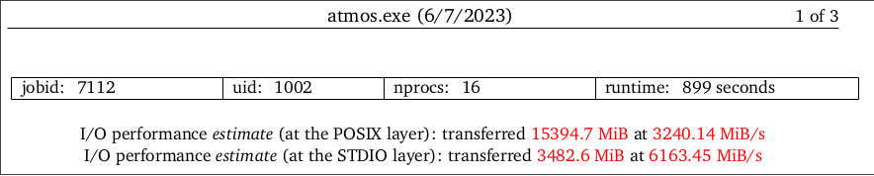
□ Modify the iodef.xml configuration on NEMO
XIOS Modification and Compression Implementation
Result modification
gzip compression
nocompression

Slide 5
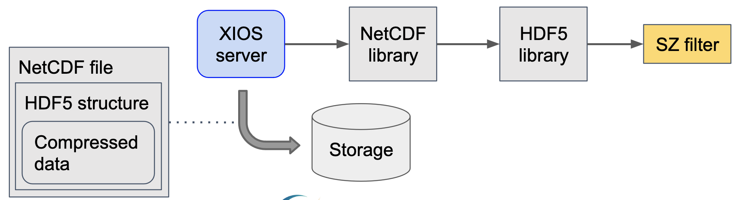
□ Implement SZ compression using SZ filter
XIOS Modification and Compression Implementation
The H5Z-SZ filter support to apply SZ compression for NetCDF4 format
The approach to implementing SZ compression is shown below figure

Slide 6
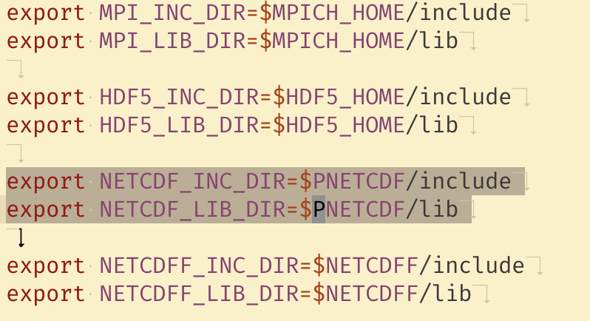
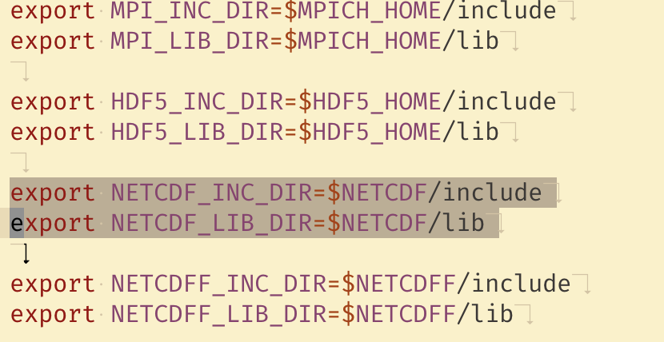
□ Implement SZ compression using SZ filter
XIOS Modification and Compression Implementation
Adjust the NetCDF library in XIOS
The SZ compression using SZ filter doesn’t support PnetCDF library
Adjust the environment variables for recompilation is required

Slide 7
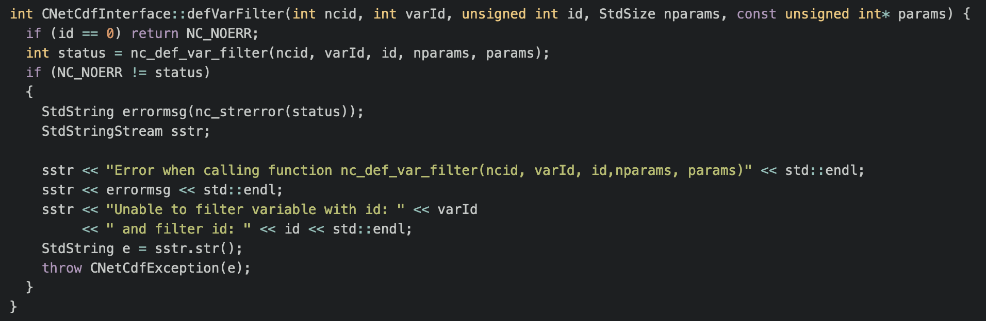
□ Implement SZ compression using SZ filter
XIOS Modification and Compression Implementation
Declare defVarFilter function at io/netCdfInterface.hpp
Add implementation at io/netCdfInterface.cpp

Slide 8
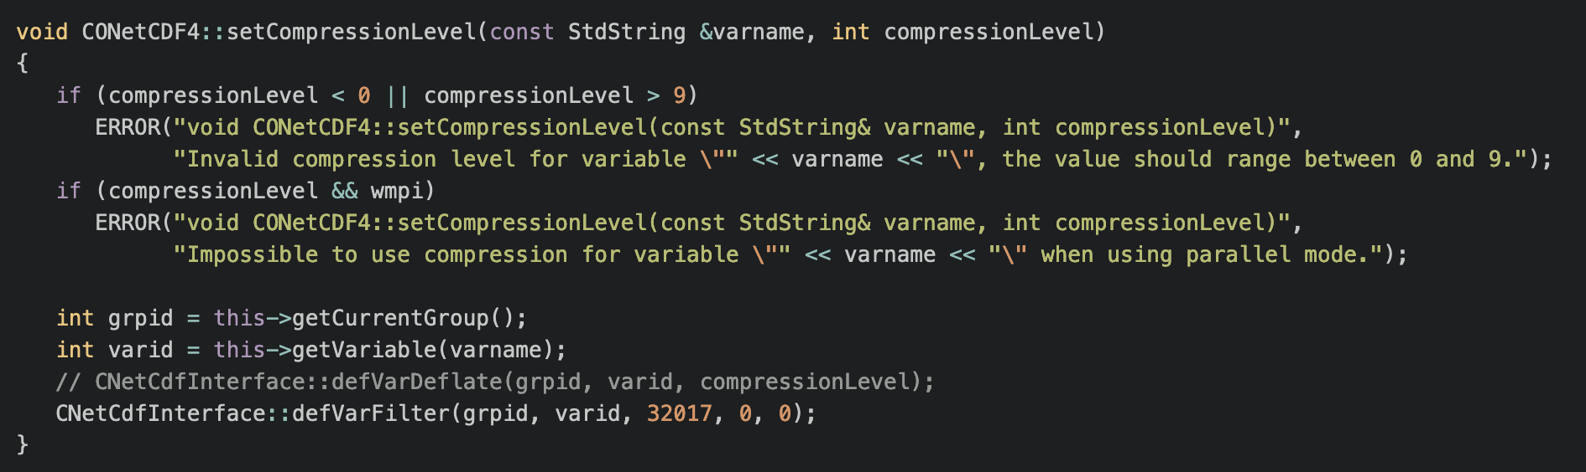
□ Implement SZ compression using SZ filter
XIOS Modification and Compression Implementation
Modification at io/onetcdf4.cpp

Slide 9
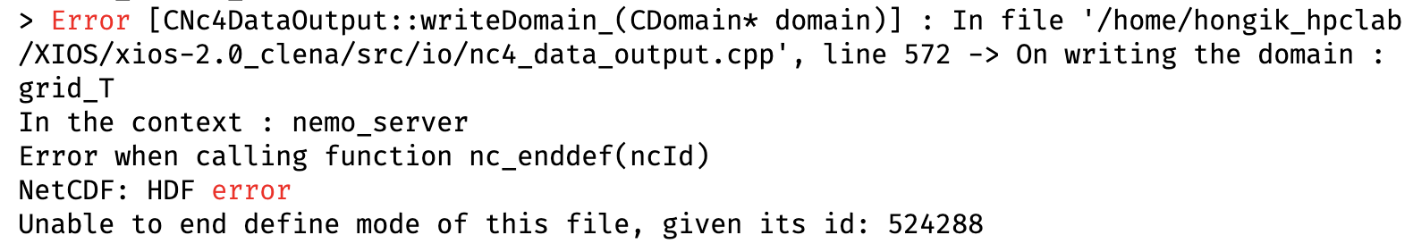
□ Implement SZ compression using SZ filter
XIOS Modification and Compression Implementation
Result Modification

Slide 10
□ Conclusion
XIOS Modification and Compression Implementation
The XIOS default gzip compression has been enabled from Low GloSea6 and can improve the I/O performance
The configuration of the SZ filter needs to be investigated further to solve the current issues.

Slide 11
감사합니다
Thank you

