Slide 1

Details of Modification SZ Compression
Dian Hanifudin Subhii

Slide 2
Outline
Low GloSea6 Identification
Code Modification
Test Result
Feedback
Plan

Slide 3
Low GloSea6 Code Identification
Searching related to netCDF and HDF5 as keywords are needed to apply the SZ filter to Low GloSea6 using netCDF API
Mostly examples and references using netCDF C API (the difference with netCDF Fortran API is the prefix NF90_ for functions declaration)
netCDF filter references
https://docs.unidata.ucar.edu/netcdf-c/current/filter__example_8c_source.html
https://www.dossier-andreas.net/software_architecture/pipe_and_filter.html
https://www.ibm.com/topics/data-pipeline

Slide 4
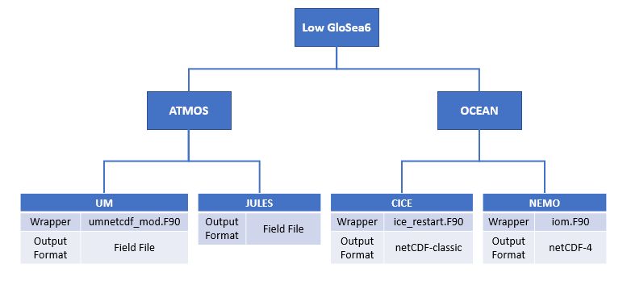
Low GloSea6 Model

Slide 5
CICE and NEMO Format
CICE and NEMO also generate output files in netCDF-classic and netCDF-4 formats.
The difference between these two formats is the structure of the library.
netCDF-4 supports HDF5 libraries, while netCDF-classic does not supports HDF5 libraries.
HDF5 library supports is important because NetCDF filters are based on HDF5 mechanism

Slide 6
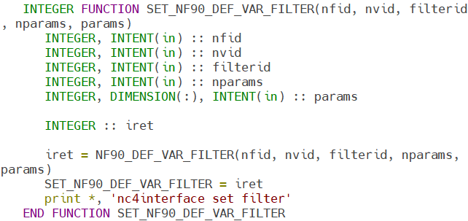
Code Modification
SZ filter application is implemented by adding function in nc4interface.F90
nc4interface is a file that defines chunk settings and lossless compression functions
The function receive nfid: NetCDF ID, nvid: Variable ID, filterid: HDFGroup filter id, nparams and params. The function return integer number that represents codes (i.e NF90_NOERR, NF90_BADID etc)
*nc4interface.F90 location: dev_r5518_GO6_package/NEMOGCM/EXTERNAL/IOIPSL/src/nc4interface.F90

Slide 7
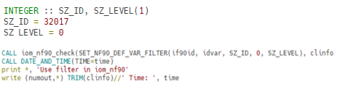

Code Modification
The filter function SET_NF90_DEF_VAR_FILTER is called in iom_nf90.F90 to apply lossless compression SZ filter in the subroutine iom_nf90_rp0123d
SZ compression filter is identified by ID 32017 (SZ_ID)
The values of the nparams and params (SZ_LEVEL) parameters (SET_NF90_DEF_VAR_FILTER function) are set to zero because SZ using separate configuration files (sz.config)
SZ sets the filter parameters in the sz.config file
The sz.config need to be linked in suite.rc file implemented in the jinja2 language
*iom_nf90.F90 location: dev_r5518_GO6_package/NEMOGCM/NEMO/OPA_SRC/IOM/iom_nf90.F90

Slide 8
Test Result
Changing the relErrBound value after code modification does not decrease the model output size.
The size of restart files is decreasing but not the size of the model output.
The modified code was compressing the restart file not the output of Low GlowSea6.
The restart file is used as an input for the models, loss compression should not be performed.

Slide 9
Feedback
Researcher Johan Lee gives some feedback:
Model performance
Model output compression at the writing stage using the compress (deflate) function of netCDF
Check the corresponding function in the XIOS Library for output compression
Enable compression options on XML files in the steps of performing the combined model (XIOS Library code and IOM/iom.F90 code modification is required)
Post processing
Compression of the NEMO output using utilities such as ncks during post-processing step.

Slide 10
Plan
XIOS Library modification
Add SZ library into XIOS project
Modify files related with writing netcdf output (nc4_data_output.hpp, nc4_data_output.cpp)
Modify fortran interface if needed
NEMO
Modify files related with iodef.xml configuration to enable SZ compression

Slide 11
Thank you

