Slide 1
Bluestock Mutual Fund Analytics
Final Capstone Presentation
Python | SQLite | Power BI | Advanced Analytics
Prepared by Dhanistha Arora
Bluestock MF Capstone | 1

Slide 2
Problem & Objective
Build a complete mutual fund analytics system for Bluestock.
Convert raw mutual fund data into cleaned, queryable, visual analytics outputs.
Evaluate fund performance using CAGR, Sharpe, Sortino, Alpha, Beta, drawdown, VaR, and CVaR.
Create an investor-friendly dashboard and final business recommendations.
Bluestock MF Capstone | 2

Slide 3
Data Sources
Fund master: AMFI code, fund house, category, plan, benchmark, risk grade.
NAV history: daily NAV used for return and risk calculations.
AUM, SIP inflow, category inflow, folio count, and benchmark datasets.
Investor transactions: amount, state, city tier, age group, gender, payment mode, KYC.
Portfolio holdings: sector exposure used for HHI concentration analysis.
Bluestock MF Capstone | 3

Slide 4
Architecture
Raw CSVs are stored in data/raw.
Python ETL validates dates, numeric values, duplicates, NAV > 0, transaction amount > 0, and KYC values.
Cleaned CSVs are written to data/processed.
SQLite schema stores dim_fund, dim_date, fact_nav, fact_transactions, fact_performance, fact_aum, and supporting fact tables.
Power BI Service consumes the cleaned Excel export for dashboarding.
Bluestock MF Capstone | 4

Slide 5
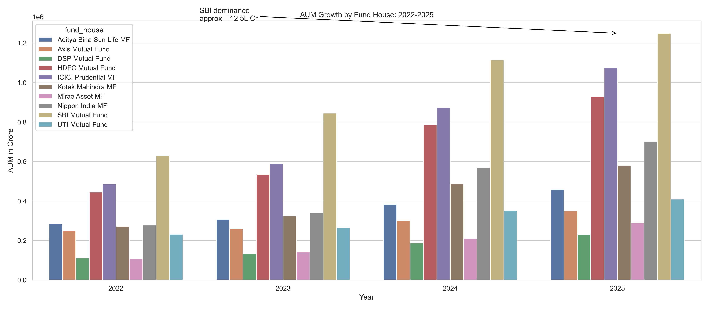
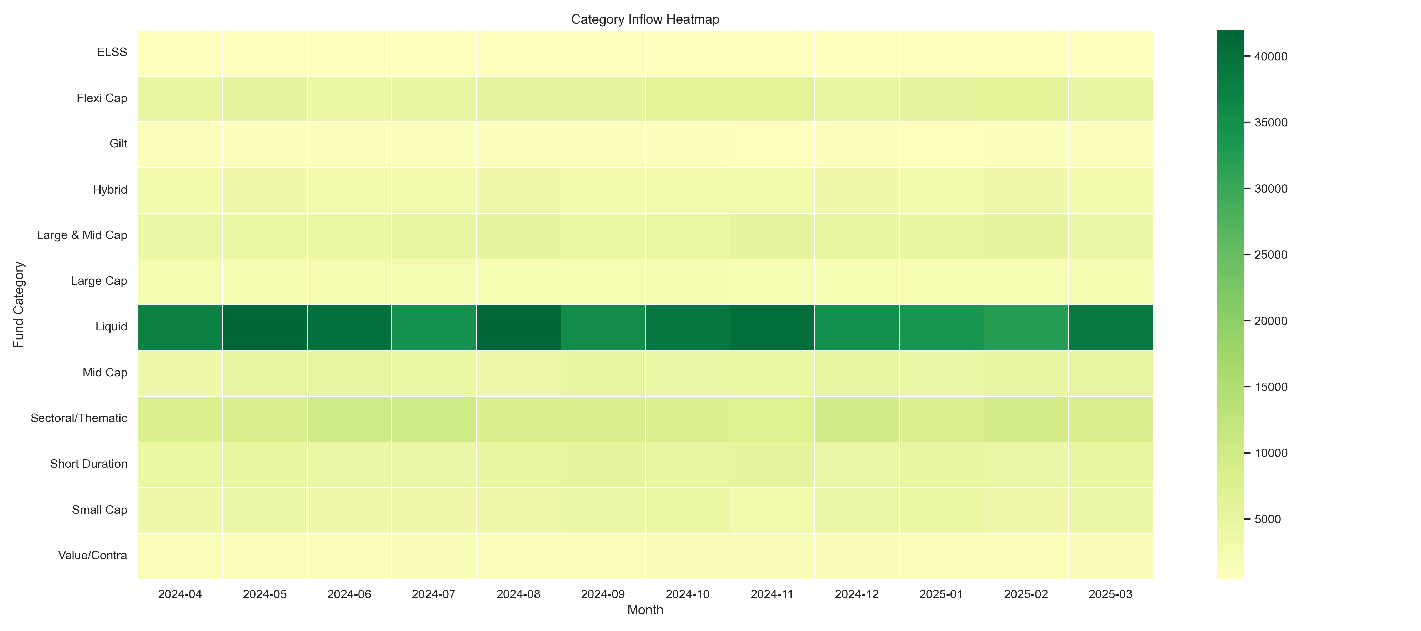
EDA Highlights: Industry Growth
AUM growth is concentrated among large AMCs.
Category inflows vary materially by month and product category.
Bluestock MF Capstone | 5

Slide 6
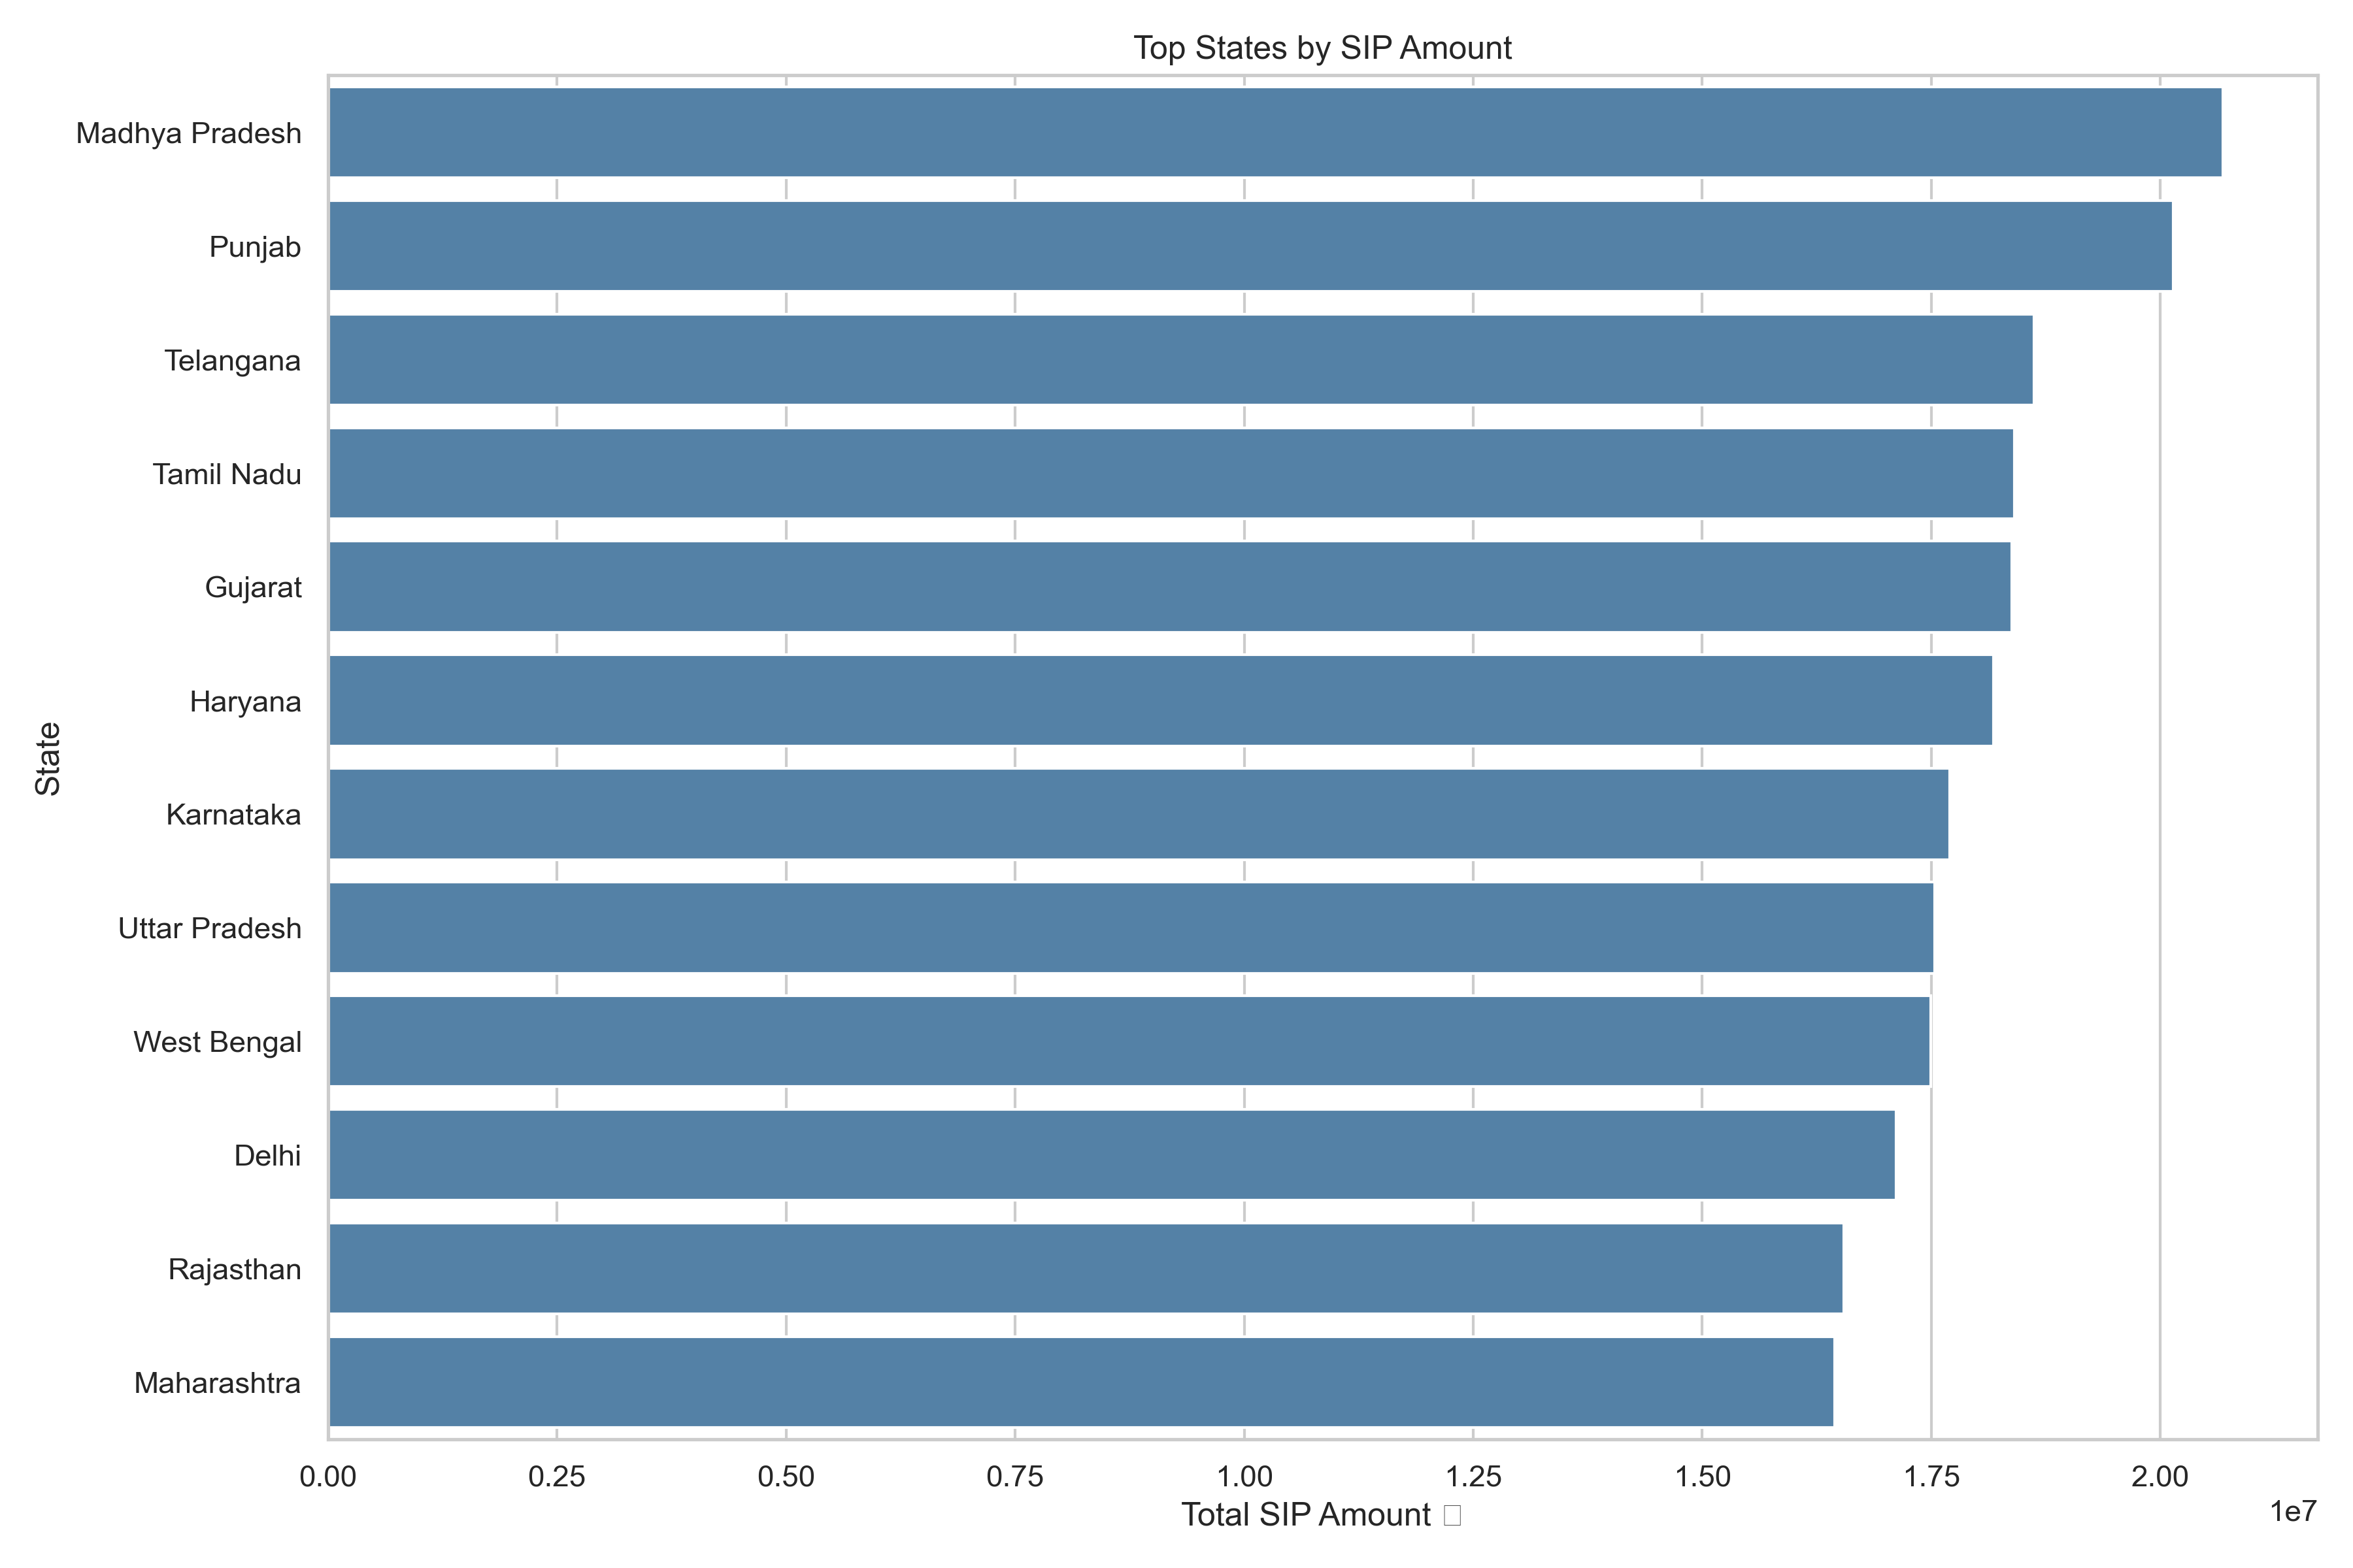
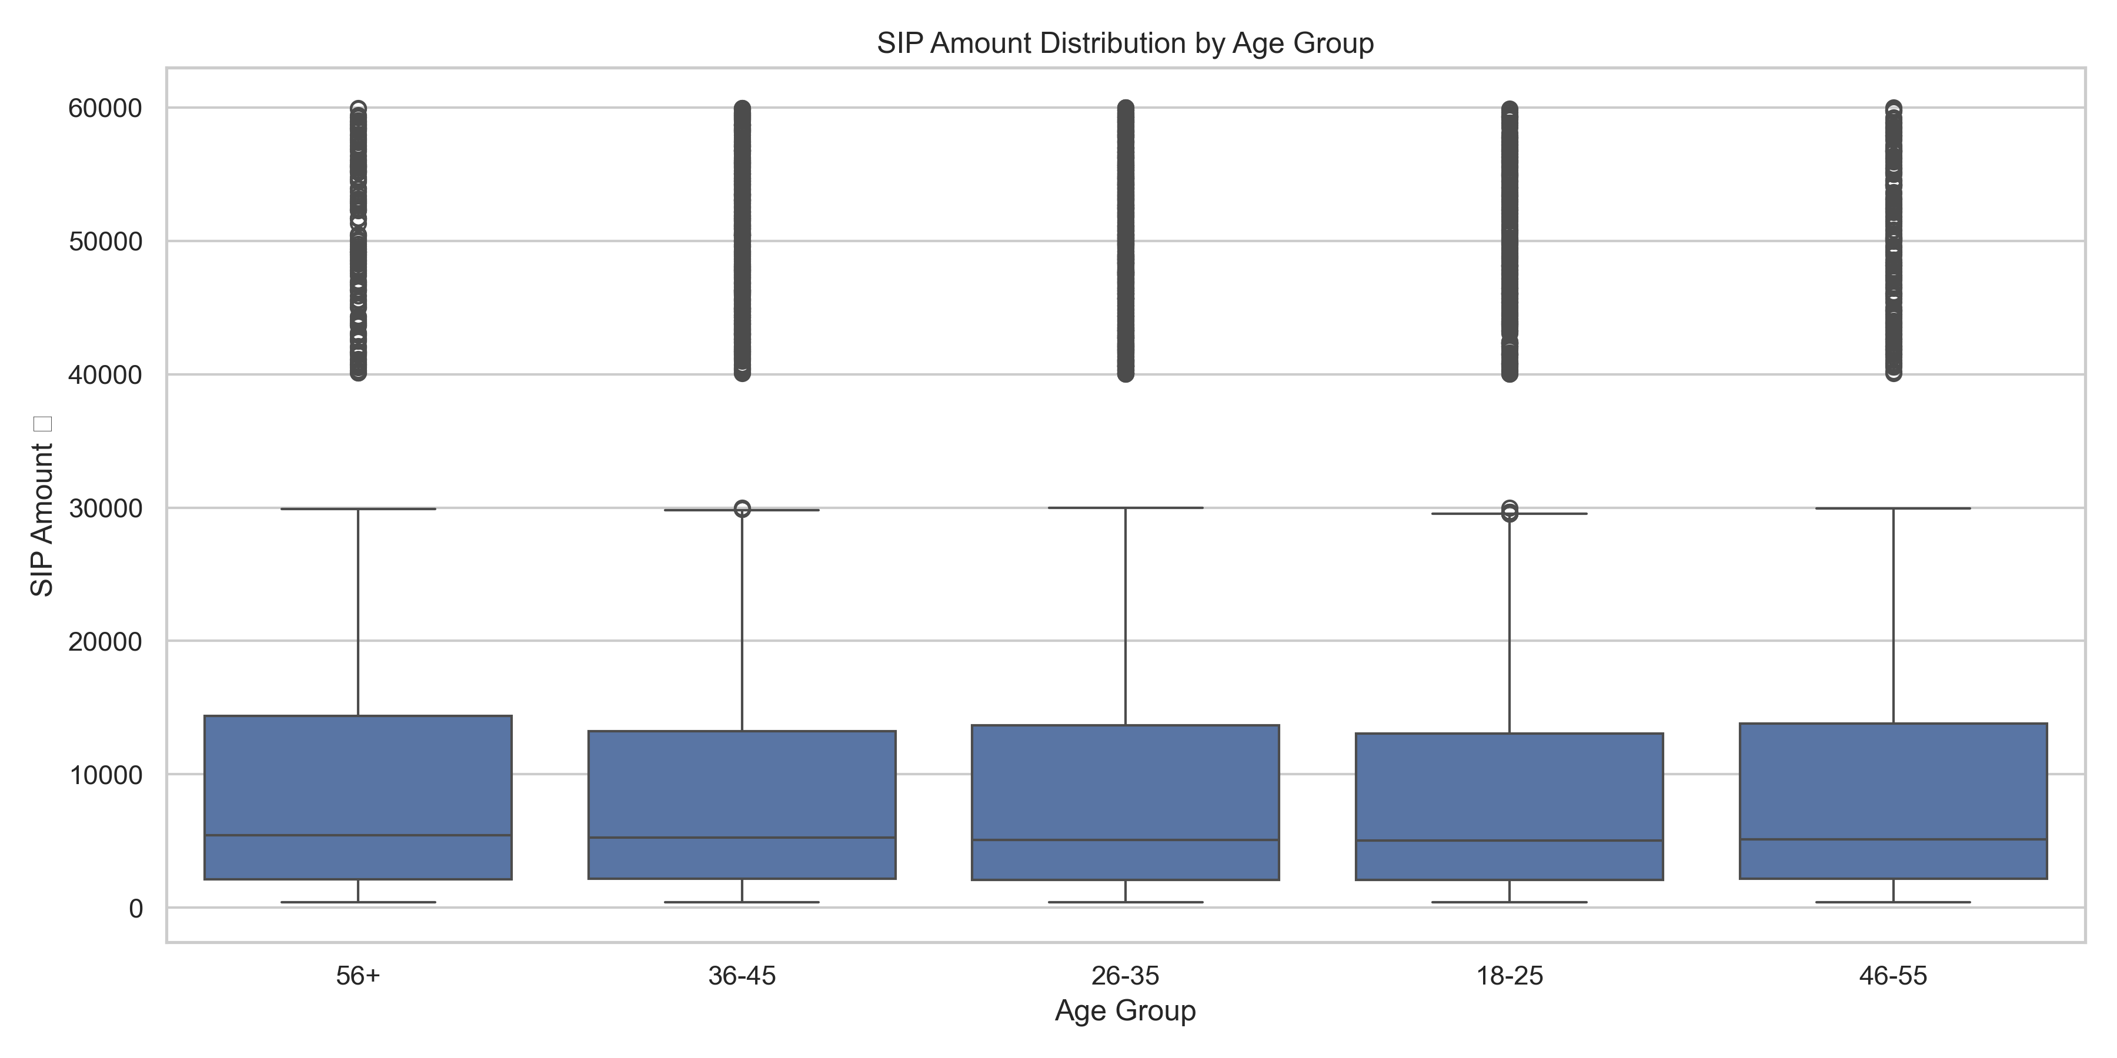
EDA Highlights: Investors
Top states contribute a large share of transaction value.
SIP ticket size differs across age groups.
Bluestock MF Capstone | 6

Slide 7
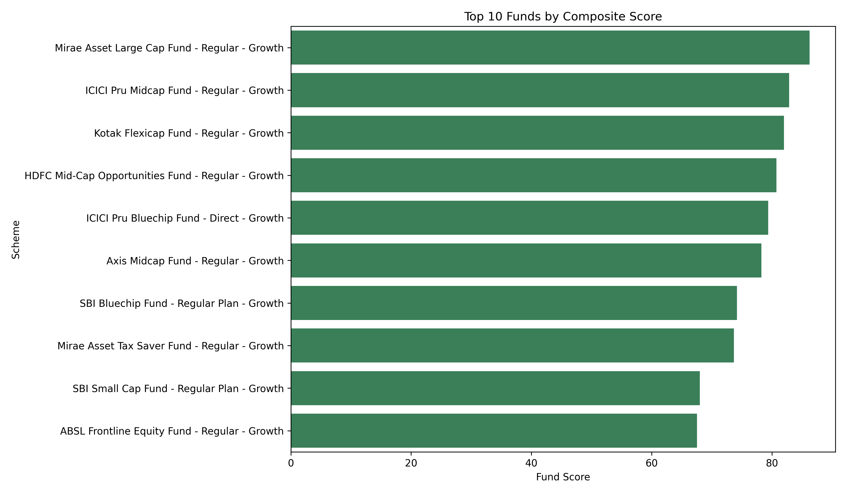
Performance Metrics: Scorecard
Composite score combines 3-year return, Sharpe, Alpha, inverse expense ratio, and inverse maximum drawdown.
The scorecard creates a simple rankable view for fund screening.
Bluestock MF Capstone | 7

Slide 8
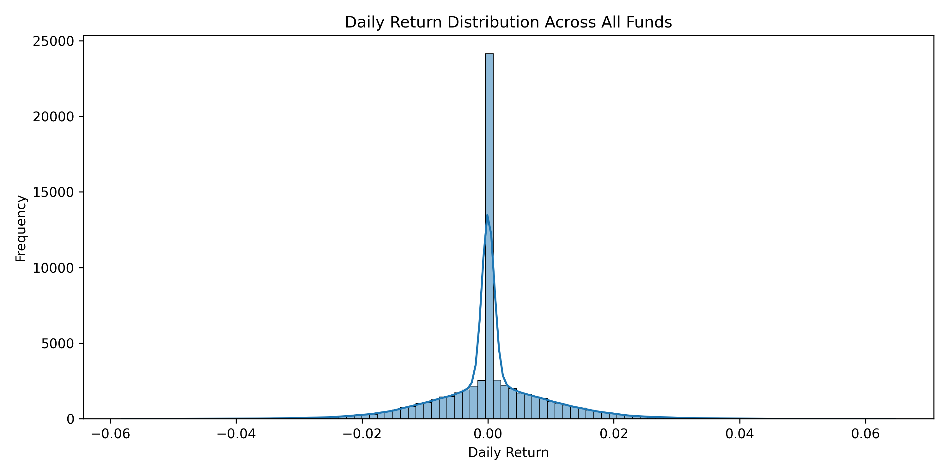
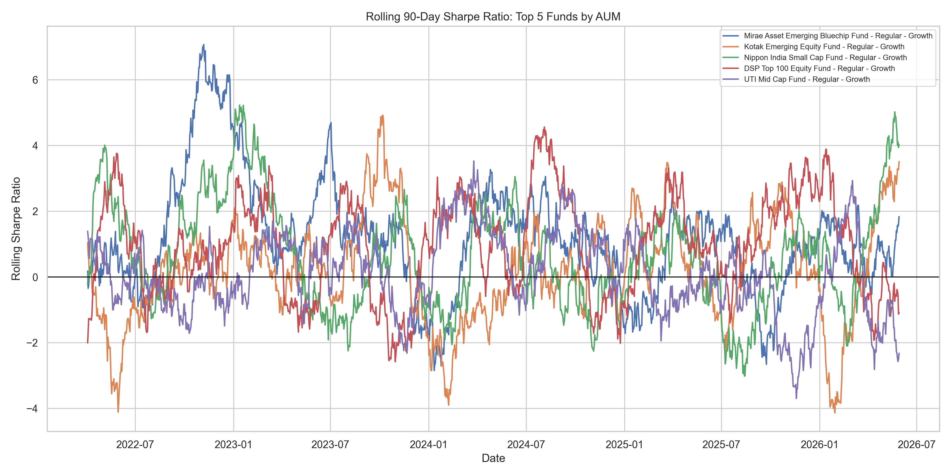
Performance Metrics: Risk
Daily return distribution supports VaR and CVaR risk estimation.
Rolling Sharpe reveals changing risk-adjusted performance over time.
Bluestock MF Capstone | 8

Slide 9
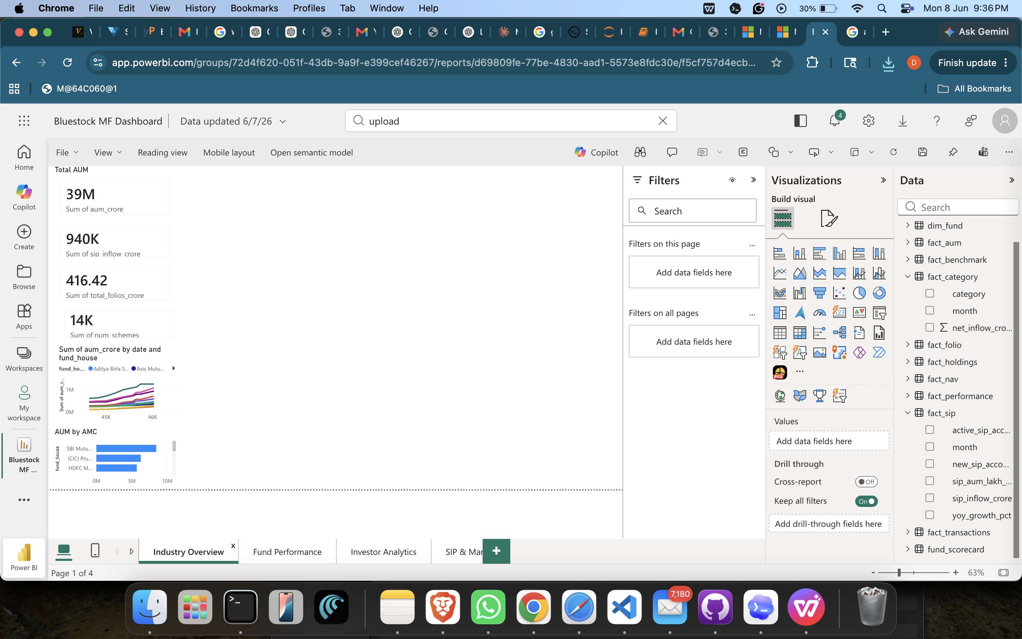
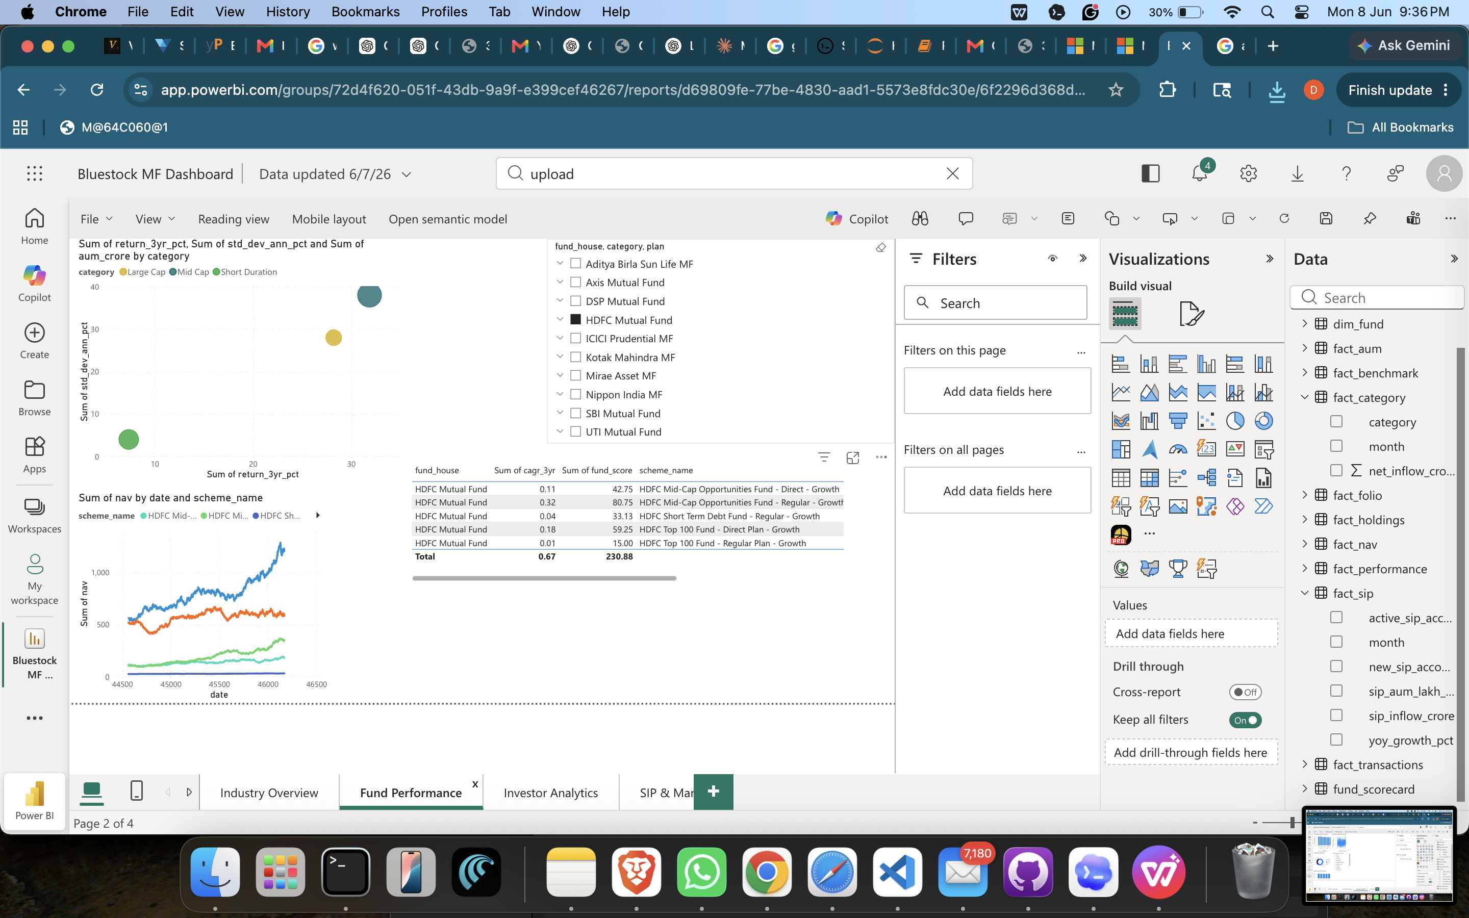
Dashboard Screenshots: Overview & Performance
Industry Overview summarizes AUM, SIP inflows, folios, schemes, and AMC trends.
Fund Performance compares returns, risk, scorecard ranks, and NAV movement.
Bluestock MF Capstone | 9

Slide 10
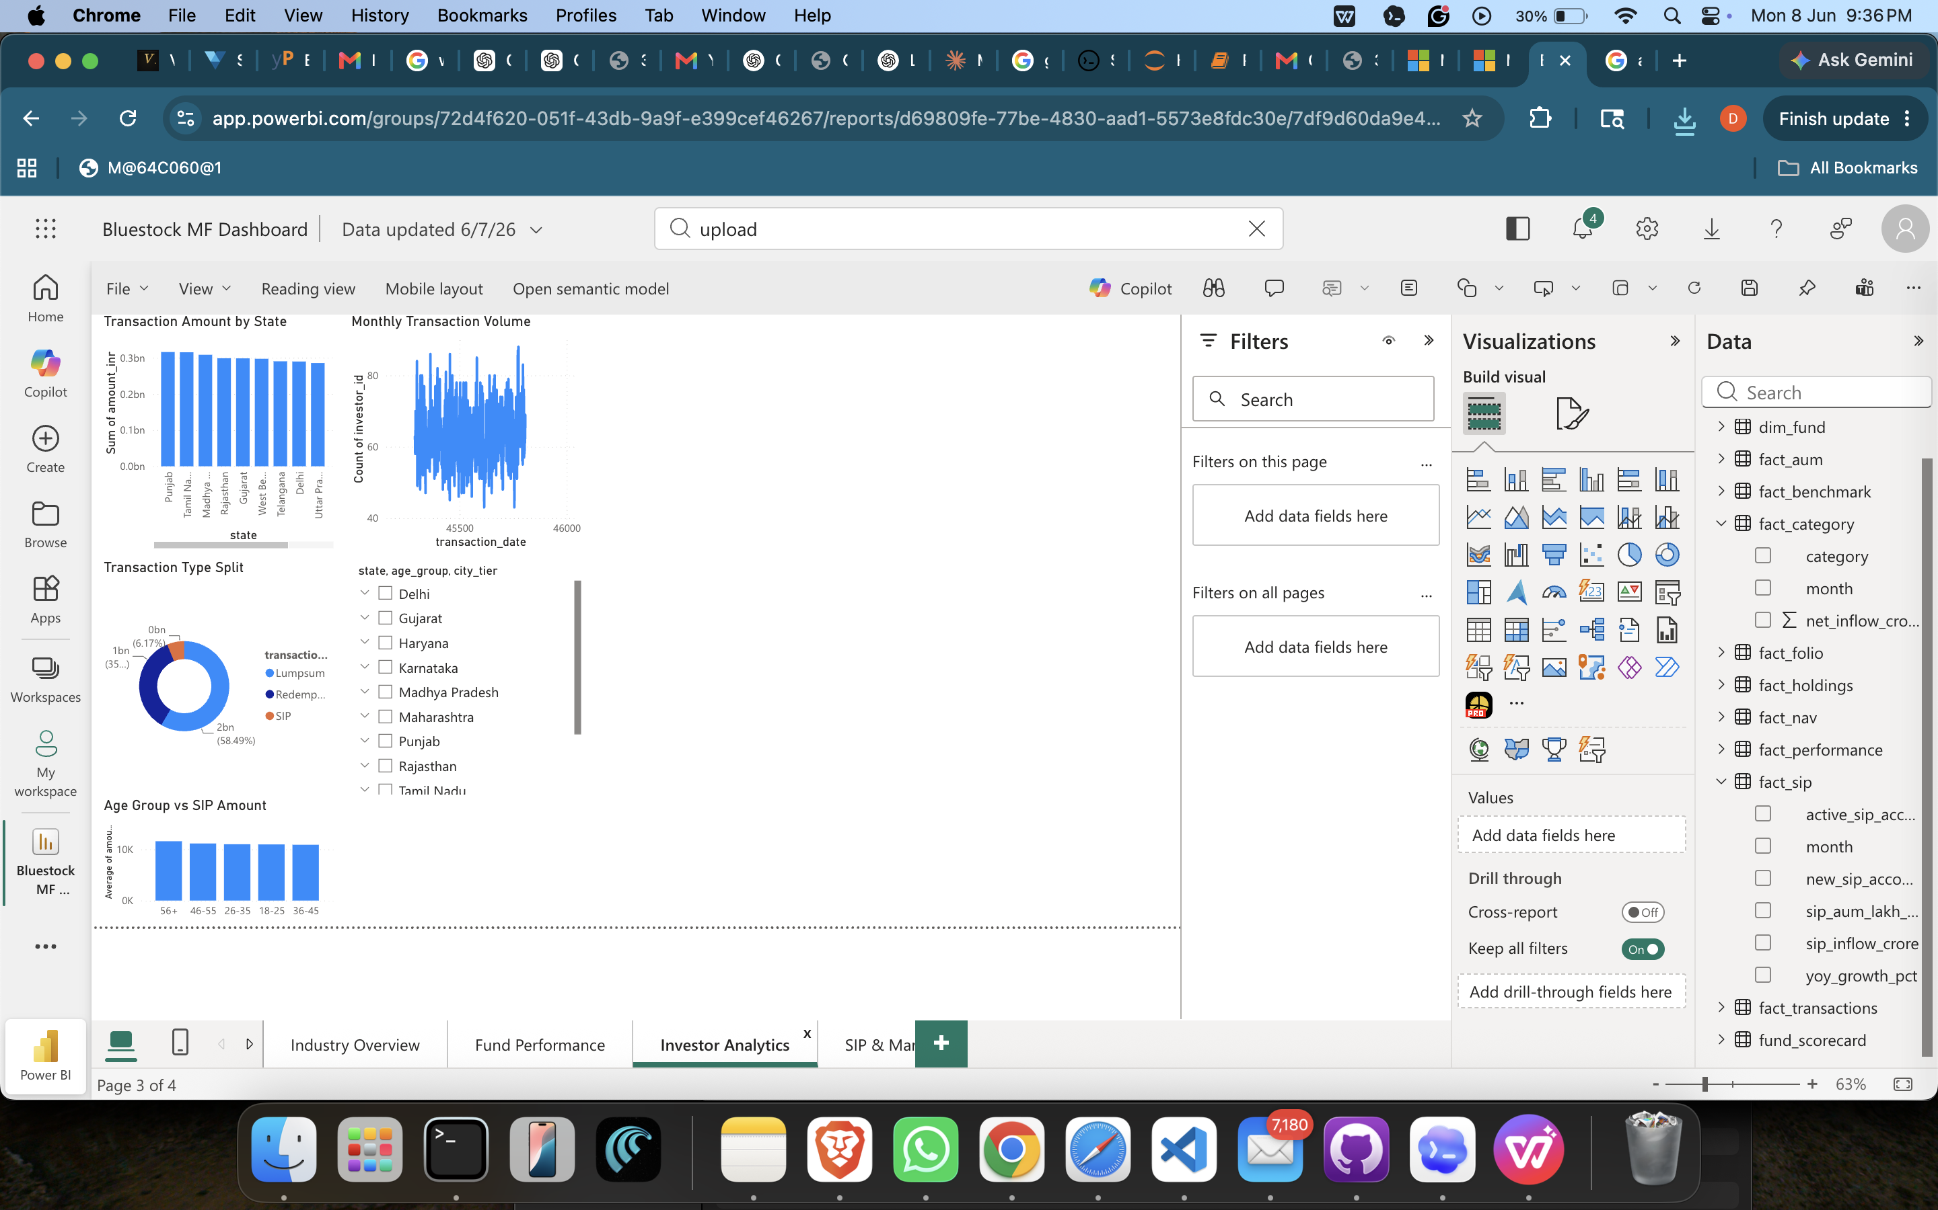
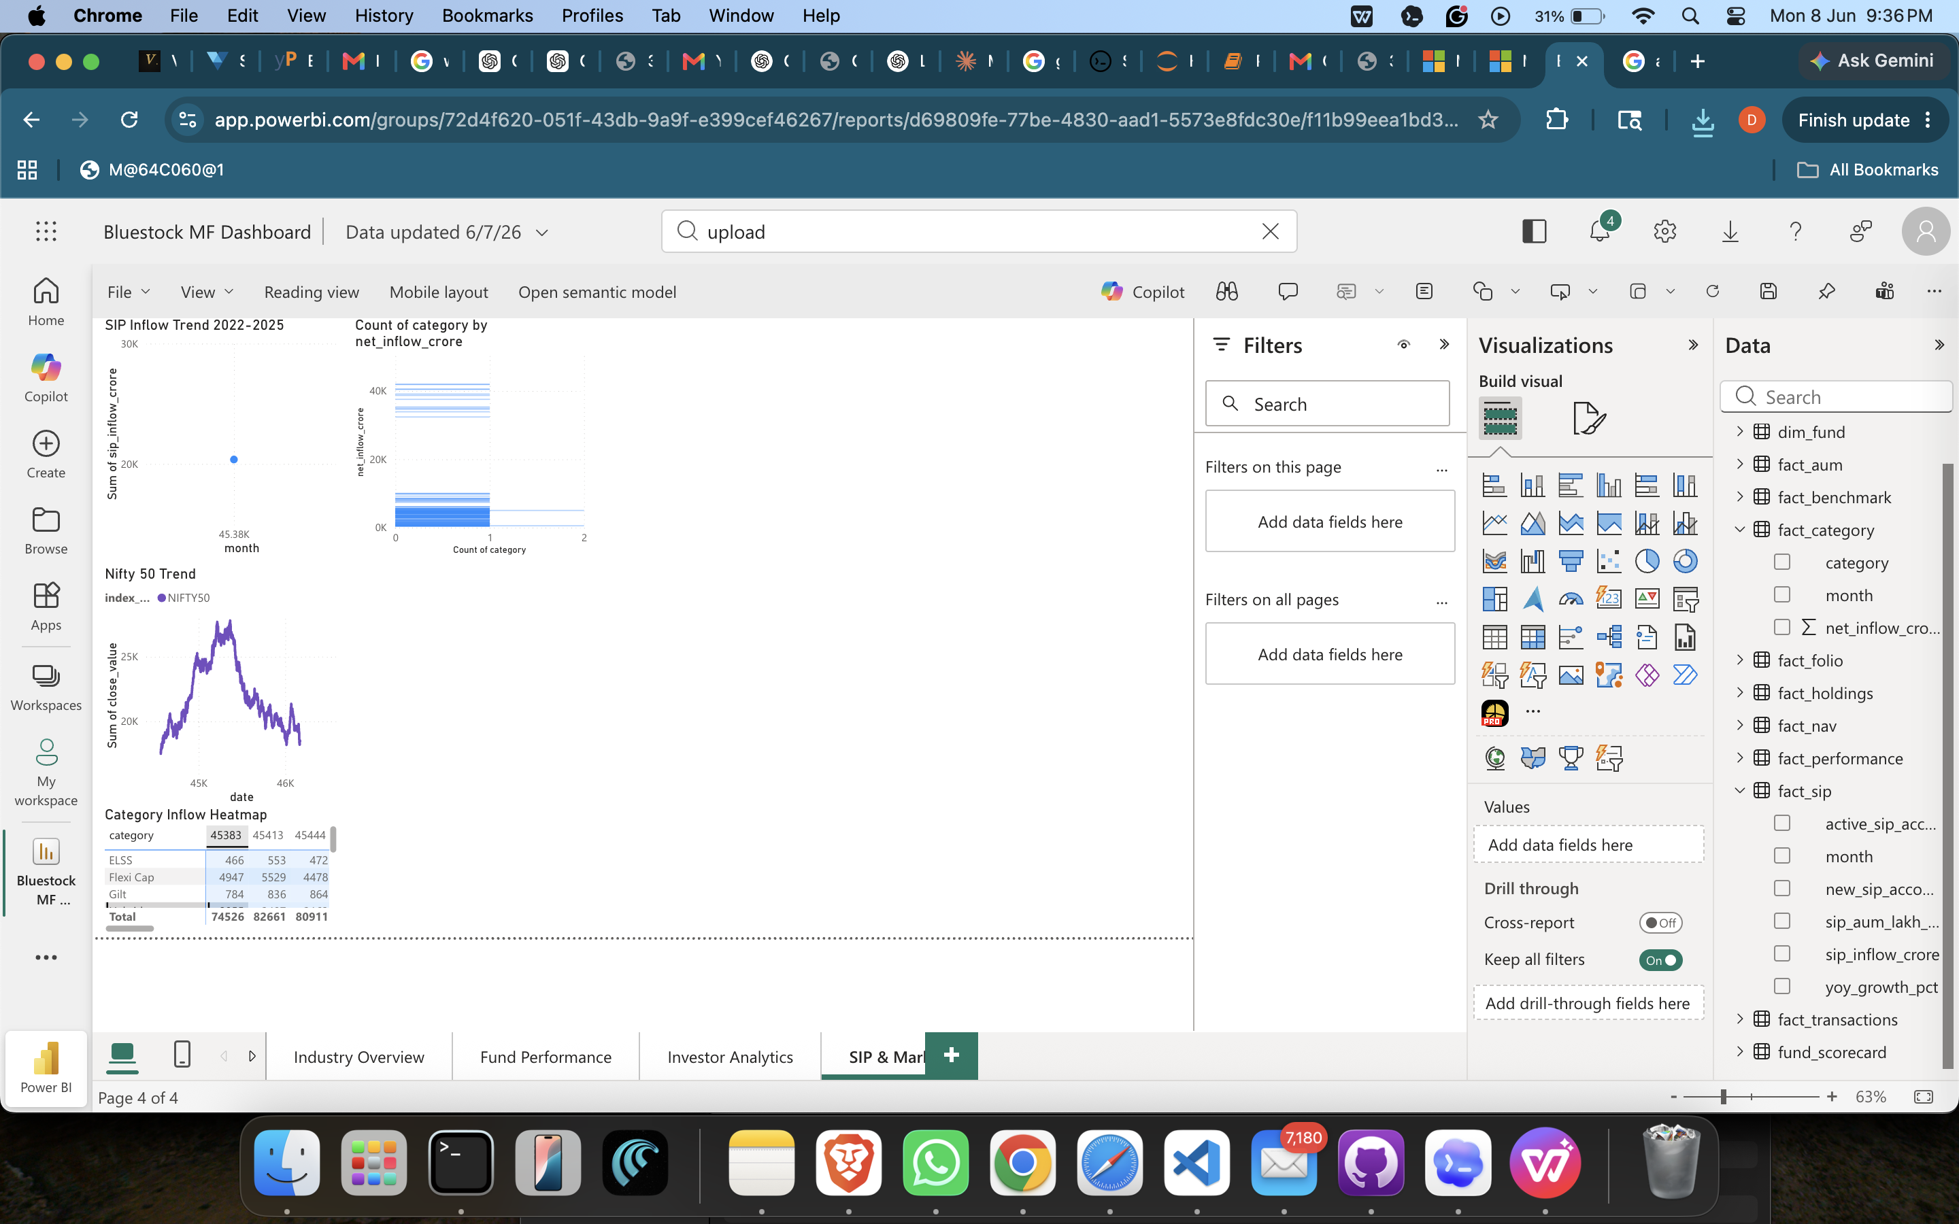
Dashboard Screenshots: Investors & Market Trends
Investor Analytics explores state, transaction type, age group, and transaction volume.
SIP & Market Trends compares SIP inflow, Nifty 50, and category inflows.
Bluestock MF Capstone | 10

Slide 11
Key Findings
Large AMCs dominate industry AUM, with SBI among the strongest visible players.
SIP inflows and folios show rising investor participation over the project period.
Risk-adjusted performance differs meaningfully across funds even when returns look similar.
VaR and CVaR identify funds with larger downside tail risk.
Investor cohort and SIP continuity analysis can support targeted retention actions.
Bluestock MF Capstone | 11

Slide 12
Thank You
Bluestock Mutual Fund Analytics Capstone
GitHub repository includes ETL, SQLite schema, notebooks, dashboard exports, report, and presentation.
Bluestock MF Capstone | 12

