Slide 1
Accelerating Super-Resolution CNN Inference via GPU Spatial Reduction
A Cross-Platform Study on Unified and Discrete Memory Architectures
IEEE ITIS 2026
M. Hamdani Ilham Latjoro

Slide 2
FSRCNN's last layer is both the compute bottleneck and a correctness hazard
Layer 8 does the upscaling: a 9×9 transposed convolution across 56 channels, accumulated into one output plane, for 2× upscaling.
Disproportionate cost: Layers 1–7 stay in low-resolution space; all upscaling work concentrates in Layer 8.
Parallelizing it is a dilemma: naive shared accumulation races; mutexes/atomics bring severe contention.
Dong, Loy & Tang (2016), FSRCNN, ECCV

Slide 3
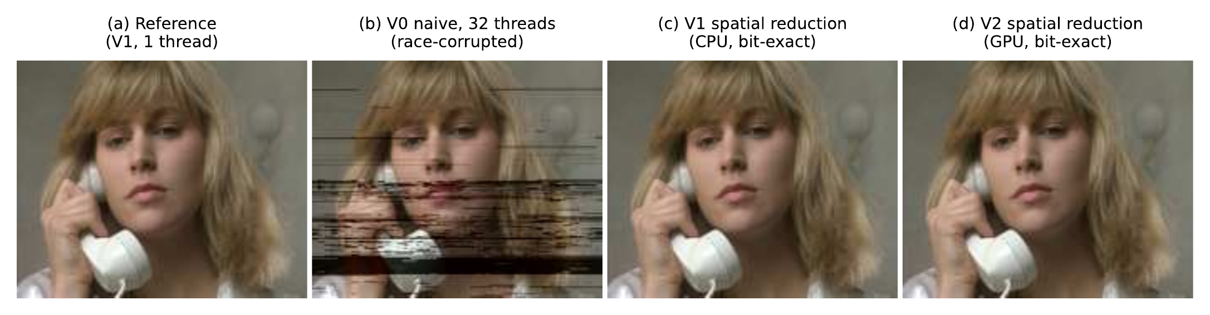
Naive multi-threaded accumulation corrupts output non-reproducibly
(b) V0 corrupted, 21.5 dB PSNR-Y / 0.767 SSIM — (c)/(d) V1 (CPU) and V2 (GPU) bit-identical to reference (a)
Same 32-thread run, three repeats: 4.75M / 5.01M / 5.04M bytes corrupted each time — never the same output twice.
Fig. 2, frame 26, i9-14900K / RTX 4090

Slide 4
Can GPU offload fix the race — and go faster — without losing bit-exactness?
Offload Layer 8's deconvolution and reduction to CUDA, executing Layers 1–7 on the CPU, and verify the GPU result is byte-identical to a deterministic CPU reference on every configuration.
Tested on two architecturally distinct platforms: an NVIDIA GB10 (unified memory) and an RTX 4090 desktop (discrete memory).

Slide 5
Privatize-then-reduce eliminates the race by writing to isolated per-channel buffers
Three variants compared
V0 (naive): threads accumulate directly into one shared buffer → races.
V1 (CPU spatial reduction): private buffer, 56×352×288 doubles (43.3 MiB), each channel isolated; fixed-order reduction pass.
V2 (GPU spatial reduction, proposed): same pattern, moved to CUDA — next slide.

Slide 6
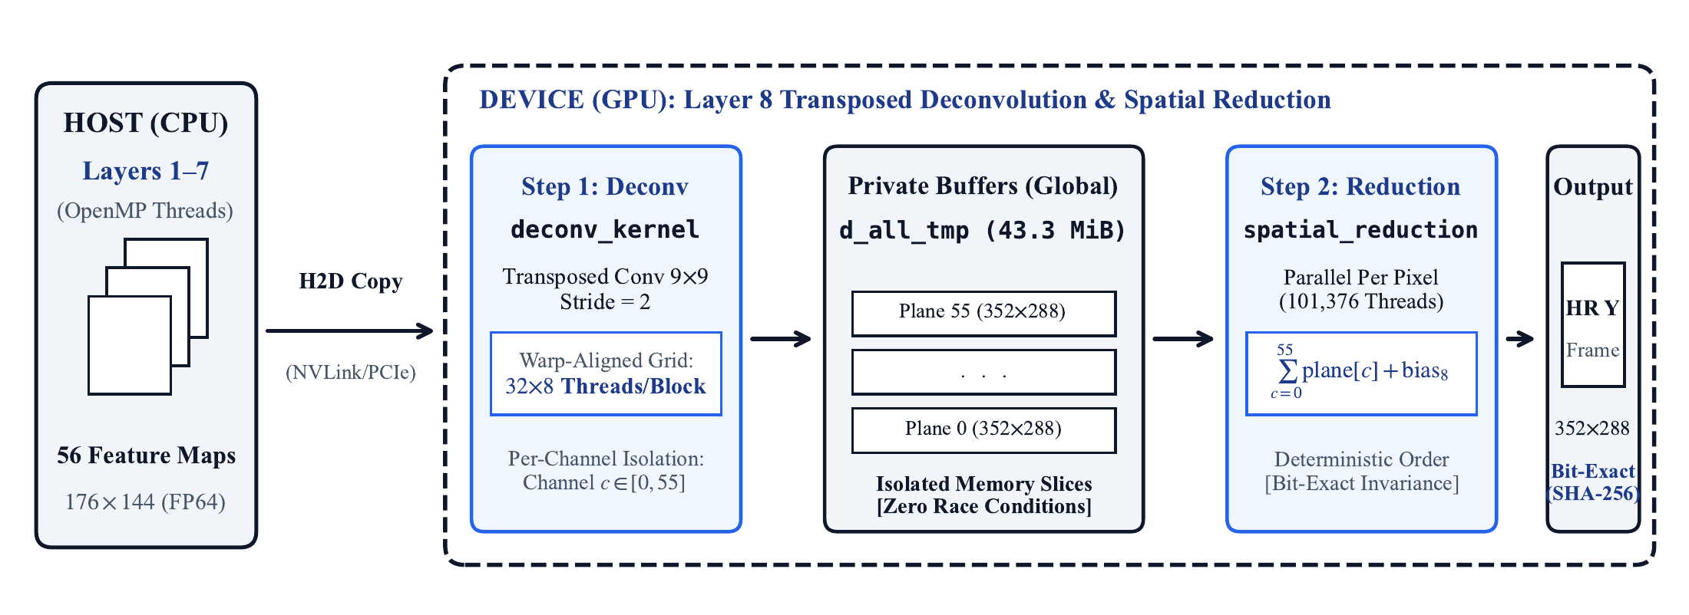
We move privatize-then-reduce onto the GPU with two custom CUDA kernels
Fig. 1: deconv_kernel writes isolated channel planes; spatial_reduction_kernel sums them in fixed order.

Slide 7
A warp-aligned 32×8 thread block maximizes memory coalescing
Custom kernels, not cuDNN or atomicAdd: atomicAdd's non-deterministic summation order across asynchronous warps breaks bit-exactness; cuDNN doesn't expose the per-channel buffers our verification needs.
Warp granularity is 32 threads: a 16×16 block splits a warp across non-contiguous rows.
32×8 aligns every warp to one contiguous row: all 32 threads issue into one memory transaction.

Slide 8
Two architecturally distinct platforms test whether the result generalizes
Component | GB10 (ASUS GX10) | RTX 4090 Desktop
CPU | 20-core ARM DynamIQ big.LITTLE (10× X925 + 10× A725) | Intel i9-14900K 8 P-core + 16 E-core
GPU | NVIDIA Blackwell, 48 SMs | NVIDIA Ada Lovelace, 128 SMs
Memory | 128 GB LPDDR5x, unified | 64 GB DDR + 24 GB GDDR6X, discrete
Interconnect | NVLink-C2C | PCIe
Table I

Slide 9
V0's race corrupts output non-reproducibly; V1/V2 are bit-exact by construction
What to take away
V0 degrades non-monotonically: 13.8 dB (GB10, 4 threads) to 68.6 dB (RTX 4090, 4 threads) to 23.0 dB at 32 threads.
68.6 dB is invisible — and still non-deterministic: a race a human reviewer would not notice by eye is exactly the case for determinism by construction.
V1 and V2 verified byte-identical: cmp -l, diff_bytes = 0, across every grid configuration tested.
Section IV-A, Table II

Slide 10
GPU offload beats the fastest verified CPU baseline by 1.46× and 1.63×
1.46× on GB10
(31.5 FPS)
1.63× on RTX 4090
(27.6 FPS)
Table II, best-grid configuration (32×8_256)

Slide 11
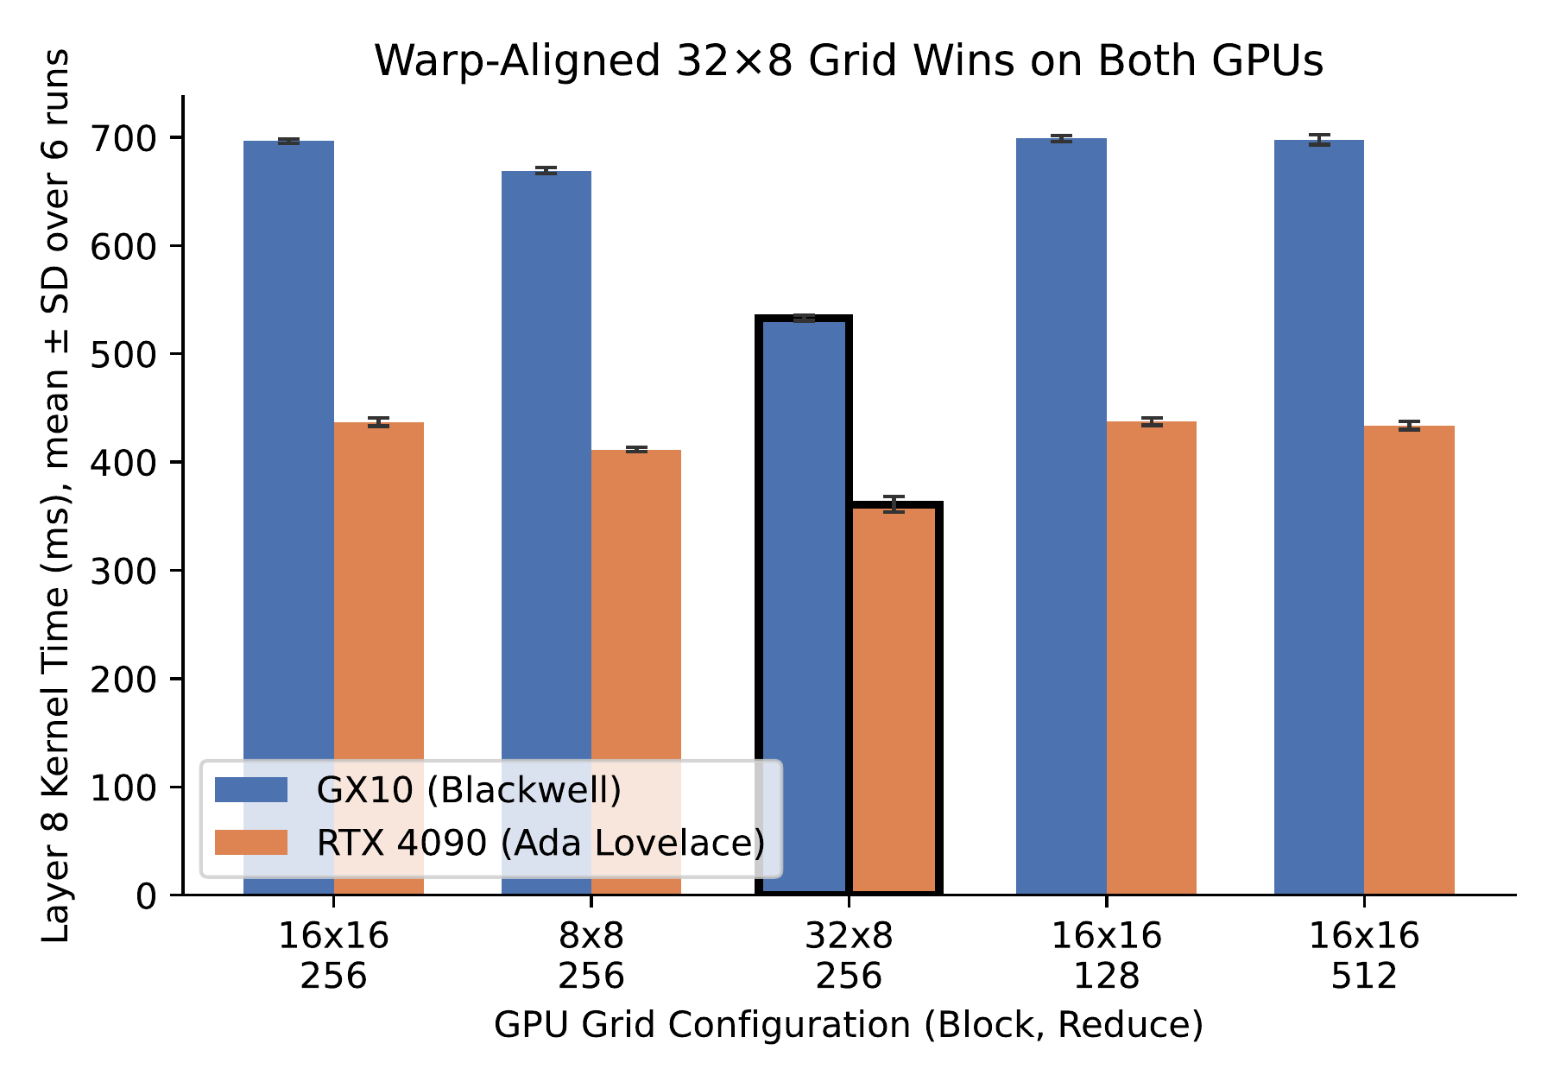
Warp alignment cuts kernel time 23.4% and 17.4% on both GPUs
What to take away
GB10: 696.5 → 533.2 ms (−23.4%)
RTX 4090: 437.1 → 360.9 ms (−17.4%)
Gain isolates entirely to deconv_kernel; the reduction kernel is unchanged.
Fig. 3, Section V-A / VI-C, Welch's t-test p < 10⁻⁴

Slide 12
Determinism costs 4.6% of GPU time on GB10 but only 0.6% on RTX 4090
Why: an L2-cache boundary
RTX 4090's 72 MB L2 holds the 43.3 MiB private buffer → reduction served from cache.
GB10 streams the buffer from unified DRAM at 95% of peak bandwidth → 10× costlier.
This L2 story is currently inferred from bandwidth arithmetic, not measured directly (see Open Questions).
Section VI-D, Table III

Slide 13
GPU output is bit-identical across two host ISAs and two GPU generations
cmp -l: 0 differing bytes.
SHA-256 digests match bit-for-bit across the ARM host / Blackwell GPU
and x86 host / Ada Lovelace GPU runs.
This is the strongest determinism test in the paper: different host instruction set, different GPU microarchitecture, same output.
Section VI-B

Slide 14
Unified memory transfers 4.74× faster; discrete GPUs reduce 10× faster
Stage | GB10 (unified) | RTX 4090 (discrete) | Winner
Device-to-host transfer | 3.46 ms | 16.42 ms | GB10, 4.74×
Spatial reduction kernel | 26.32 ms | 2.62 ms | RTX 4090, 10.0×
No single architecture wins every stage: which memory model helps depends on whether the stage is transfer-bound or bandwidth-bound-and-cacheable.
Section VI-D, Table III

Slide 15
Three open questions the paper names as future work
No competitive GPU baseline (atomicAdd, cuDNN)
Reasoned in the paper: both break bit-exactness or hide the buffers we verify — not run.
L2 residency model is inferred, not measured
DATA PENDING
Nsight Compute profiling (L2 hit rate, throughput, occupancy) on both GPUs.
FP32 / FP16 / BF16 trade-off is unmeasured
DATA PENDING
Reduced-precision Layer 8 variant built; throughput vs. PSNR-Y/SSIM trade-off to be measured.
Section VII — collect_ncu_profile.sh / collect_fp16_comparison.sh will supply the two pending numbers

Slide 16
Conclusions
1. GPU spatial reduction is deterministic by construction: bit-exact vs. a verified CPU reference on every configuration, and bit-identical across two host ISAs and two GPU generations.
2. It is also faster: 1.46× (GB10, 31.5 FPS) and 1.63× (RTX 4090, 27.6 FPS) over the fastest verified CPU baseline.
3. Warp-aligned 32×8 blocks cut kernel time 23.4%/17.4%; memory architecture picks the winner per stage — unified wins transfer, discrete wins the cacheable reduction.
M. Hamdani Ilham Latjoro | IEEE ITIS 2026

Slide 17
References
Dong, C., Loy, C.C., Tang, X. (2016). Accelerating the Super-Resolution CNN. ECCV.
Annisa, A., Adnan, A., Zainuddin, Z. (2025). Enhancing Computational Efficiency... FSRCNN on AMP Architecture. IEEE AIMS.
Wang, S. et al. (2020). High-Throughput CNN Inference on Embedded ARM big.LITTLE. IEEE TCAD.
Chetlur, S. et al. (2014). cuDNN: Efficient Primitives for Deep Learning. arXiv:1410.0759.
Chen, T. et al. (2018). TVM: An Automated End-to-End Optimizing Compiler for Deep Learning. USENIX OSDI.
NVIDIA Corp. CUDA C++ Programming Guide; Ada GPU Architecture Whitepaper; TensorRT Architecture Overview.

Slide 18
Appendix A — Anticipated Question
Why not compare against atomicAdd or cuDNN?
atomicAdd: floating-point addition is non-associative; asynchronous warps race to accumulate in different orders, so results vary run to run — the opposite of what this paper needs.
cuDNN: optimizes for batched matmul; does not expose the isolated per-channel buffers our zero-race verification contract depends on.
Future work: a throughput-only (not correctness) comparison against both remains useful to price determinism against an unconstrained baseline.

Slide 19
Appendix B — In Progress
Nsight Compute counters for deconv_kernel / spatial_reduction_kernel
DATA PENDING
Metric | GB10 | RTX 4090
L2 hit rate (lts__t_sector_hit_rate.pct) | TBD | TBD
L2 throughput (% of peak) | TBD | TBD
DRAM throughput (% of peak) | TBD | TBD
Achieved occupancy (sm__warps_active) | TBD | TBD
Run: newpaper/plans/collect_ncu_profile.sh on both machines, then fill this table.

Slide 20
Appendix C — In Progress
What does bit-exact determinism cost against FP16/BF16?
DATA PENDING
Variant | GPU L8 time | diff_bytes | PSNR-Y / SSIM
FP64 (paper's baseline) | 533.19 ms (GB10) | 0 (bit-exact) | ∞ / 1.000
FP16 | TBD | TBD | TBD
BF16 | TBD | TBD | TBD
Run: newpaper/plans/collect_fp16_comparison.sh on both machines, then fill this table.

