Slide 1
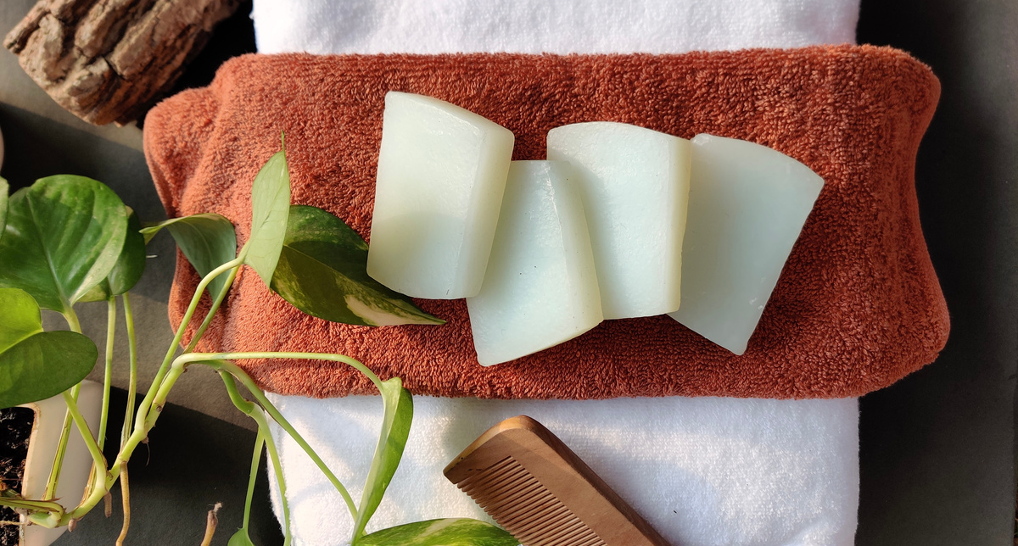

1
Project Abeer
Project Head
Simran Dhankar & Tushar Kapoor
THE PROJECT WORK IS DONE BY THE CONTRIBUTION OF EVERY MEMBER OF ENACTUS ADGITM.
Overview
Project Abeer was initiated to uplift the underprivileged communities by giving them a chance to earn some extra income by the production of various hygiene products.
The project's main objective is to help these communities develop and make them aware about the importance of hygiene and cleanliness by going organic all the way.

Slide 2
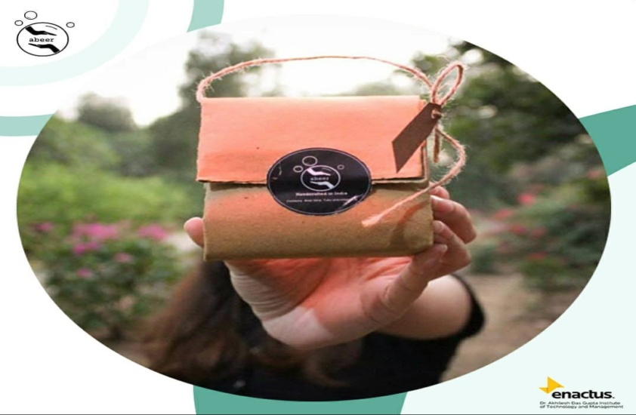
2
PRODUCT DESCRIPTION
Ingredients
Products are hand-crafted using natural, skin-safe, pure ingredients like Tulsi, Aloevera and Vitamin E infused with soap bases.
Packaging
We believe that making organic soaps doesn't complete our duty towards our mother Earth. Therefore, we chose to create packaging that is both aesthetically pleasing and environmentally friendly. Our Product Packaging is 100% Plastic-Free and biodegradable!

Slide 3
3
Various Stages of the Project
Stage -1: Research and Prototyping Phase
1. The research stage encompassed of finding a list of suitable organic ingredients that are necessary for making soaps and dry shampoo bars and choosing the finest of them as per the requirements of the product.
2. The prototyping phase included the making of a sample product and examining if the soap met with the basic standards set by a satisfactory hygiene product. The sample product of the soap was tested by our team and it was certified that it carried all the required qualities present in decent soap.
Stage - 2: Implementation Phase
1. Under this phase, we manufactured the first batch of our soap which was later tested and was substantiated as a satisfactory product.
2. Later, these soaps were enfolded in an environmental-friendly packaging by keeping hygiene our first priority.
3. We have launched our project on 1st December and have started publicising our product.
Stage - 3: Marketing and Selling Phase
1. We aim to sell these products to our customers through our Enactus store i.e. (DARPAN) and it’s Instagram handle.
2. We will also be marketing the project through our main Instagram handle which has around 1.5k followers.
3. We will be collaborating with various NGOs and organizations for the success of this venture.
4. We target to expand our project by collaborating with different hotels and resorts in future.
5. We also intend to sell our products in different college and school fests.

Slide 4
4
METHODOLOGY
1. The community will manufacture soap and packaging and we will provide our assistance by teaching them about the strategies and techniques required
in manufacturing of a decent hygiene product.
2. We will provide the communities with the ingredients required in the process of making soaps and will support them market their produces.
3. All the profits earned from the programme will be handed over to these communities.
4. In the later stage of our project, we intend to tie up with different hotels and resorts and sell these produces to them which will ensure a constant income to these communities.
5. Last but not least, in parallel to making these communities financially independent we also aim to teach them about the importance of hygiene and cleanliness.
BENEFITS TO COMMUNITY
A SOURCE OF INCOME
We aim to support underserved communities by helping them earn some regular profits which will support them fulfill their basic requirements.
ENTREPRENEURIAL EXPERIENCE
With the help of project Abeer, they will learn how to work in a team, take initiative and accept responsibility. They learn the basic skills needed to run an effective business.
FINANCIAL INDEPENDENCE
Through project Abeer, we aim to assistant these communities to become financially independent. This will help them to acquire qualities like capacity building and self-reliance.

Slide 5
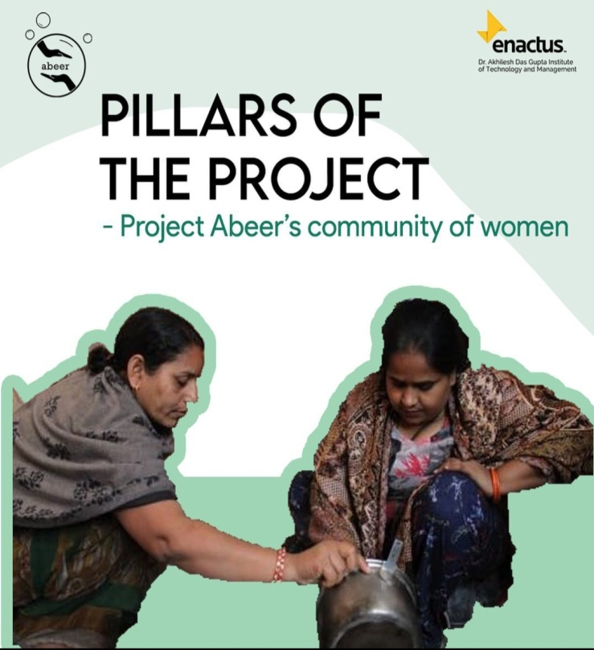
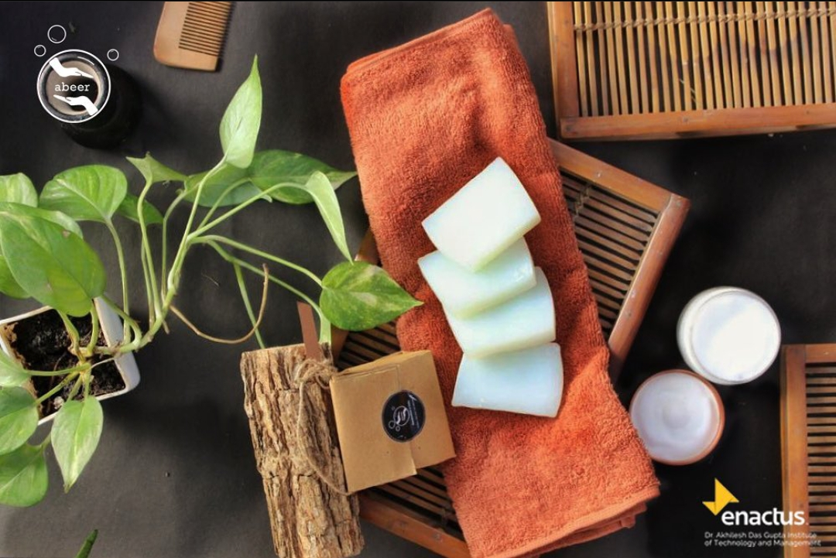
5
FUTURE PLANS
1. We plan to expand our product range to other environment-friendly
hygiene products such as Shampoo Bars Scented Soap Bars,etc.
2. We aim to expand our project by collaborating with different hotels and resorts in future.
3. We aim to spread awareness about the importance of proper sanitation and hygiene.
4. We aim to increase our product sale by setting up Facebook Marketplace so that the community can earn more.
THANK YOU

