Slide 1
Cisco Azure HDInsight Kafka and Ambari
Aqil Syed (Specialist)
Sayanthani Goswami (CSA-infra)
Sridhar Kothalanka (CSA-Data&AI)
Feb 2020

Slide 2
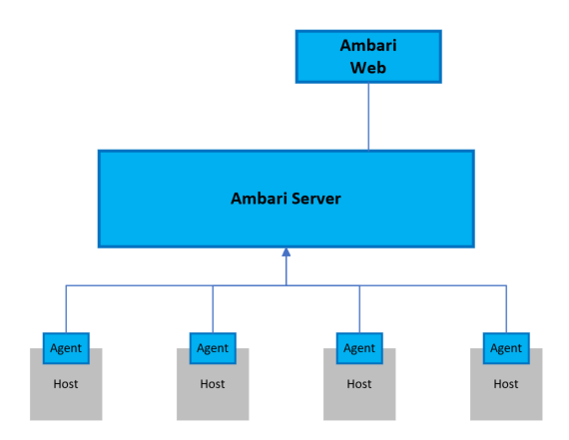
What is Apache Ambari
Apache Ambari simplifies the management and monitoring of an Apache Hadoop cluster by providing an easy to use web UI and REST API.
Ambari is included on HDInsight clusters, and is used to monitor the cluster and make configuration changes.
Reference:
https://docs.microsoft.com/en-us/azure/hdinsight/hdinsight-hadoop-manage-ambari
The Ambari Web UI is available on your HDInsight cluster at
http://CLISTERNAME.azurehdinsight.net, where CLUSTERNAME is the name of your cluster

Slide 3
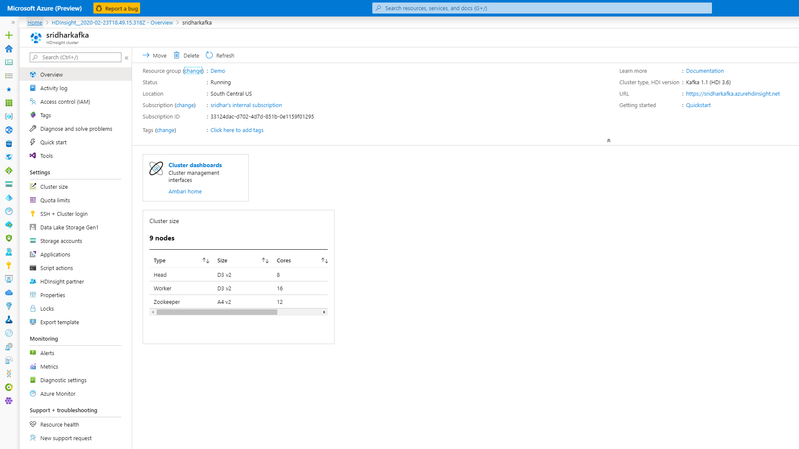
Launch Ambari Web UI from Azure HDInsight Kafka
Click to launch Ambari
Cluster URL

Slide 4
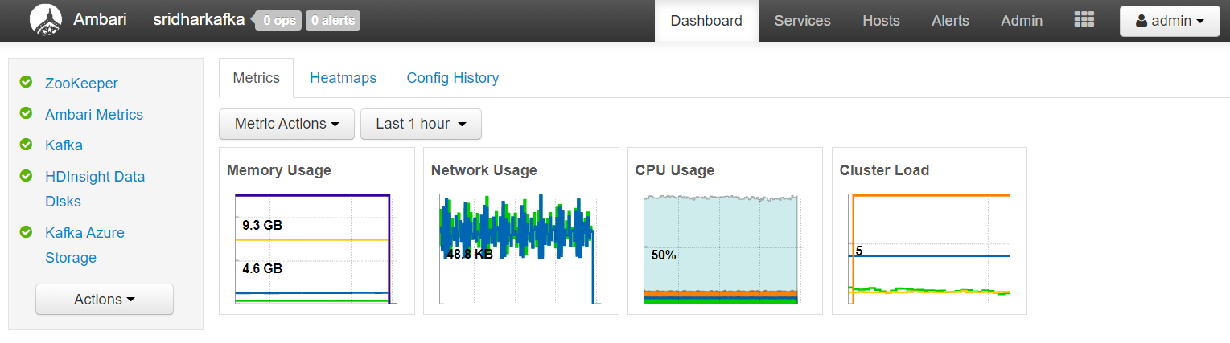
Ambari Dashboard
Dashboard includes three options:
The services sidebar on the dashboard provides quick insight into the status of the services running on the cluster. Various icons are used to indicate status or actions that should be taken. For example, a yellow recycle symbol is displayed if a service needs to be recycled.

Slide 5
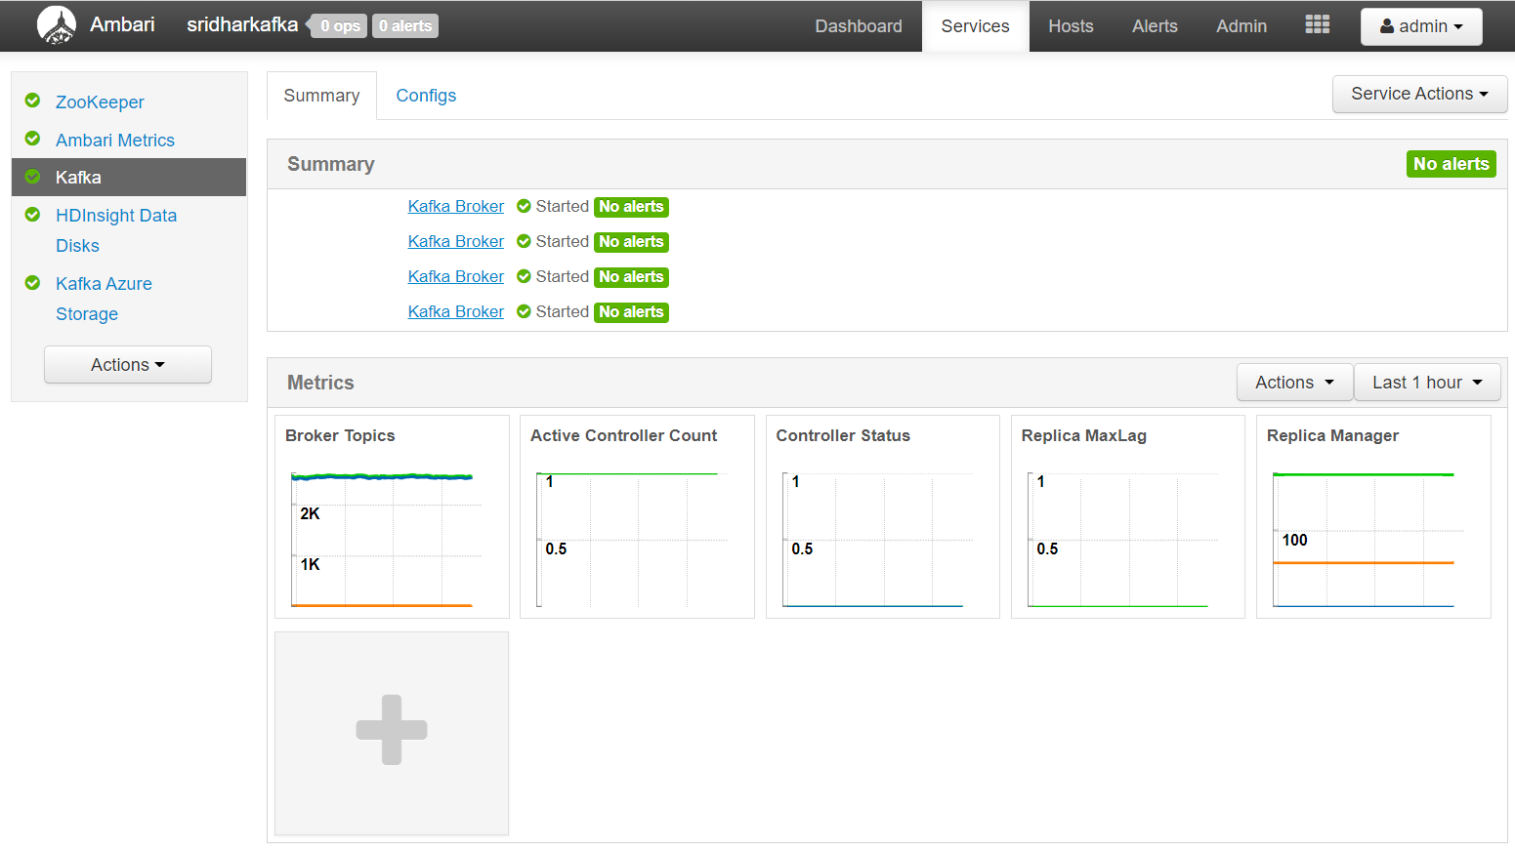
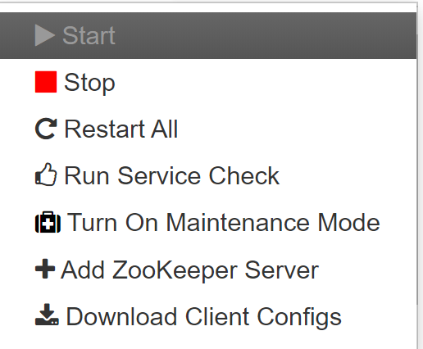
Kafka Service Summary
4 broker nodes

Slide 6
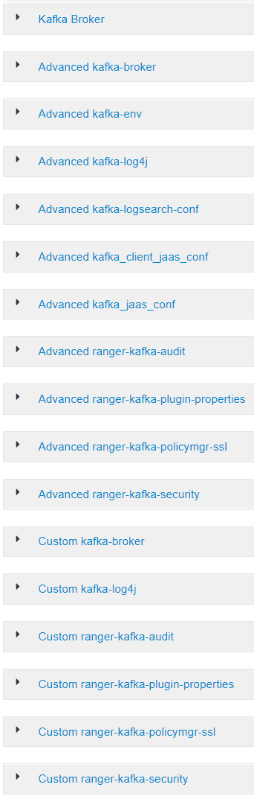
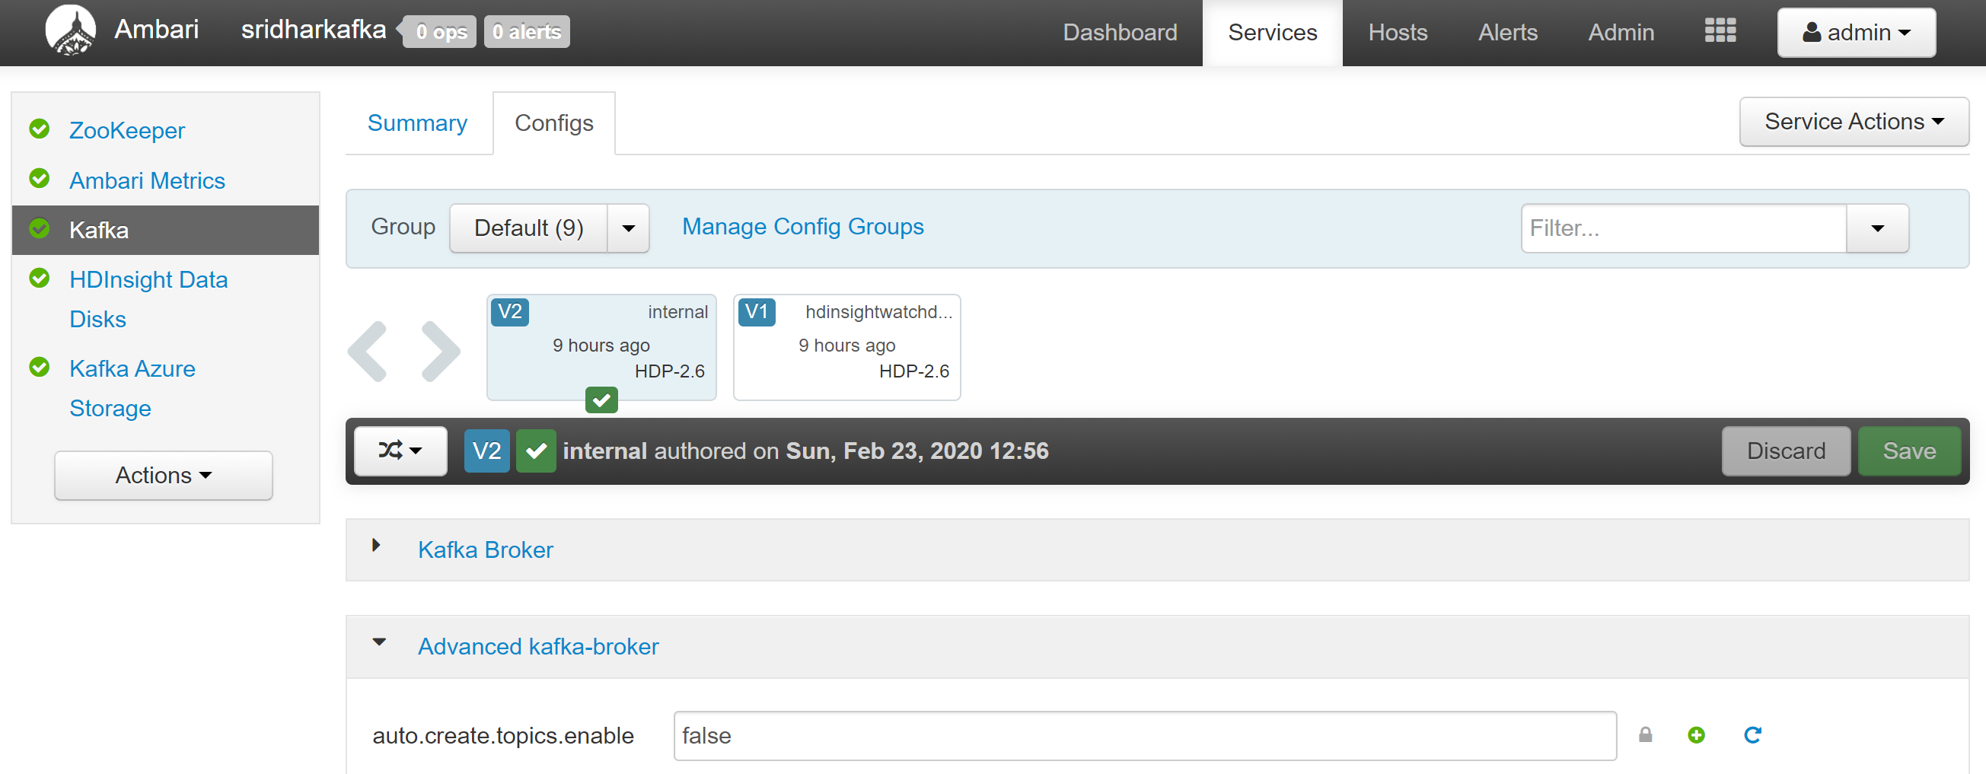
Kafka Configs

Slide 7
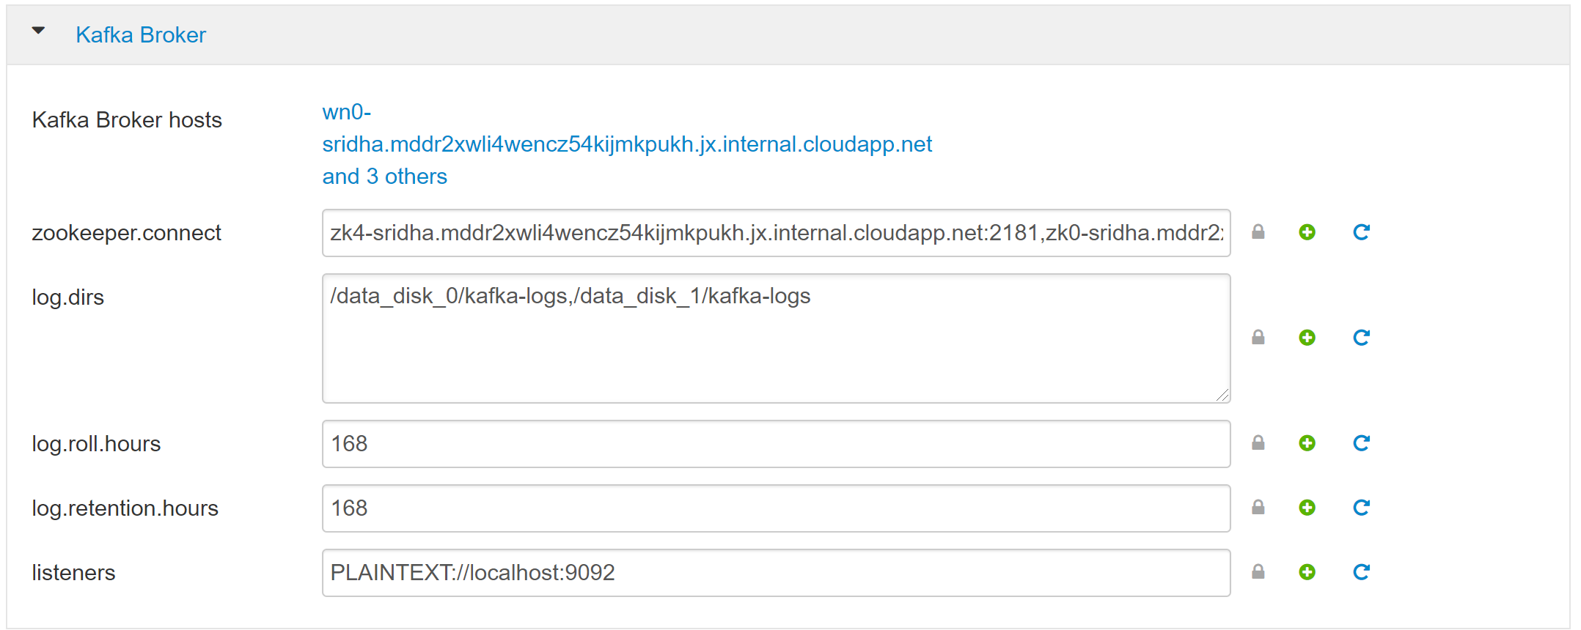
Kafka Broker config

Slide 8
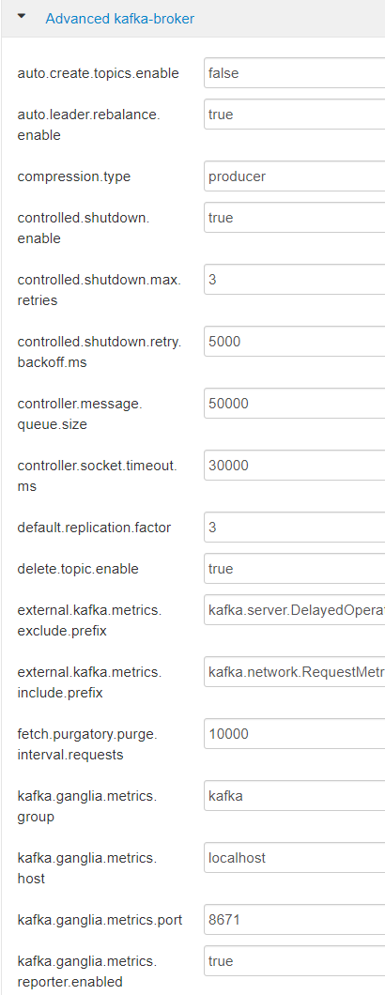
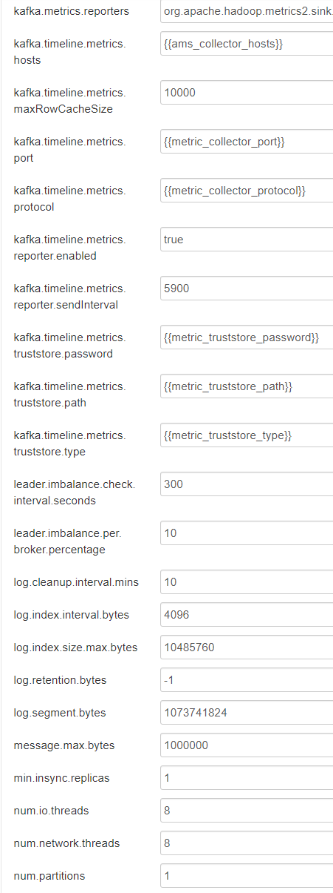
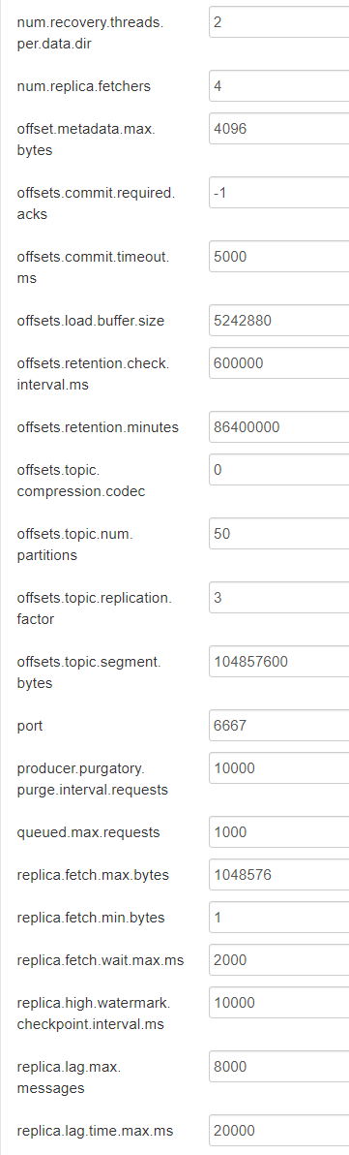
Advanced Kafka-broker config

Slide 9
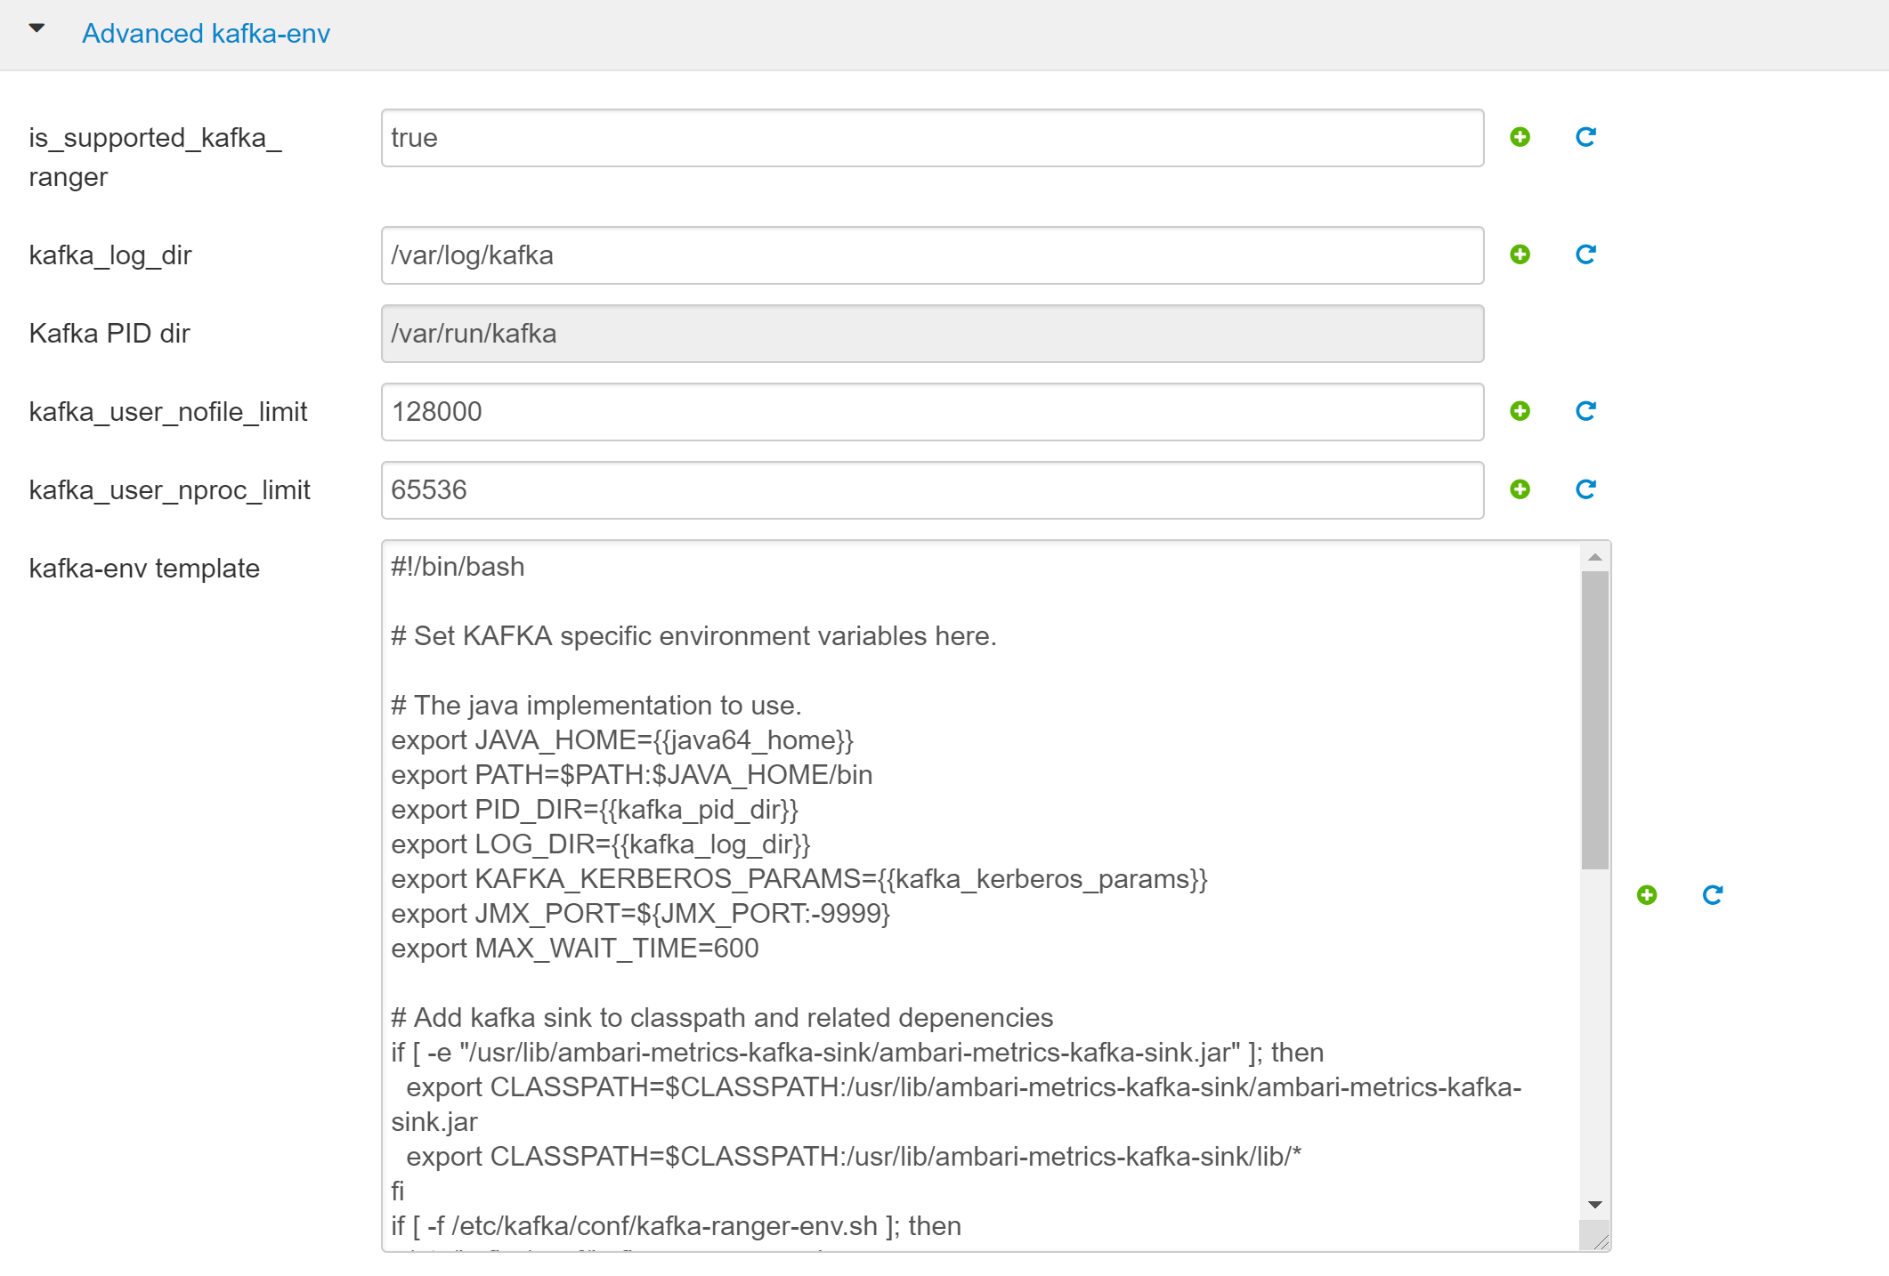
Advanced Kafka-env config

Slide 10
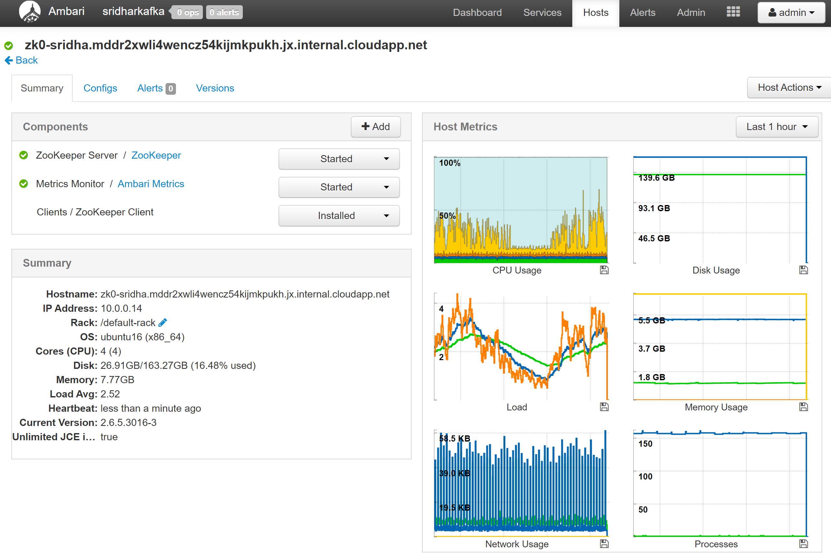
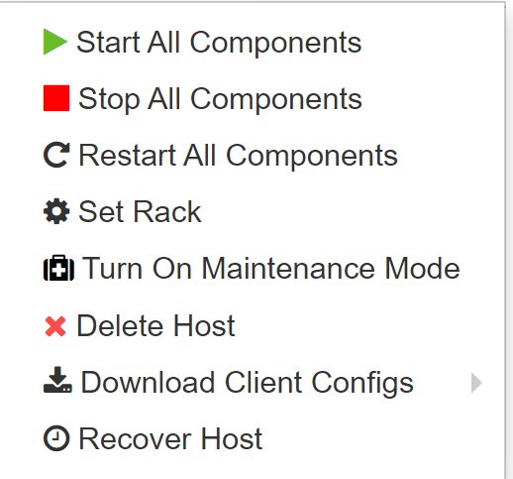
Kafka Broker Drill Down

Slide 11
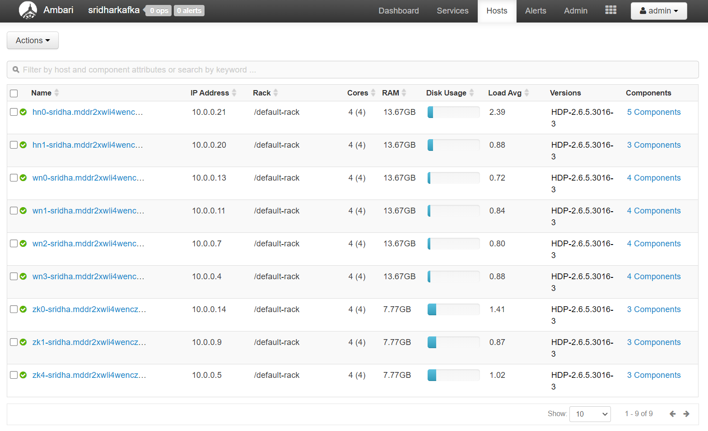

Hosts
Kafka Azure Export
Kafka Azure Import
Metrics Collector
Grafana
Metrics Monitor
Head nodes
Kafka Azure Export
Kafka Azure Import
Metrics Monitor
Azure HDInsight Data Disks Validator
Azure HDInsight Data Disks Watcher
Kafka Broker
Metrics Monitor
Worker nodes
Metrics Monitor
ZooKeeper Client
ZooKeeper Server
Zookeeper nodes

Slide 12
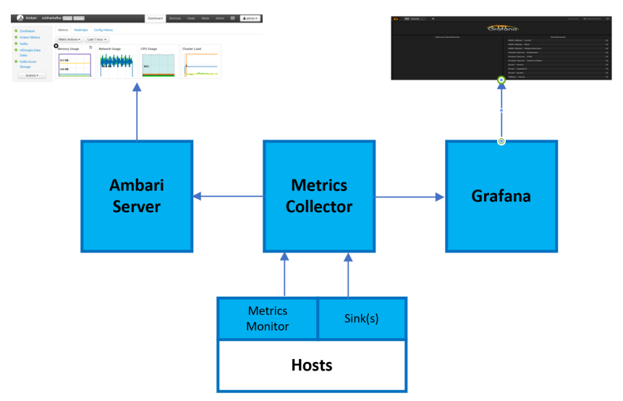
Metrics Collector
Ambari Metrics System has four components:
Metrics Monitors on each host in the cluster collect system-level metrics and publish to the Metrics Collector.
Hadoop Sinks plug in to Hadoop components to publish Hadoop metrics to the Metrics Collector.
The Metrics Collector is a daemon that runs on a specific host in the cluster and receives data from the registered publishers, the Monitors, and the Sinks.
Grafana is a daemon that runs on a specific host in the cluster and serves prebuilt dashboards for visualizing metrics collected in the Metrics Collector.
AMBARI: http://CLISTERNAME.azurehdinsight.net
GRAFANA: https://CLUSTERNAME.azurehdinsight.net/grafana/

Slide 13
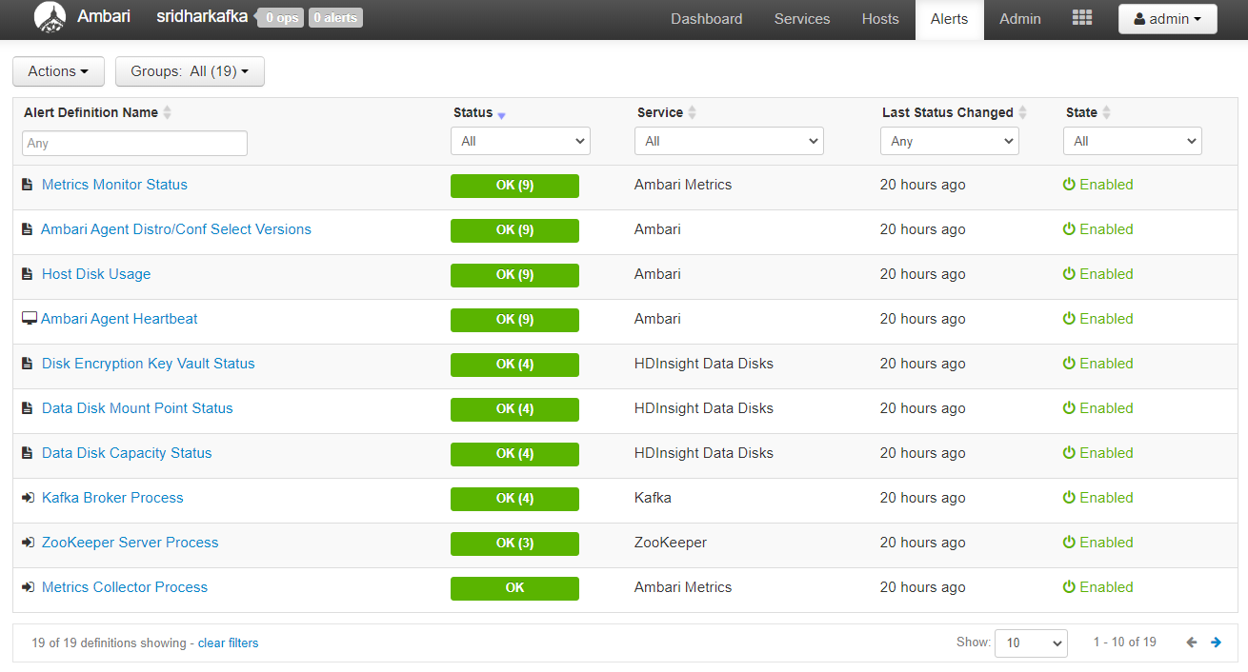
Alerts

Slide 14
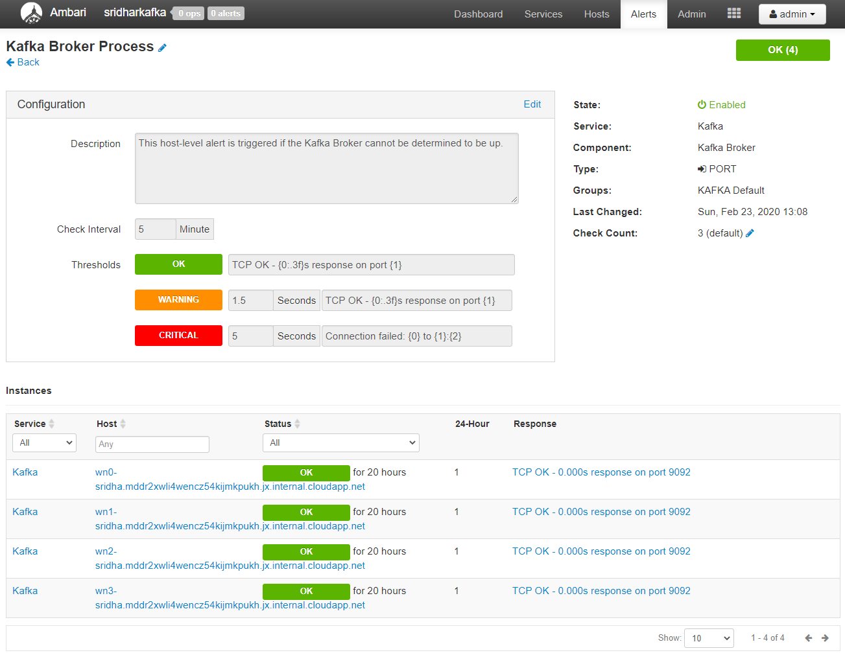
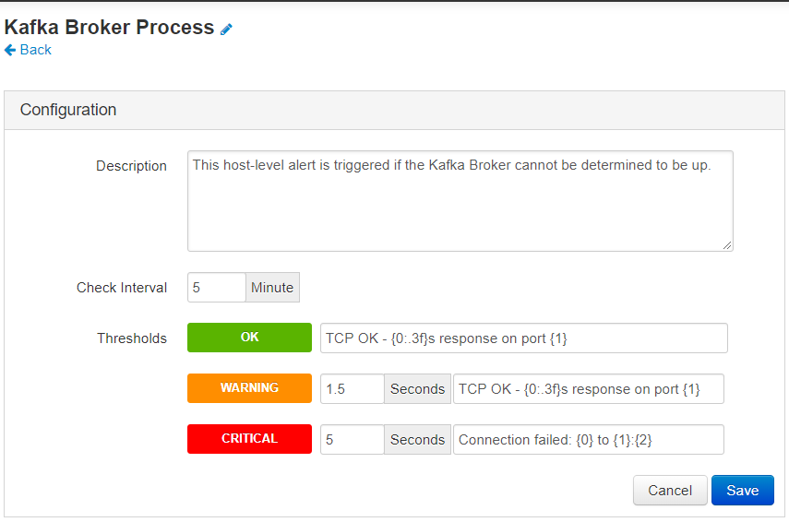
Kafka Service Alert

Slide 15
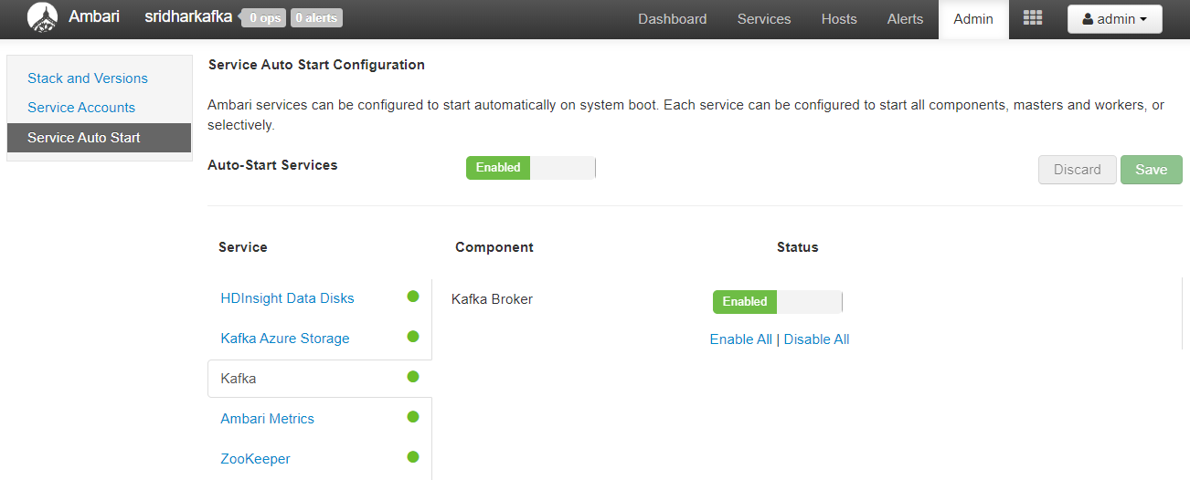
Admin

Slide 16
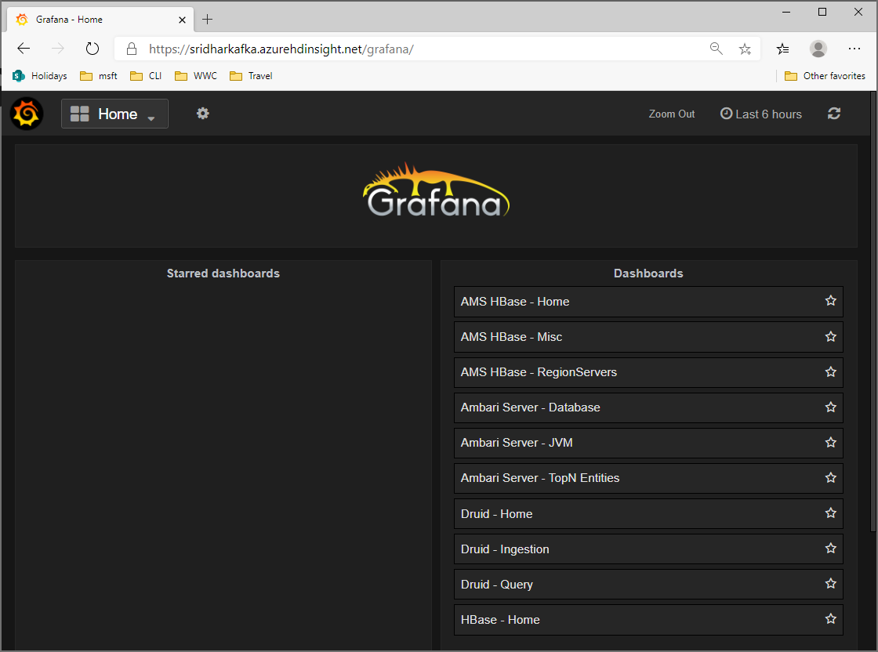
Grafana
GRAFANA: https://CLUSTERNAME.azurehdinsight.net/grafana/
Grafana is a popular, open-source graph and dashboard builder. Grafana is feature rich; not only does it let users create customizable and shareable dashboards, it also offers templated/scripted dashboards, LDAP integration, multiple data sources, and more.
https://docs.microsoft.com/en-us/azure/hdinsight/interactive-query/hdinsight-grafana

Slide 17
Q&A

Slide 18
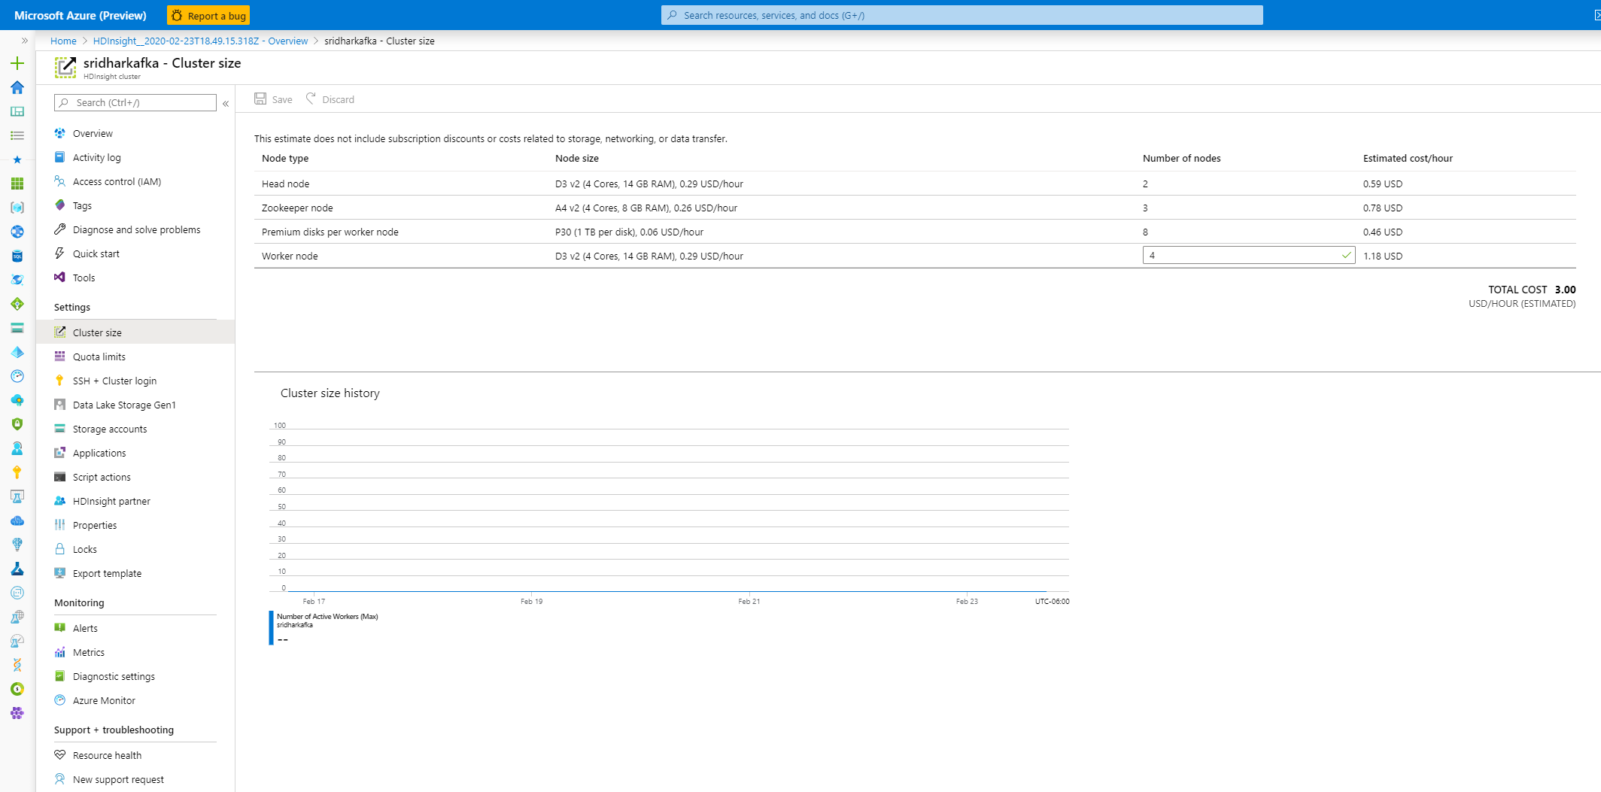
Create a HDInsight Kafka Cluster
Note the type and number of nodes in the kafka cluster

