Slide 1
PostgreSQL Questions
Sridhar Kothalanka (CSA-Data&AI)
Jan 2020

Slide 2
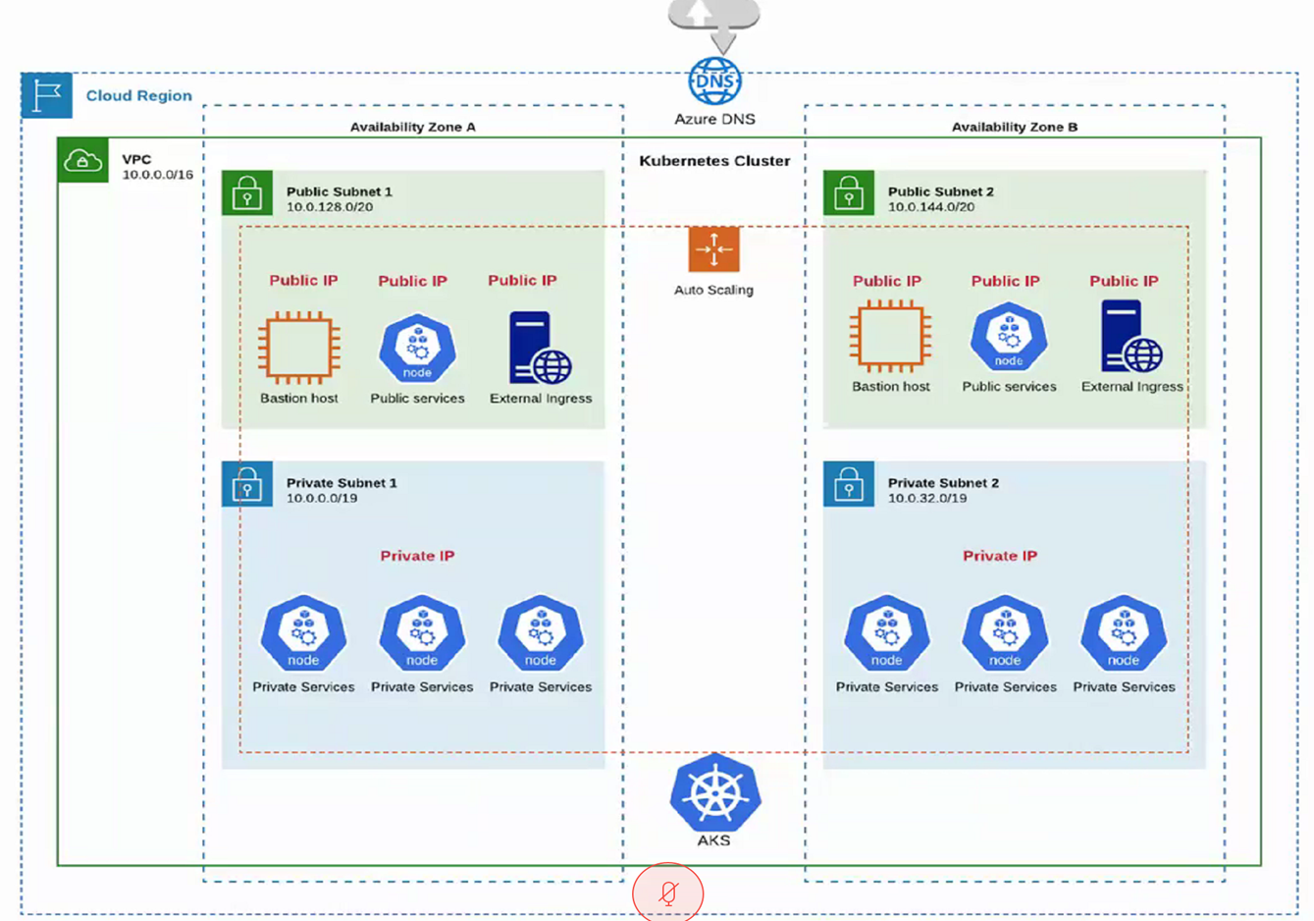
Introduction
Overview
Customer is currently exploring Azure cloud services and evaluating if the below PaaS solutions meet their needs
Kubernetes
PostgreSQL
Redis
Customer has used these open source products available on AWS and is technically aware of the products and features however would like to understand how these PaaS solutions are offered by Azure as a managed service.
High level use case
End devices will need to communicate in real time to a cloud infrastructure where a proprietary solution is deployed as a microservice in Kubernetes (Pls see backup slide).

Slide 3

Azure Database for PostgreSQL Questions
Pricing
What are the pricing options available?
High Availability
High availability with no additional cost (99.99% SLA), need details?
Upgrades
How are upgrades handled as a managed service?
DB Schema Versioning
How is DB schema handled?
Optimization
How is optimization handled on the database?
Maintenance (Backup & Restore)
How is backup and restore handled?

Slide 4
Pricing
Deployment
Tiers
Options
Single Server
Hyperscale
Basic
General Purpose
Memory Optimized
Compute
Storage
Backup
High Availability
Read Replicas
TOTAL
PRICE
Basic:
Light compute & IO Performance
Example: Dev/Test/Small scale infrequent applications
General Purpose:
Most business workloads
Example: Web/Mobile applications, Enterprise applications
Memory Optimized:
High performance database workloads
Example: Realtime data, Transactional or Analytic apps
Recommendation:
 Memory Optimized
To get an estimate of the price please refer to below link
https://azure.microsoft.com/en-us/pricing/details/postgresql/server/

Slide 5
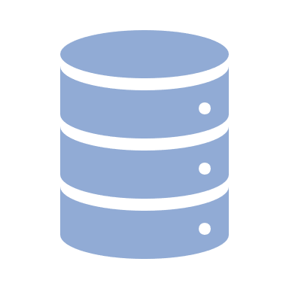
Deployment Options
Single Server
Hyperscale
1
2
3
4
5
Max of 5 replicas in the same region
Cross region replication
Universal replication regions
Paired regions
Same Region
Read Replicas (optional)
Server Group
(single coordinator, multiple workers)
Standby replica
(for every node in server group)
Async
Azure
Sync
Same Region
Server-level Firewall Rules
GW
Coordinator
Workers
Coordinator
Workers
Azure
GW
Sync
Internet
(HA is Optional)
Server-level Firewall Rules
Standby Replica
(In-Built HA,
no additional cost)
GW
Server
Single Database
GW
Internet
Database 1
Database 2
...
Database n
In a nutshell:
Enterprise-grade security and compliance
Built-in high availability, no additional cost
Vertical scale as needed
Secured to protect data at-rest and in-motion
Automatic backups and point-in-time restore
Monitoring and alerting to assess your server
Workloads:
Transactional and operational analytics workloads
Apps requiring JSON, geospatial support, or full-text search
Cloud-native apps built with modern frameworks
In a nutshell:
Enterprise-grade security and compliance
High availability (optional), cost will double if enabled
Horizontal scaling across multiple machines using Sharding
Query parallelization across the servers
Excellent support for multi-tenant applications, Realtime operational analytics, and high throughput transaction workloads (>100GB of data)
Monitoring and alerting to assess the nodes in your server group
Workloads:
Multi-tenant SaaS applications
Real-time operational analytics
High-throughput transactional applications

Slide 6
High Availability
Single Server (Built-in)
Financially backed service level agreement (SLA) 99.99%
Hyperscale (Optional)
Financially backed service level agreement (SLA) 99.95%
standby replicas of every node in a server group
standby replicas of single node
Note: Cost doubles the cluster price if HA is turned on
Note: Built-In HA with no additional cost
MSFT documentation will be updated shortly
NOTE:
At all times, changes made to an Azure Database for PostgreSQL database server occur in the context of a transaction. Changes are recorded synchronously in Azure storage when the transaction is committed. If a node-level interruption occurs, the database server automatically creates a new node and attaches data storage to the new node. Any active connections are dropped, and any inflight transactions are not committed.
It is important that PostgreSQL database applications are built to detect and retry dropped connections and failed transactions.

Slide 7
Read Replica (Single Server, Hyperscale)
When to use
Read replica help to improve the performance and scale of read-intensive workloads. Read workloads can be isolated to the replicas, while write workloads can be directed to the master
Highlights
Up to 5 replicas
Each replica is billed separately
Uses PostgreSQL asynchronous replication
Cross-region replication is supported and can help in scenarios like disaster recovery or bringing data closer to the consumers
Universal replica regions
Paired regions
Replications can be monitored
Limitation
Asynchronous replication, replica will eventually become consistent with the master but there will be a delay
Paired regions may not be available in a region. Some regions are paired in one direction only
If replication is stopped the replica becomes a standalone server. Standalone server cannot be made into a replica again
There is no automated failover between master and replica servers

Slide 8
Upgrades
Microsoft aims to support n-2 versions of the PostgreSQL engine in Azure Database for PostgreSQL.
Current supported PostgreSQL versions: 11, 10, 9.6, 9.5
Minor Version
Automatic minor version upgrades supported
Major Version
Automatic major version upgrades not supported

Slide 9
DB Schema Versioning
Not Supported
PostgreSQL does not support DB schema versioning
Need to use a 3rd party solution

Slide 10
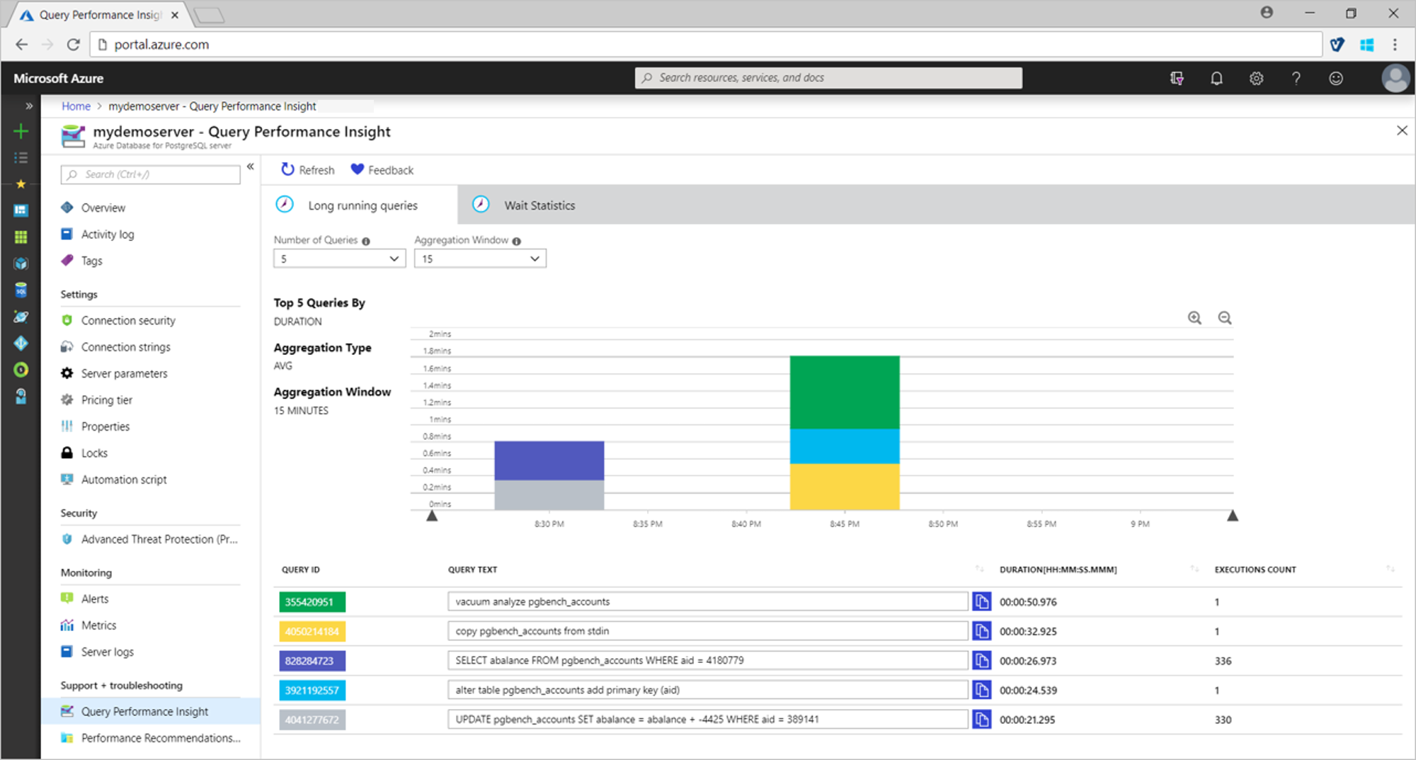
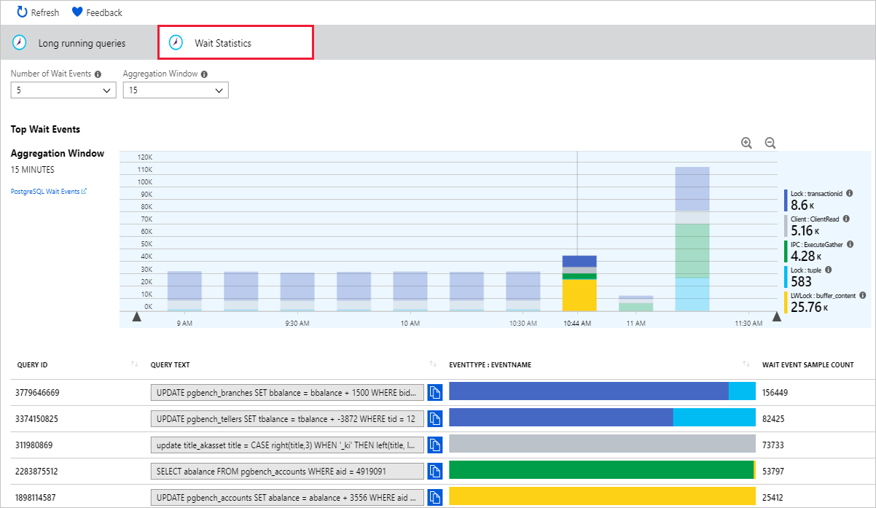
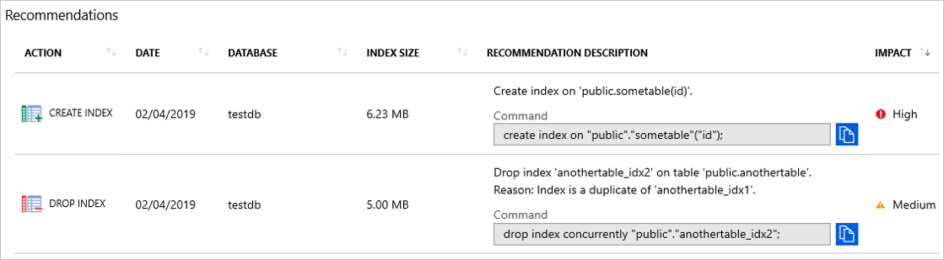
Optimization
Query Store (opt-in feature)
Query Performance Insight
Visualize long running queries
Performance recommendation
Create index suggestions
Tracks query performance over time
Automatically captures query history and runtime stats
Database usage pattern
Visualize wait statistics
Drop index suggestions

Slide 11
Monitoring
Azure Monitor
Service Health
View notifications
Setup alerts
View scheduled maintenance
Azure Monitor collects and aggregates data from a variety of sources into a common data platform where it can be used for analysis, visualization, and alerting.
Metrics
The percentage of CPU in use
The percentage of memory in use
The percentage of IO in use
The percentage of storage used out of the server's maximum
The amount of storage in use
The maximum storage limit for server
The percentage of server log storage used
The amount (Bytes) of server log storage used
The maximum server log storage for server
The number of active connections to the server
The number of failed connections to the server
Network ingress across active connections
The amount of backup storage used
The lag in bytes between the master and the most lagging replica (master server only)
The time since the last replayed transaction (replica servers only)

Slide 12
Backup & Restore (Single Server, Hyperscale)
Redundancy options
Local redundancy (basic tier)
Geo redundancy (local + paired region)
Retention period
7 days (default)
Max 35 days (optional config)
Backup frequency
Full backup – weekly
Differential backup – twice a day (upto 4TB) *or* Snapshot backup – once a day (upto 16TB)
Transaction log – every 5 minutes
Restore
Point-in-time restore (same region)
Geo restore (only available if configured)
Note:
Configuring locally redundant or geo-redundant storage for backup is only allowed during server creation. Once the server is provisioned, you cannot change the backup storage redundancy option.
Azure Database for PostgreSQL provides up to 100% of your provisioned server storage as backup storage at no additional cost. Typically, this is suitable for a backup retention of seven days. Any additional backup storage used is charged in GB-month. For example, if you have provisioned a server with 250 GB, you have 250 GB of backup storage at no additional charge. Storage in excess of 250 GB is charged.

Slide 13
PgBouncer
Application
PgBounder
Assumption: Application is containerized and running on Azure Kubernetes Service (AKS). An Azure Database for PostgreSQL server is created and blinded to the AKS cluster.
Highlights
It is highly recommended to use a connection pool while running applications against Azure Database for PostgresSQL
PgBouncer can run as a sidecar proxy, PgBouncer sidecar proxy image is available in Microsoft container registry
PgBouncer, built-in retry logic further ensures connection resilience, high availability, and transparent application failover during the planned or unplanned failover of the database server
Advantages
Improved throughput and performance
No connection leaks by defining the maximum number of connections to the database server
Improved connection resilience against restarts
Reduced memory fragmentation

Slide 14
Best Practices
Single Server
Query performance tuning
Enable Query Store (opt-in feature) this helps with identifying and tuning top expensive queries, identify and improve ad hoc workloads etc.,
Use Query Performance Insight feature to help you to quickly identify what your longest running queries are, how they change over time, and what waits are affecting them
Use Performance Recommendations feature to analyze workloads across your server to identify indexes with the potential to improve performance
Connectivity errors
Transient connection errors should be handled using retry logic
Connection retry pattern
Wait for 5 seconds before your first retry
For each following retry, increase the wait exponentially up to 60 seconds
Set a max number of retries at which point your application considers the operation failed
Monitoring
Review the health of your apps with Azure Monitor. Use Azure Monitor to monitor metrics and configure alerts
Enable server logs
Azure Service health helps you stay informed and act when Azure service issues like outages and planned maintenance affects you. Setup alerts to be notified
Connection pooling
Microsoft Container Registry provides a lightweight containerized PgBouncer that can be used in a sidecar to pool connections from AKS to Azure Database for PostgreSQL
Hyperscale
Multi-tenant apps
Partition distributed tables by a common tenant_id column
Convert small cross-tenant tables to reference tables
Restrict filter all application queries by tenant_id
Real time Apps
Choose a column with high cardinality as the distributed column (e.g., user, hosts or devices)
Choose a column with even distribution
Distribute fact and dimension tables on their common columns
Change some dimension tables into reference tables
Time-series data
Don’t choose a timestamp as the distributed column
Use PostgreSQL table partitioning for time instead (break a large table of time-ordered data into multiple inherited tables with each table containing different time ranges

Slide 15
Questions
PagerDuty Integration
https://www.pagerduty.com/docs/guides/azure-integration-guide/
InfluxDB
Alternate, is to use TimescaleDB, as a PostgreSQL extension
Grafana
Use Azure Monitor as a data source using a plugin

Slide 16
Q&A

