Slide 1
Numeric Performance Evaluation of Centralized Uplink Operation in User-Centric Cell-Free Massive MIMO
- Dhanraj Murali (734003894)

Slide 2
CONCEPTS:
Centralized vs Distributed
Cell-Free Massive MIMO
Spectral Efficiency
Throughput = Spectral Efficiency * Bandwidth
Receive Combining – MR with DCC, MMSE with DCC, MMSE

Slide 3
STEPS:
Deploy the APs in the simulation area either in a random manner with independent uniform distribution or using a square grid.
Randomly drop the UEs one by one.
Compute the distance from the considered UE to each AP by using the wrap-around topology.
Compute the channel gain from the considered UE to each AP by using (5.42). The shadow fading realizations are generated using the conditional Gaussian distribution recursively from [98, Theorem 10.2] to simulate the shadowing according to (5.43).
Generate spatial correlation matrices Rkl and estimation error correlation matrices Ckl.
Determine the pilot assignment and DCC by implementing Algorithm 4.1 on p. 288.
Generate the estimated channels hb kl and use them to compute sample averages that approximate all the expectations in the SE expressions.

Slide 4
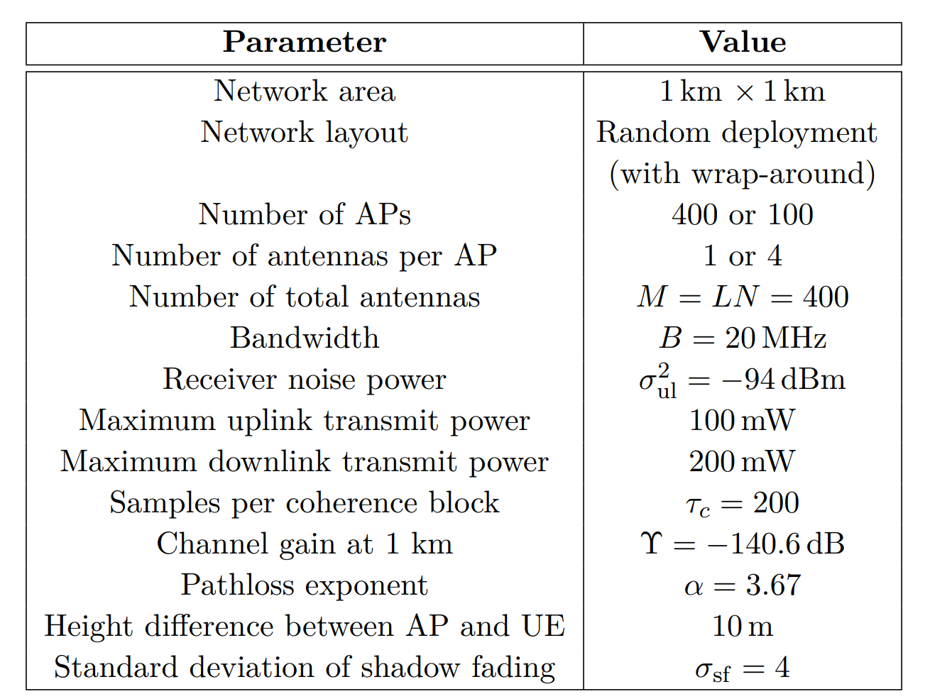
PARAMETERS:
L - No of APs
N – No of Antennas per AP
K – No of Users
Azimuth Angle – 30
Elevation Angle – 15

Slide 5
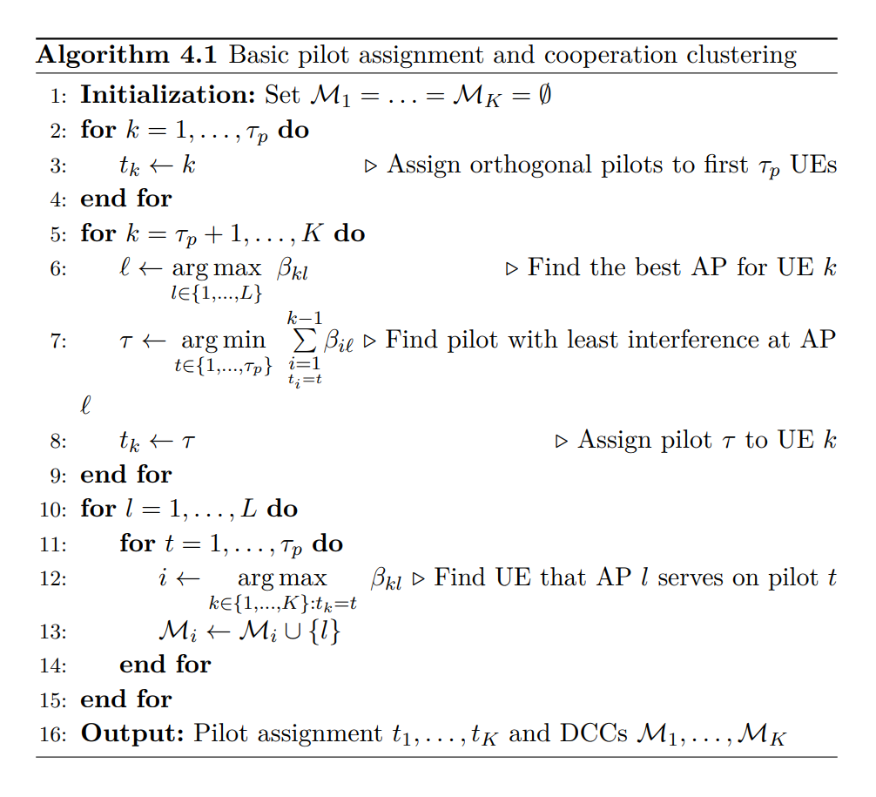
PILOT ASSIGNMENT AND DCC FORMATION:

Slide 6
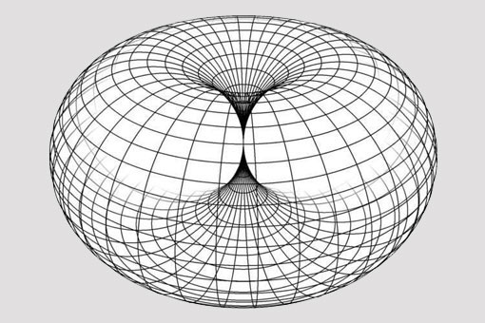
WRAP-AROUND TOPOLOGY:

Slide 7
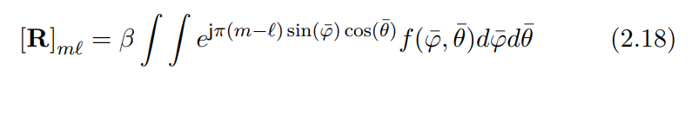
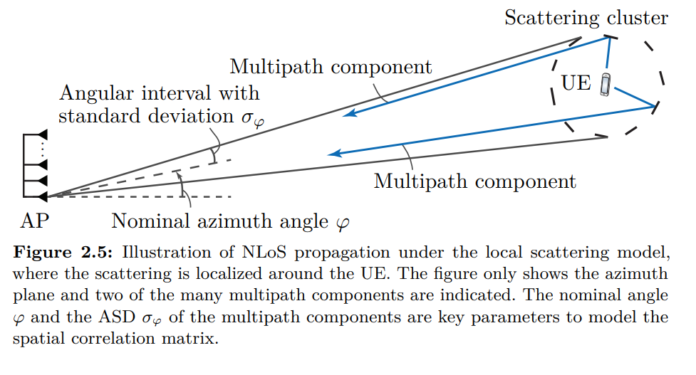
Local Scattering Model

Slide 8
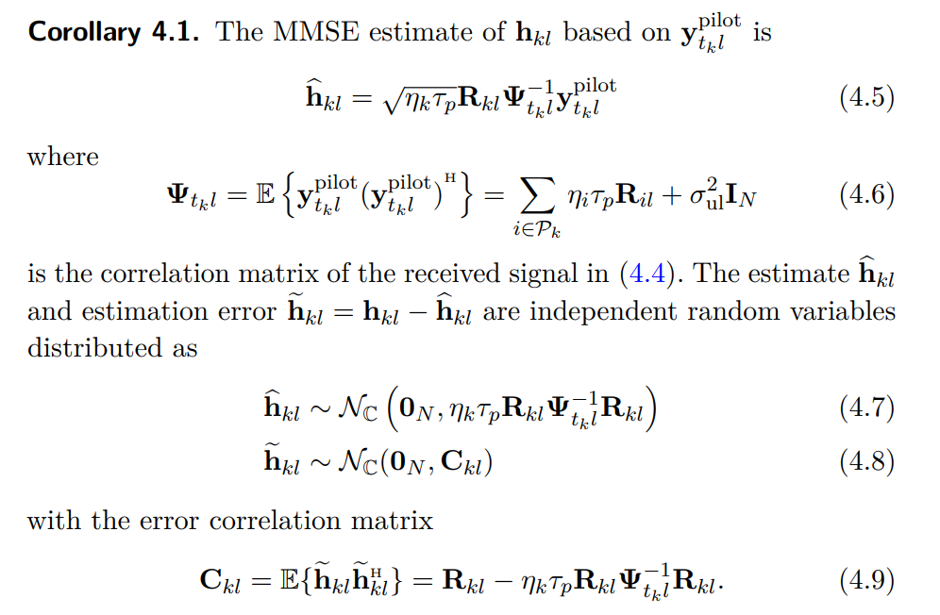
Channel Estimation – MMSE

Slide 9
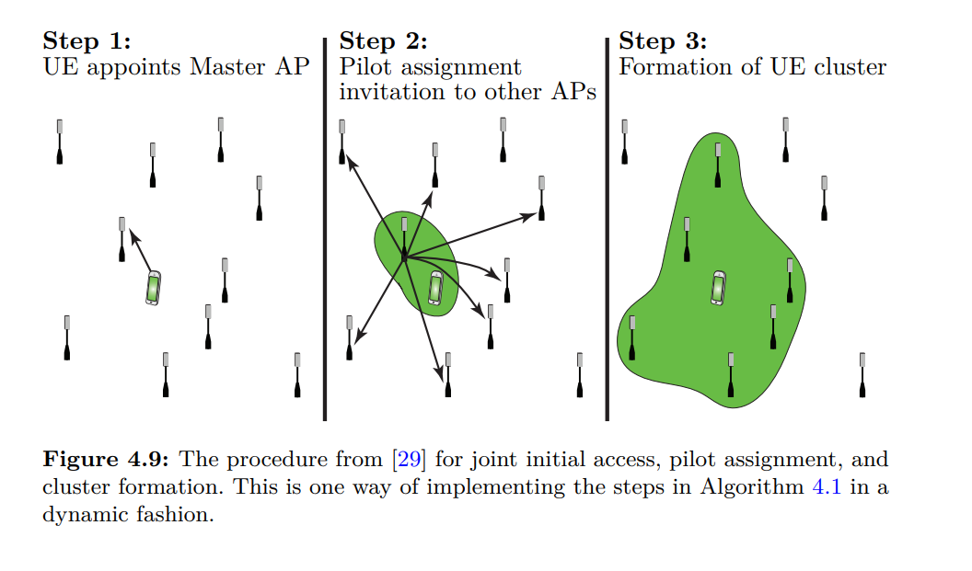
UE CLUSTER FORMATION:

Slide 10
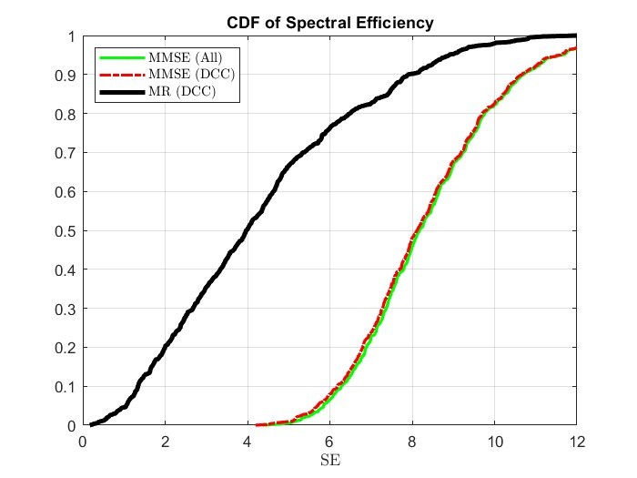
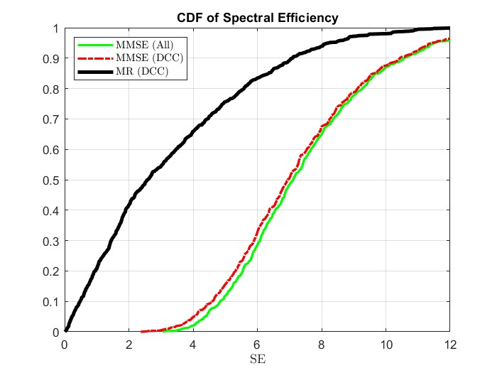
L = 400 / N = 1
INFERENCE:
L = 100 / N = 4

Slide 11
CHALLENGES:
Generating a simulation setup considering wraparound situation and choosing which US is served by which AP based on the channel strength between the nodes.
Pilot assignment keeping in mind the limitation posed by the number of orthogonal pilot sequences available and in turn forming cooperative cluster surrounding the UE (User centric)
Chanel estimation based on the pilot sequence.
Receive combining – MMSE, MR

