Slide 1
PREDICTING EFFECTIVENESS OF DIFFERENT DRUG COMBINATIONS
EEE 511, Fall 2022
Re-examined By - Team 9
Sumant Kulkarni, Dhanraj Bhosale,
Pratyush Pandey, Shayal Shamsu

Slide 2
Model - Compositional Perturbation Autoencoder (CPA)
The Compositional Perturbation Autoencoder (CPA) is a deep generative framework.
CPA combines the interpretability of linear models with the flexibility of deep-learning approaches for single-cell response modeling.
CPA encodes and learns transcriptional drug response across different cell types, doses, and drug combinations.
The model produces easy-to-interpret embeddings for drugs and cell types, allowing drug similarity analysis and predictions for unseen dosages and drug combinations

Slide 3
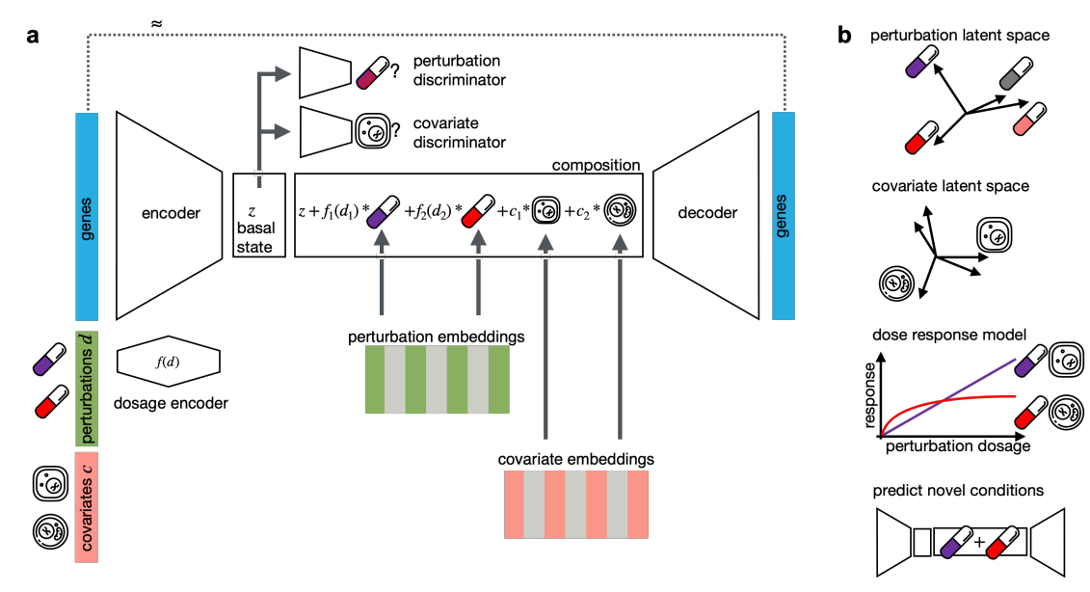
Methods - Compositional Perturbation Autoencoder (CPA)
Given the dataset and target perturbation, model trained to estimate the gene expression showing how the distribution of original gene expression with covariates would look like if the perturbation was changed from its original value to target perturbation.

Slide 4
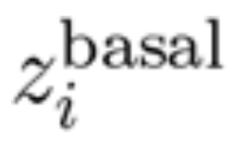
Methods - Data generating process
The three initial components of this generative process are a latent (unobserved) basal latent state for cell i, together with its perturbation vector di and covariate vector ci.
Generated perturbed latent state (zi) of a cell.
By applying matrix manipulations and calculations on this data we get an observed gene expression that is added to the dataset

Slide 5


Methods - Training
Encoding gene expression to basal state to form estimated perturbed state and then decoding this estimated perturbed state into observed gene expression.
Estimated basal state used to compute estimated perturbed state Z’i
Loss Function-

Slide 7
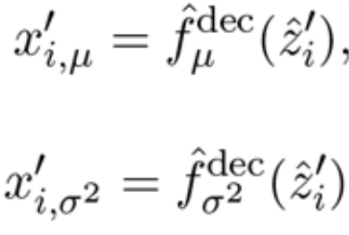
Methods - Testing
Answering how the counterfactual distribution of gene expression with covariates would change if the perturbation changes.
We compute the estimated basal state first then the counterfactual perturbed state and then return the counterfactual gene expression.
Compute and return the counterfactual gene expression mean and Variance -

Slide 9
Methods - Evaluation and Uncertainty Estimation
Evaluating model performance using several metrics like -
Quality of reconstruction for in and OOD cases
Quality of disentanglement of cell information from perturbation information.
Uncertainty estimation:
Estimating uncertainty of predictions using minimum distance between queried perturbation and (covariate + perturbation combinations) seen while training.
This gives predictions on queried conditions that are more distant from the set of seen conditions are less certain.

Slide 10
References
Paper: https://www.biorxiv.org/content/10.1101/2021.04.14.439903v1
Meta AI blog: https://ai.facebook.com/blog/ai-predicts-effective-drug-combinations-to-fight-complex-diseases-faster/
CIFAR 10: https://www.cs.toronto.edu/~kriz/cifar.html
Video (for model understanding): https://www.facebook.com/Meta/videos/251982756671572/?t=13
Code: https://github.com/facebookresearch/CPA

Slide 11
Thank You

