Slide 1
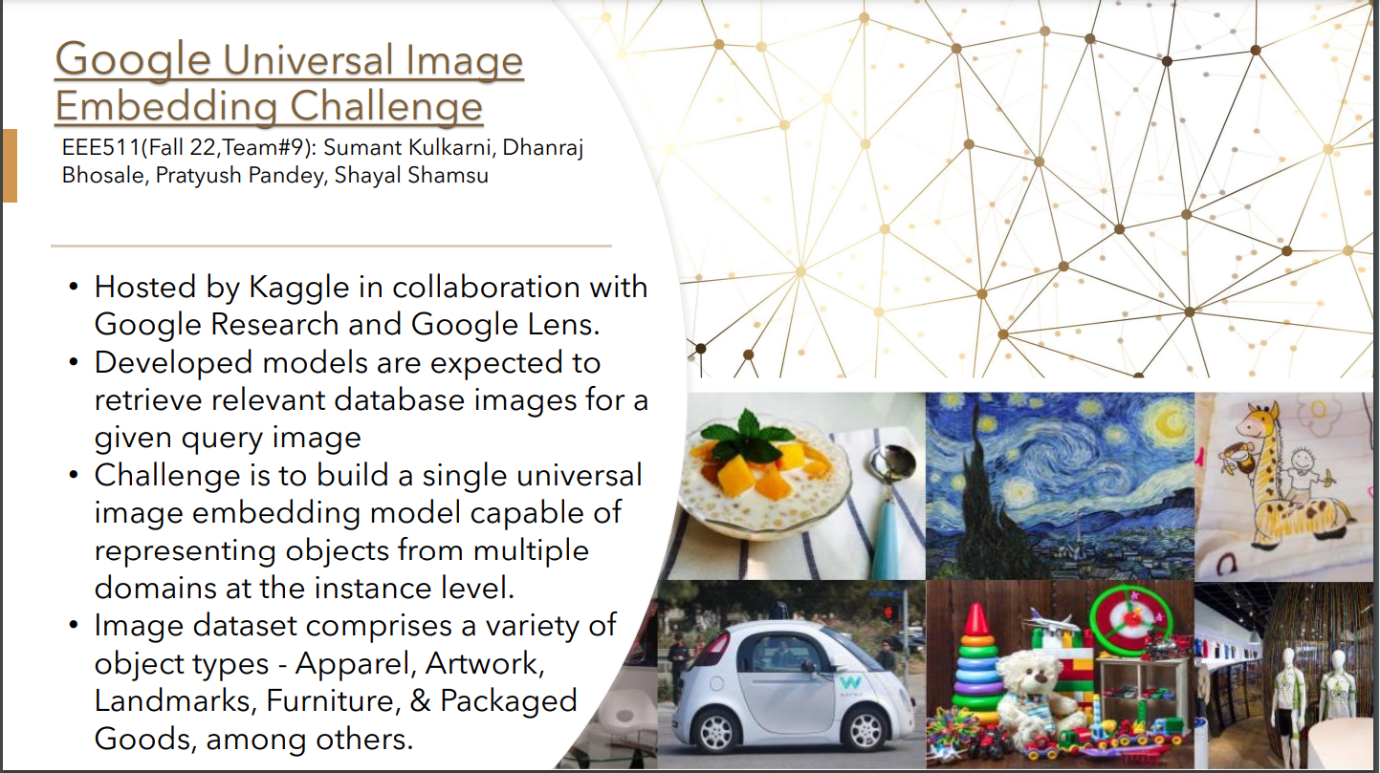

Slide 2
Expected Results and Datasets
Expected Results
We will submit the developed model in the Kaggle competition. The model will be evaluated against a held out test datasets and a score will be assigned.
It would be exciting for all class to see implementation of one of the top DL competition.
We will build a simulation jig to demonstrate the model performance. The model will be provided a set of input images and it will search through a dataset of images and identify images which match the input images.
We will demonstrate with multiple images from different object types.
Datasets
Imagenet - https://www.image-net.org/index.php (Available for free to researchers for non-commercial use)
Products -10K - https://products-10k.github.io/ (Available for free for non-commercial research and educational purposes)
Google Landmark Recognition 2021 - https://www.kaggle.com/competitions/landmark-recognition-2021/data (Dataset is part of Kaggle competition in 2021)
Some datasets are provided by Google as part of the competition
90% data is used for training while 10% is used for validation.

Slide 3
Key Literature and Implementation Code
Key Literature
Google AI Blog - Introducing the Google Universal Image Embedding Challenge, August 4, 2022, Posted by Bingyi Cao and Mário Lipovský, Software Engineer, Google Lens, https://ai.googleblog.com/2022/08/introducing-google-universal-image.html
Baseline model implementation for the Kaggle universal image embedding challenge - https://github.com/google-research/googleresearch/tree/master/universal_embedding_challenge
Training data-efficient image transformers & distillation through attention - https://arxiv.org/pdf/2012.12877.pdf
Transformers for image recognition at scale - https://arxiv.org/pdf/2010.11929.pdf
Implementation Code
We are using the following Code notebook as a reference implementation - https://www.kaggle.com/code/akihirok/9th-place-guie-fintune-tf-clip-with-training
The notebook has achieved a score amongst the top 10 performers in the competition and is most used and commented by the users.
For training: backbone(CLIP) + Dropout + Dense(units=256) + Arcface + Softmax (classes=17691)
For inference: backbone(CLIP) + Dropout + Dense(units=64) + L2Norm

Slide 4
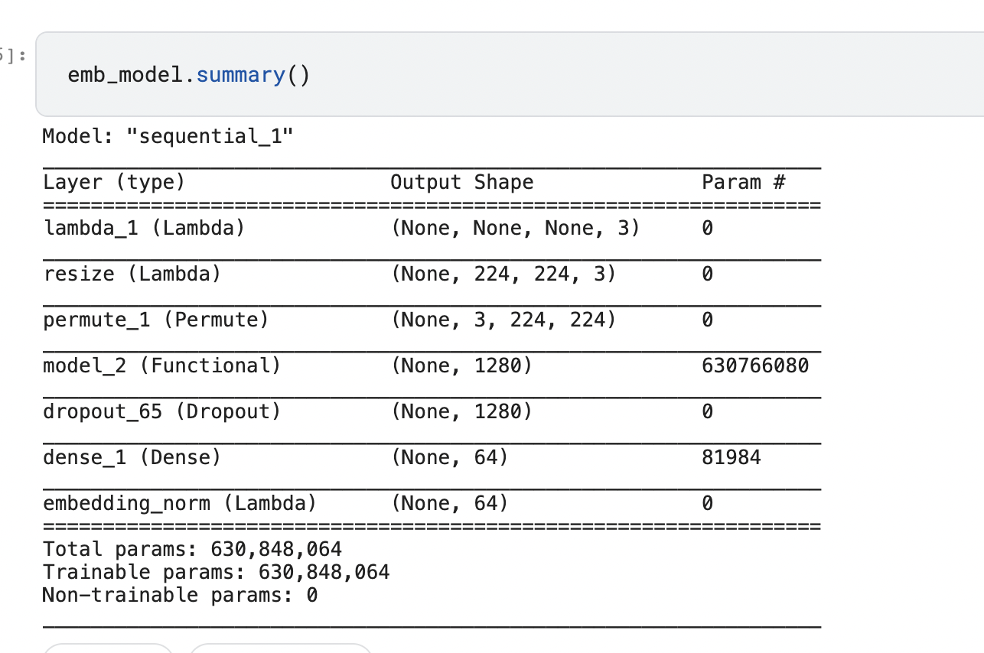
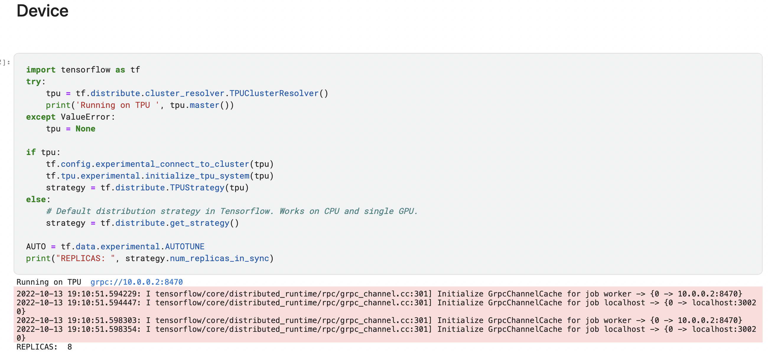
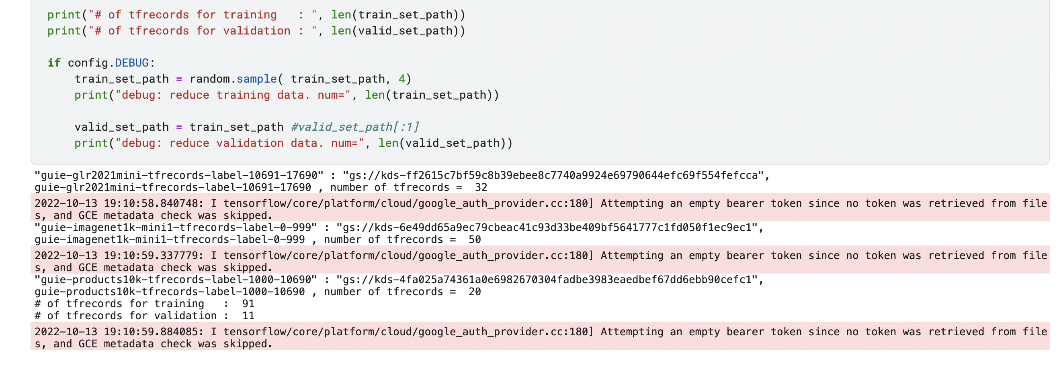
Computation Platform and Progress
We are using Google Colaboratory, Kaggle Notebook, Tensorflow and TPUs for the training and the development of the model. All the needed software environment is available in Google Colaboratory.
We have replicated the entire notebook and have successfully developed the model that can be submitted for the competition. It includes running several epochs of training.
Link of Video Clip of Model Training –
https://drive.google.com/file/d/1pYY6dtD1uJMVzEj-woFsRSw08WmqBDzE/view?usp=sharing
We are going to develop the simulation test rig on our individual systems to demonstrate the model.

Slide 5
Remaining Activities
Revise the developed model with additional training datasets and epochs – All team members – Ongoing, to be completed by Nov-11
Submit the model to Kaggle competition and obtain the evaluation score – Dhanraj and Pratyush – First submission by Oct-21, several submissions based on improvements in the model
Develop the test rig to demonstrate the model – Sumant and Shayal - by Oct-28
Document Progress Check 2 – Sumant and Dhanraj – Nov-11
Develop the Project presentation – All team members – Nov-11 to Nov-15
Document the First draft Project report – All team members – Nov-1 to Nov-15
Group Review of the Project report – All team members – Nov-16 to Nov-23
Document and submit the Final Project report – All team members – Nov-23 to Dec-9

