Slide 1

QuantMesh x402
Atomic Multi-Agent Service Router on Algorand
Problem Statement: PS0404 — Agentic Payments (x402 Protocol)
Team: QuantMesh Innovators College: CSBS Dept., BV(DU)COE, Pune Event: AlgoVerse 2026 Hackathon | Algorand Blockchain Club Live API: https://api.dhanrajgupta.xyz

Slide 2
ALGOVERSE 2026 HACKATHON — PS0404
1. Problem Statement & Motivation
❌ Subscription Fatigue
• Crypto signal APIs cost $100–$500/month.
• Retail traders & bots pay high fixed costs even for 2–3 trades/mo.
• Prohibitive barrier for micro autonomous AI agents.
❌ Single-AI Risk & Wasted Fees
• Single AI models hallucinate or fail under high volatility.
• Standard x402 routers charge micro-fees BEFORE calling downstream workers.
• User money is lost if a downstream worker crashes.
❌ Multi-Agent Friction
• Querying 4 separate AI APIs requires 4 separate transactions.
• High gas fees & network latency destroy micro-payments.
• Zero consumer protection for API buyers.

Slide 3
ALGOVERSE 2026 HACKATHON — PS0404
2. Proposed Solution: QuantMesh x402 Architecture
⚡ Pay-Per-Use AI Intelligence ($0.007)
• Granular micropayments via Algorand x402 AVM scheme.
• 🛡️ Pre-Execution Zero-Fee Guarantee: Router validates all 4 sub-agents FIRST. If any fail, returns HTTP 502 with $0 charged.
• 🔐 Cryptographic SHA-256 Attestation: Produces verifiable signal digest anchored to transaction ID.
• Fuses NLP Sentiment + Whale Flow + TA Indicators into a 0-100 composite score.
🔑 Core Zero-Fee Execution Flow
1. Client sends POST request to Hono Router.
2. Router executes Worker A, B, C, D in parallel.
3. IF any worker fails -> HTTP 502 Sub-Agent Failed ($0 charged to user).
4. IF all workers pass -> Issue HTTP 402 Challenge.
5. Lute Wallet signs $0.007 USDC -> Algorand Testnet Settlement.

Slide 4
ALGOVERSE 2026 HACKATHON — PS0404
3. Identified Paying User & Business Model
🤖 Autonomous AI Agents
• Agentic trading scripts & DeFi bots.
• Require low-latency, pay-per-use market intelligence.
• Cannot manage $300/mo SaaS subscriptions.
📊 Quant Retail Traders
• Traders seeking high-confidence multi-agent signals.
• Pay micro-fees only when executing active strategies ($0.007/signal).
• Guaranteed zero fees on failed API responses.
💼 Sustainable Business Model
• $0.007 USDC / Execution
• $0.005 split to sub-agent model providers.
• $0.002 router protocol fee.
• 100% Zero-Cost on failed downstream calls.

Slide 5
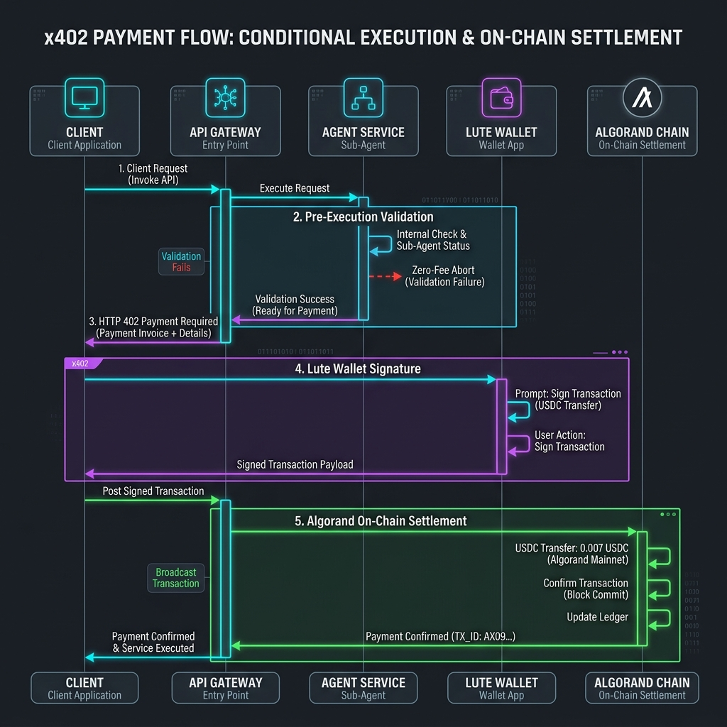
ALGOVERSE 2026 HACKATHON — PS0404
4. x402 Payment Flow (Technical Core)
🔄 The 4-Step AVM Protocol
1. Challenge (402): Gateway validates workers, then returns HTTP 402 Payment Required.
2. Sign: Lute Wallet signs Algorand ASA payment ($0.007 USDC, ASA 10458941).
3. Retry: Client retries request with signed transaction payload.
4. Settle: Gateway verifies tx on Algorand Indexer & releases signal receipt.

Slide 6
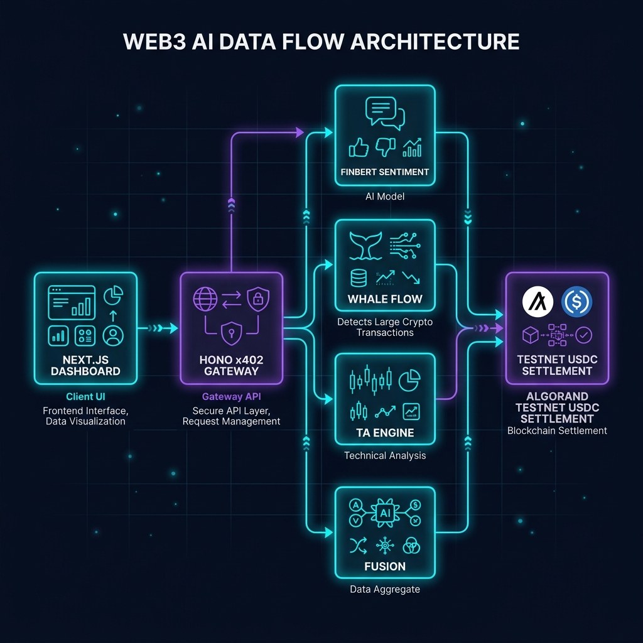
ALGOVERSE 2026 HACKATHON — PS0404
5. System Architecture & Tech Stack

Slide 7
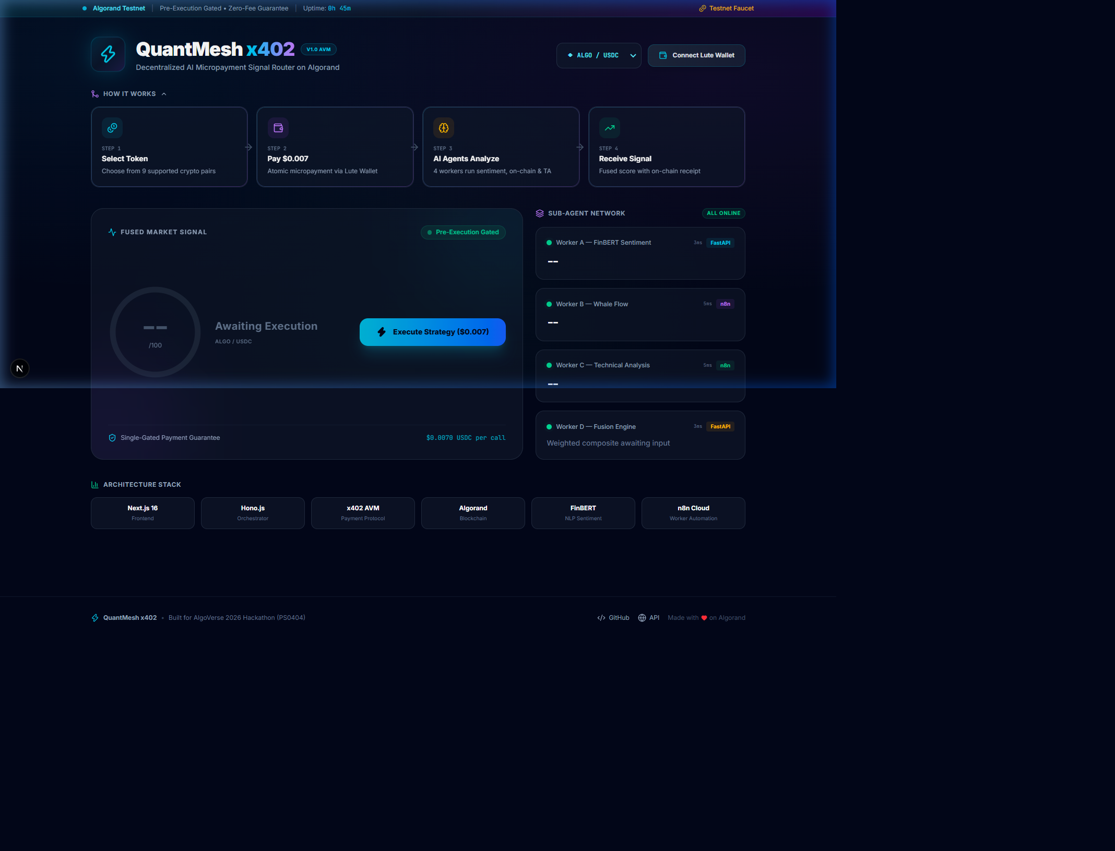
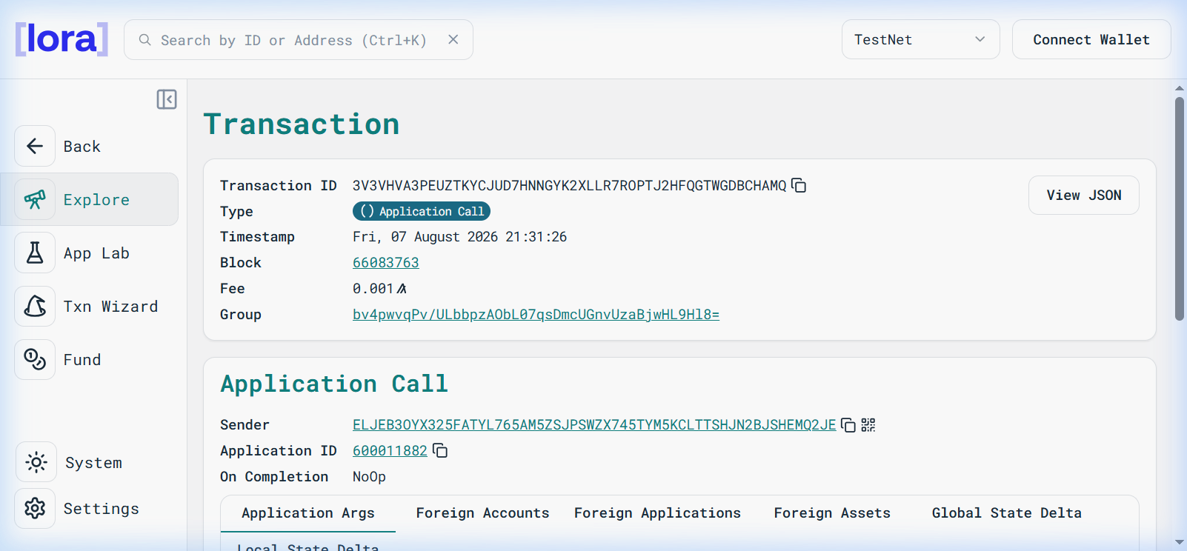
ALGOVERSE 2026 HACKATHON — PS0404
6. Live Demo & Lora Explorer Proof

Slide 8
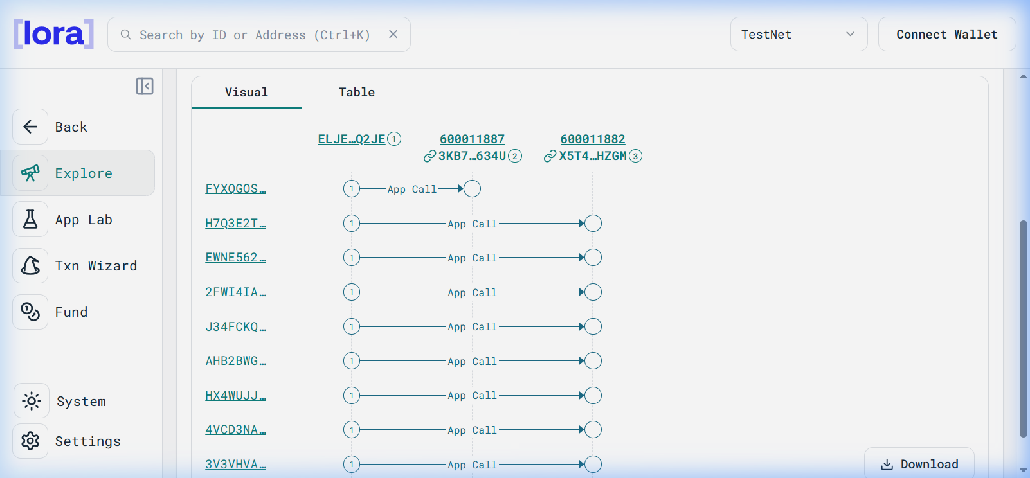
ALGOVERSE 2026 HACKATHON — PS0404
6b. Lora Explorer Atomic Group Visual Flow
⚡ Atomic AVM Group Settlement
• Group Hash: bv4pwvqPv/ULbbpzAObL07qsDmcUGnvUzaBjwHL9Hl8=
• Tx ID: 3V3VHVA3PEUZTKYCJUD7HNNGYK2XLLR7ROPTJ2HFQGTWGDBCHAMQ
• App ID: 600011882 | Block: #66083763
• All sub-agent calls execute atomically inside AVM group.
• Zero Wasted Gas: If any single tx fails, whole group reverts.

Slide 9
ALGOVERSE 2026 HACKATHON — PS0404
7. Innovation & Competitive Differentiation
🛡️ Zero-Fee Shield
• Pre-execution gating aborts at zero cost if sub-agents crash.
• Prevents money loss.
🤖 Multi-Agent Consensus
• Combines FinBERT NLP + CoinGecko Whale Flow + TA Engine.
• Robust 0-100 composite score.
⚡ Sub-3s AVM Finality
• Algorand AVM provides instant settlement.
• $0.00018 gas fee per tx.
🔐 Cryptographic Digest
• SHA-256 attestation digest anchored on-chain.
• Auditably verifiable.

Slide 10
ALGOVERSE 2026 HACKATHON — PS0404
8. Completeness & Functionality (Done vs. Pending)
✅ Live & Operational (Done)
• Hono Gateway live on AWS EC2.
• 4 Sub-Agents (FinBERT, Whale Flow, TA Engine, Fusion).
• Lute Wallet x402 AVM payment integration.
• Pre-Execution Zero-Fee Shield (502 logic verified).
• SHA-256 Attestation receipt generation.
• Next.js 16 Dashboard with Radial Score Arc.
🔮 Future Roadmap (Pending)
• Algorand Mainnet Deployment (ASA 315667040).
• PyTeal Box Storage Contract deployment.
• Developer SDK (@quantmesh/x402-client).
• Multi-asset automated rebalancing.

Slide 11
ALGOVERSE 2026 HACKATHON — PS0404
9. Real-World Impact & Scalability
🌍 Democratic Access
• Democratizes quant trading signals for micro-traders & AI agents.
• 100x cost reduction vs monthly SaaS.
⚡ Mainnet Readiness
• Production ready today.
• Mainnet switch requires updating 2 environment variables (Network & ASA ID).
🚀 Enterprise Scalability
• Hono + EC2 handles 1,000+ req/sec.
• Algorand AVM handles 10,000 TPS with sub-second finality.

