Slide 1
Profit & Investment Efficiency Analysis
A comprehensive analysis of profit performance, investment allocation, and ROI efficiency across key markets.
Name: Dhanraj Beldar
Project id: PTID-CDA-JAN-26-1198

Slide 2
Key Performance Metrics
$5.6M
$112K
$192K
$20.3M
Total Profit
Average Profit
Maximum Profit
Total Investment
Aggregate profit across all states and operations
Mean profit per transaction or unit
Peak profit achievement recorded
Combined capital deployed across markets
27.58%
ROI
Return on investment percentage

Slide 3


State Market Analysis
Our analysis focuses on three key markets driving business performance and investment returns.
California
Florida
West Coast market leader
Southeast growth region
New York
Northeast financial hub

Slide 4
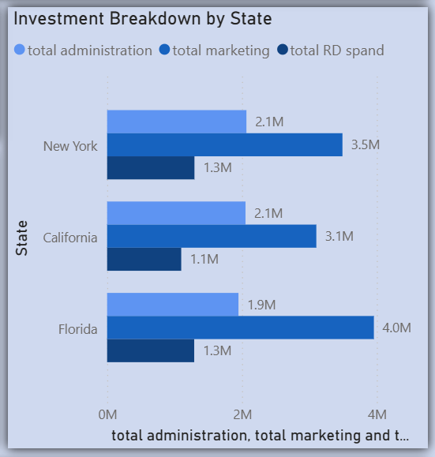
Investment Breakdown by State
Marketing spend has the strongest association with profit across states.
State
Administration
Marketing
R&D Spend
New York
~$2.1M
~$2.8M
~$1.5M
California
~$2.1M
~$2.8M
~$1.2M
Florida
~$2.1M
~$2.8M
~$1.5M

Slide 5

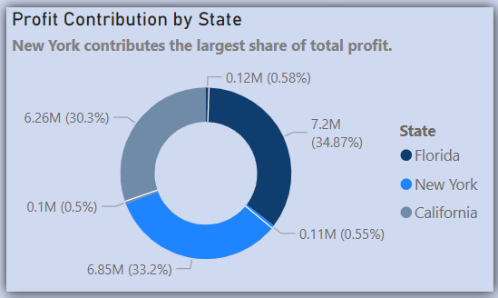


Profit Contribution by State
New York contributes the largest share of total profit.
34.87%
Florida
$7.2M combined contribution
33.2%
30.3%
New York
California
$6.85M profit contribution
$6.26M profit contribution

Slide 6
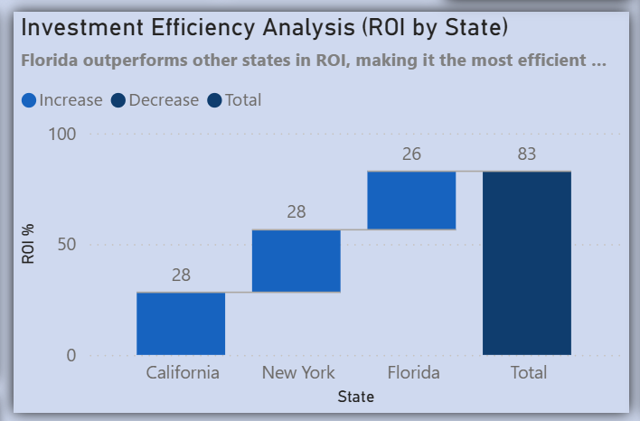
Investment Efficiency Analysis
ROI by State
Florida outperforms other states in ROI, making it the most efficient market for investment returns.
California
New York
28% ROI
28% ROI
Florida
26% ROI

Slide 7
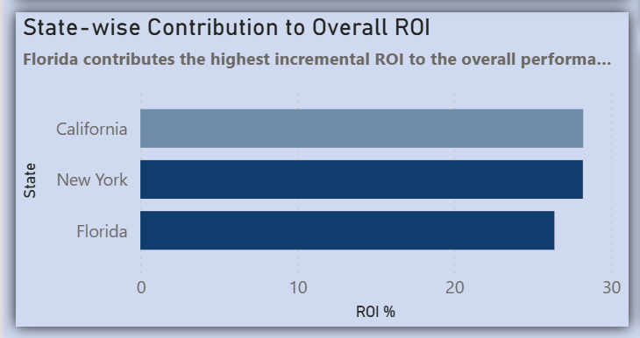
State-wise Contribution to Overall ROI
Florida contributes the highest incremental ROI to the overall performance despite slightly lower total percentage.
California
New York
Florida
~28% ROI contribution
~28% ROI contribution
~26% ROI contribution

Slide 8

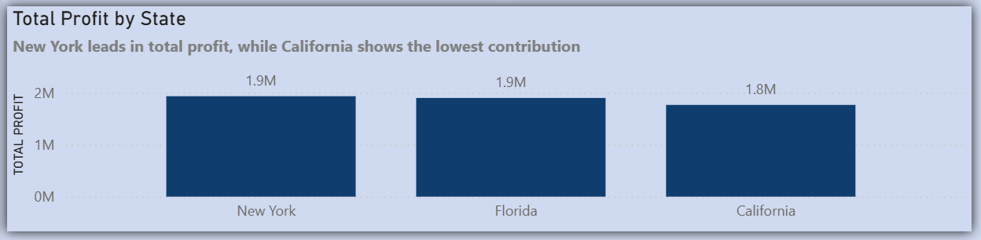


Total Profit by State
New York leads in total profit, while California shows the lowest contribution among the three primary markets.
New York
~$1.9M total profit
Florida
~$1.9M total profit
California
~$1.8M total profit

Slide 9
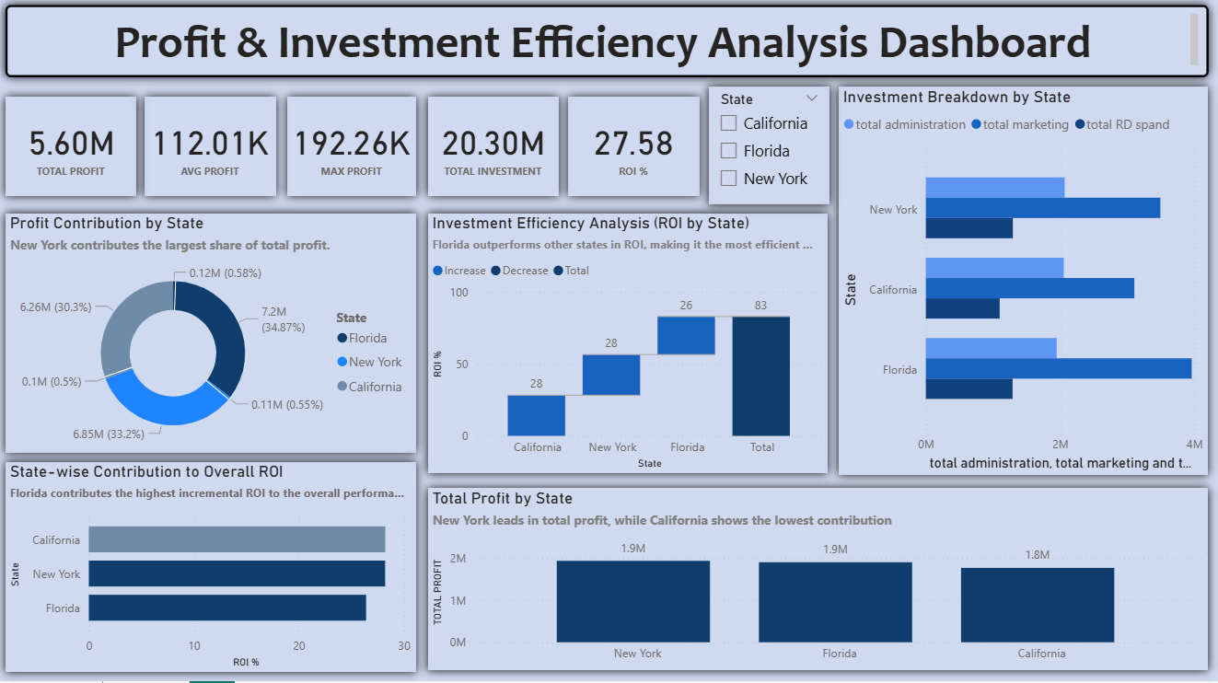
Dashboard For Profit Analysis

Slide 10
Key Findings & Implications
Marketing Drives Profit
Marketing spend shows the strongest correlation with profit generation across all states, suggesting continued investment in this area.
Florida's Efficiency Edge
Despite similar profit levels, Florida demonstrates superior ROI efficiency, indicating optimal resource allocation and market conditions.
New York's Volume Leadership
New York contributes 33.2% of total profit, establishing it as the highest-value market in absolute terms.
Balanced Investment Strategy
Consistent investment levels across states (~$2.1M admin, ~$2.8M marketing) enable fair performance comparison and strategic planning.

Slide 11




Strategic Recommendations
Prioritize Marketing Investment
Continue allocating resources to marketing given its strong profit correlation across all markets.
Scale New York Operations
Leverage New York's profit leadership position to drive additional growth and market expansion.
Replicate Florida's Efficiency
Analyze Florida's operational practices and apply successful strategies to California and New York.
Optimize California Performance
Investigate opportunities to improve California's contribution relative to investment levels.

Slide 12
Thank you for your time and consideration.
Name: Dhanraj Beldar
Role: Data Analyst
Tools : SQL | Power BI | Excel
LinkedIn: www.linkedin.com/in/dhanraj-beldar-ab8a0232a

