Slide 1
Types of SHELLs in Linux
Bourne Shell (sh)
C Shell (csh)
Tcsh is enhanced C shell, it can be used as an interactive login shell and shell script command processor
The Korn Shell (ksh) stands for Korn shell and was designed and developed by David G. Korn. It is a complete, powerful, high-level programming language and an interactive command language just like many other Unix/GNU Linux shells.
The GNU Bourne-Again Shell (Bash) stands for Bourne Again Shell and it is the default shell on many Linux distributions today
Zsh is designed to be interactive and it incorporates many features of other Unix/GNU Linux shells such as bash, tcsh, and ksh.
Widely used ones are as follows:
/bin/sh
/bin/bash

Slide 2
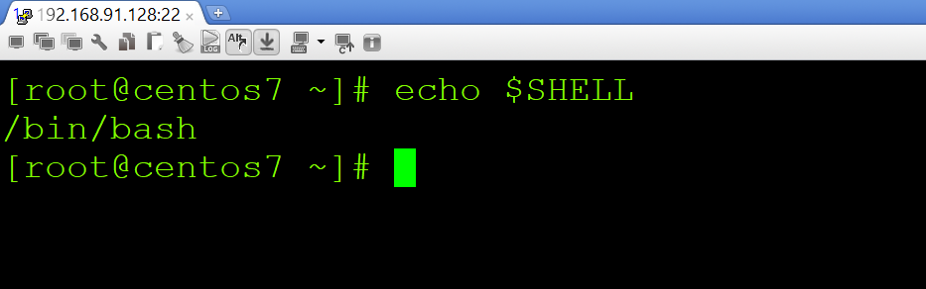
Command to check the shell
echo $SHELL

Slide 3
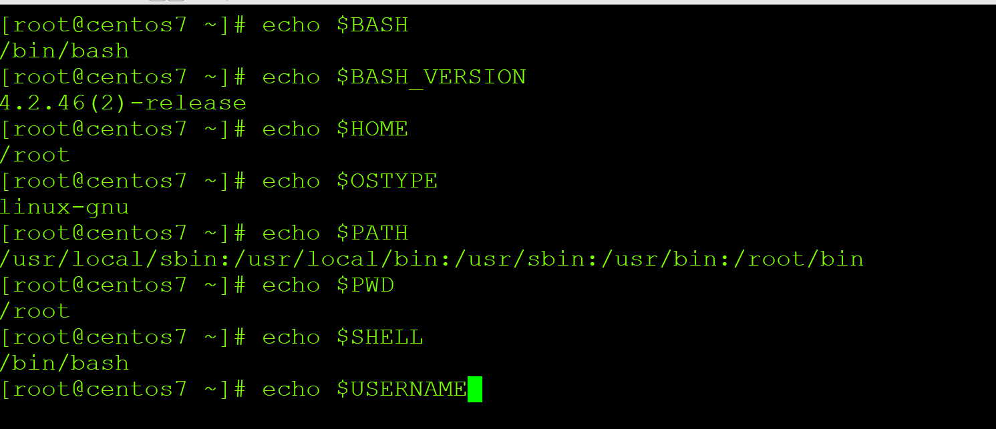
SHELL Variables – System Defined

Slide 4
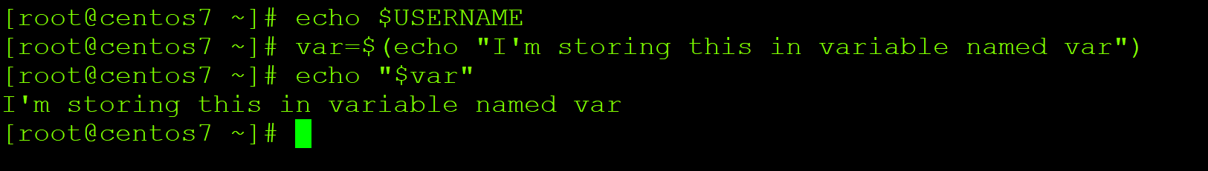
SHELL Variables – User Defined

Slide 5
Wild Card symbols
There are three main wildcards in Linux:
An asterisk (*) – matches one or more occurrences of any character, including no character.
Question mark (?) – represents or matches a single occurrence of any character.
Bracketed characters ([ ]) – matches any occurrence of character enclosed in the square brackets. It is possible to use different types of characters (alphanumeric characters): numbers, letters, other special characters etc.

Slide 6
Output Processing Commands – grep, awk, sed and cut
grep filter searches a file for a particular pattern of characters, and displays all lines that contain that pattern
awk command searches files for text containing a pattern. When a line or text matches, awk performs a specific action on that line/text
sed is a stream editor. A stream editor is used to perform basic text transformations on an input stream
cut command in UNIX is a command for cutting out the sections from each line of files and writing the result to standard output

Slide 7
SHELL Metacharacters
Symbol Meaning
> Output redirection
>> Output redirection (append)
< Input redirection
* File substitution wildcard; zero or more characters
? File substitution wildcard; one character
[ ] File substitution wildcard; any character between brackets
`cmd` Command Substitution
$(cmd) Command Substitution

Slide 8
SHELL Metacharacters – Continued…
| The Pipe (|)
; Command sequence, Sequences of Commands
[ ] File substitution wildcard; any character between brackets
|| OR conditional execution
&& AND conditional execution
( ) Group commands, Sequences of Commands
& Run command in the background, Background Processes
# Comment
$ Expand the value of a variable
\ Prevent or escape interpretation of the next character
<< Input redirection

Slide 9
Introduction to SHELL scripting
A shell script is a computer program designed to be run by the Unix shell, a command-line interpreter.
It is a file containing a series of commands. The shell reads this file and carries out the commands as though they have been entered directly on the command line.
For example: checkout the following script
#!/bin/bash
echo "Run these system defined variables and display their output"
sleep 1s
echo $BASH
echo $BASH_VERSION
echo $HOME

