Slide 1

Crash Triage
From a mobile-banking crash to a human-approved draft fix — faster, and built for a regulated environment.
AI-assisted crash triage for mobile banking · Internal review deck

Slide 2
THE PROBLEM
A crash in a banking app is not just a bug
P1
Hours
Manual
A crash in payments or login is a regulatory and reputational event — not a backlog item.
Mobile fixes are slow to ship — app-store review and user updates mean the damage is done before the fix lands.
Triage today is hand-done: who owns it, what's the cause, which PR — slow and inconsistent under pressure.
The cost lands in the first 30 minutes of a bad release — before any fix exists. That's where triage speed matters most.

Slide 3




WHY THIS IS DIFFERENT
Generic crash tools don't fit a bank
Customer data in crashes
Breadcrumbs can carry account numbers and tokens — they can't be sent to an external AI as-is.
We can't auto-merge
A fix can't go straight into a banking release. Anything automated must propose, never merge.
Obfuscated mobile traces
Android/iOS stacktraces arrive obfuscated; without per-build symbol files they can't be mapped to code.
Blame ≠ cause
The last edit to a line isn't proof of the bug. Triage has to offer leads, not verdicts.
The constraint is the opportunity: a tool built for these rules is one no off-the-shelf product gives you.

Slide 4



THE SOLUTION
One pipeline: crash → fix, with a human gate
1
2
3
4
5
Analyze
Root cause
Owner
Solution + tests
Draft PR
symbolicate & read the trace
cause, module, confidence
route to the right team
ranked fixes, with tests
human approves, never auto-merge
Inputs come from AppDynamics (crash, version, build, platform). Every output is a proposal a person approves.

Slide 5
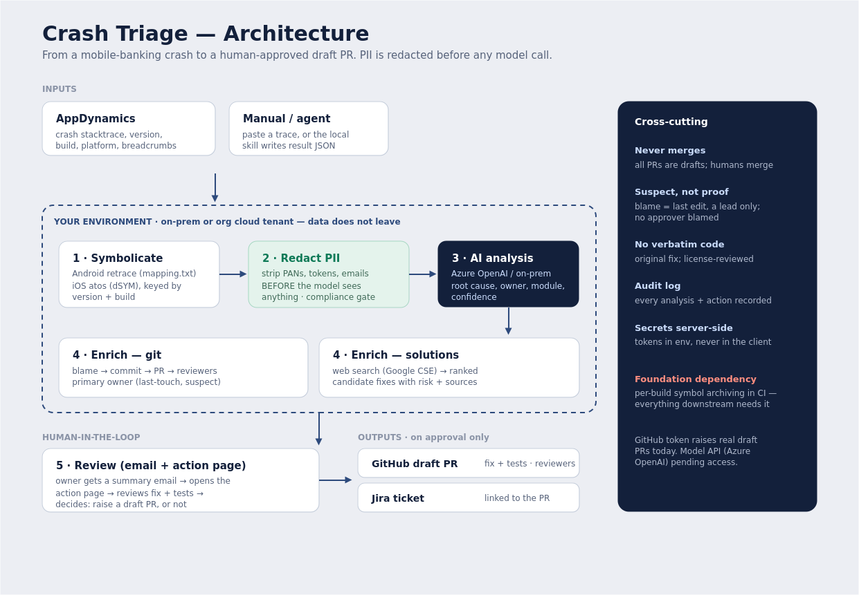
HOW IT WORKS
Architecture

Slide 6



BUILT FOR A BANK
Trust is the product
PII redacted first
Never merges
Leads, not blame
Account numbers and tokens are stripped before anything reaches a model.
Every change is a draft PR; a human reviews and merges.
Owners are suspects to involve, not verdicts. No approver is blamed.
Original code only
Audit trail
Your model, your tenant
Proposed fixes are written fresh, not copied — license-reviewed.
Every analysis and action is recorded for review.
Runs against on-prem or your Azure OpenAI — data stays in your control.

Slide 7

WHERE WE ARE
Status — honest snapshot
Working today
In progress / needed
Agent produces real analysis on a local machine
React dashboard: analyze, solutions, decide
Email summary → action page → draft PR
Real GitHub draft PRs with fix + tests
Model API for server-side analysis (Azure OpenAI — access pending)
Per-build symbol archiving in CI (the foundation)
Hosting so others can use it, not just localhost
PII redaction hardening + audit log
The analysis is genuine; full hands-off automation needs the model API wired in. Saying so plainly is the credibility.

Slide 8
WHERE IT GOES
Roadmap
NOW
NEXT
LATER
Foundation
Trust & scale
Proactive
Symbol archiving in CI
AppDynamics ingestion
Analysis via approved model
Draft-PR flow live
PII + audit hardening
Owner/PR accuracy
Hosted for all developers
Solutions + tests in PRs
Rollout-halt advisor in the first 30 min
Learning from past incidents
Device/OS clustering

Slide 9
DELIVERY
Five owners, one pipeline
1
Symbolication & build artifacts
CI symbol archiving + iOS/Android symbolication — the critical path
2
AppDynamics ingestion
Pull crashes by id, map fields, device/OS clustering
3
AI pipeline & evaluation
Model integration, PII redaction, accuracy eval harness
4
Git / Jira / PR automation
Blame→PR→owners, draft-PR flow, audit logging
5
Frontend & integration
React app to live backend, end-to-end testing, hosting
Cross-cutting (kept with the lead): security, the PII boundary, and the on-prem vs Azure model decision.

Slide 10

What we need to go further
Approved model access — confirm Azure OpenAI in our tenant for the analysis step.
A decision on per-build symbol archiving in CI — the foundation everything rests on.
A small internal host so the tool serves the whole team, not one laptop.
Security sign-off on the PII boundary and data flow.
Crash Triage — a tool that's fast, trustworthy, and built for how a bank actually ships.

