Slide 1
Counters
Counter is a sequential circuit.
A digital circuit which is used for a counting pulses is known counter.
Counter is the widest application of flip-flops. It is a group of flip-flops with a clock signal applied.

Slide 2
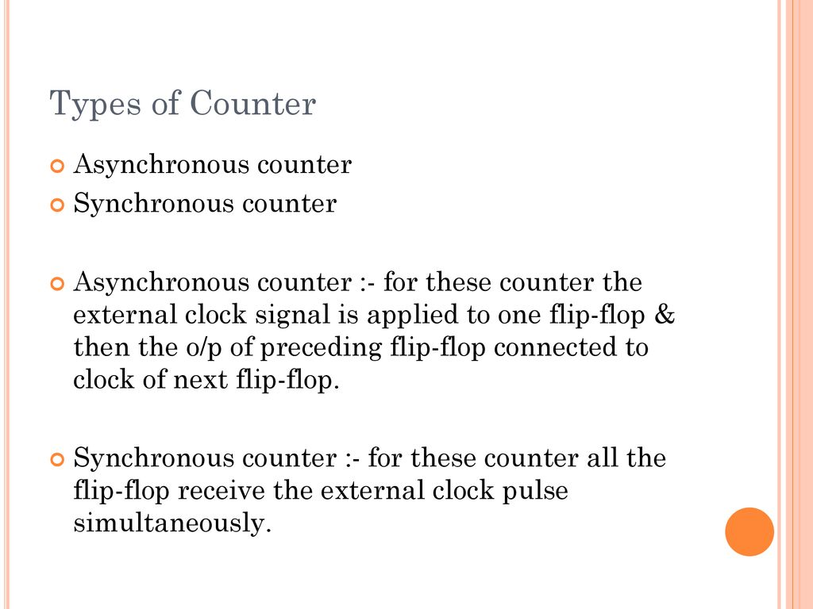

Slide 3
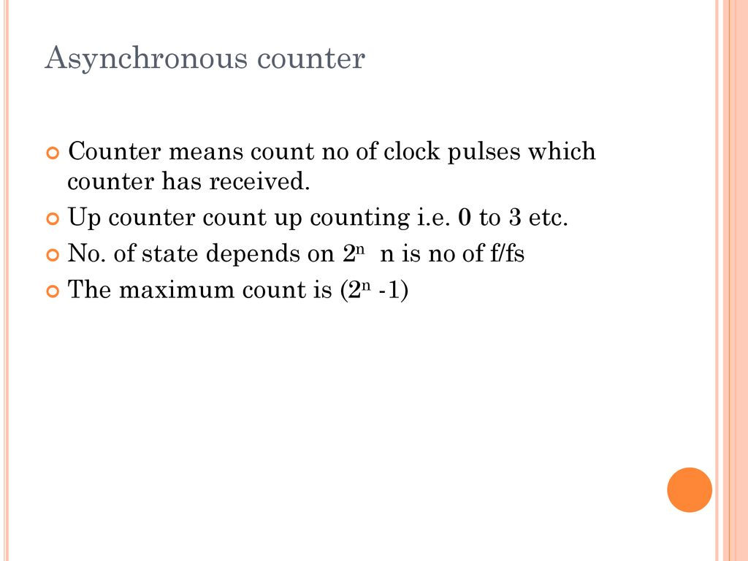

Slide 4
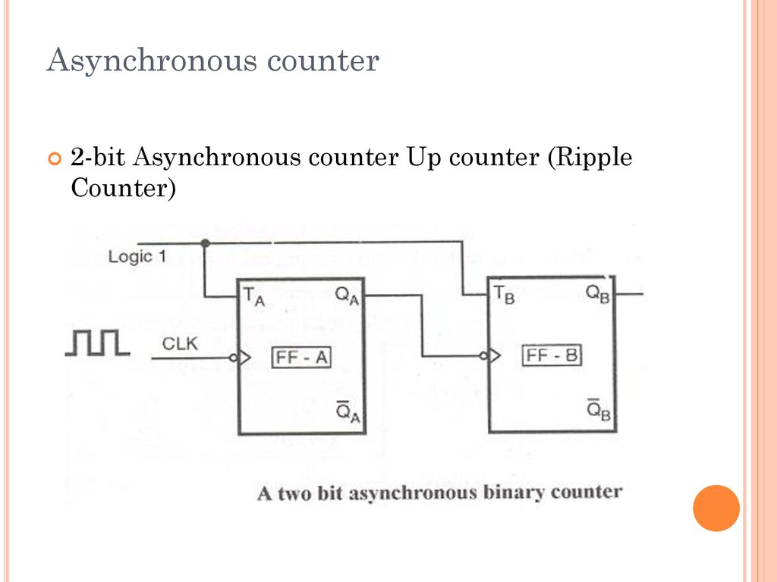

Slide 5
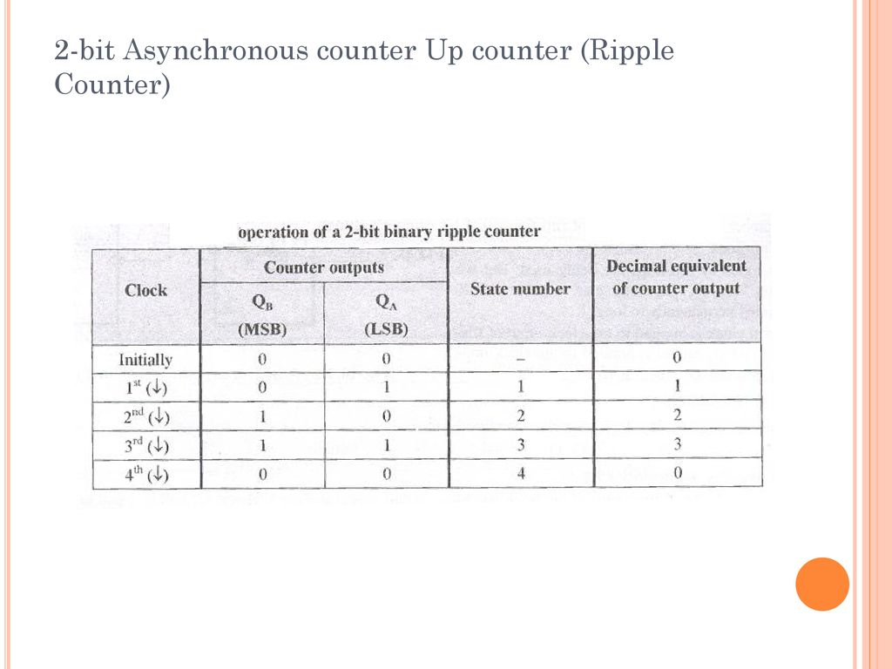

Slide 6
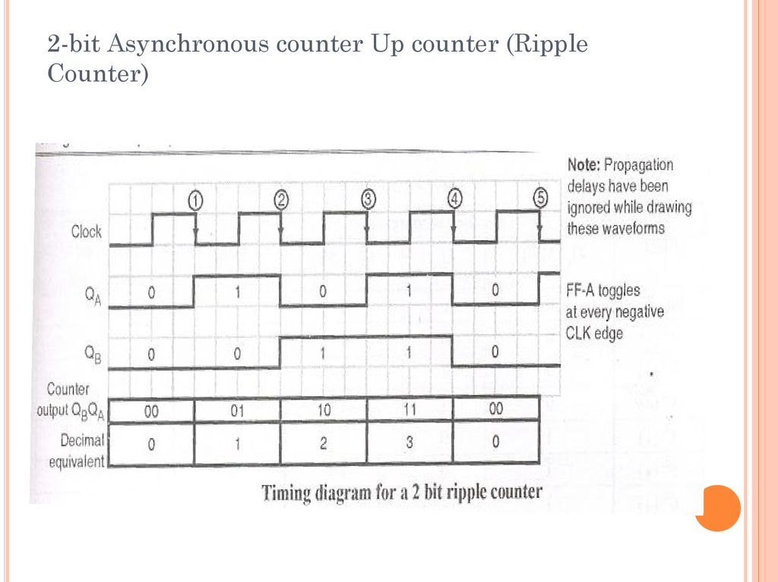

Slide 7
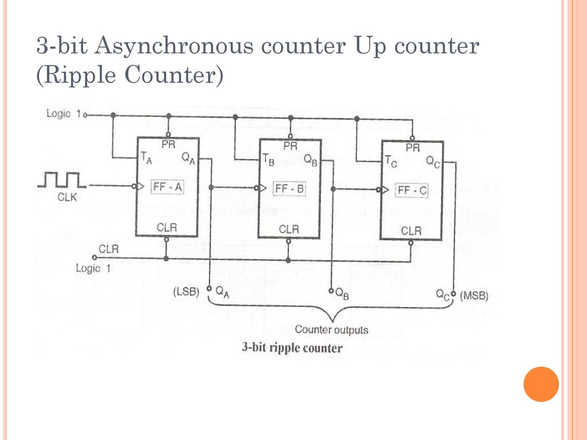

Slide 8
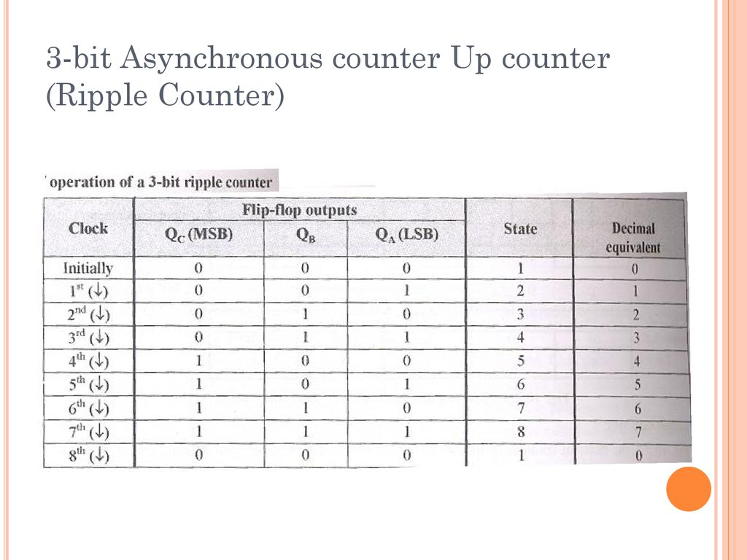

Slide 9
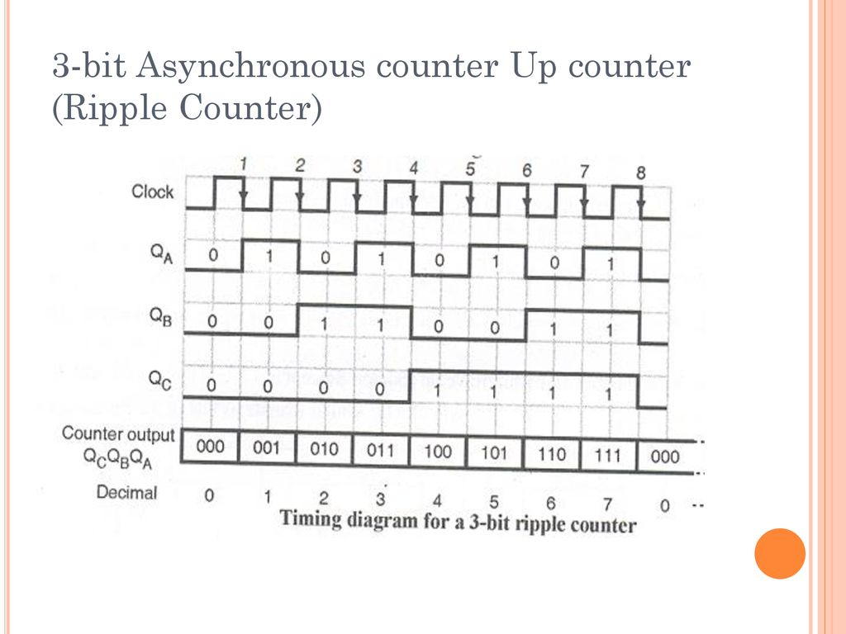

Slide 10
UP/DOWN Counter
Up counter and down counter is combined together to obtain an UP/DOWN counter. A mode control (M) input is also provided to select either up or down mode. A combinational circuit is required to be designed and used between each pair of flip-flop in order to achieve the up/down operation.
Type of up/down counters
UP/DOWN ripple counters
UP/DOWN synchronous counter

Slide 11
UP/DOWN Ripple Counters
In the UP/DOWN ripple counter all the FFs operate in the toggle mode. So either T flip-flops or JK flip-flops are to be used. The LSB flip-flop receives clock directly. But the clock to every other FF is obtained from (Q = Q bar) output of the previous FF.
UP counting mode (M=0) − The Q output of the preceding FF is connected to the clock of the next stage if up counting is to be achieved. For this mode, the mode select input M is at logic 0 (M=0).
DOWN counting mode (M=1) − If M = 1, then the Q bar output of the preceding FF is connected to the next FF. This will operate the counter in the counting mode.

Slide 12
UP/DOWN Counter
3-bit binary up/down ripple counter.
3-bit − hence three FFs are required.
UP/DOWN − So a mode control input is essential.
For a ripple up counter, the Q output of preceding FF is connected to the clock input of the next one.
For a ripple up counter, the Q output of preceding FF is connected to the clock input of the next one.
For a ripple down counter, the Q bar output of preceding FF is connected to the clock input of the next one.
Let the selection of Q and Q bar output of the preceding FF be controlled by the mode control input M such that, If M = 0, UP counting. So connect Q to CLK. If M = 1, DOWN counting. So connect Q bar to CLK.

Slide 13
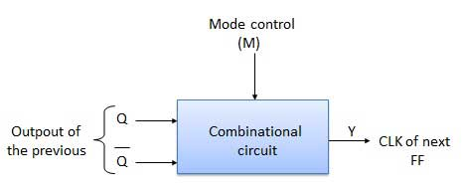
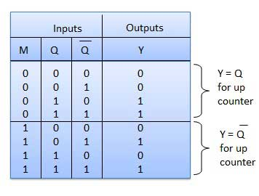
UP/DOWN Counter

Slide 14
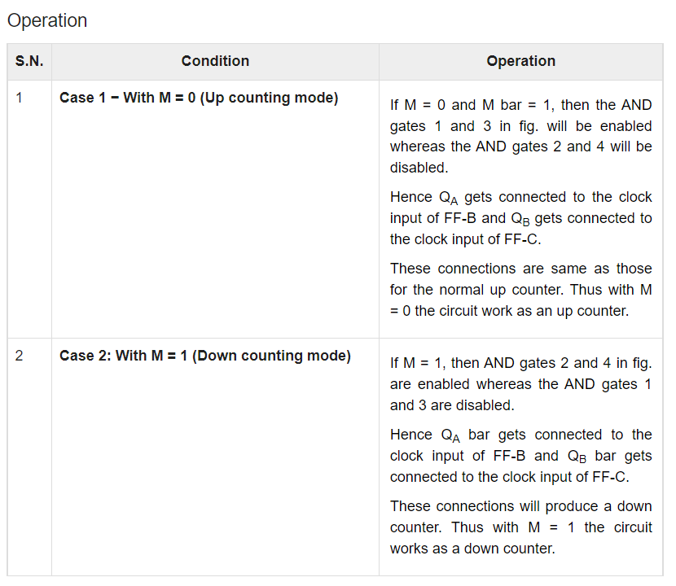
UP/DOWN Counter

Slide 15
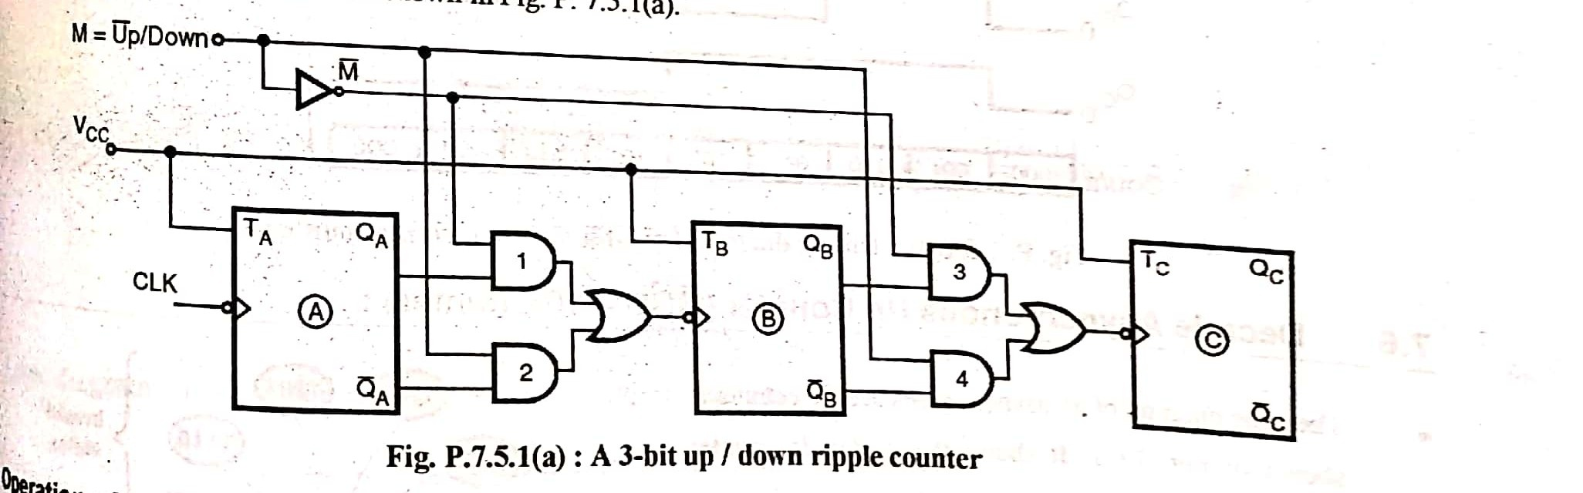
UP/DOWN Counter

