Slide 1
From Static Telemetry to Degradation Dynamics
Baseline Operational Predictors ↓ Operational Overlap Between Derate and Non-Derate States ↓ EDA (Elxploratory Data Analysis)of Instability and Recovery Behavior
↓ Engineered Predictive Features ↓ Degradation-Dynamics Framework
Baseline operational predictors showed substantial overlap between derate and non-derate states
Static telemetry values alone were insufficient for stable early-warning prediction
Time-based validation revealed poor operational separability under real-world conditions
EDA identified progressive instability and shrinking recovery behavior approaching future derates
Feature engineering focused on temporal degradation dynamics rather than isolated abnormal sensor values
Notes:
“These observations motivated a transition from static operational telemetry toward degradation-dynamics feature engineering.”

Slide 2
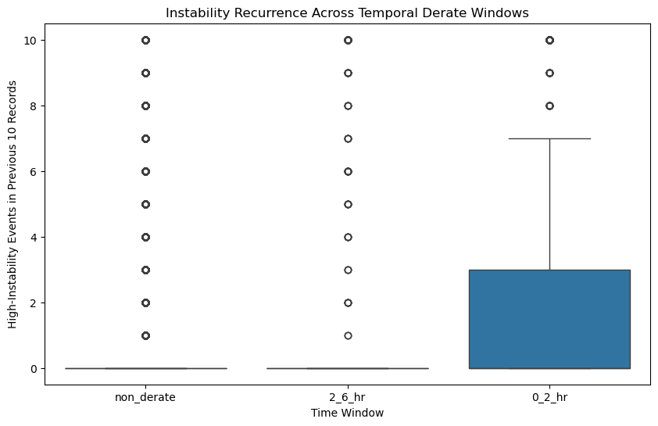
Evolution of Predictive-Feature Frameworks
Framework | Operational Meaning
Baseline Predictors | Static operational state
Rolling Features | Short-term trends
Instability Features | Operational fluctuation
DG Features | Progressive degradation dynamics
Final Degradation-Dynamics Predictors
Combined instability score
Instability recurrence
Recovery gap behavior
Instability density
Recovery-trend dynamics
Increasing instability recurrence was observed approaching future full derate events
Trucks with persistent instability frequently demonstrated shrinking operational recovery behavior
These patterns suggested progressive operational resilience collapse rather than isolated abnormal telemetry states

Slide 3
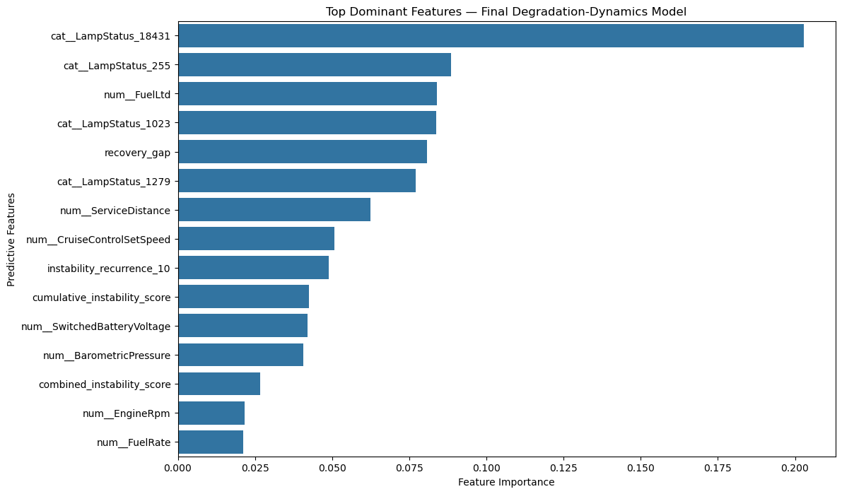
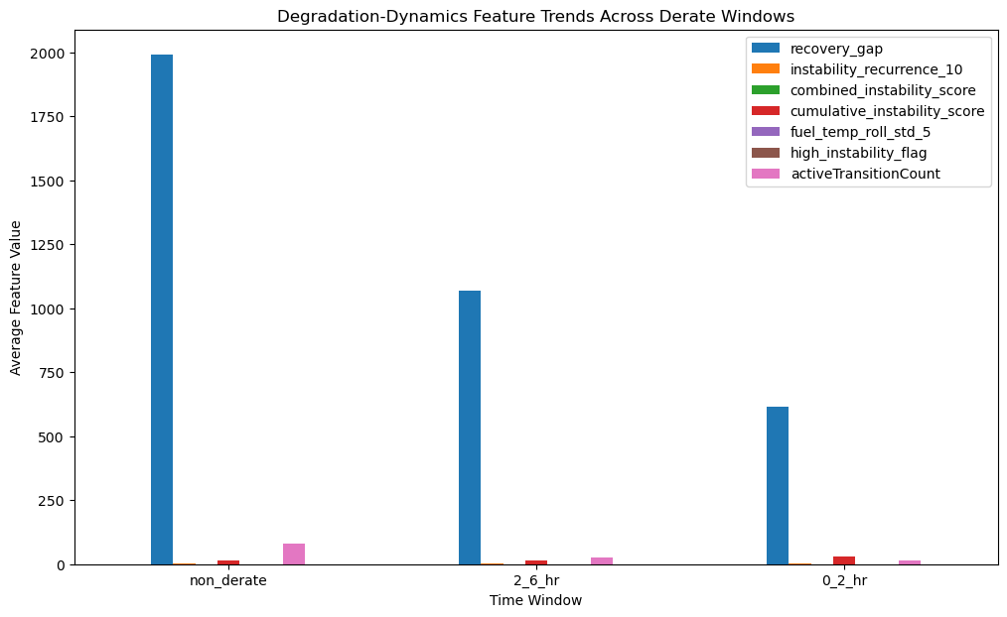
Recovery Behavior and Degradation-Dynamics Modeling
Recovery-gap behavior emerged as one of the dominant predictors within the final degradation-dynamics framework
Persistent instability and shrinking recovery periods were strongly associated with future full derate behavior
Degradation-dynamics features improved temporal degradation separability compared to earlier feature-engineering frameworks
The strongest degradation signals emerged closer to future full derate events

