Slide 1

Black Friday Sales Prediction
Submitted to
Nikhil Bharadwaj
Submitted by Group 1
Aishwarya Shivanand(300317462)
Minal Dhansukhlal (300318615)
Saurabh Varshney(300317857)

Slide 2
Introduction
Black Friday as we know it today is an extravaganza of sales, promotions, and long lines outside of stores.
This project attempted to predict amount each customer spent in this special day using the different customer demographics
Though predicting might be difficult, as the purchase amount varies depend on many factors, getting a minor relation between the factors will provide an insight on business status.
The data was retrieved from Kaggle website https://www.kaggle.com/kkartik93/black-friday-sales-prediction which comes from a sample record of transaction in one retail store in that day.

Slide 3
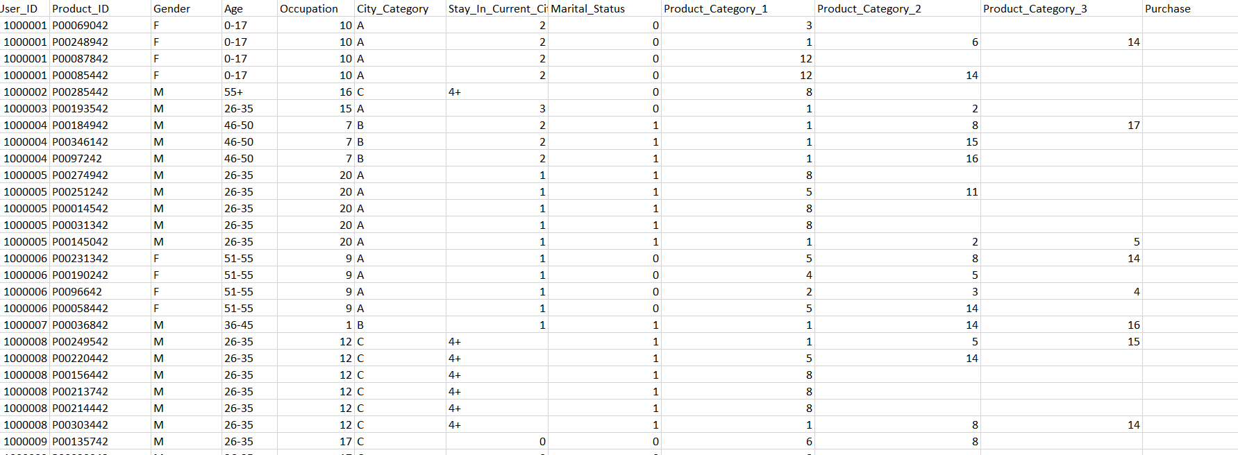
Introduction
The dataset has train dataset around 550000 entries and 12 columns and test dataset with 233600 entries and 11 columns that contains details of customer and product purchased.
fig: train dataset

Slide 4
Software used
R studio - Editor
R i386.4.0.3 – scripting language
Excel – database and to verify the model

Slide 5
Steps involved
Cleaning of data- remove null values and duplicate values
Change the numerical representation of marriage status and alphabetical representation of gender into category to better understand
Marital status : 0- Single, 1- married
Gender: M- Male, F-Female
We have done few exploratory analysis on the data to understand the customer purchase behavior (specifically, purchase amount) against various products of different categories.

Slide 6
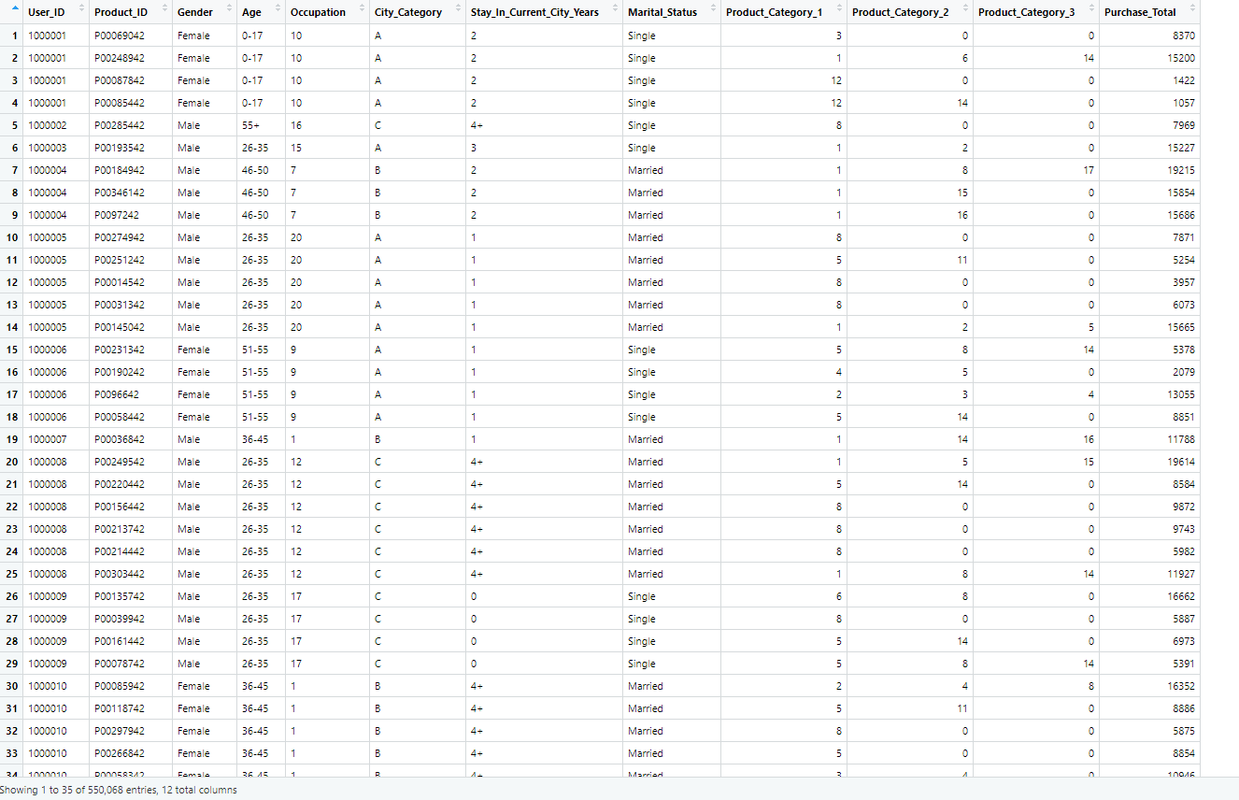
Steps involved
After cleaning the data and renaming the values, it is looked like in the below picture

Slide 7
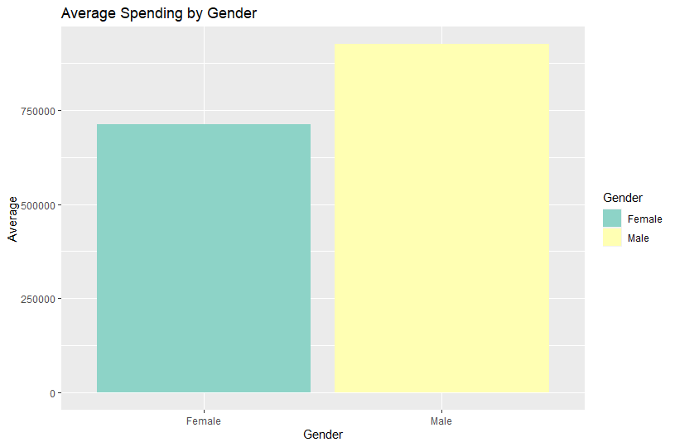

Exploratory Analysis
1. To start our analysis, lets find out who is more likely to spend more on Black Friday- male or female?
Conclusion: Male spend more than women on Black Friday

Slide 8
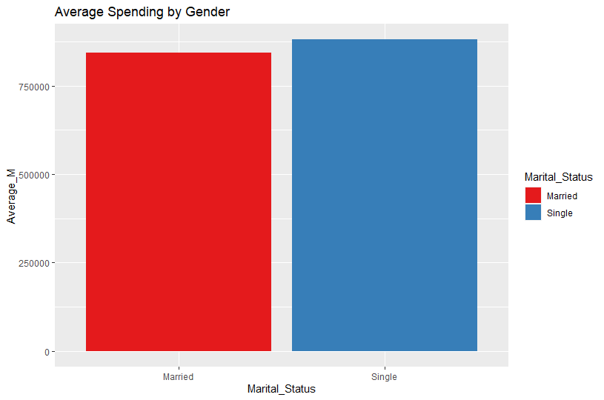

Exploratory Analysis
2. Find out who is more likely to spend more on Black Friday- married or single?
Conclusion: Singles spend more than married people on Black Friday

Slide 9
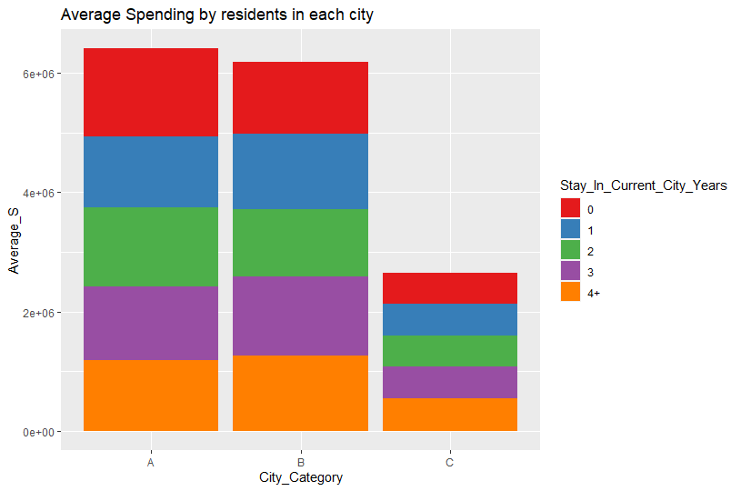
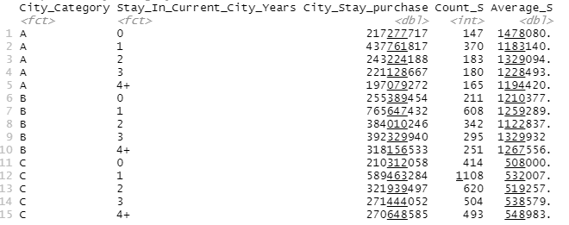
Exploratory Analysis
3. Find out who is more likely to spend more on Black Friday- based on the years they stay in the city
Conclusion: Customers from city A who stayed there for less than a year spends the highest

Slide 10
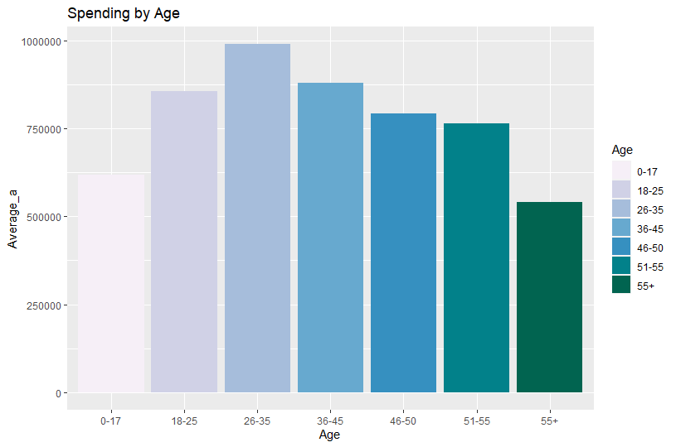
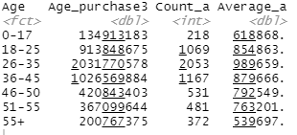
Exploratory Analysis
4. Find out who is more likely to spend more on Black Friday- based on age
Conclusion: Customers aging from 26 – 35 are likely to spend more on black friday

Slide 11
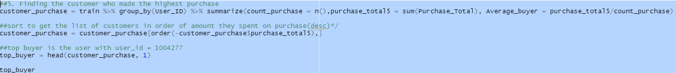
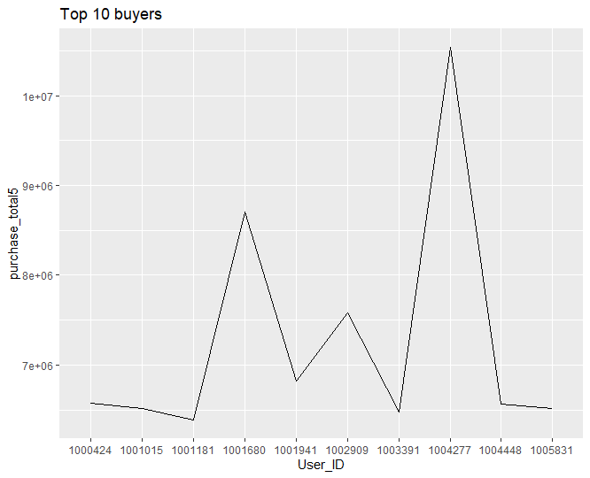

Exploratory Analysis
5. Find the customer who made the highest purchase
Customer with ID = 1004277 is the top buyer with purchase total of 10536909 dollar and average of 10763 dollar

Slide 12
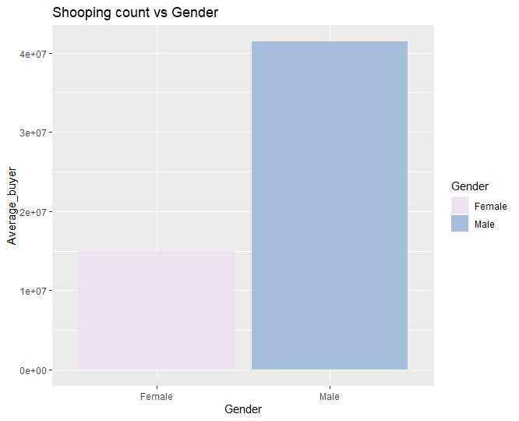
Exploratory Analysis
6. Who does the most shopping on Black-Friday : Men or Women?
Conclusion: There are considerably more male shoppers than female shoppers.

Slide 13
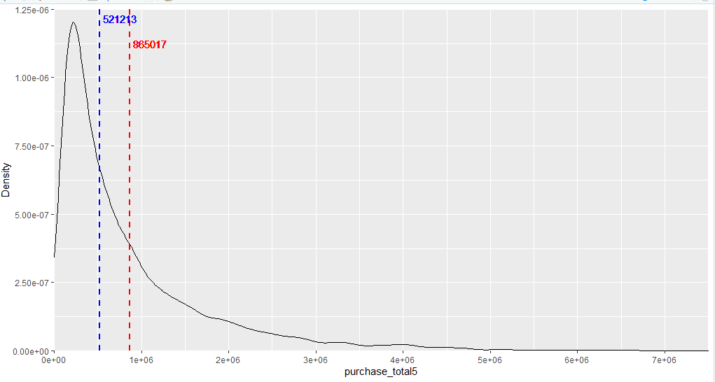
Exploratory Analysis
Density chart is plot to show the distribution of purchase amounts to see where the highest number of similar purchase amount lie in accordance with the whole customer base
Conclusion: We see very right (positive) skewed density plot with a long tail indicating that there are quite a few values that sit higher than the mean and that the highest density of values isn't a standardly distributed series.

Slide 14
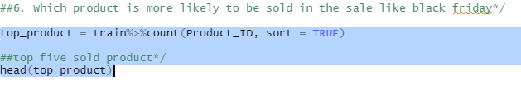
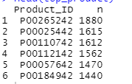
Exploratory Analysis
7. Which product is more likely to be sold in the sale like black friday
Conclusion: The product with ID P00265242 was highly purchased i.e. 1880 number of times.

Slide 15
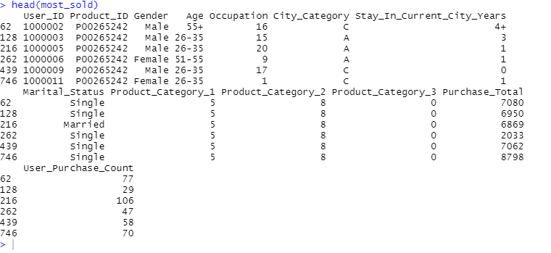
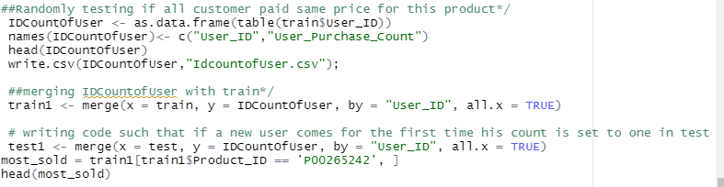

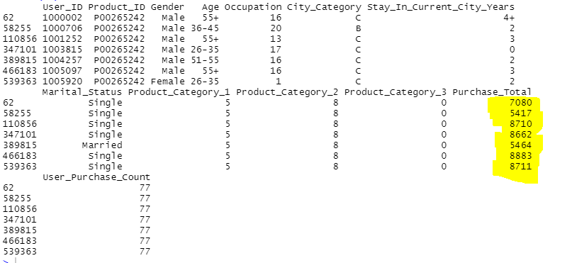
Exploratory Analysis
Randomly check done if the highly sold product was sold for the same price for all customers or not
Even though the count of purchase made is same the price each customer paid is different

Slide 16
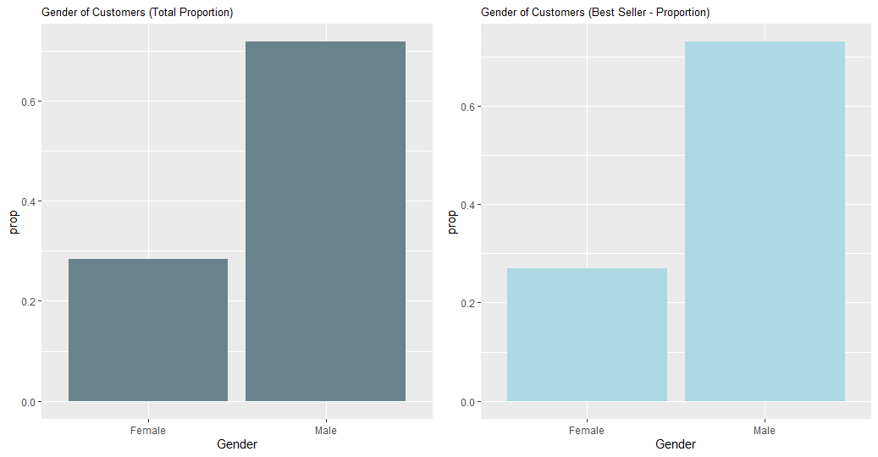
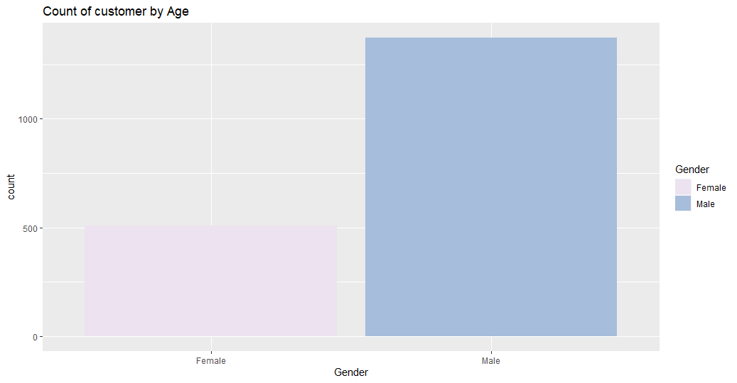
Exploratory Analysis
Analyze the most purchased product to see if any relationship to Gender exits
Comparing this with our gender graph for whole database, we see some similarities.
Both are roughly 25% female and 75% male

Slide 17
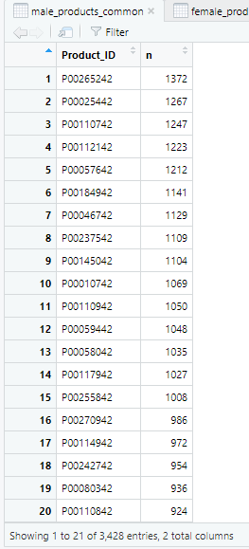
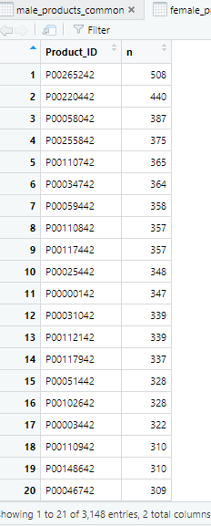
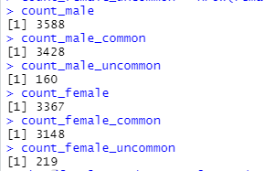
Exploratory Analysis
8. Which type of product are common among men and product common among women and save the details in data frame
Count of products common among male and female
Products male commonly purchase
Products female commonly purchase

Slide 18
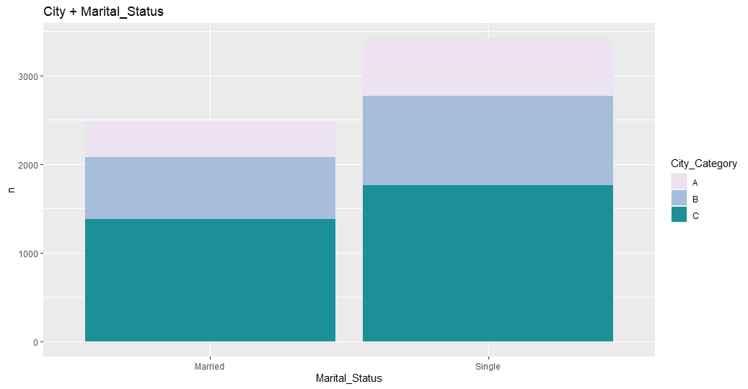
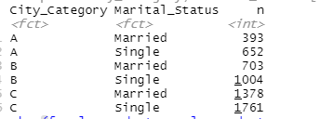
Exploratory Analysis
9. Analyzing the relationship between the city category and marital status
Number of single customers are more in all the three cities, City A, City B and City C

Slide 19
Model 1: Association Rule - Apriori
Apriori Algorithm is used to create some association rules to see the customer’s purchase behavior.
Association rule attempts to predict customer transaction
This will help the store in implementing effective product placement strategy that is proved to be purchased together in a sale
Customer purchasing a gaming laptop normally also buy gaming accessories- gaming mouse, headset
Placing them together will be a smart move .
On the other hand, placing them far apart will lead the customer to walk around where another product may interests them – marketing strategy.

Slide 20
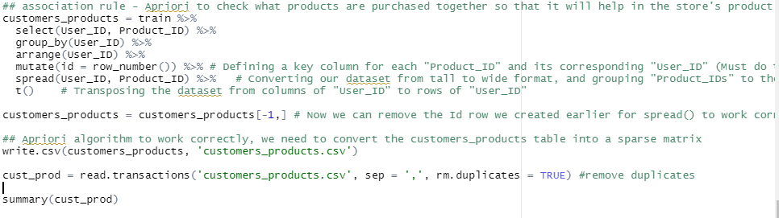
Model 1: Association Rule - Apriori
For the Apriori algorithm to work correctly, we need to convert the customers-products table into a sparse matrix
Apriori doesn't take strings or text as input, but rather binary values
Column must be allocated for each product-id and if any user purchase it then the number is 1 else 0.

Slide 21
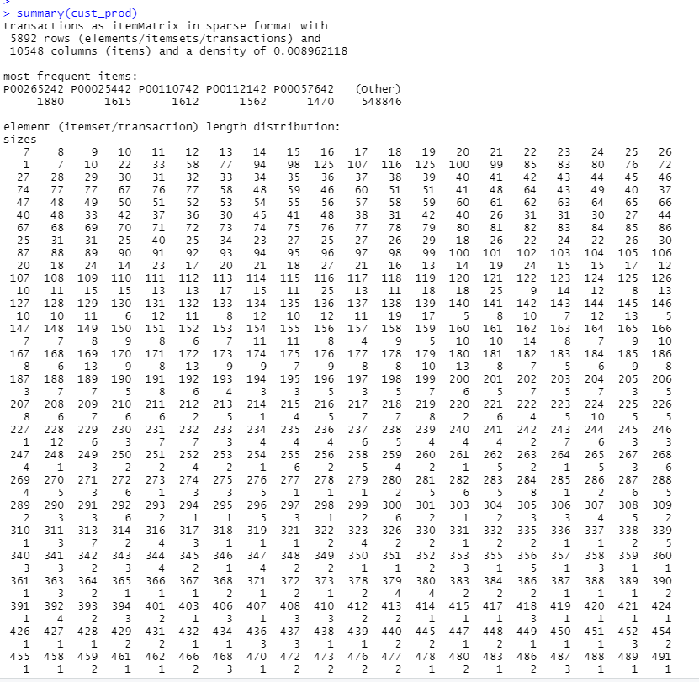
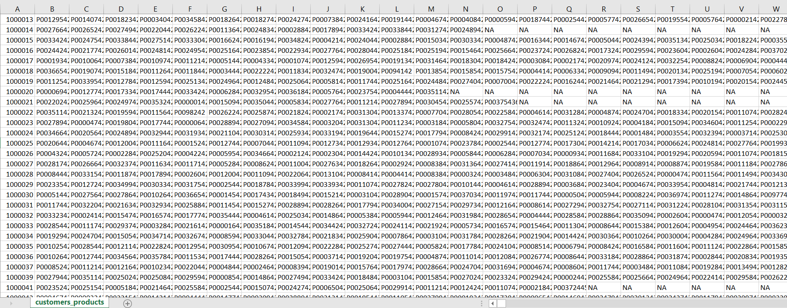
Model 1: Association Rule - Apriori
Sparse matrix
Excel file saved

Slide 22
Model 1: Association Rule - Apriori
Given itemset L, support of L is the percent of transactions that contain L
Support: Our support value will be the minimum number of transactions necessary divided by the total number of transactions.
As described by summary(cust_prod), we have a total number of unique customer transactions of 5892.
Assuming that we want to choose a product which was purchased by at least 50 different customers in our dataset
With these two values established, we can compute the support value with simple division. (50/5892) = .008486083
Confidence measures the certainty of a rule
The confidence value determines how often a rule is to be found true
The default confidence value in the apriori() function is 0.80 or 80%, so we can begin with that number and then adjust the parameters to applicable results.

Slide 23
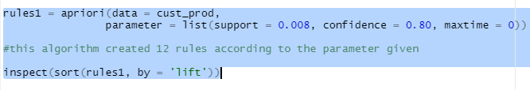
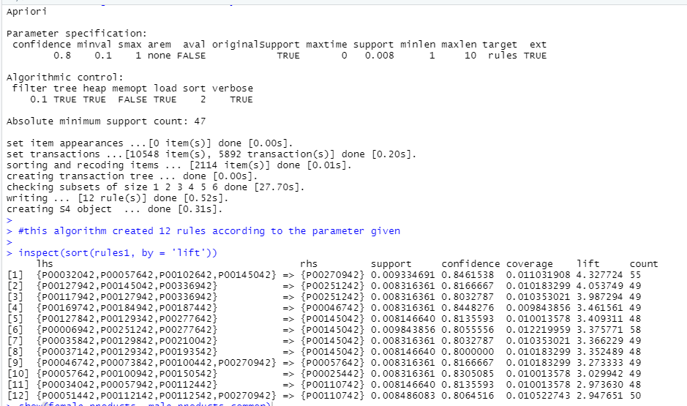
Model 1: Association Rule - Apriori

Slide 24
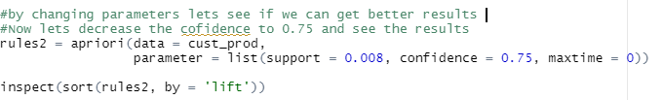
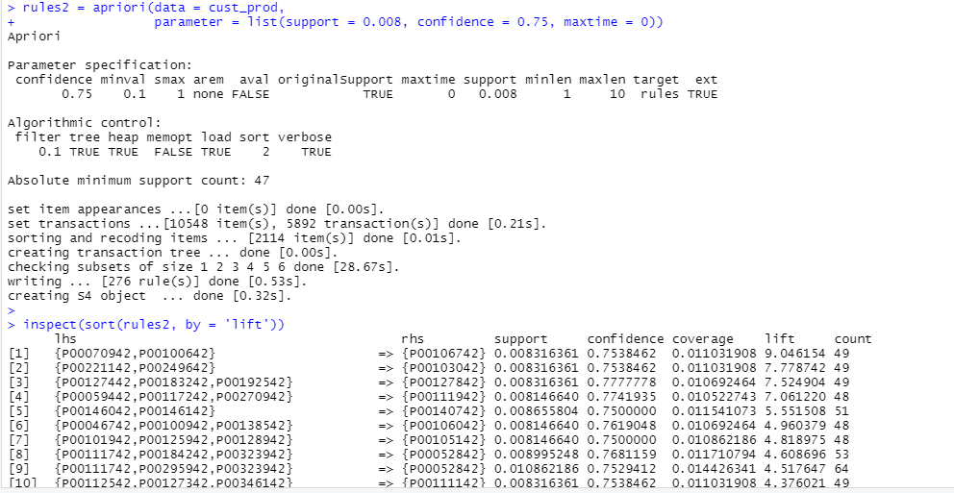


Model 1: Association Rule - Apriori

Slide 25

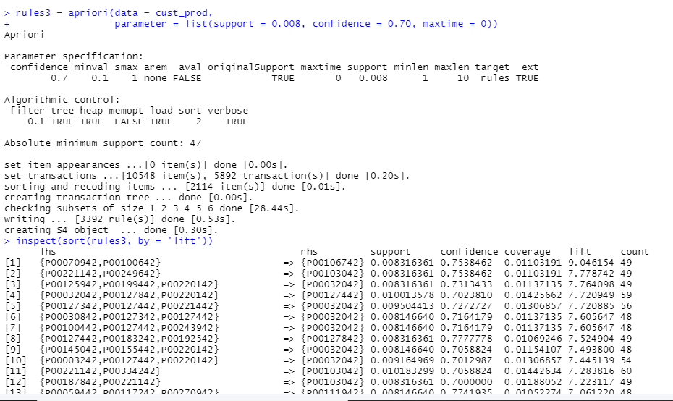


Model 1: Association Rule - Apriori

Slide 26
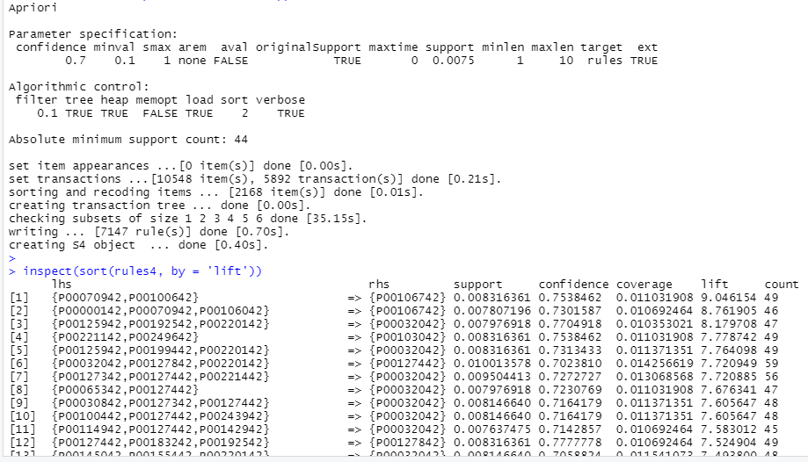

Model 1: Association Rule - Apriori

Slide 27
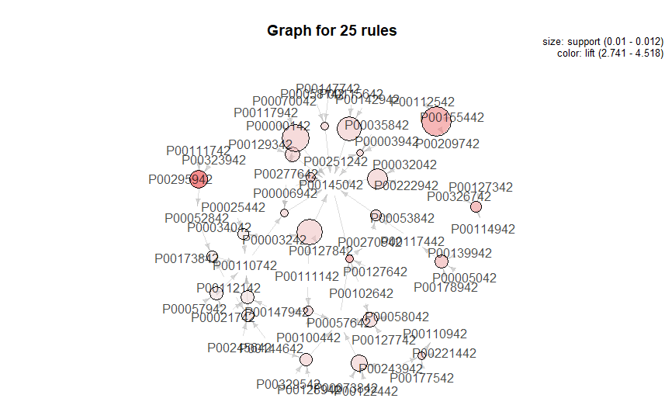
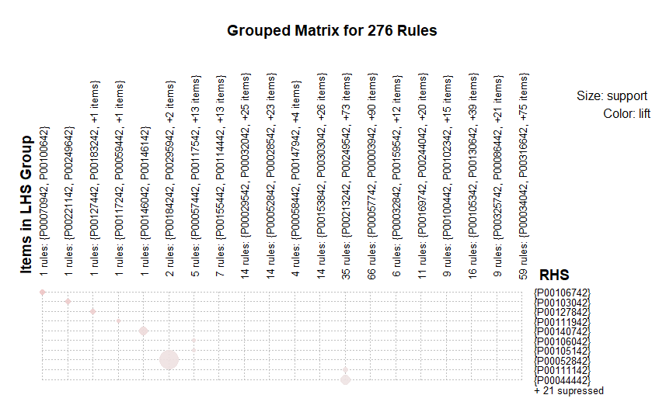
Model 1: Association Rule - Apriori
plot(rules2, method = 'graph', max = 25)
plot(rules2, method = 'grouped', max = 25)

Slide 28
Model 1: Association Rule - Apriori
Conclusion:
From running following rules, rules2 is best as it has the highest lift and in rule 3 and rule 2 the lift remain the same as the highest.
product P00106742 was purchased along with product P00070942,P00100642 with 75.4 % confidence and 0.8% support and highest lift 9.046154

Slide 29
Model 2: Linear Regression
Steps Involved
Cleaning of data- replaced null values with 0
Changed the variables to categorical data then to integer data so as to be compatible in doing regression as categorical data breaks down the categorical data into different variables in regression model. Converting to integer replaces the categories to a numerical value such as 0,1,2,….
Performed Correlation of all variable to know the strength of relationship among variables
Removed variables (User_ID, Product_ID, Product_Category_1, Product_Category_2, Product_Category_3) that have low correlation with other variables, especially with Purchase.
Thereafter, we performed regression model, predicted values of Purchase (y variable) with both train and test data set, calculated R square, RMSE (Root Mean Square Error) and ANOVA

Slide 30
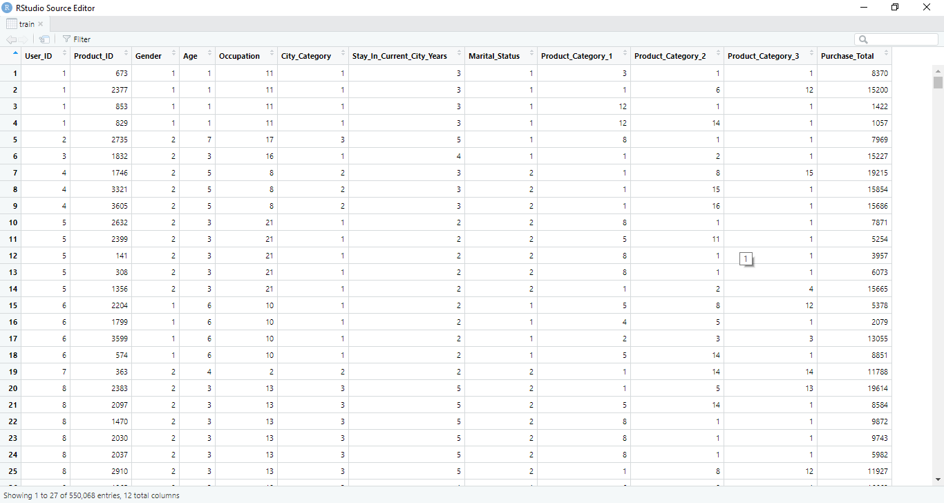
Model 2: Linear Regression
After replacing the NULL values and changing the data to numeric from categorical

Slide 31
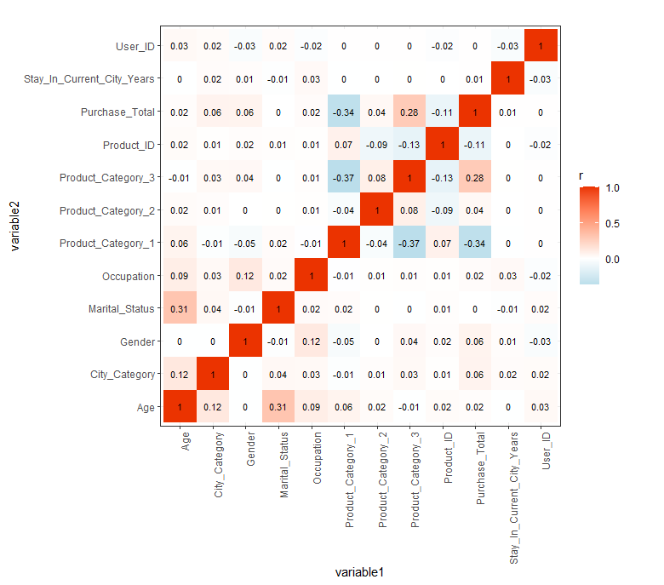
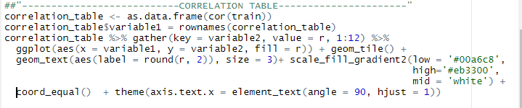
Model 2: Linear Regression
Steps involved: Correlation Table
From the table, we can clearly see that very low correlation is found in variable like Product_Category_1, Product_Category_2, Product_Category_3 and Product_ID, User_ID
Therefore we believe that the four variables mentioned above do not have strong relationship with Purchase_Total thus we dropped the column

Slide 32
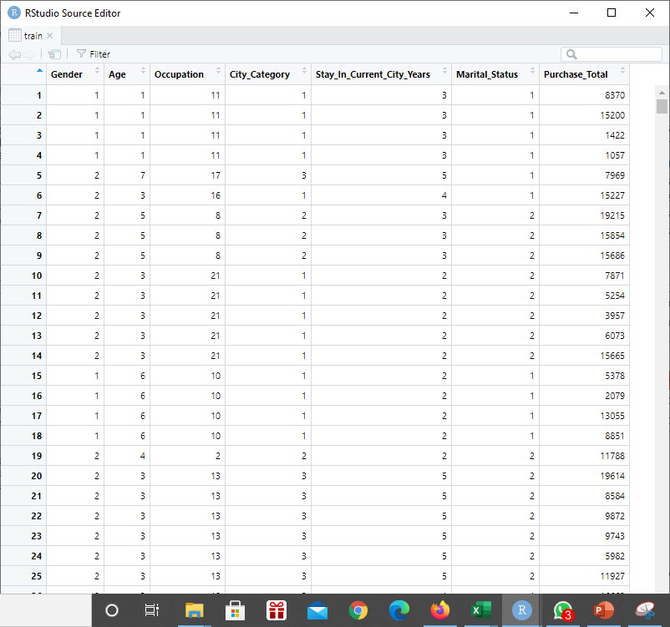
Model 2: Linear Regression
Steps involved: Final Data
After dropping unwanted columns from dataset, we had the following dataset to do regression:

Slide 33
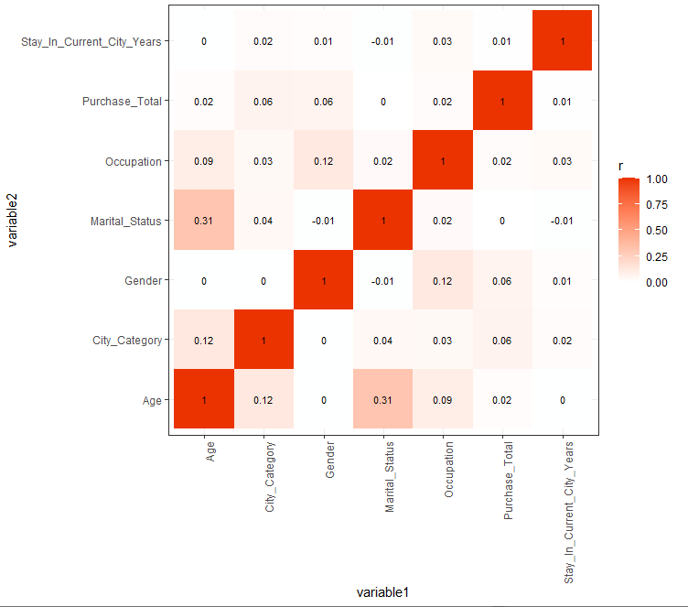
Model 2: Linear Regression
After dropping unwanted columns from dataset, we had the following dataset to do regression:

Slide 34
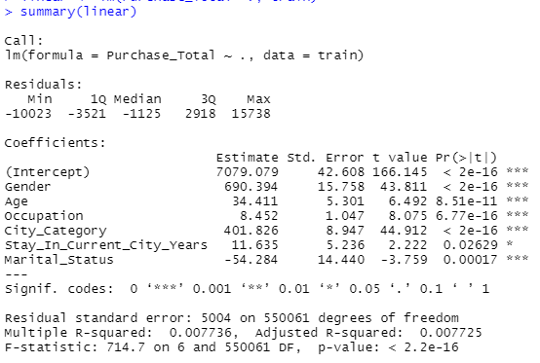
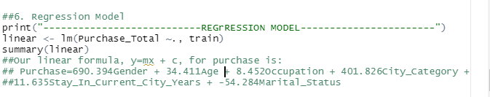
Model 2: Linear Regression
Our linear formula, y=mx + c, for purchase is:
Purchase = 690.394Gender + 34.411Age + 8.452Occupation + 401.826City_Category + 11.635Stay_In_Current_City_Years + -54.284Marital_Status

Slide 35
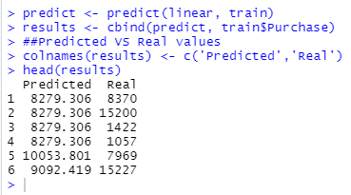
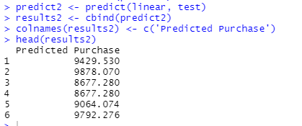
Model 2: Regression Model Prediction
Train Dataset: in this dataset, we had real values of Purchase
Test Dataset: as test dataset do not have real values, we predicted the Purchase from the linear regression model we built

Slide 36
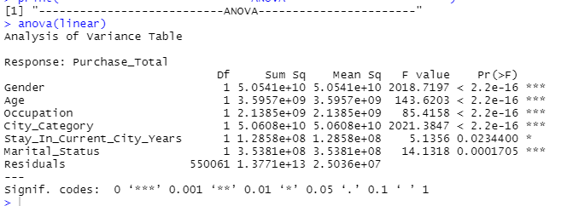
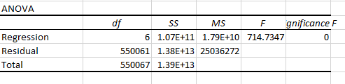
Model 2: Regression Model ANOVA

Slide 37
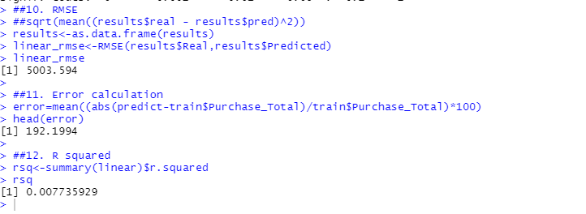
Regression Model: RMSE, R²,Error Calculations

Slide 38
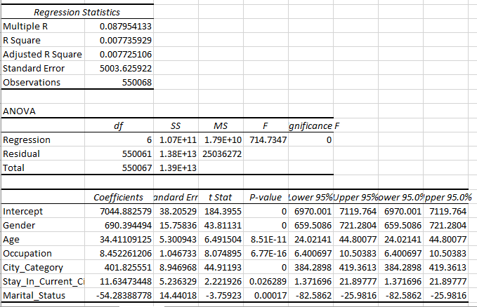
Regression Model in Excel

Slide 39
Conclusion
Since we have tested the accuracy of the output of R we got for the coefficient of intercept and slope by running regression analysis on Excel.
From the regression model, we obtained predicted values.
We calculated R square, RMSE and error from the results we obtained from regression.
We got R square vale as 0.007 and RMSE value as 5003.594 and error as 192.1994.
A good prediction model would be one with smaller RMSE and error and higher R square.
We got 0.007 as R square which might be low but not regarded as insignificant.

Slide 40
Future Work
We can implement other regression model as SVM regression, Ridge regression, Lasso regression or stepwise regression and compute R square, RMSE and error to check which one have smaller RMSE and error and higher R square.
The model having small RMSE and high R square would be considered as best model for prediction

Slide 41
References
Dabate. (2018, December 24). Black Friday Examined (EDA + Apriori). Retrieved December 01, 2020, from https://www.kaggle.com/dabate/black-friday-examined-eda-apriori/notebook
Michaelmallari. (2019, March 16). Multiple Linear Regression: Black Friday. Retrieved December 01, 2020, from https://www.kaggle.com/michaelmallari/multiple-linear-regression-black-friday
Ostwal, K. (2019, September 04). Black Friday Sales Prediction. Retrieved December 01, 2020, from https://www.kaggle.com/kkartik93/black-friday-sales-prediction/notebooks
Sign In. (n.d.). Retrieved December 01, 2020, from https://rpubs.com/DuyTuan/503311
Sign In. (n.d.). Retrieved December 01, 2020, from https://rpubs.com/RaminderSingh/363589
Stephenshen. (2019, May 07). Black Friday Analysis. Retrieved December 01, 2020, from https://www.kaggle.com/stephenshen/black-friday-analysis

