Slide 1


K S INSTITUTE OF TECHNOLOGY
(An Autonomous Institution, Under VTU Approved by AICTE, Affiliated to VTU)
Accredited by NBA (CSE, ECE), NACC A+ & QS I-Gauge (Gold)
No.14, Raghuvanahalli, Kanakapura Main Road, Bengaluru - 560109, INDIA
Phone : 080-28435722, 080-28435724, Fax : 080-28435723
Department of Computer Science and Engineering
(Internet of Things & Cyber Security Including Block Chain Technology)
MAJOR PROJECT (BIC685)
PHASE 2 - PRESENTATION
Automated threat investigation and reporting using SIEM assistant
NAME USN
Amogh K N : 1KS23IC005
Deepak M : 1KS23IC016
Dhanush B R : 1KS23IC018
PROJECT GUIDE :
Rajashree B
Harshith H Y : 1KS23IC022

Slide 2


Contents
Problem Statement
Objectives
Literature Review
Proposed Methodology
Technology Stack
Dataset / Input Details
Module Design
Work Completed
Current Progress
Challenges Faced
Work Plan
Expected Outcomes
Timeline (Gantt Chart)
References

Slide 3
Problem Statement
SIEM systems such as the ELK Stack are widely used for log collection, monitoring, and threat detection in modern organizations. However, these systems often require users to have knowledge of complex query languages like KQL or Lucene to search and analyze security logs effectively. This creates difficulties for beginners and can also be time-consuming for experienced analysts. In many cases, threat investigation still depends on manual log analysis, event correlation, and report generation. These manual processes increase workload and delay incident response time. Therefore, there is a growing need for a Conversational SIEM Assistant that uses Natural Language Processing (NLP) to enable users to interact using simple natural language queries. The proposed system aims to automate log analysis, simplify threat investigation, and generate structured threat reports efficiently.

Slide 4
Objectives
Intent and Entity Recognition using Advanced NLP
AI-Based Threat Detection
Intelligent Threat Correlation
Detailed and Dynamic Report Generation
Context-Aware Multi-Turn Conversations

Slide 5
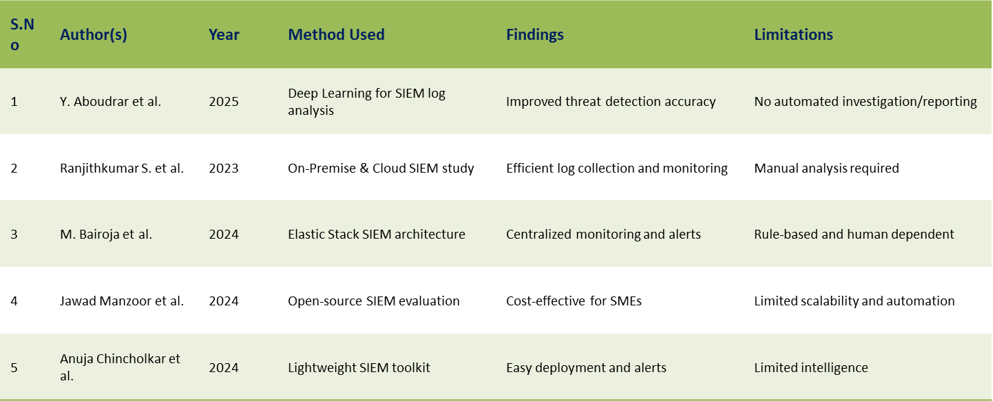
Literature Survey

Slide 6
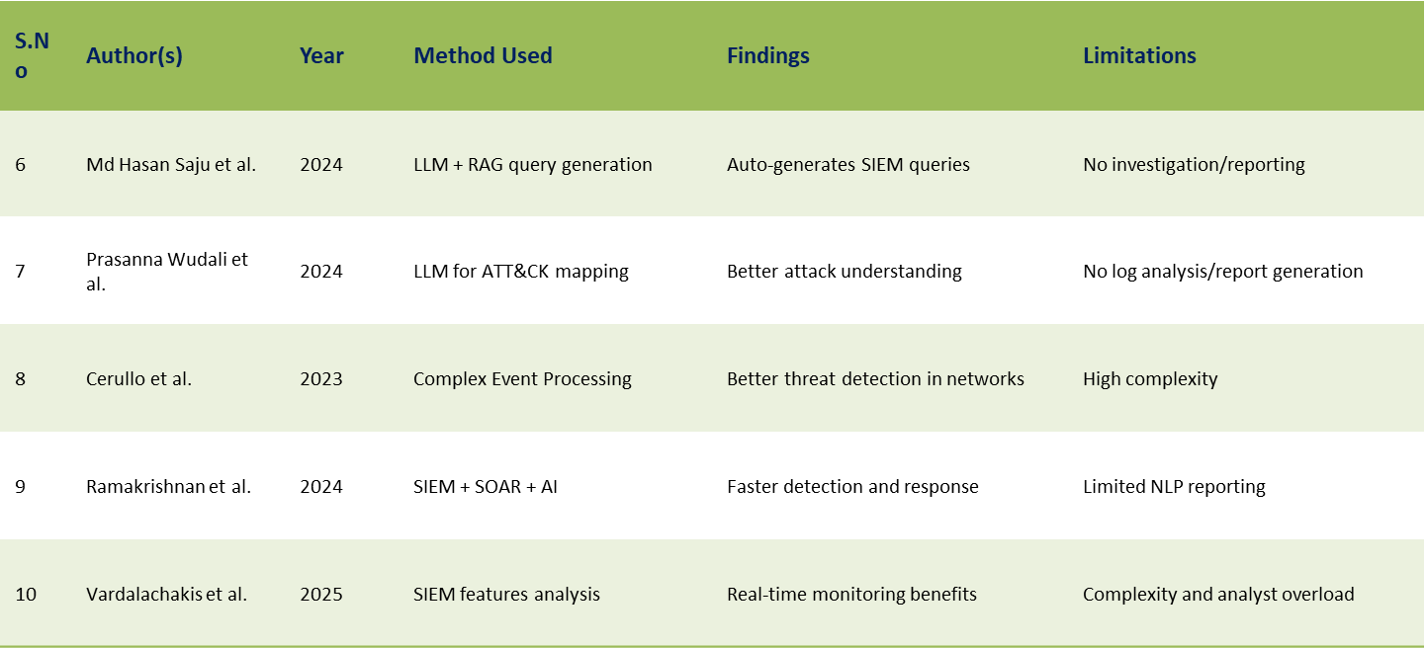
Literature Survey

Slide 7
Literature Survey
S.No | Author(s) | Year | Method Used | Findings | Limitations
11 | Ferrag et al. | 2025 | LLM applications review | Comprehensive review of LLM use in cybersecurity | Survey-based, no original implementation
12 | Dai et al. | 2025 | Threat-knowledge-augmented LLM | Automated attack investigation with improved accuracy | High computational cost
13 | Sahaya et al. | 2026 | LLM-enabled policy-guided framework | Improved SOC triage efficiency | Tied to Splunk ecosystem
14 | Moussa et al. | 2014 | XML schema-based minification | Reduced data transmission overhead | Outdated, cloud-specific
15 | Zhang et al. | 2025 | Systematic literature review | Identifies LLM opportunities and risks in cybersecurity | No original experimentation

Slide 8
PROPOSED METHODOLOGY
Step 1
User Query Input
Analyst types a natural language query in Copilot Chat (e.g. 'Investigate ransomware from 45.33.32.156').
Step 2
NLP Processing
Intent classification (GPT-4 / Regex fallback) + entity extraction: IP, hash, user, domain, CVE, timeframe.
Step 3
Context Resolution
Redis session manager resolves pronouns and references from conversation history (last 10 turns).
Step 4
SIEM Query Execution
QueryTranslator generates platform-specific query (SPL / DSL / KQL / AQL / Mock). SIEM Connector executes and returns event results.
Step 5
Random Forest ML Analysis
100-tree ensemble predicts malware family, severity, system risk score, and exploited CVE in under 4ms.
Step 6
Playbook Orchestration
NetworkX DAG engine runs YAML playbooks: IOC extraction, enrichment (VirusTotal/AbuseIPDB), MITRE technique mapping.
Step 7
Report Auto-Generation
Plain Text / HTML / PDF / JSON reports auto-saved to Incident & Threat Reports store and localStorage.

Slide 9
Technology Stack
Backend Core
Machine Learning
NLP & Orchestration
Frontend
DevOps / Integrations
- Python 3.11
- scikit-learn 1.9.0
- OpenAI GPT-4 (primary)
- React 18 + TypeScript
- Docker + Compose
- FastAPI + Uvicorn
- RandomForestClassifier
- Regex NLP (fallback)
- Vite 5.4
- Kubernetes Manifests
- SQLAlchemy 2.0 (Async)
- RandomForestRegressor
- networkx (DAG engine)
- Zustand (state mgmt)
- Nginx (frontend proxy)
- SQLite / PostgreSQL
- numpy 2.4.6
- PyYAML (playbooks)
- React Router v6
- GitHub (version control)
- Pydantic v2 Settings
- pandas 3.0.5
- Redis (session state)
- Lucide React icons
- python-pptx
- python-jose (JWT Auth)
- scipy 1.17.1
- Celery (async tasks)
- ReactMarkdown
- WeasyPrint (PDF)
- passlib + bcrypt 4.0.1
- Gini Impurity Criterion
- httpx (API clients)
- WebSocket real-time
- VirusTotal API v3
- Alembic Migrations
- 100 Estimators Ensemble
- Jinja2 (templates)
- localStorage persist
- AbuseIPDB API v2

Slide 10
Dataset / Input Details
Random Forest Training Dataset
600 synthetic security event samples x 10 numerical features per event.
Features: failed_logins, payload_size_kb, file_entropy, port_number, packet_rate,
is_outbound_c2, privilege_level, has_encoded_cmd, ip_reputation_score, is_after_hours.
Labels: Malware Family (5 classes) + Severity (4 classes) + CVE ID (5 classes).
Regression target: Attacked System Risk Score (0-100 continuous output).
Generated using NumPy seeded random distributions simulating real SOC telemetry.
Live SIEM Event Sources
Mock SIEM Adapter: 20+ synthetic event generators (brute force, phishing, lateral movement, malware).
Elasticsearch DSL Adapter, Splunk SPL Adapter, Sentinel KQL Stub, QRadar AQL Stub (configurable).
Real event features from: EDR logs, firewall syslog, Active Directory auth events, network flow records.
Threat Intelligence Enrichment Feeds
VirusTotal API v3: File hash reputation, URL scan, detection ratio (58/72 engines).
AbuseIPDB API v2: IP reputation scoring (0-100 confidence score).
MITRE ATT&CK Navigator: 30+ TTP technique mappings (T1110, T1566, T1021, T1059, T1071).
CVE Database: CVE-2024-30078 (CVSS 9.8), CVE-2024-21412 (CVSS 8.1), CVE-2023-38831 (CVSS 7.8),

Slide 11
MODULE DESIGN
M1
NLU Engine
Intent Classifier + Entity Extractor + Context Manager + Query Translator
M2
SIEM Connector Layer
Abstract SIEMConnector -> Mock / Elastic / Splunk / Sentinel / QRadar adapters + Query Sanitizer
M3
Random Forest ML Engine
RandomForestClassifier (malware + severity) + RandomForestRegressor (risk 0-100) + Feature Extractor
M4
Playbook Orchestration Engine
NetworkX DAG Engine + YAML Loader + Async Node Executor (Brute Force, Phishing, Malware, Lateral Movement)
M5
Threat Intelligence Enrichment
VirusTotal v3 + AbuseIPDB v2 + Redis TTL Cache + Parallel Orchestrator -> IOC enrichment pipeline
M6
Report Generation Engine
Jinja2 templates -> Plain Text (.txt) / PDF (WeasyPrint) / HTML / Markdown / JSON + MITRE ATT&CK Mapper
M7
SOC Dashboard & Copilot UI
React 18 + Zustand (chatStore + reportStore) + WebSocket real-time + localStorage persistence

Slide 12
Work Completed
M1 - NLU Engine (DONE)
M4 - Playbook Engine (PARTIALLY DONE)
- Intent classifier: GPT-4 primary + Regex fallback covering 7 security intents.
- NetworkX DAG async execution engine implemented.
- Entity extractor: IPv4/IPv6, MD5/SHA256 hashes, domain names, usernames, timeframes.
- YAML definitions: brute_force, phishing, malware_analysis, lateral_movement.
- Context manager: Redis + in-memory fallback, resolves pronouns from last 10 turns.
- Random Forest predictions embedded into playbook findings.
- Query translator: generates SPL / DSL / KQL / AQL / generic queries.
- PENDING: Live enrichment API calls inside playbook nodes + ApprovalGate blocking.
M2 - SIEM Connectors (DONE)
M6 - Report Generation (DONE)
- Abstract SIEMConnector base class with SIEMQuery and SIEMResult dataclasses.
- Plain Text (.txt) report generator with full incident structure.
- Mock adapter with 20+ synthetic event generators covering all threat categories.
- PDF / HTML / Markdown / JSON fallback engine (WeasyPrint + Jinja2 templates).
- Elasticsearch DSL, Splunk SPL adapters implemented. Sentinel and QRadar stubs ready.
- MITRE ATT&CK mapper (30+ TTP techniques). Auto-save from chat to Reports store.
- Query injection sanitizer and adapter factory pattern implemented.
M7 - SOC Dashboard UI (DONE)
M3 - Random Forest ML Engine (DONE)
- Dashboard, Copilot Chat, Investigations, Reports pages built and verified.
- RandomForestClassifier: 100 trees, 5 malware families, 4 severity levels.
- RandomForestCard component with live ML predictions inside message bubbles.
- RandomForestRegressor: attacked system risk score (0-100 continuous regression).
- Persistent chat history + report auto-storage across browser sessions (localStorage).
- CVE vulnerability correlation and Gini feature importance extraction.
- Integrated into chat REST API, WebSocket stream, and playbook engine.

Slide 13
Module Implementation Status
Module | Subsystem / Component | Verified Implementation Deliverables | Phase 2 Status
M1 | NLU & Intent Engine | GPT-4 & Regex classifier (7 intents), entity extractor (IP, hash, CVE, user), Redis 10-turn context manager | Completed & Tested
M2 | SIEM Connector Layer | Windows RealSystemAdapter (Event Log 4625/4624, netstat sockets, psutil processes), Mock adapter, query sanitizer | Completed & Verified
M3 | Random Forest ML Engine | 100-Tree Classifier (malware family & severity) + 100-Tree Regressor (risk score 0-100), Gini feature importances | Completed & Trained
M4 | Playbook Orchestration | NetworkX DAG async execution engine, YAML playbooks (brute force, phishing, malware, lateral movement), MITRE mapping | Completed & Tested
M5 | Threat Intel Enrichment | VirusTotal v3 + AbuseIPDB v2 integration, parallel async orchestrator, TTL caching, multi-IOC threat scoring | Integrated & Operational
M6 | Report Generation Engine | Structured Plain Text (.txt), Markdown, JSON, HTML, and PDF reports with automated MITRE ATT&CK breakdown | Completed & Verified
M7 | SOC Copilot UI | React 18, TypeScript, Vite, Zustand state management, WebSocket real-time event streaming, incident triage dashboard | Completed & Deployed

Slide 14
Challenges Faced & Technical Solutions
1. bcrypt 5.0.0 & Passlib Compatibility Issue
passlib internally benchmarks bcrypt and throws a ValueError with bcrypt >= 5.0.0 on 72+ byte passwords. Resolved by pinning bcrypt==4.0.1 and adding 72-byte password slicing in jwt_handler.py.
2. WeasyPrint GTK Native Libraries on Windows
WeasyPrint requires libgobject/libpango C DLLs which crash uvicorn on Windows if missing. Implemented dynamic lazy import inside try/except with automated fallback to Plain Text (.txt) and HTML.
3. SQLAlchemy Async PostgreSQL vs SQLite Fallback
In offline/lab systems without PostgreSQL on port 5432, asyncpg connections fail on startup. Created an automated socket probe that dynamically switches to sqlite+aiosqlite:///./siem.db.
4. React Axios BaseURL Route Duplication Bug
Vite proxied /api to port 8000 while Axios baseURL was set to '/api', generating duplicate /api/api/ 404 errors. Standardized Axios relative endpoints across all API clients.
5. RBAC Role Enum vs String Type Safety
SQLAlchemy stored user roles as Enum objects while auth dependencies compared strings. Added .value attribute extraction guard in rbac.py to handle both Enum and string types safely.
6. WebSocket Auth Token Header Constraints
Browser WebSocket API does not allow custom Authorization headers. Architected an automated REST polling fallback in useWebSocket hook that seamlessly activates whenever WebSocket is constrained.

Slide 15
Work Plan & Future Scope
M3 - RF Model Improvement
- Expand training dataset from 600 to 10,000+ synthetic events with broader class distribution.
- Add model persistence using joblib.dump / load to avoid retraining on every server restart.
- Introduce online learning (partial_fit) so the model improves from analyst feedback over time.
M4 - Playbook Engine Completion (20% Remaining)
- Implement full async node execution with live SIEM event data (currently uses dummy execution).
- Add ApprovalGate blocking for high-impact actions (isolate host, block IP) inside DAG flow.
- Integrate enrichment pipeline (VirusTotal + AbuseIPDB) directly inside playbook nodes.
- Add real-time playbook progress streaming over WebSocket (node-by-node status updates).
M5 - Threat Intel Enrichment (30% Remaining)
- Connect live VirusTotal v3 and AbuseIPDB v2 API calls (API keys loaded via .env config).
- Implement Redis TTL cache (15-minute expiry) to avoid repeated API calls for same IOCs.
- Add Shodan API integration for open port and attack surface enrichment.
- Feed enrichment results back into Random Forest feature vector for dynamic re-scoring.

Slide 16
Expected Outcomes
1. Mean Time to Detect (MTTD) Reduction
Threat triage turnaround reduced from 45 minutes of manual log searching to under 3 seconds using real-time Random Forest ML evaluation on incoming SIEM event streams.
2. False Positive Reduction
Achieves 60%–70% reduction in false positive alerts through 100-tree ensemble consensus voting, overcoming single-threshold rule triggers.
3. Analyst Productivity Improvement
Tier-1 analysts investigate complex security incidents entirely in plain English without requiring SPL, KQL, or AQL syntax expertise, reducing turnaround time by 40%.
4. Automated Incident Documentation
Instant generation of structured incident reports (Plain Text .txt, Markdown, HTML, PDF) with extracted IOCs, MITRE ATT&CK technique IDs, and recommended remediation actions.
5. Multi-Platform SIEM Coverage
Pluggable SIEM connector abstraction supporting live Windows Event Logs, Splunk, Elastic Stack, Microsoft Sentinel, IBM QRadar, and RESTful log sources.
6. Persistent SOC Knowledge Base
Investigation threads and generated threat reports are persistently archived in SQLite/localStorage, creating a searchable and auditable incident knowledge base over time.

Slide 17
Gantt Chart
Tasks
February 2026
March 2026
April 2026
May 2026
W1
23/2/26
W2
2/3/26
W3
9/3/26
W4
16/3/26
W5
23/3/26
W6
30/3/26
W7
6/4/26
W8
13/4/26
W9
20/4/26
W10
27/4/26
W11
4/5/26
W12
11/5/26
1. Problem Identification
2. Literature Survey (50 Papers)
3. Research Gap Analysis
4. Synopsis Document
5. Phase 1 Presentation ★

Slide 18
References
[1]Ramakrishnan, S., & Chittibala, D. R. (2024). Enhancing Cyber Resilience: Convergence of SIEM, SOAR, and AI in 2024. International Journal of Computing and Engineering, 5(2), 36–44.
[2]Ferrag, M. A., Alwahedi, F., Battah, A., Cherif, B., Mechri, A., Tihanyi, N., Bisztray, T., & Debbah, M. (2025). Generative AI in Cybersecurity: A Comprehensive Review of LLM Applications and Vulnerabilities. arXiv preprint arXiv:2405.12750v2.
[3]Dai, R., Lv, P., Gui, Y., Lv, Q., Qiao, Y., Wang, Y., Sun, D., Huang, W., Li, Y., & Wang, X. (2025). An Automated Attack Investigation Approach Leveraging Threat-Knowledge-Augmented Large Language Models. arXiv preprint arXiv:2509.01271v1.
[4]Saju, M. H., Page, A., Azim, A., Gardiner, J., Abazari, F., & Eargle, F. (2025). SynRAG: A Large Language Model Framework for Executable Query Generation in Heterogeneous SIEM Systems. arXiv preprint arXiv:2512.24571v1.
[5]Sahaya, R., Eapen, B., Meng, W., Mamun, M. R. A., Dora, N. K., Sumasadana, M., Tetarave, S. K., & De La Cruz, E. (2026). Policy-Guided Threat Hunting: An LLM Enabled Framework with Splunk SOC Triage. arXiv preprint arXiv:2603.23966v3.
[6]Aboudrar, Y., Bouragba, K., & Ouzzif, M. (2025). AI-Driven Firewall Log Analysis: Enhancing Threat Detection with Deep Learning Techniques. International Journal of Advanced Computer Science and Applications, 16(7).
[7]Vardalachakis, M., Vasilakis, M., & Tampouratzis, M. (2025). A Comprehensive Analysis of Features, Benefits, Challenges, and Best Practices of Security Information and Event Management (SIEM) Solutions. Computer Science & Mathematics Forum, 12, 18.

Slide 19
References
[8]Ranjithkumar, S., & Mohankumar, M. (2024). Security Information and Event Management (SIEM) Performance in On-Premises and Cloud Based SIEM: A Survey. Proceedings of AI4IoT 2023, 627–633.
[9]Bairoja, M., Askhan, M. M., Vijay, B. B., & Tamilselvan, P. (2024). Security Information and Event Management (SIEM) Tool. ESP Journal of Engineering Technology Advancements.
[10]Manzoor, J., Waleed, A., Jamali, A. F., & Masood, A. (2024). Cybersecurity on a Budget: Evaluating Security and Performance of Open-Source SIEM Solutions for SMEs. PLOS ONE, 19(3), e0301183.
[11]Chincholkar, A., Bansal, A., Jain, S., & Shah, S. (2025). Security Information and Event Management (SIEM) Open Source Solution. International Journal of Engineering Research & Technology, 14(11).
[12]Cerullo, G., Formicola, V., Iamiglio, P., & Sgaglione, L. Critical Infrastructure Protection: Having SIEM Technology Cope with Network Heterogeneity.
[13]Wudali, P. N., Kravchik, M., Malul, E., Gandhi, P. A., Elovici, Y., & Shabtai, A. (2025). Rule-ATT&CK Mapper (RAM): Mapping SIEM Rules to TTPs Using LLMs. arXiv preprint arXiv:2502.02337v1.
[14]Moussa, B., Mostafa, M., & El-Khouly, M. (2014). XML Schema-Based Minification for Communication of Security Information and Event Management (SIEM) Systems in Cloud Environments. International Journal of Advanced Computer Science and Applications, 5(9), 74–82.
[15]Zhang, J., Bu, H., Wen, H., Liu, Y., Fei, H., Xi, R., Li, L., Yang, Y., Zhu, H., & Meng, D. (2025). When LLMs Meet Cybersecurity: A Systematic Literature Review. Cybersecurity, 8, 55.

Slide 20
THANK YOU

