Slide 1

Gun Violence
in USA and its impact
Arjun, Sree, Dhanu
This Photo by Unknown Author is licensed under CC BY-NC-ND

Slide 2

Introduction
This report presents our comprehensive analysis of gun incident data spanning the years 2013 to 2018, employing advanced PySpark tools. Our investigation primarily centered on understanding incident severity and frequency variations across states and over time. Through meticulous examination, we identified dynamic trends in incidence rates, shedding light on the nuanced nature of gun-related incidents.

Slide 3

METHODOLOGY
FINDINGS
DEMONSTRATED STREAMING USING KAFKA
EXPLORATORY DATA ANALYSIS
FEATURE ENGINEERING
TOKENIZATION AND CLUSTERING
Temporal Trends in Gun Violence
Tokenization of Incident Descriptions
Geospatial representation of severity-based clustering paraphrase

Slide 4

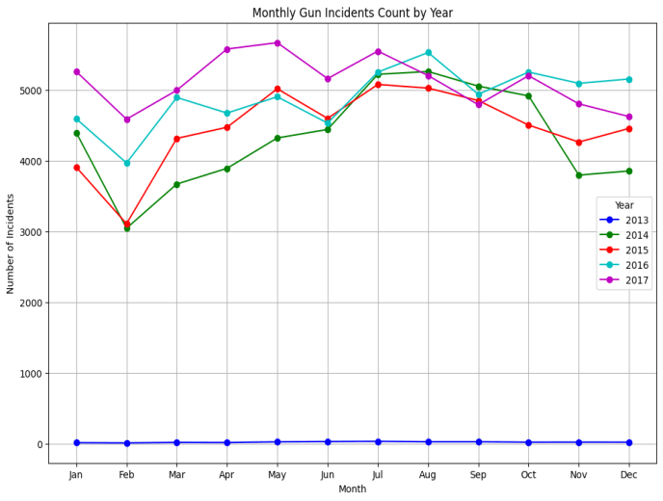
Incidents

Slide 5

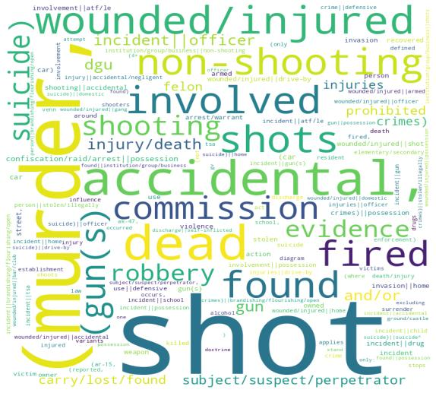
Word Map
This Photo by Unknown Author is licensed under CC BY-SA

Slide 6
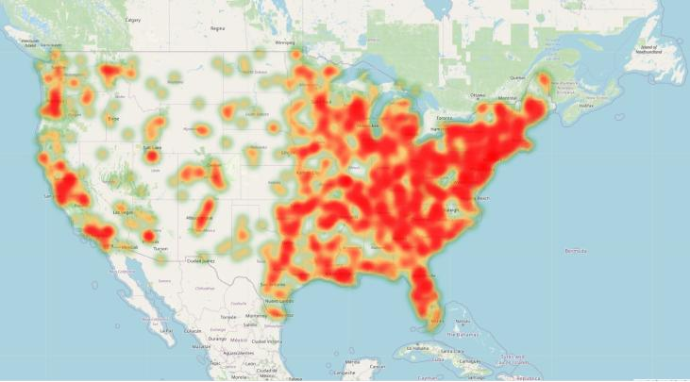
Clustering
High Risk Zones
Chicago
Baltimore
Washington
New Orleans
Low Risk Zones
Cresskill
Metter
Lynch
Dayton
Ravena

Slide 7

CLASSIFICATION
For each incidence, we created a severity classification and assigned categories based on that classification. Then, using data not included in the initial severity evaluation process, we used a predictive model to estimate the severity level of new incidents. We divided the samples into low, middle, and high categories using a multiclass classification evaluator. Our accuracy rate was 77.89%.

Slide 8

Thankyou

