Slide 1
CISC (Complex Instruction Set Computer) versus RISC (Reduced Instruction Set Computer)

Slide 2
Main Point
How many instructions we can start at the same time is more important than how much time a single instruction requires

Slide 3
CISC versus RISC
ADD [BX+SI+10], AX
Here, [BX+SI+10] specifies the memory address where the operand is located
This expression involves complex addressing modes, including base registers (BX and SI) and a constant offset (10)
Memory access and arithmetic are combined into a single instruction
LOAD R1, 10(R2) ; Load the value at memory address R2+10 into R1
LOAD R3, 20(R4) ; Load another value from memory into R3
ADD R5, R1, R3 ; Add the values in R1 and R3 and store the result in R5
Also, memory instructions are separate from arithmetic instructions

Slide 4
RISC Philosophy
Simplicity: Simple instruction set to minimize the number of instructions, addressing modes, and instruction formats, making it easier to design, implement, and optimize CPU hardware
Fixed-Length Instructions: Fixed-length instructions, typically 32 or 64 bits in length to simplify instruction decoding and execution, leading to more predictable performance
Single-Cycle Execution: Designed to be executed in a single clock cycle to simplify the CPU's control unit and pipeline stages, resulting in faster instruction throughput
Load-Store Architecture: Follow a load-store architecture, where memory operations (loads and stores) are separated from arithmetic and logic operations to reduce complexity and allow for more efficient memory access

Slide 5
RISC Philosophy
Register-Register Operations: Mainly perform operations between registers, promoting efficient use of CPU registers for temporary storage of data and operands
Compiler-Friendly: Designed to be compiler-friendly that allows compilers to generate optimized code more easily, which can lead to better performance
Reduced Addressing Modes: Offer a limited set of addressing modes, reducing complexity and promoting regularity in instruction formats
Pipelining: Employ pipeline architectures, where the execution of multiple instructions is overlapped to improve throughput

Slide 6
RISC Philosophy
Hardwired Control: Use hardwired control logic for instruction decoding and execution, which can result in faster operation compared to microcoded control
Efficiency: Prioritize efficiency in terms of power consumption and performance using less number of transistors
Parallelism: Encourage instruction-level parallelism (ILP), where multiple instructions are executed concurrently
Scalability: Scalable, allowing for the creation of CPUs with different levels of performance by adding more execution units or cache memory

Slide 7
The ARM Architecture
ARM = Advanced RISC Machine … Now
ARM = Acorn RISC Machine … Earlier
In 1985, the U.K.-based company Acorn Computer, created the Acorn Archimedes personal computer
They called their design the Acorn RISC Machine
Other RISC architecture examples: MIPS, PowerPC, and RISC-V

Slide 8
Intel versus ARM
*SoC combines CPU, GPU, RAM, DSP, modems on a single chip. So, data does not have to travel much, making it faster.
Intel | ARM
CISC-based | RISC-based
Mainly used in PC and laptop devices | Mainly used in low-power devices such as smartphones, tablets, wearables, smart home devices, etc
Designs and manufactures chips | Only designs chips and licenses the designs to other companies for manufacturing the chips
Designed to perform complex tasks simultaneously, so need high clock speed | Designed to perform a series of simple tasks, so do not need high clock speed
Rely on hardware to perform complex tasks, so need complex manufacturing, high power, cooling equipment | Optimized on both hardware and software, hence need less power, produce lesser heat, allowing these chips to be embedded in a System on a Chip (SoC)*

Slide 9
RISC/CISC Evolution Cycle
Early Days (1940s - 1970s)
Use of simple instruction sets with a limited number of instructions
Similar to RISC due to hardware constraints and the need for simplicity
Examples: IBM 701 (vacuum tube-based) and early minicomputers
Mainframe Era (1960s - 1970s)
As computers became larger and more complex, CISC architectures emerged
A large number of complex and versatile instructions
Example: IBM's System/360 architecture
Microprocessor Revolution (1970s - 1980s)
Emergence of early RISC architectures
Goal: Simplify CPU design to fit on a single chip and achieve higher clock speeds
Example: The MIPS architecture

Slide 10
RISC/CISC Evolution Cycle
CISC Dominance (1980s - 1990s)
CISC architectures like the x86 architecture (used in Intel processors), gained widespread popularity
A wide range of instructions and microcode for compatibility with existing software
RISC Renaissance (1980s - 1990s)
The limitations of CISC designs, such as pipeline stalls and inefficiencies, led to a renewed interest in RISC
SPARC, MIPS, and PowerPC started becoming popular as RISC alternatives
Hybrid Architectures (1990s - 2000s)
Some processor designs adopted a hybrid approach, incorporating elements of both RISC and CISC
Modern x86 processors (e.g., Intel's Pentium Pro) employed microcode and complex instruction decoding but with a RISC-like execution core

Slide 11
RISC/CISC Evolution Cycle
Multicore and Parallelism (2000s - Present)
The shift towards parallel computing and multi-core processors changed the picture
Many modern processors, including both RISC and CISC designs, now have multiple cores for parallel processing
SIMD (Single Instruction, Multiple Data) and SIMT (Single Instruction, Multiple Threads) architectures have been integrated for better performance
RISC-V and Open Architectures (2010s - Present):
RISC-V, an open and modular RISC architecture, gained attention for its simplicity and adaptability
Open architectures like RISC-V allow for customization and innovation in processor design

Slide 12
Fetch-Decode-Execute Cycle

Slide 13
Instruction Execution Step-by-Step
The x86 CPUs do not complete execution of an instruction in a single clock cycle
The CPU executes several steps for each instruction
For example, the CU issues the following commands to execute the mov reg, reg/memory/constant instruction:
Fetch the instruction byte from memory (one clock cycle)
Update the ip register to point at the next byte (one clock cycle)
Decode the instruction to see what it does (one clock cycle)
If required, fetch a 16-bit instruction operand from memory (0 or more clock cycles)
If required, update ip to point beyond the operand (0 or 1 clock cycle)
Compute the address of the operand, if required (i.e., bx+xxxx) (0-2 clock cycles)
Fetch the operand (one clock cycle)
Store the fetched value into the destination register (Execute) (1-3 clock cycles)

Slide 14
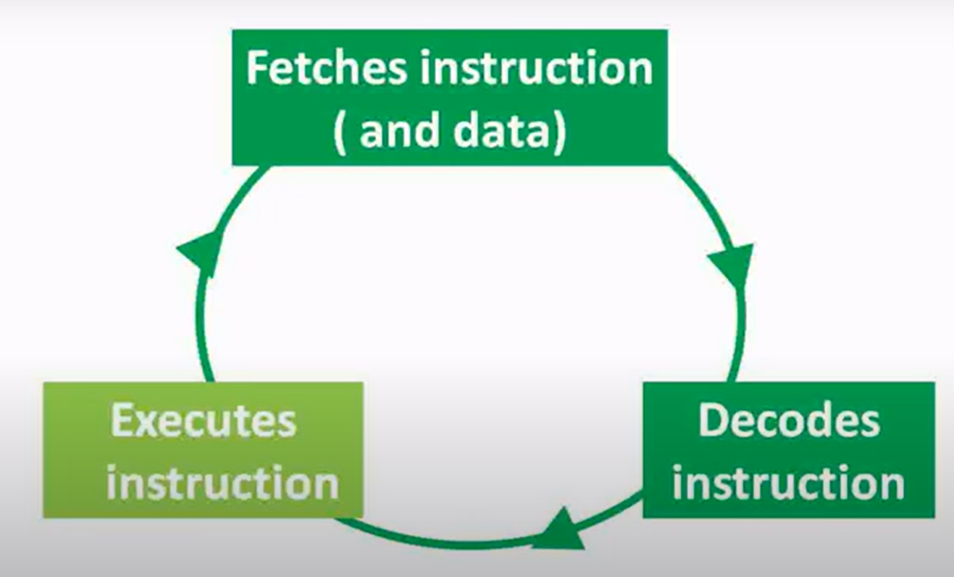
CPU Actions: Fetch-Decode-Execute

Slide 15
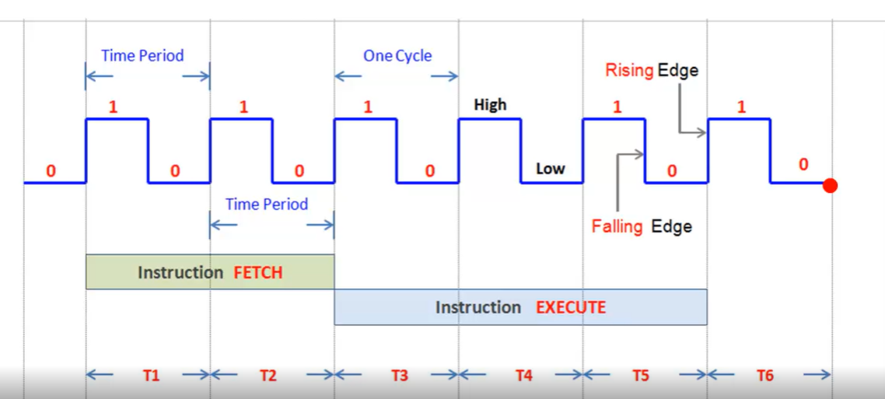
CPU Cycles and Instructions – Just an Example

Slide 16
Pipelining

Slide 17
Steps in a General Instruction
Fetch opcode
Decode opcode and (in parallel) prefetch a possible 16-bit operand
Compute complex addressing mode (e.g., [xxxx+bx]), if applicable
Fetch the source value from memory (if a memory operand) and the destination register value (if applicable)
Compute the result
Store result into destination register

Slide 18
Writing the Steps in a General Instruction as Stages
If we can design a separate piece of hardware for each stage, almost all of these steps can take place in parallel
In general, if we have an n-stage pipeline, we will usually have n instructions executing concurrently
Stage 1
2
3
4
5
6
Fetch Opcode
Decode Opcode / Prefetch Operand
Compute Address
Fetch Source and Destination Values
Compute Result
Store Result

Slide 19
Instruction Execution in a Pipeline
T1 | T2 | T3 | T4 | T5 | T6 | T7 | T8 | T9
…
Opcode | Decode | Address | Values | Compute | Store
Instr 1
Opcode | Decode | Address | Values | Compute | Store
Instr 2
Opcode | Decode | Address | Values | Compute | Store
Instr 3
Etc

Slide 20
Understanding Pipeline Execution
T1, T2, T3, etc., represent consecutive "ticks" of the system clock
At T=T1 the CPU fetches the opcode byte for the first instruction.
At T=T2, the CPU begins decoding the opcode for the first instruction. In parallel, it fetches 16-bits from the prefetch queue in the event the instruction has an operand. Since the first instruction no longer needs the opcode fetching circuitry, the CPU instructs it to fetch the opcode of the second instruction in parallel with the decoding of the first instruction.
At T=T3, the CPU computes an operand address for the first instruction, if any. The CPU does nothing on the first instruction if it does not use the [nnnn+bx] addressing mode. During T3, the CPU also decodes the opcode of the second instruction and fetches any necessary operand. Finally the CPU also fetches the opcode for the third instruction. With each advancing tick of the clock, another step in the execution of each instruction in the pipeline completes, and the CPU fetches yet another instruction from memory.
At T=T6 the CPU completes the execution of the first instruction, computes the result for the second, etc., and, finally, fetches the opcode for the sixth instruction in the pipeline.
The important thing to see is that after T=T5 the CPU completes an instruction on every clock cycle. Once the CPU fills the pipeline, it completes one instruction on each cycle. Note that this is true even if there are complex addressing modes to be computed, memory operands to fetch, or other operations which use cycles on a non-pipelined processor. All we need to do is add more stages to the pipeline, and we can still effectively process each instruction in one clock cycle.

Slide 21
Multi-Processor Architecture

Slide 22
Parallel Processing
Parallel processing is a computing approach that involves the simultaneous execution of multiple tasks or instructions to achieve (a) improved performance, (b) increased throughput, and (c) reduced execution time
Key concepts in parallel processing
Task/Instruction-level parallelism
Concurrency
Parallelism types: Task parallelism, Data parallelism
Parallel architectures: Shared memory, Distributed memory, SIMD and MIMD

Slide 23
Task/Instruction Level Parallelism
Parallel processing is based on the principle of breaking down a task or a set of instructions into smaller, independent sub-tasks that can be executed concurrently
These sub-tasks can be executed by multiple processing units or cores
Need is to identify dependency among instructions, types:
Data dependencies: One instruction depends on the result of a previous instruction (See next slide)
Control dependencies: Based on conditional branches

Slide 24
Data Dependencies
Read-after-Write (RAW) Dependency: One instruction reads a data item that another instruction writes. The second instruction cannot execute until the first instruction has completed its write operation.
Example:
ADD R1, R2
SUB R3, R1 (RAW dependency on R1)
Write-after-Read (WAR) Dependency: One instruction writes to a data item that another instruction reads. The first instruction cannot write until the second instruction has completed its read operation.
Example:
MUL R3, R4
ADD R5, R3 (WAR dependency on R3)
In this example, Instruction 2 depends on the result of Instruction 1 because it reads the value of R1, which is written by Instruction 1. Instruction 2 cannot execute until Instruction 1 has finished writing to R1.
In this example, Instruction 2 depends on the value of R3 as produced by Instruction 1. Instruction 2 must wait for Instruction 1 to complete its read operation of R3 before it can safely read R3 itself.

Slide 25
Data Dependencies
Write-after-Write (WAW) Dependency: In a WAW dependency, two instructions write to the same data item. The second instruction cannot write until the first instruction has completed its write operation.
Example:
ADD R1, R2
SUB R1, R4 (WAW dependency on R1)
In this example, both Instruction 1 and Instruction 2 write to the same register, R1. There's a conflict because Instruction 2 attempts to write to R1 before Instruction 1 has finished writing to it.

Slide 26
Control Dependencies
Control dependencies specify the order in which operations or tasks should be executed to ensure correct program behavior
Example: Parallel Matrix Multiplication algorithm
Divide the matrices A and B into smaller submatrices for parallel processing
Multiply the corresponding submatrices in parallel to produce intermediate results
Sum up these intermediate results to obtain the final result matrix C
What will be the control dependencies in this?

Slide 27
Control Dependencies
Control Dependency 1
Before you can multiply submatrices in parallel, you must ensure that all submatrices are correctly divided. For example, submatrix [i, j] of A must be available before you can multiply it with its counterpart in matrix B. This ensures proper data dependencies.
Control Dependency 2
After multiplying submatrices, you must wait until all multiplications are complete before summing up the intermediate results to get matrix C. This ensures that you're adding valid values to compute C.
See next slide

Slide 28
Control Dependencies
# Pseudocode for Parallel Matrix Multiplication
for i in range(rows_A):
for j in range(cols_B):
# Control Dependency 1: Divide matrices A and B into submatrices
submatrix_A = get_submatrix_A(i)
submatrix_B = get_submatrix_B(j)
# Control Dependency 2: Multiply submatrices in parallel
result = multiply(submatrix_A, submatrix_B)
store_result(result, i, j)
# Control Dependency 2: Sum up intermediate results to get C
C = sum_intermediate_results()

Slide 29
Concurrency
Concurrency and parallel processing are related, but different
Concurrency
Ability of a system or program to manage multiple tasks or processes simultaneously, without necessarily executing them in parallel
Concurrency can be achieved in various ways, such as through multitasking, multithreading, or asynchronous programming
Parallel processing
Simultaneous execution of multiple tasks or processes to achieve improved performance and throughput
Used when we have computationally intensive tasks that can be divided into smaller subtasks that can be executed parallely

Slide 30
Concurrency versus Parallel Processing
Concurrency example: A web server handling multiple requests
It does not necessarily execute all the request-handling code simultaneously but can switch between handling different requests, allowing it to serve multiple clients simultaneously
Parallel processing example: Image processing
When we want to apply the same image filter to multiple images, we can divide the images among multiple CPU cores or processors, allowing them to process the images in parallel
Each core processes a different image, significantly reducing the time it takes to complete the task

Slide 31
Task Parallelism
In task parallelism, different tasks or functions are executed in parallel, and each task may have its own independent set of data
Used when tasks are inherently distinct and can be executed concurrently without significant data sharing or dependencies
Example: Video Processing Pipeline
Video Frame Capture: Capture individual frames from a video file
Frame Enhancement: Enhance the quality of each frame
Object Detection: Detect objects within each frame
Object Tracking: Track the movement of detected objects
Frame Rendering: Render the processed frames to create the final output video
We can assign each of these tasks to separate threads or processes, allowing them to execute concurrently
Each task operates on its own data (video frames), and they can be performed independently, making it an ideal scenario for task parallelism

Slide 32
Data Parallelism
Data parallelism divides a large dataset into smaller parts and processes these concurrently using the same task or function
Used when the same operation needs to be applied to different parts of a dataset
Associated with parallel processing frameworks like MapReduce or SIMD (Single Instruction, Multiple Data)
Example: Image Filtering on Multiple Cores
Suppose we have a large image, and we want to apply a blur filter to it
Instead of processing each pixel sequentially, e can divide the image into smaller blocks or sections and apply the same blur filter to each block concurrently using multiple CPU cores
Each core works on a different section of the image, applying the filter in parallel
Finally, we combine the filtered blocks to obtain the fully processed image
In this data parallelism example, the same operation (blur) is applied to different parts of the data (image blocks) concurrently, resulting in a significant speedup compared to sequential processing

Slide 33
Parallel Architectures – Shared Memory
Shared memory architecture has multiple processors or cores in a multiprocessor system that share access to a common global physical memory address space
All processors can read from and write to the same memory space, which simplifies communication between processors and enables them to work together on parallel tasks
In Uniform Memory Access (UMA) systems, all memory locations have roughly the same access time for all processors
This means that accessing any part of the shared memory has similar latency, making memory access predictable
In Non-Uniform Memory Access (NUMA) systems, memory is divided into banks or nodes, and the access time may vary depending on which processor is accessing which part of the memory
NUMA architectures are designed to handle larger numbers of processors and memory banks efficiently
Examples: Modern multicore processors, Symmetric multiprocessor (SMP)

Slide 34
Parallel Architectures – Distributed Memory
Distributed memory has multiple processors/nodes connected in a network, and each node has its own separate private memory
Memory that is physically distributed across the nodes
Nodes communicate with each other explicitly by sending messages over the network to share data and coordinate their activities
Highly scalable, because new nodes can be added without major architectural changes – suitable for High Performance Computing (HPC)
Latency is higher and bandwidth is lower
Examples: HPC, Super computers, Grid computers, Programming using Hadoop or MPI (Message Passing Interface)

Slide 35
Parallel Architectures - SIMD
SIMD (Single Instruction, Multiple Data) allows a single instruction to be applied to multiple data elements simultaneously
Related to data parallelism
Commonly found in modern CPUs and GPUs
Used in multimedia processing, scientific simulations, and graphics rendering
Vectorization concept is used
Operations are performed on vectors or arrays of data elements in a single instruction
Example: We can add two arrays of numbers element-wise with a single SIMD instruction, which is much faster than doing it sequentially
SIMD ISA examples: Intel’s SSE (Streaming SIMD Extensions), AVX (Advanced Vector Extensions), ARM NEON

Slide 36
SIMD Example
#include <immintrin.h> // Include the header for SSE intrinsics
void vector_add(float* a, float* b, float* result, int size) {
// Process the vectors in chunks of 4 (SSE supports 4 single-precision floats per instruction)
for (int i = 0; i < size; i += 4) {
// Load 4 floats from arrays 'a' and 'b' into SSE registers
__m128 vec_a = _mm_load_ps(&a[i]);
__m128 vec_b = _mm_load_ps(&b[i]);
// Perform vector addition
__m128 vec_result = _mm_add_ps(vec_a, vec_b);
// Store the result back into the 'result' array
_mm_store_ps(&result[i], vec_result);
}
}
int main() {
int size = 8; // Number of elements in the arrays
float a[] = {1.0, 2.0, 3.0, 4.0, 5.0, 6.0, 7.0, 8.0};
float b[] = {8.0, 7.0, 6.0, 5.0, 4.0, 3.0, 2.0, 1.0};
float result[size];
// Call the vector addition function
vector_add(a, b, result, size);
// Print the result
for (int i = 0; i < size; i++) {
printf("%.2f ", result[i]);
}
printf("\n");
return 0;
}

Slide 37
SIMD Example – Explanation
The <immintrin.h> header file provides access to SSE intrinsics (SIMD instructions) in Intel-compatible processors
The vector_add function takes three arrays (a, b, and result) and the number of elements to process (size)
It performs vector addition on chunks of 4 elements at a time using SSE instructions
Inside the loop, we load 4 single-precision floating-point values from arrays a and b into SSE registers using _mm_load_ps
We then use _mm_add_ps to add the values element-wise in parallel and store the result in another SSE register
Finally, we store the result back into the result array using _mm_store_ps

Slide 38
Parallel Architecture - MIMD
MIMD (Multiple Instruction, Multiple Data) has multiple processors executing different instructions on different sets of data
Each processor has its own program counter and instruction stream, allowing it to execute instructions independently of the other processors
More suitable for task parallelism
More complex than SIMD
Processors may need to communicate with each other

Slide 39
MIMD Example
Suppose we have a cluster of computers, each with its own CPU and memory and we want to perform a distributed search on a large dataset
Each computer in the cluster can independently execute a search algorithm on a different portion of the dataset
The computers can use message-passing or other communication mechanisms to share information about their search results or coordinate their efforts
As each computer executes its search algorithm concurrently, the entire search operation becomes faster and more efficient

Slide 40
Hardware Multithreading
Hardware multithreading allows multiple threads to execute concurrently
Main types: Simultaneous Multithreading (SMT) and Chip Multithreading (CMT)
SMT
A single CPU core is designed to execute multiple threads simultaneously by interleaving the execution of instructions from different thread
Each thread is assigned a separate set of registers, program counter, and execution resources, but they share the same execution pipelines and functional units
CMT
Multiple CPU cores or processor modules are integrated onto a single chip
Each CPU core in a CMT chip is designed to run a separate thread independently

Slide 41
Graphics Processing Unit (GPU)
A Graphics Processing Unit (GPU) is a specialized electronic circuit designed to accelerate the processing of images and videos, as well as general-purpose computational tasks
Excel in parallel processing, unlike CPUs
A GPU has hundreds or thousands of shader cores
Primary processing unit in a GPU – called CUDA cores in NVIDIA GPUs
Perform mathematical calculations and graphics-related work
To program, we need special APIs such as CUDA (NVIDIA), OpenCL, or DirectX

Slide 42
NVLink
NVLink (NVIDIA Link) is a high-speed, high-bandwidth interconnect technology developed by NVIDIA for connecting various components within a computer system, particularly in data center and high-performance computing (HPC) environments
Provides faster and more efficient communication between GPUs, GPUs and CPUs, and GPUs and other system components compared to traditional PCI Express (PCIe) connections
High bandwidth, low latency, GPU-to-GPU or CPU-to-GPU communication etc

